Slide 1
Notes:
At the 2021 Synod Convention, delegates enthusiastically approved a WELS Home Missions initiative to plant 100 home mission churches and enhance 75 ministries in 10 years beginning in 2023. During the same time, we want to support 75 enhancement grants to help existing congregations reach more souls, often in other cultures.

Slide 2
This is a big goal. Why start 100 new home missions?
Our Savior directs us to reach more souls with the good news. This initiative isn’t as much about planting more churches as it is about sharing the gospel of Jesus Christ. It’s about Christ’s mission to his church. It’s about aggressively reaching lost souls.
Notes:
Why are we doing this?

Slide 3
To reach more people like Jerry and Denice
Notes:
The 100 Missions in 10 Years initiative isn’t as much about planting more churches but about sharing the gospel of Jesus Christ. It’s about aggressively reaching lost souls. It’s about Christ’s mission to his church.
As we continue to work towards our goal, we will be featuring more stories of the “Faces of Faith” reached with the gospel message through home mission congregations. Hear from Jerry Laster, a trauma surgeon, who draws a powerful parallel between his work of healing physical wounds and the church’s role as a hospital for sick souls. Discover how he and his wife, Denice, found peace and healing through God’s free grace at Christ Alone Lutheran Church in in Keller, Texas.
Video link: https://wels.net/faces-of-faith-jerry-and-denice/

Slide 4
Notes:
WELS Home Missions plants new churches and assists mission-minded congregations in the United States, Canada, and English-speaking West Indies. Home Missions currently supports 144 congregations with financial subsidy or district mission board/mission counselor assistance, with 29 of those being cross-cultural mission congregations. Home Missions also provides over 45 campus ministries with financial support, while assisting hundreds of other congregations that serve college students around the United States and Canada.

Slide 5
Supporting home mission churches
100 Mission in 10 Years
Notes:
So how does it work?

Slide 6
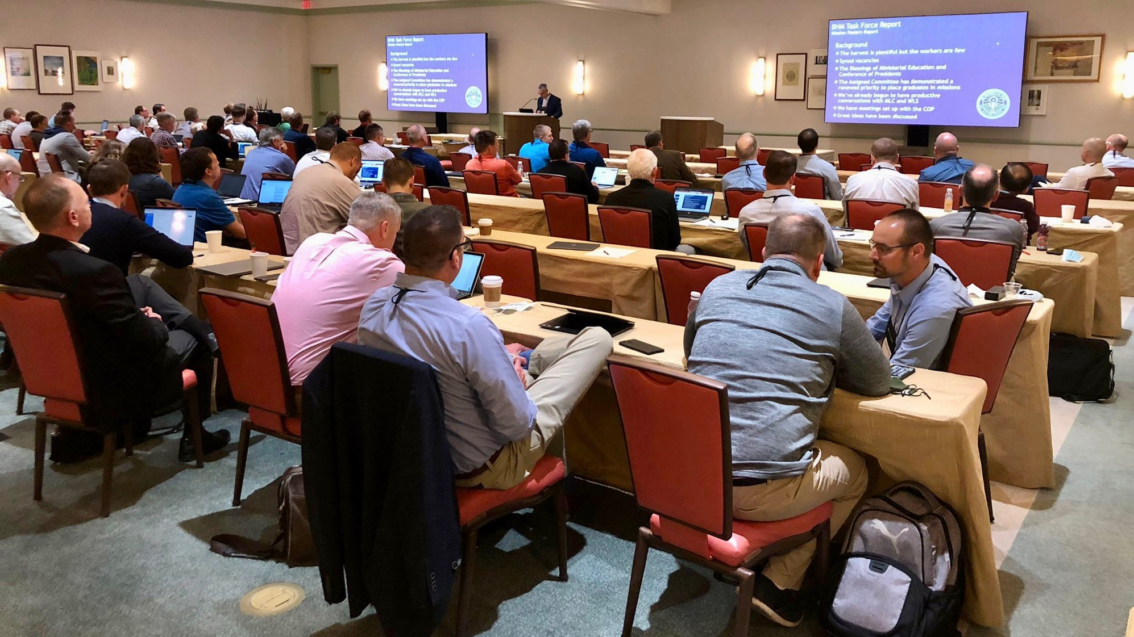
District Mission Boards (DMB)
The heart and core of Home Missions
Notes:
FOR PRESENTERS: I would recommend including a group photo of the DMB where you’re presenting for this slide.
District mission boards (DMB) are the heart and core of Home Missions. They are the “boots on the ground” as they support existing home mission churches and work with area congregations to identify locations to plant new churches throughout their district. This group of 2-4 pastor and 2-4 laymen volunteers helps build a solid foundation for each new mission start and shepherds these new churches and their pastors on their path from starting a new mission to being a self-supporting church. Learn more at wels100in10.net/timeline/dmb.

Slide 7
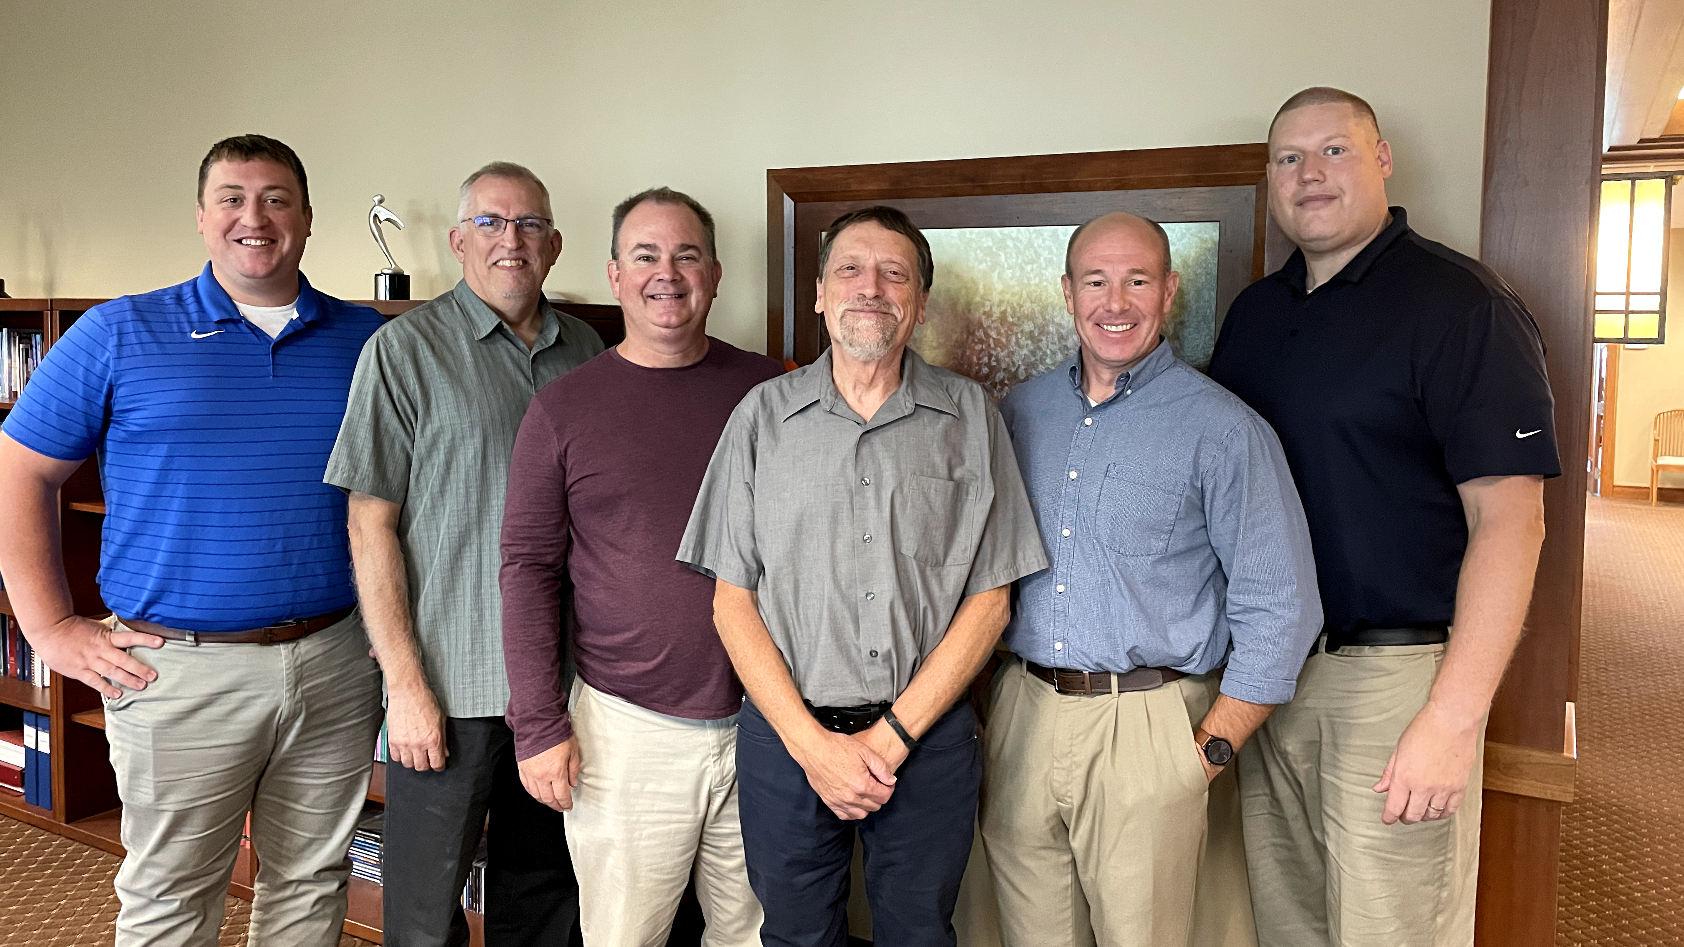
Mission Counselors: Guiding mission congregations and assisting District Mission Boards
Notes:
District mission boards (DMBs) and home mission churches are supported by three home mission counselors. They work with the DMBs to find, evaluate, and develop new home mission locations. They also provide onsite assistance to home mission congregations and counseling and training to the new missionaries who are called to serve them. This support is crucial in guiding mission churches on the way to becoming self-supporting congregations. WELS Home Missions also works with three specialized mission counselors that assist congregations with Hispanic, Asian, and Campus Ministry outreach.
Pictured (from left to right):
Rev. Neil Birkholz, North American Asian Ministry Consultant
Rev. Tim Flunker, Hispanic Outreach Consultant
Rev. Wayne Uhlhorn, Mission Counselor
Rev. Mark Birkholz, Mission Counselor
Rev. Matt Vogt, Mission Counselor,
Rev. Dan Lindner, Campus Ministry Mission Counselor

Slide 8
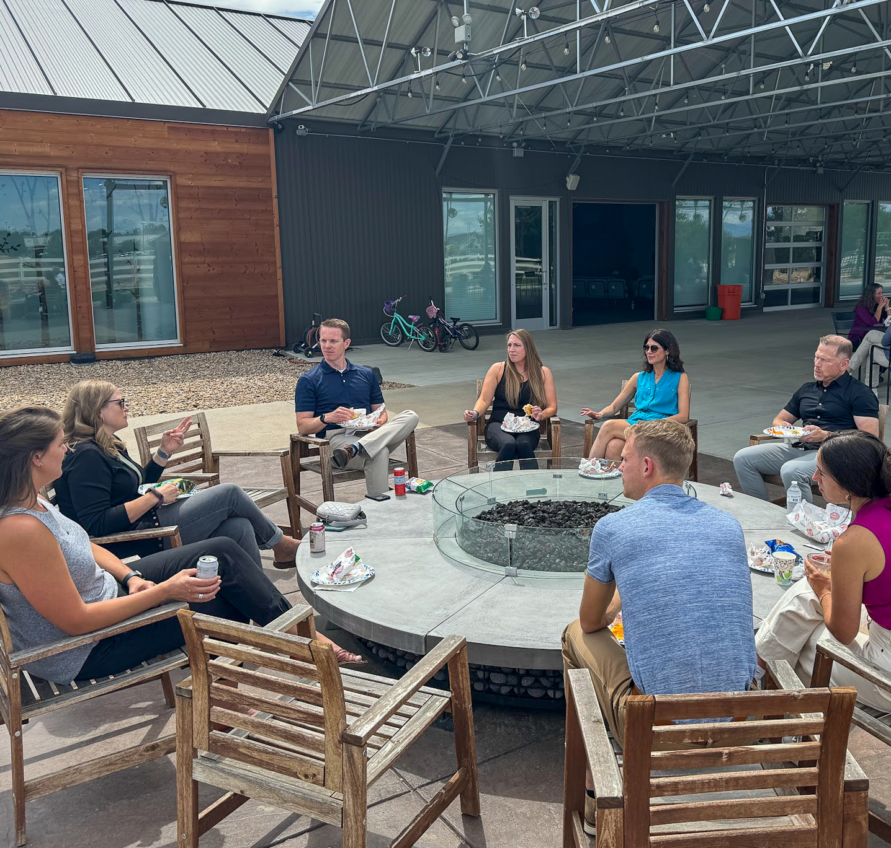
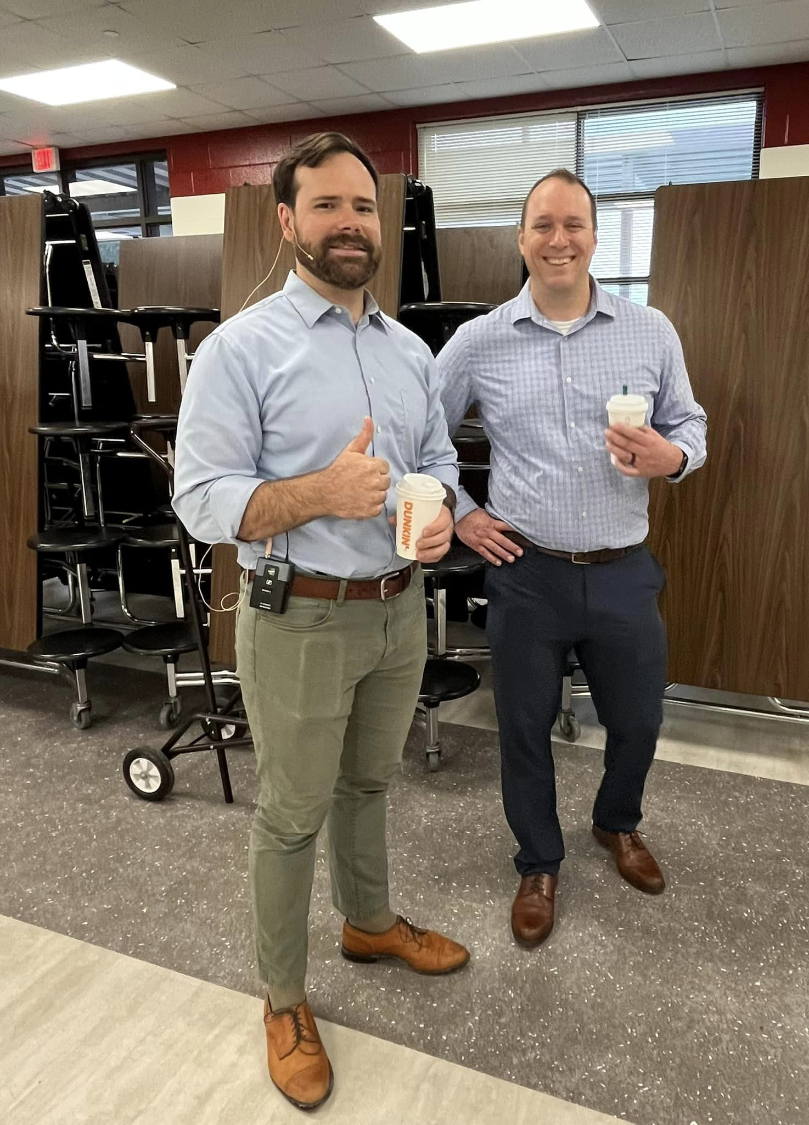
Church Planter Intensive and coaching program
Notes:
Pictured:
Left: Church Planter Intensive, August 2024
Right: Home Missionary Cale Mead (left) from Christ the Rock in Canton, GA, with his mentor Steven Prahl (Foundation, Payton, CO) during a visit leading up to their worship launch in October 2023.
New church planters are not left to fend on their own!
Brand new church planters gather together with experienced home missionaries for a Church Planter Intensive at Carbon Valley Lutheran Church in Firestone, Colo. The most recent one occurred in August 2024. Experienced church planter Jared Oldenburg (Eternal Rock – Castle Rock, Colo.) developed the program and Home Missionary Matt Rothe (The Way – Fredericksburg, Va.) now leads the training. This extended weekend seminar encourages and equips pastors who are called to plant brand new home mission churches. The purpose of this event is to:
Talk through church planting principals.
Be a sounding board to new missionaries and their unique situations.
Give the missionary a chance to think about all aspects of starting a church
Encourage the missionary to make decisions and plans based on the core group, community and place God has placed him. In other words, don’t copy, but instead learn to lead intuitively.
Help the missionary establish some big picture benchmarks/activities.
Offer encouragement by openly sharing what it’s like to be a church planter
Provide the opportunity for a new missionary to network with other missionaries.
After the intensive, new church planters are paired with a coach from an established mission church to guide them for their first two years of launching a new church. Home Missionary Joel Schulz (Divine Savior – Delray Beach, Fla.) leads that portion of the program.
Both the Church Planter Intensive and the coaching program are sponsored and encouraged by WELS Home Missions.
“As much as Church Planter Intensive was able to ground me, set our ministry on a good path, and send us out with valuable information, the coaching program is now my lifeline in an ongoing way. My coach is the most-accessible avenue to bounce ideas off, get input from, and help me grow as a pastor.” – Rev. Joe Lindloff, church planter in Marquette, Mich.

Slide 9
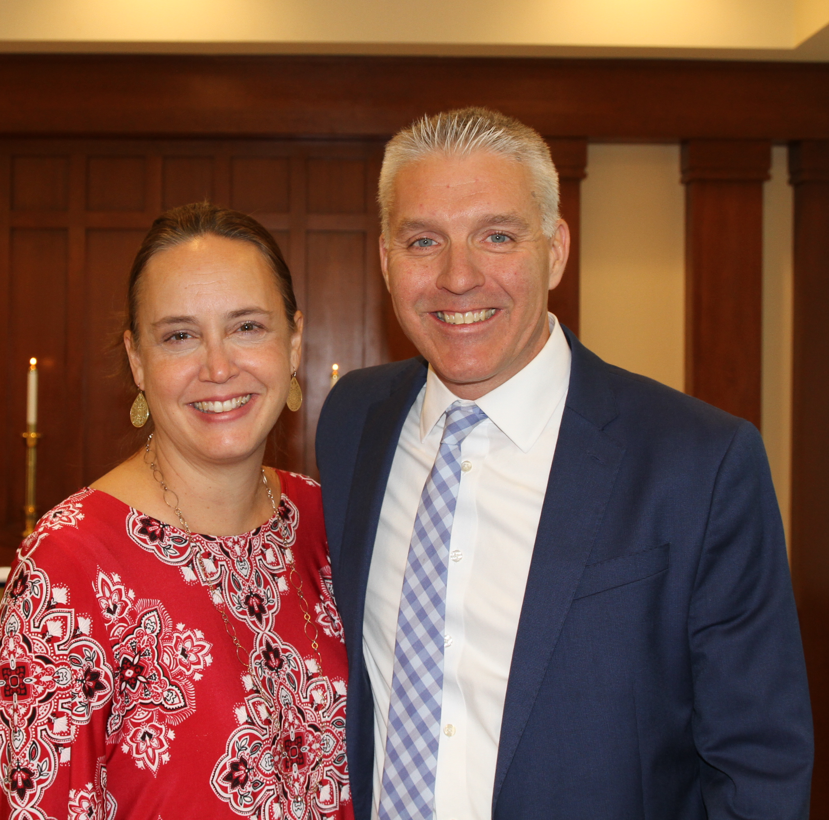
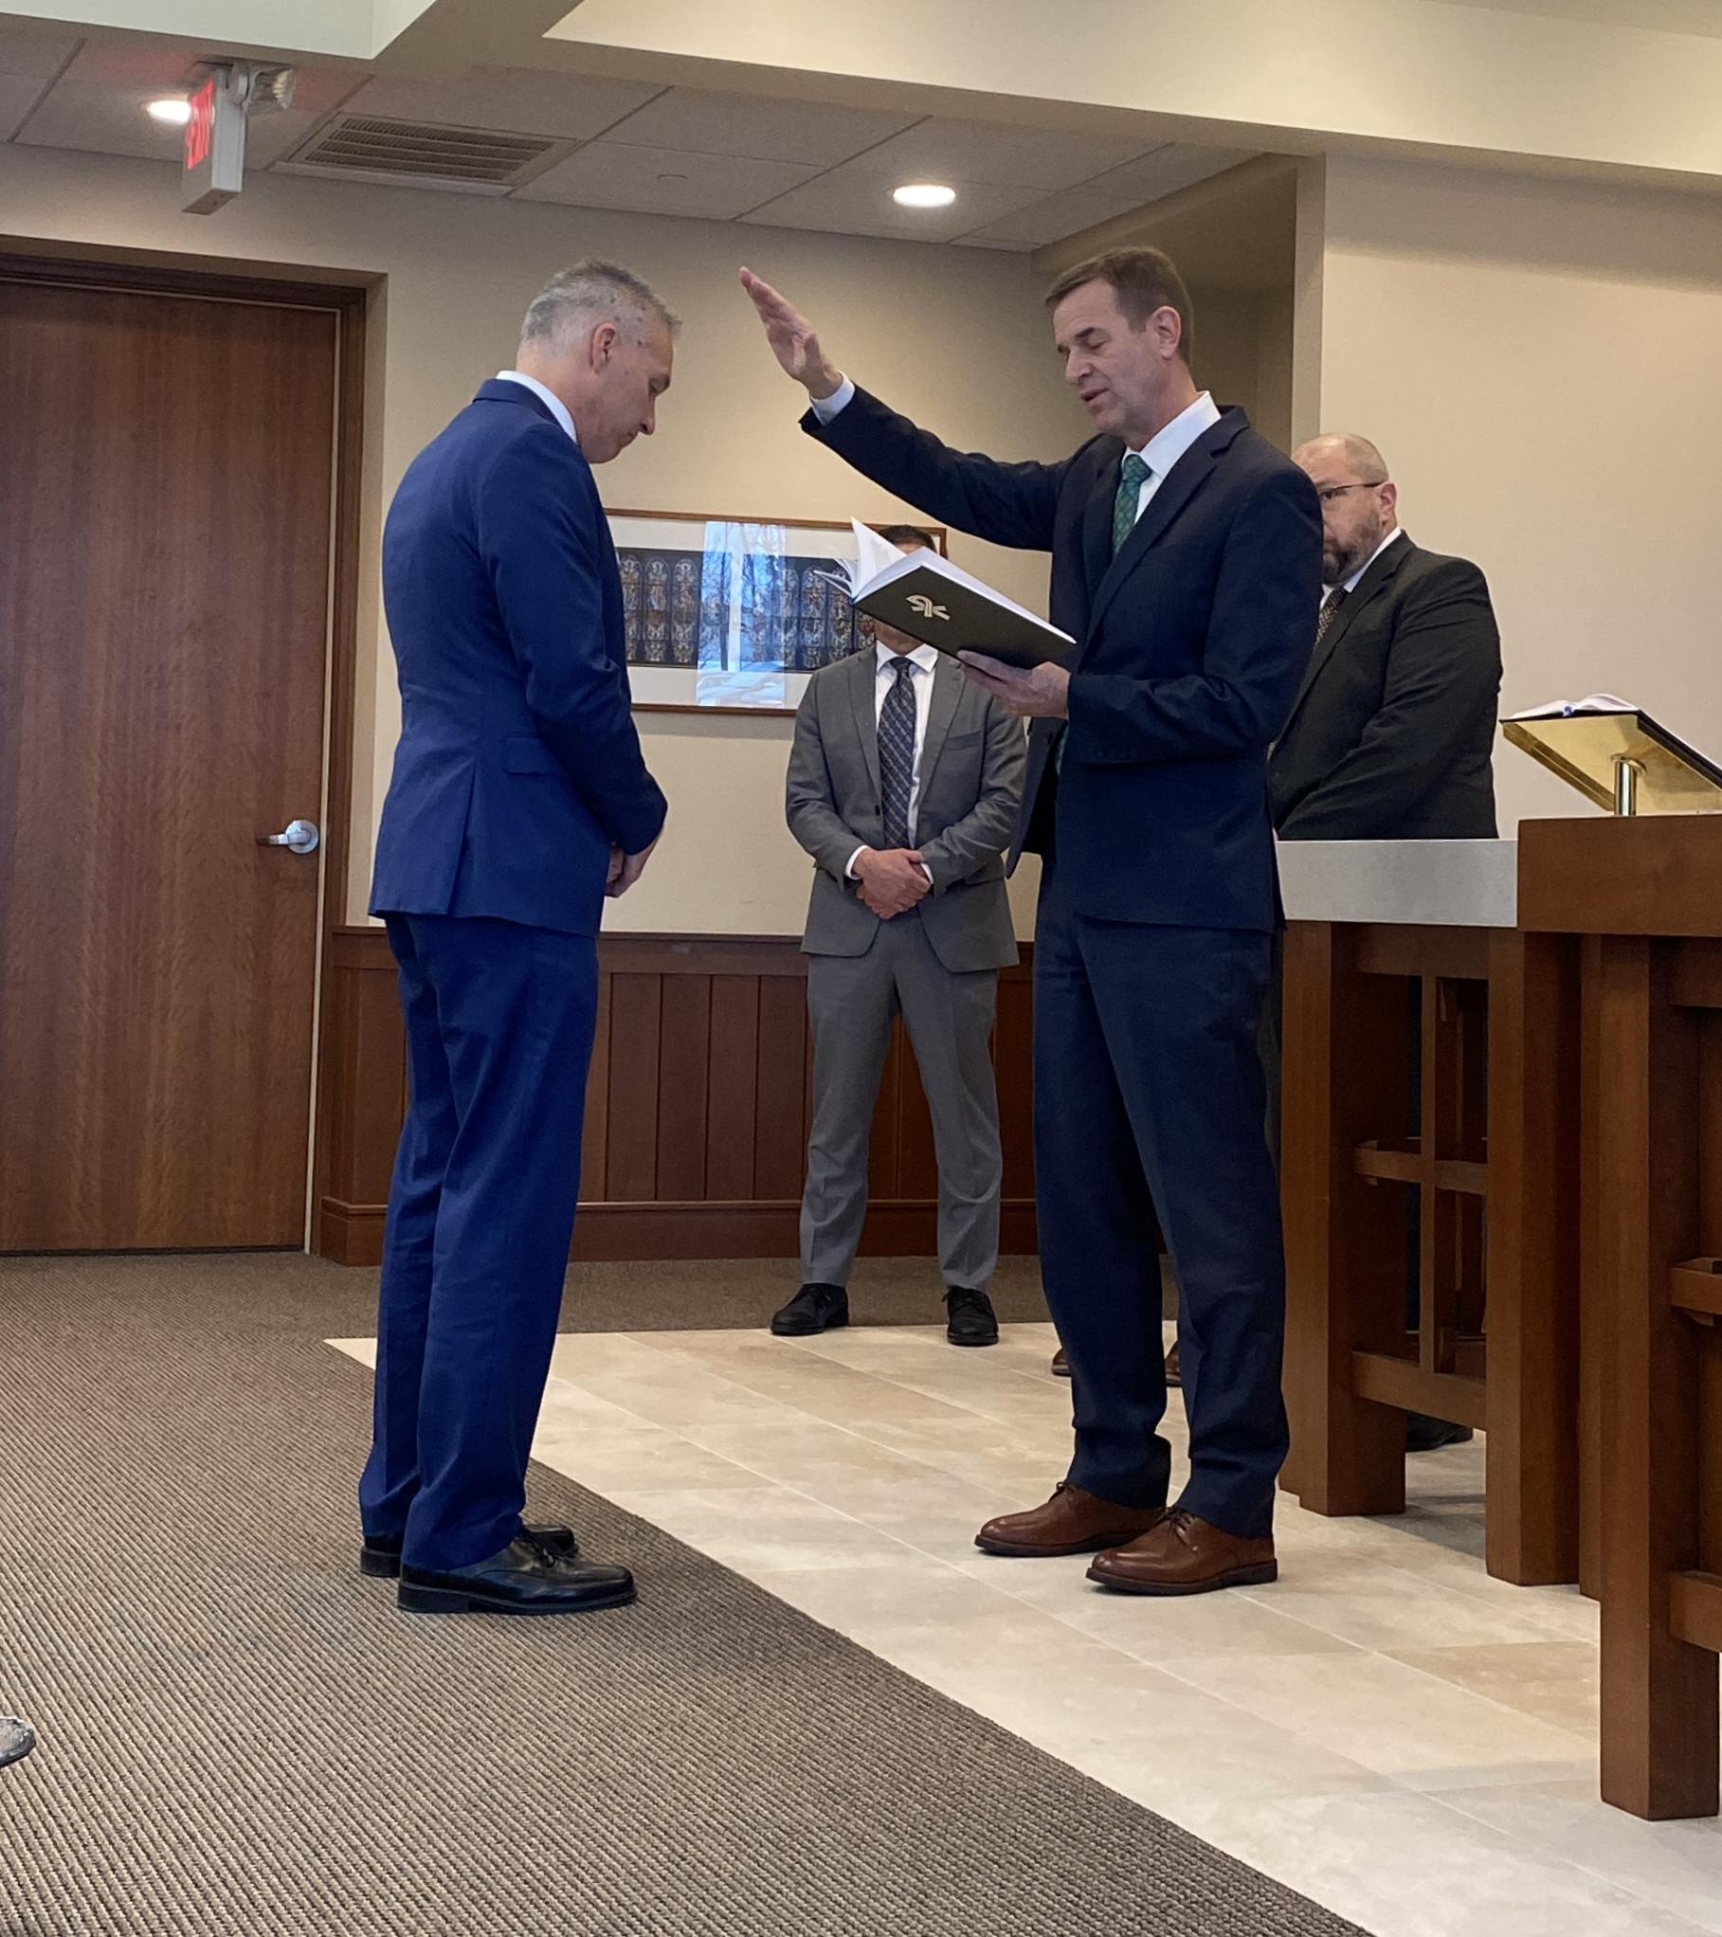
New Home Missions administrator
Rev. Mark Gabb
Notes:
WELS Missions welcomes Mark Gabb as the new administrator for WELS Home Missions. Gabb began serving in this role in January following a vacancy in the position since spring 2022, when previous administrator Keith Free accepted a call to parish ministry. Gabb was formally installed as the Home Missions administrator Wed., Jan. 31, at the WELS Center for Mission and Ministry weekly chapel service. Gabb is not new to the work of WELS Home Missions. He has served as a member of the Board for Home Missions for ten years and as chairman for three, taking on additional leadership responsibilities during the vacancy.

Slide 10
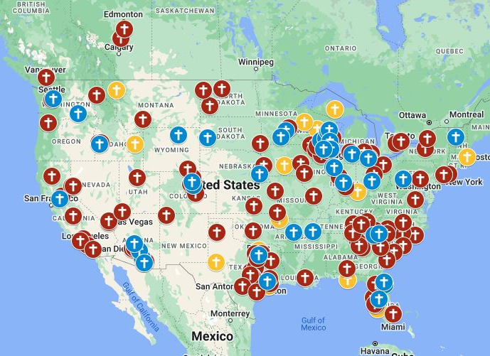
Exploratory missions in your district
Notes:
View our interactive Google map found at wels100in10.net to see where your district mission board is exploring outreach in your district. Anything in “blue” indicates an exploratory mission. District mission boards and mission counselors work with exploratory missions to develop a core group of members and begin Bible study and initial outreach before coming to the Board for Home Missions for official home mission status. These missions are not currently approved but are preparing the groundwork needed for their formal ministry request to the Board for Home Missions. Each request is thoroughly vetted and either prioritized, deferred, or denied. Prioritized requests are authorized as funding is available. Please note that there might be some exploratory missions on this list that will not end up receiving home mission status after the review process.

Slide 11
2025 New Starts:
Arlington, Tenn.
Erie, Colo.
Jarrell, Texas
Madison, Wis.
San Tan Valley, Ariz.
Notes:
On April 3–4, WELS Board for Home Missions approved five new mission starts and six enhancements toward the synodwide 100 Missions in 10 Years initiative.
Each of the five new starts is backed by a mature, mission-minded core group that has been actively sharing the gospel in their communities—even before seeking formal support. That kind of groundwork helps lay a strong foundation for long-term gospel ministry.
Thanks to the generous gifts received over the past year, WELS Home Missions is also in a financial position to approve up to five additional new missions this fall. Giving core groups additional time to prepare their requests will strengthen their proposals for fall.

Slide 12
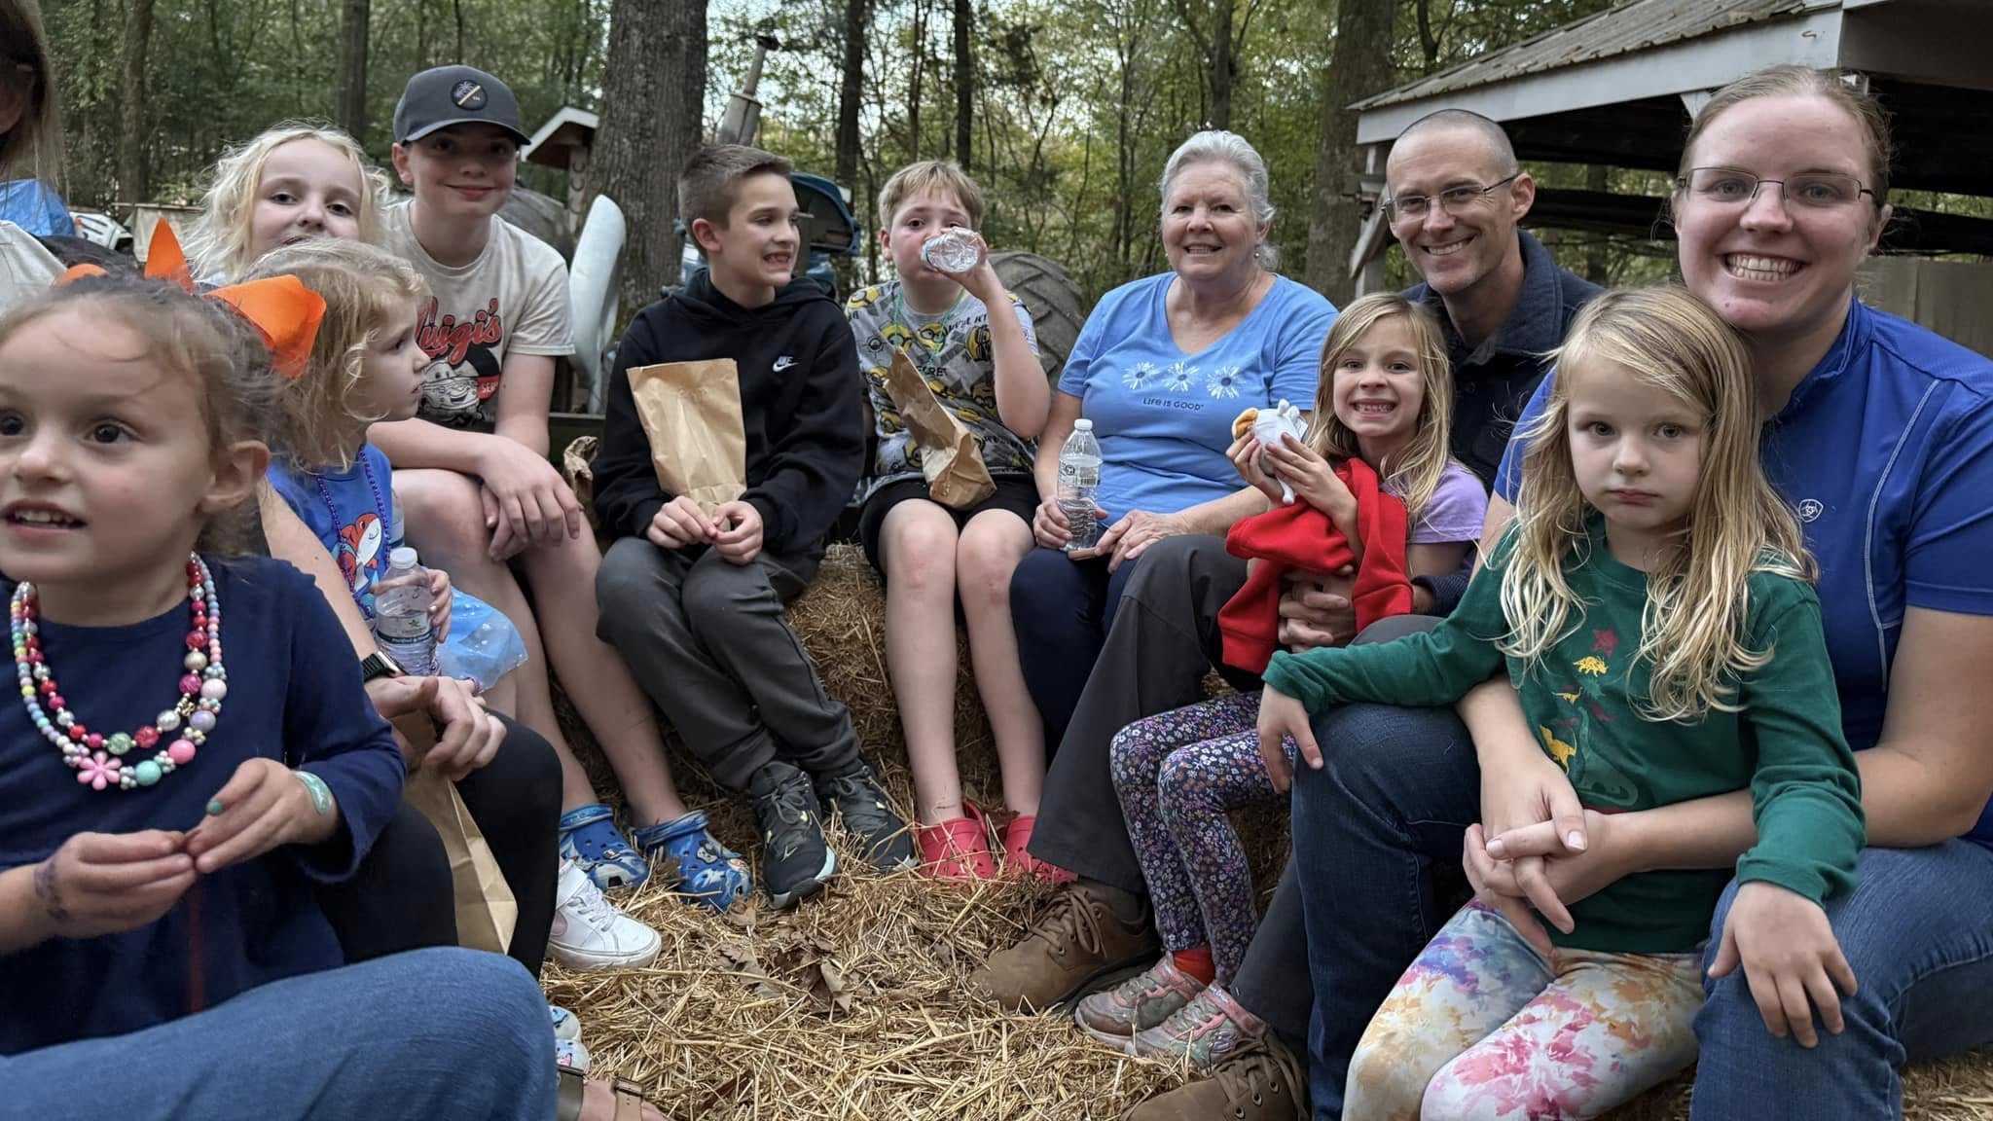
New Start – Arlington, Tenn.
Notes:
Arlington, located 25 miles northwest of Memphis, is on the brink of rapid growth with Ford Motor Company set to build a new plant for electric truck production. Since 2022, the South Atlantic District Mission Board has been working with a dedicated group of 60 members and Pastor Jim Turriff from Gloria Dei, Memphis, who plan to relocate and establish a fresh start in Arlington under a new name.

Slide 13
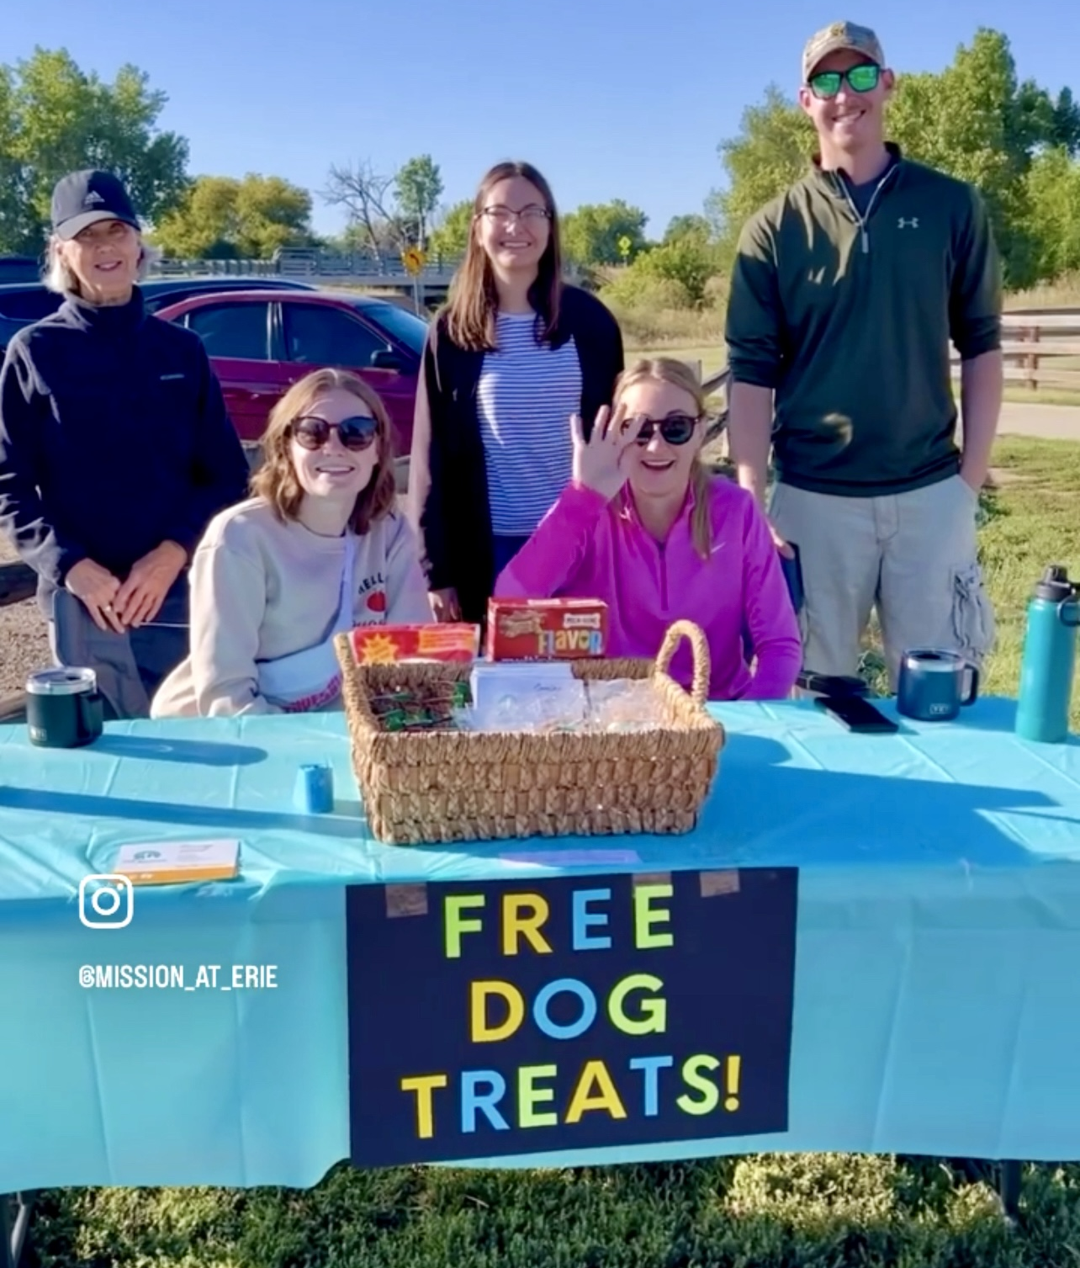
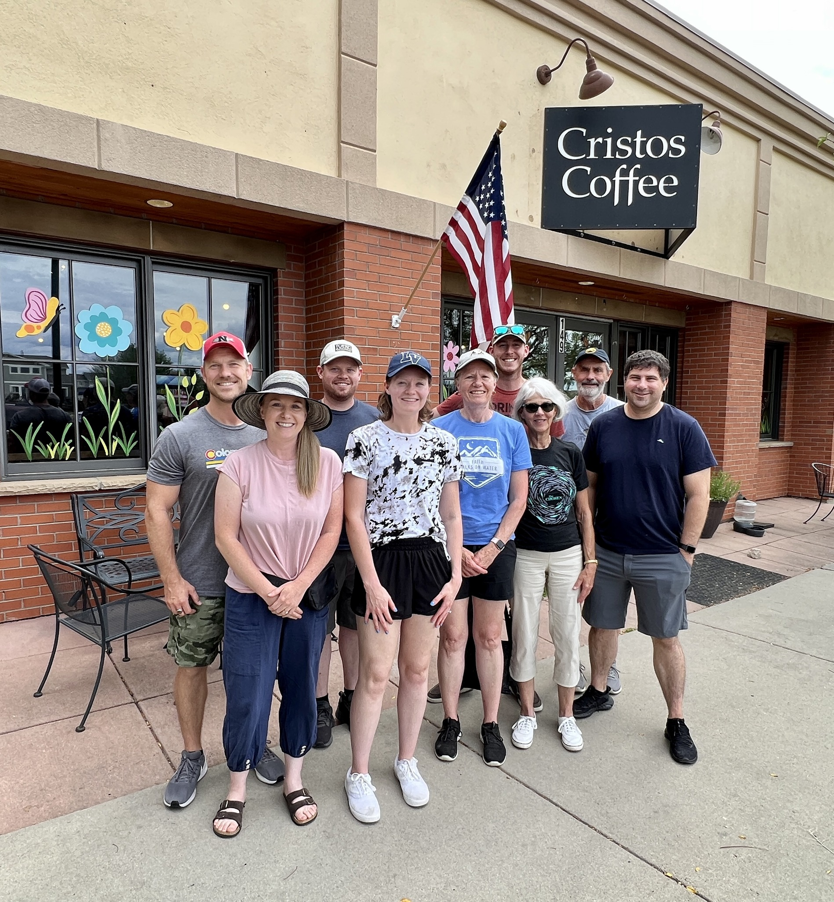
New Start – Erie, Colo.
Notes:
Erie, located 30 miles north of Denver, has experienced a 55 percent population increase from 2010 to 2020, with continued growth expected. The Colorado District Mission Board began exploring this area in 2022. A core group of 10 adults has been gathering for fellowship and Bible study while attending local festivals to share its plans for a new church. So far, 25 people have expressed interest in learning more about the mission efforts.

Slide 14
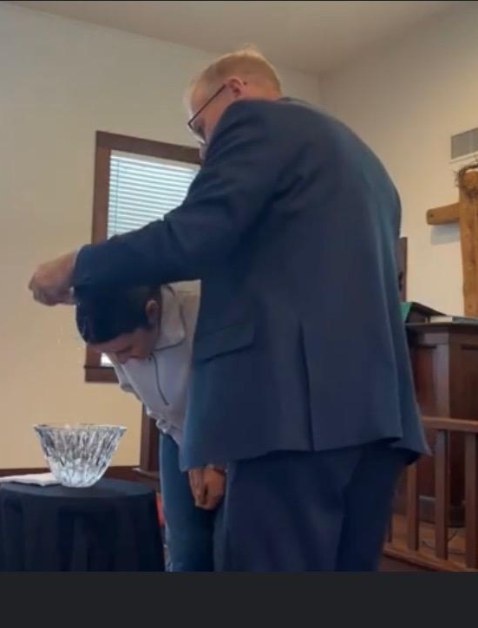
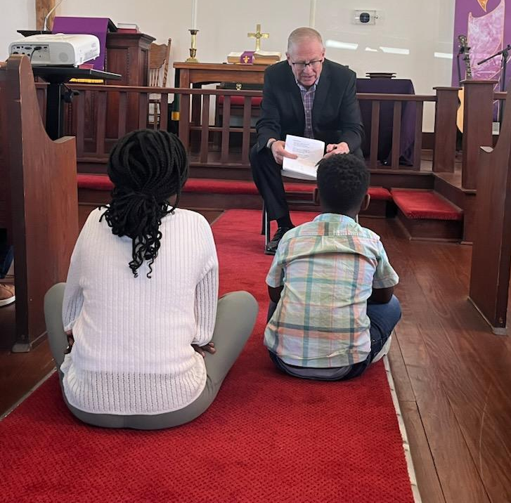
New Start – Jarrell, Texas
Notes:
Jarrell is a rapidly growing town located 44 miles north of Austin in northern Williamson County. The county has seen its population surge from 426,000 in 2010 to 671,000 in 2022, with continued growth expected. For the past three years, Pastor Don Patterson has been working with a core group of 11, which began holding weekly worship in October 2024. The group has identified 90 prospects, many of whom they connected with by volunteering in the Jarrell Bible Community Food Pantry. The plan is to rent space for eight years before securing land and constructing a permanent church home.

Slide 15
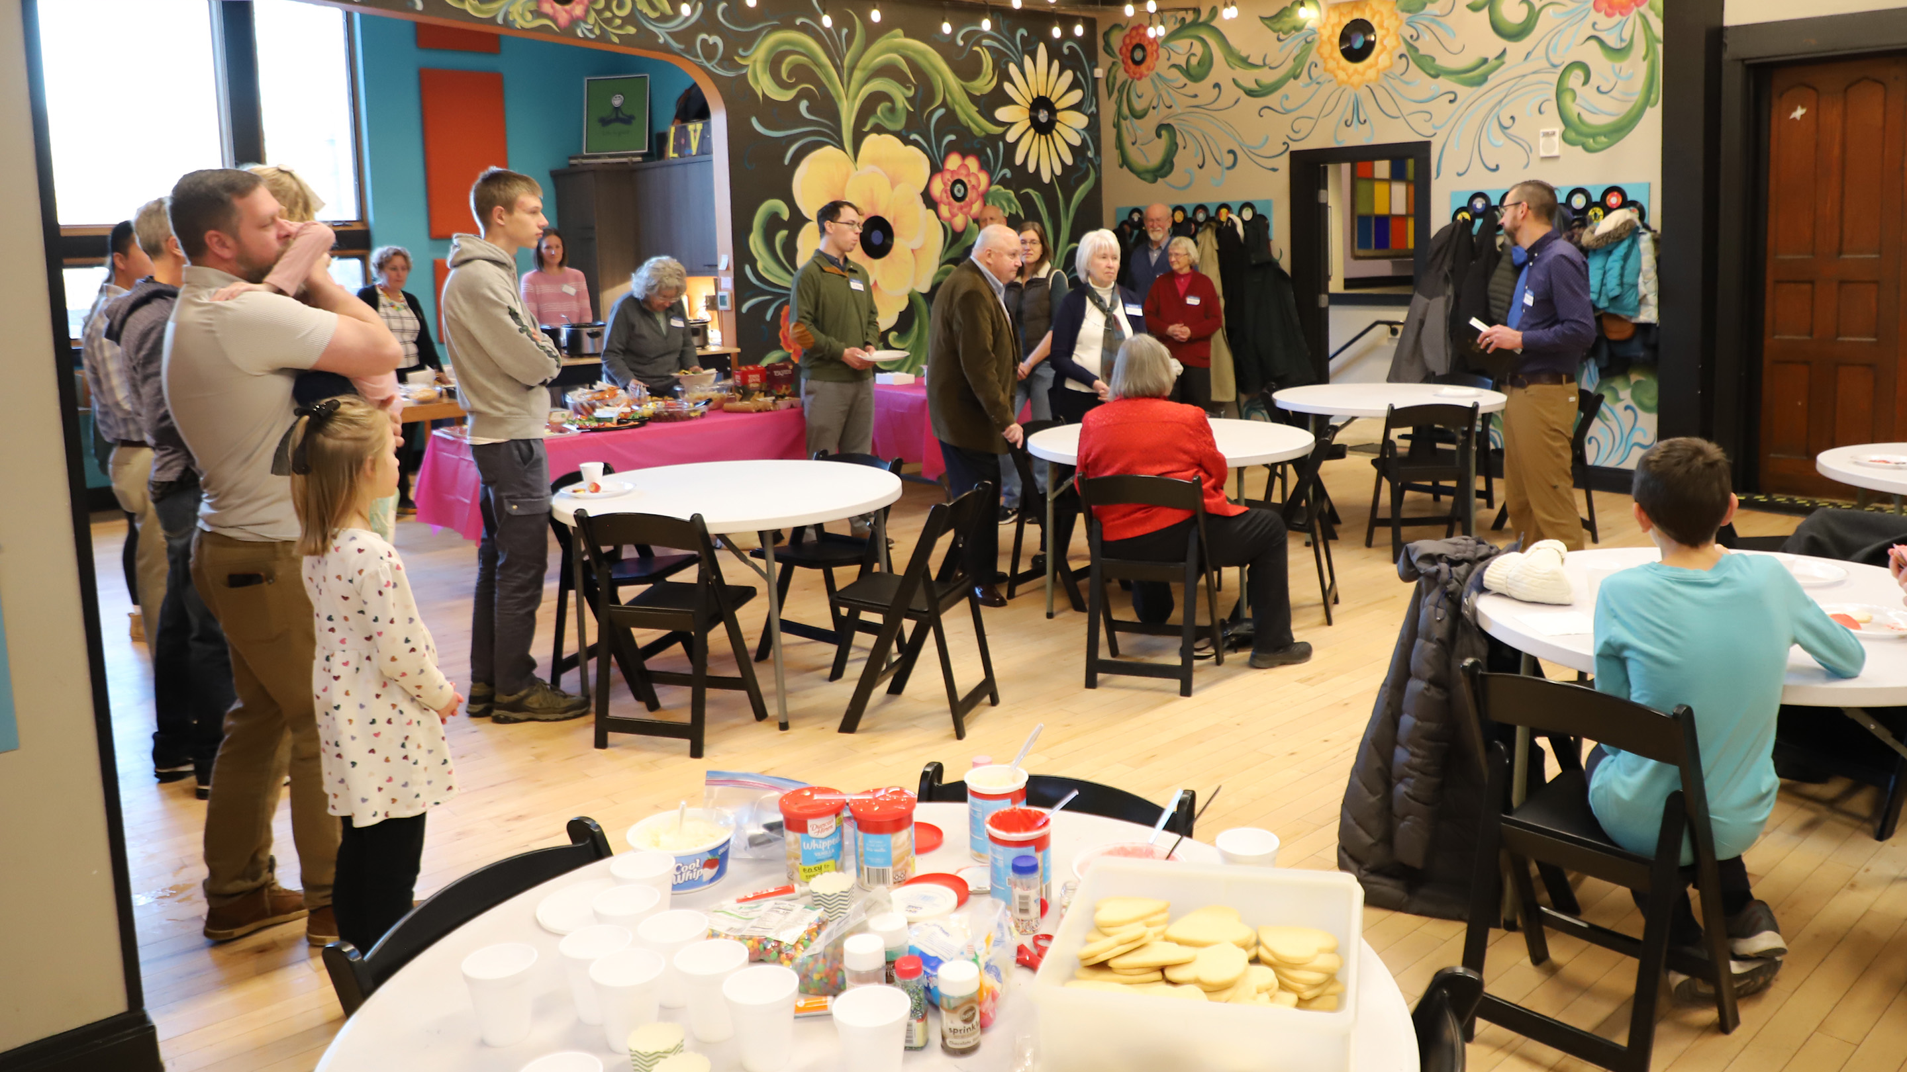
New Start – Madison, Wis.
Notes:
The center of Madison is expected to grow by 200,000 in future years, with many residents seeking an urban lifestyle. A core group of 14 adults, familiar with the area, has been working together since 2022—meeting regularly for Bible study and ministry planning—and has also secured a rental space for worship and community activities. Twenty prospects have expressed a strong interest in learning more about this new mission. A new mission plant in the center of urban Madison would allow WELS to reach an entirely new demographic.

Slide 16
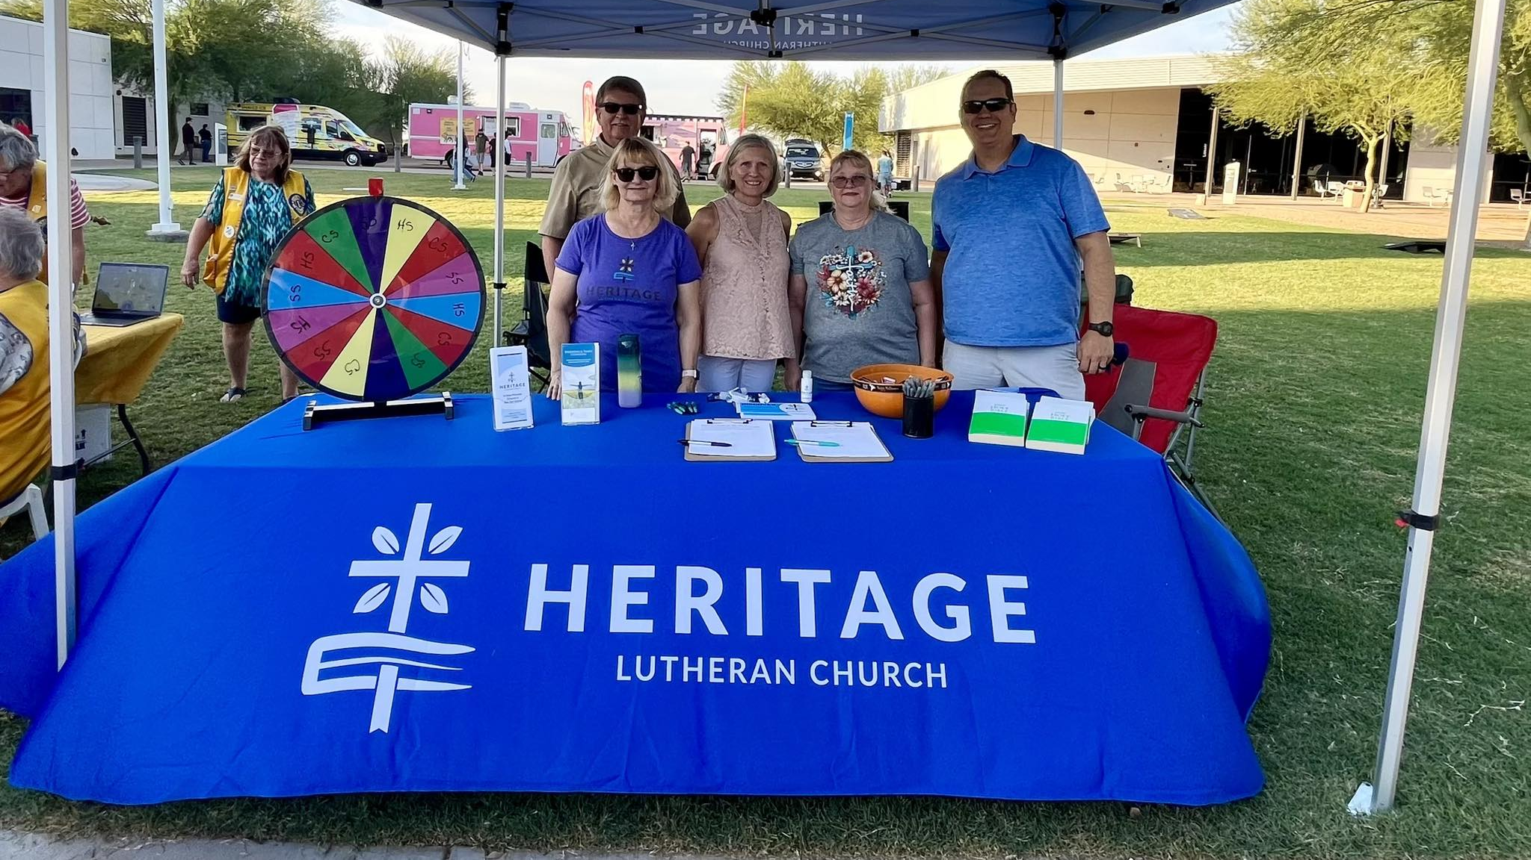
New Start – San Tan Valley, Ariz.
Notes:
Located on the eastern edge of Phoenix, San Tan Valley is experiencing rapid growth with no signs of slowing down. Since 2022, the Arizona-California District Mission Board has been working with Heritage in Gilbert, Ariz., to plant a new mission in the area. A core group of 26 adults has been gathering regularly for Bible study and community events, building connections and momentum. In October 2024, they began holding regular worship services and have already identified 127 prospects interested in learning more about the new church.

Slide 17
2025 Enhancements:
Christ, Clarksville, Md.(restart)
Living Word, Petaluma, Calif. (restart)
Living Word, Waukesha, Wis.
Redeemer, Edna, Texas
Risen Savior, Lakewood Ranch, Fla.
Saint Mark Mankato, Minn.
Notes:
Christ, Clarksville, Md. (restart): Christ in Clarksville, Md., is looking for short-term Home Missions support to revitalize its outreach efforts. Located in the Washington–Baltimore metropolitan area, the church is ideally positioned to reach a diverse community. Despite facing challenges due to an unexpected pastoral vacancy and after-effects of the pandemic, the core group remains dedicated and mission-minded. The church aims to grow both spiritually and numerically under the guidance of a full-time pastor.
Living Word, Petaluma, Calif. (restart): A dedicated core group of members at Living Word are excited to relaunch their outreach efforts with the addition of a full-time home missionary. Situated north of San Francisco, this growing community presents numerous outreach opportunities. Living Word is already actively engaging with the nearby Coast Guard, leading worship and Bible studies at a local senior center, hosting “Stay and Play” events for families, and managing a community garden on its property that fosters gospel conversations.
Living Word, Waukesha, Wis.: Strategically built across the street from the local high school, Living Word has experienced steady growth, with membership increasing by 20 percent since 2022. The congregation has welcomed 50 adult confirmations in the last four years. Now, with 400 names on its prospect list, Living Word will receive short-term Home Missions support to call a staff minister who will assist Pastor John Borgwardt in reaching high school families with the gospel and following up with prospective members.
Redeemer, Edna, Texas: Redeemer is a growing congregation with a mission-minded pastor leading the effort. Over the past three years, membership has increased by 26 percent, with 29 adult confirmations during that time. With 279 names on its prospect list and outreach opportunities expanding beyond what one pastor can manage, Redeemer is requesting short-term Home Missions support to call a second bilingual pastor to help connect with the growing community, both Spanish- and English-speakers, and continue reaching more people with the gospel.
Risen Savior, Lakewood Ranch, Fla.: Risen Savior is a thriving congregation in a rapidly growing community with a second site now established in Parrish, Fla. Since its beginning in 2016, the congregation has grown from 66 to 440 members, with 134 adult confirmations in the last three years alone. The church now has 350 families on its prospect list. To help manage the expanding outreach efforts, Risen Savior is requesting short-term Home Missions support to call a second pastor who will assist with these growing ministry opportunities.
Saint Mark Mankato, Minn.: Over the past three years, Saint Mark Mankato has experienced steady growth, with weekly worship attendance increasing from 97 to 130 and membership rising from 200 to 283. During this time, the congregation celebrated 24 adult confirmations, with even more expected. With 168 names on its prospect list, Saint Mark Mankato is seeking short-term Home Missions support to hire a manager of ministry, which would allow the pastor to dedicate more time to outreach and further strengthen this growing ministry.
Learn more about these enhancements at wels100in10.net/category/enhancement/.

Slide 18
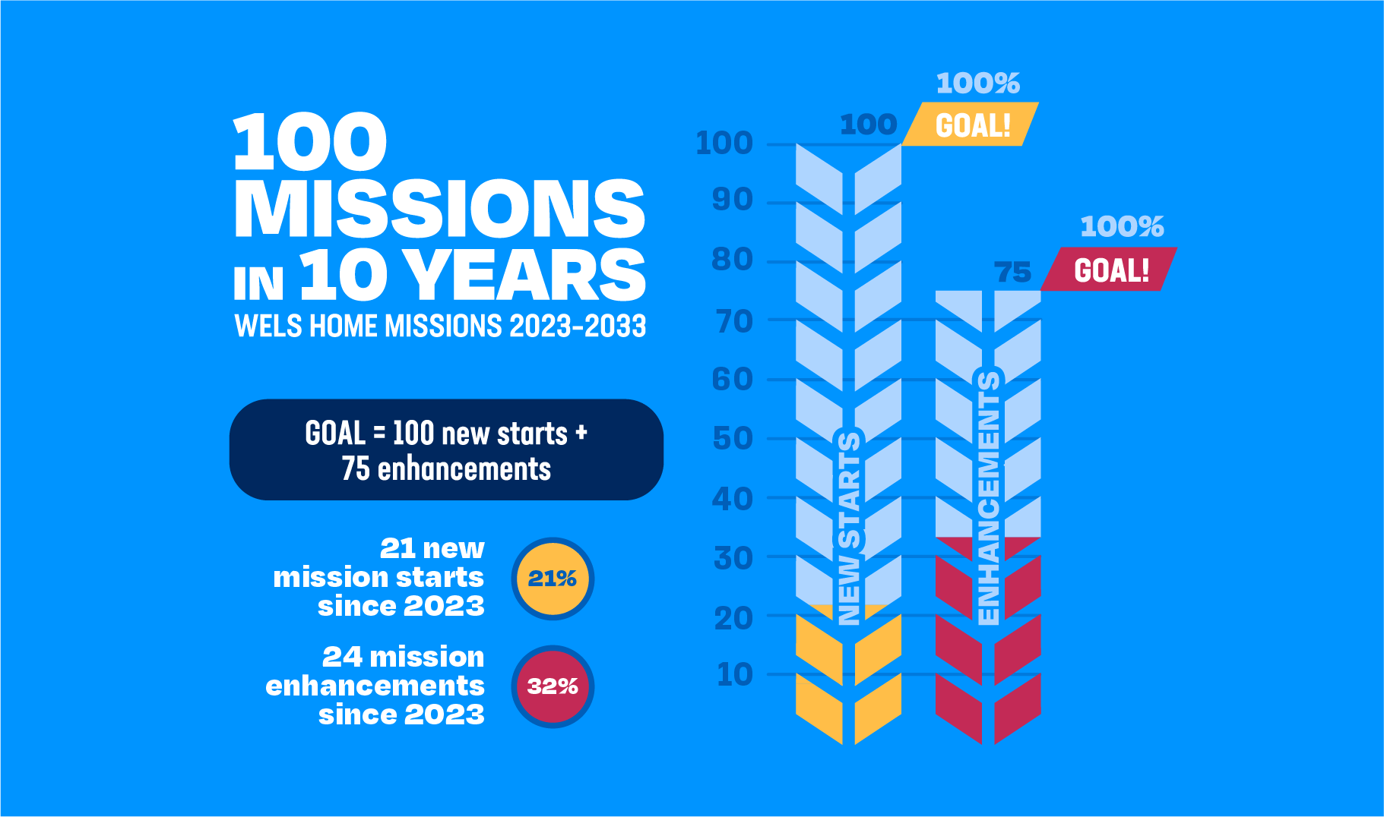
Notes:
Home Missions has limitless opportunities with a limited amount of resources. The Board for Home Missions is actively looking at ways to reduce costs, even in the current economic climate, so that more people can be reached with the gospel. It’s all about being faithful stewards of the resources God has given us. Home Missions will continue working diligently to aggressively reach the lost with the gospel while also being faithful stewards. We trust God will bless our efforts.

Slide 19
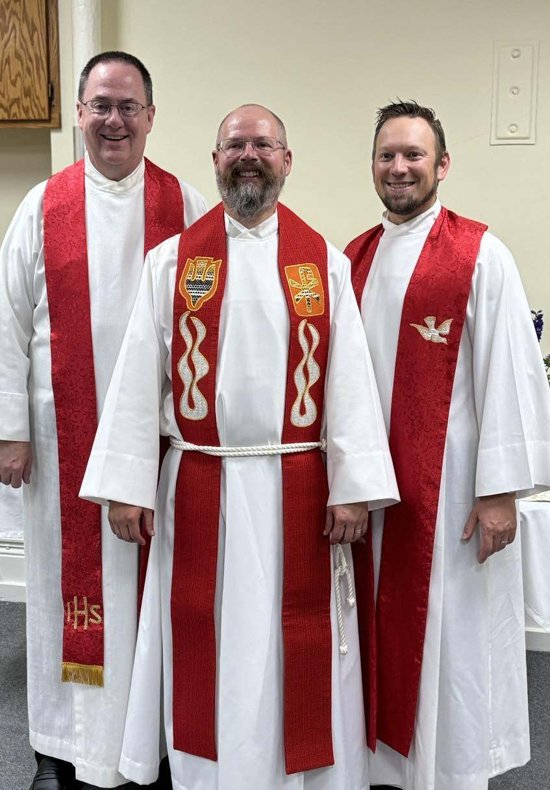
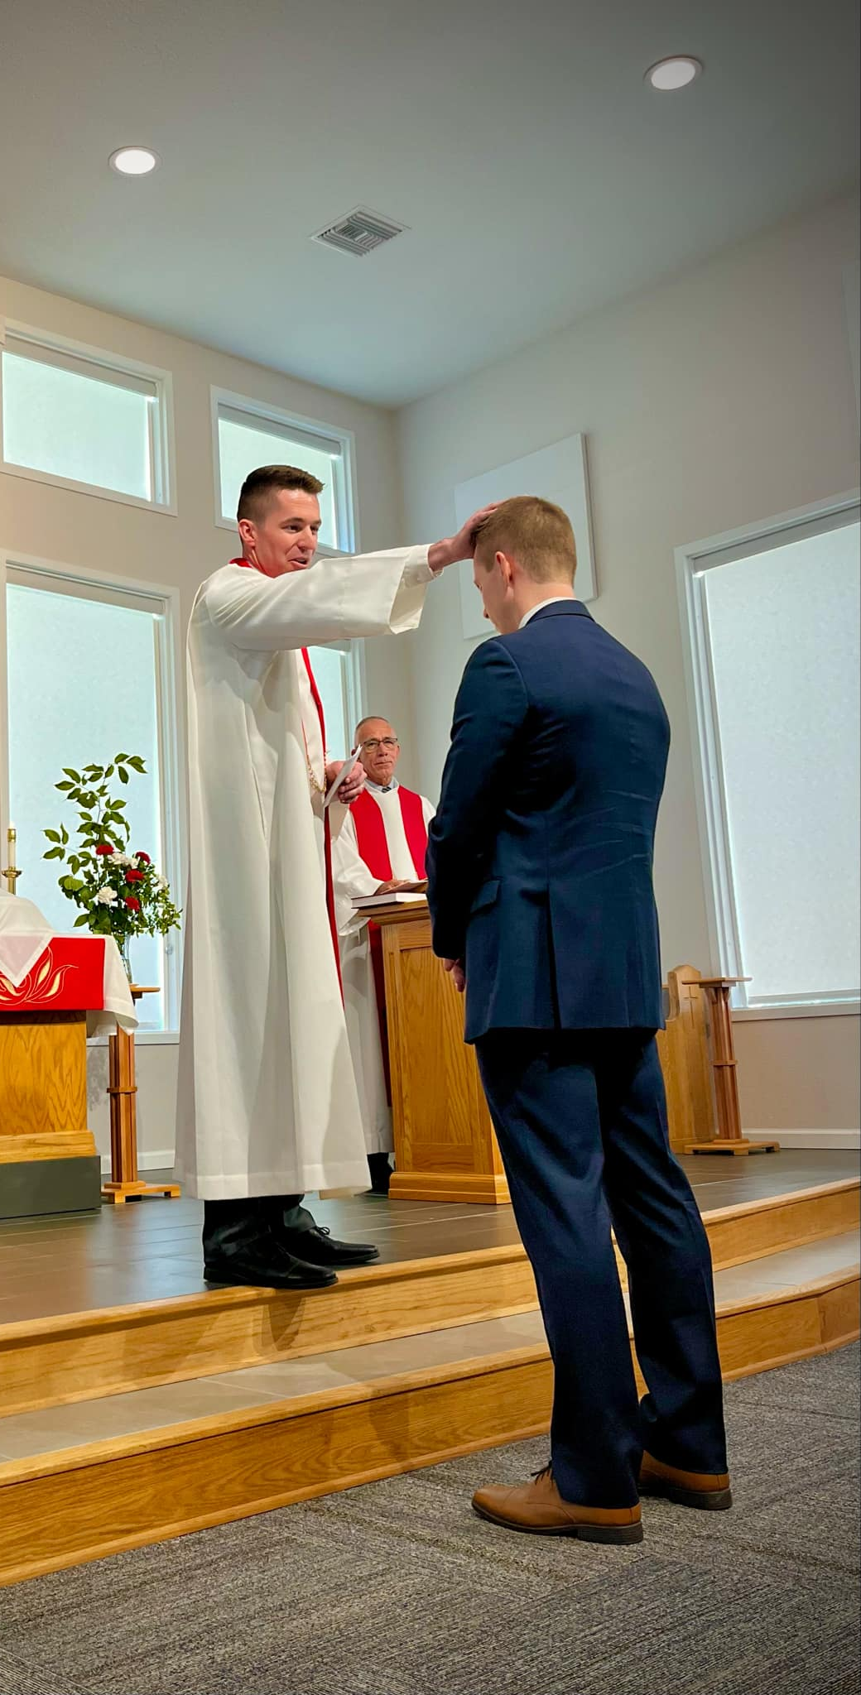
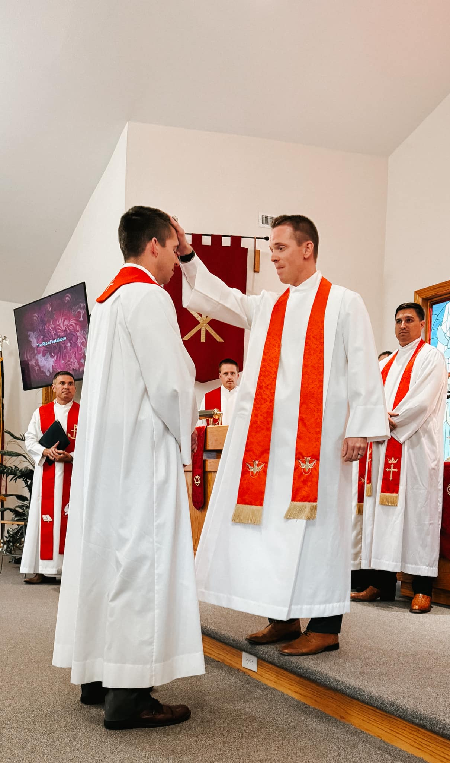
New home missionaries: 14 new home missionaries in total
Notes:
Eight current pastors accepted home mission calls since June 2024:
Rev. Fred Schurman: Christ the King, Buffalo, WY (New start approved Fall 2023)
Installed on July 7
Pictured left
wels100in10.net/new-starts/buffalo-wyoming/
Rev. Evan Chartrand: New Start, Panama City Beach, FL (New start approved Spring 2023)
Installed on July 21
Pictured center (Brother Ross Chartrand laying on hands)
wels100in10.net/new-starts/panamacitybeach-fl/
Rev. Ross Chartrand: New Start, Bentonville, AR (New start approved Spring 2023)
Installed on August 11
Pictured right (Brother Evan Chartrand laying on hands)
wels100in10.net/new-starts/bentonville-ar/
Rev. Fred Berger: New Start, Kronenwetter, WI (New start approved Spring 2023)
Installed on September 15
wels100in10.net/new-starts/kronenwetter-wi/
Rev. Thad Bitter: New Start, Bend, OR (New start approved Spring 2024)
wels100in10.net/new-starts/bend-or/
Rev. Michael Quandt: New Start, Easley, SC (New start approved Spring 2024)
https://wels100in10.net/new-starts/easley-sc/
Rev. Benjamin Schone: Calvary, Dallas, TX (Enhancement approved Spring 2024)
https://wels100in10.net/enhancement/calvary-dallas-tx/
Rev. Andrew Ewings: Lamb of God, West Lafayette, IN (Existing home mission congregation)

Slide 20
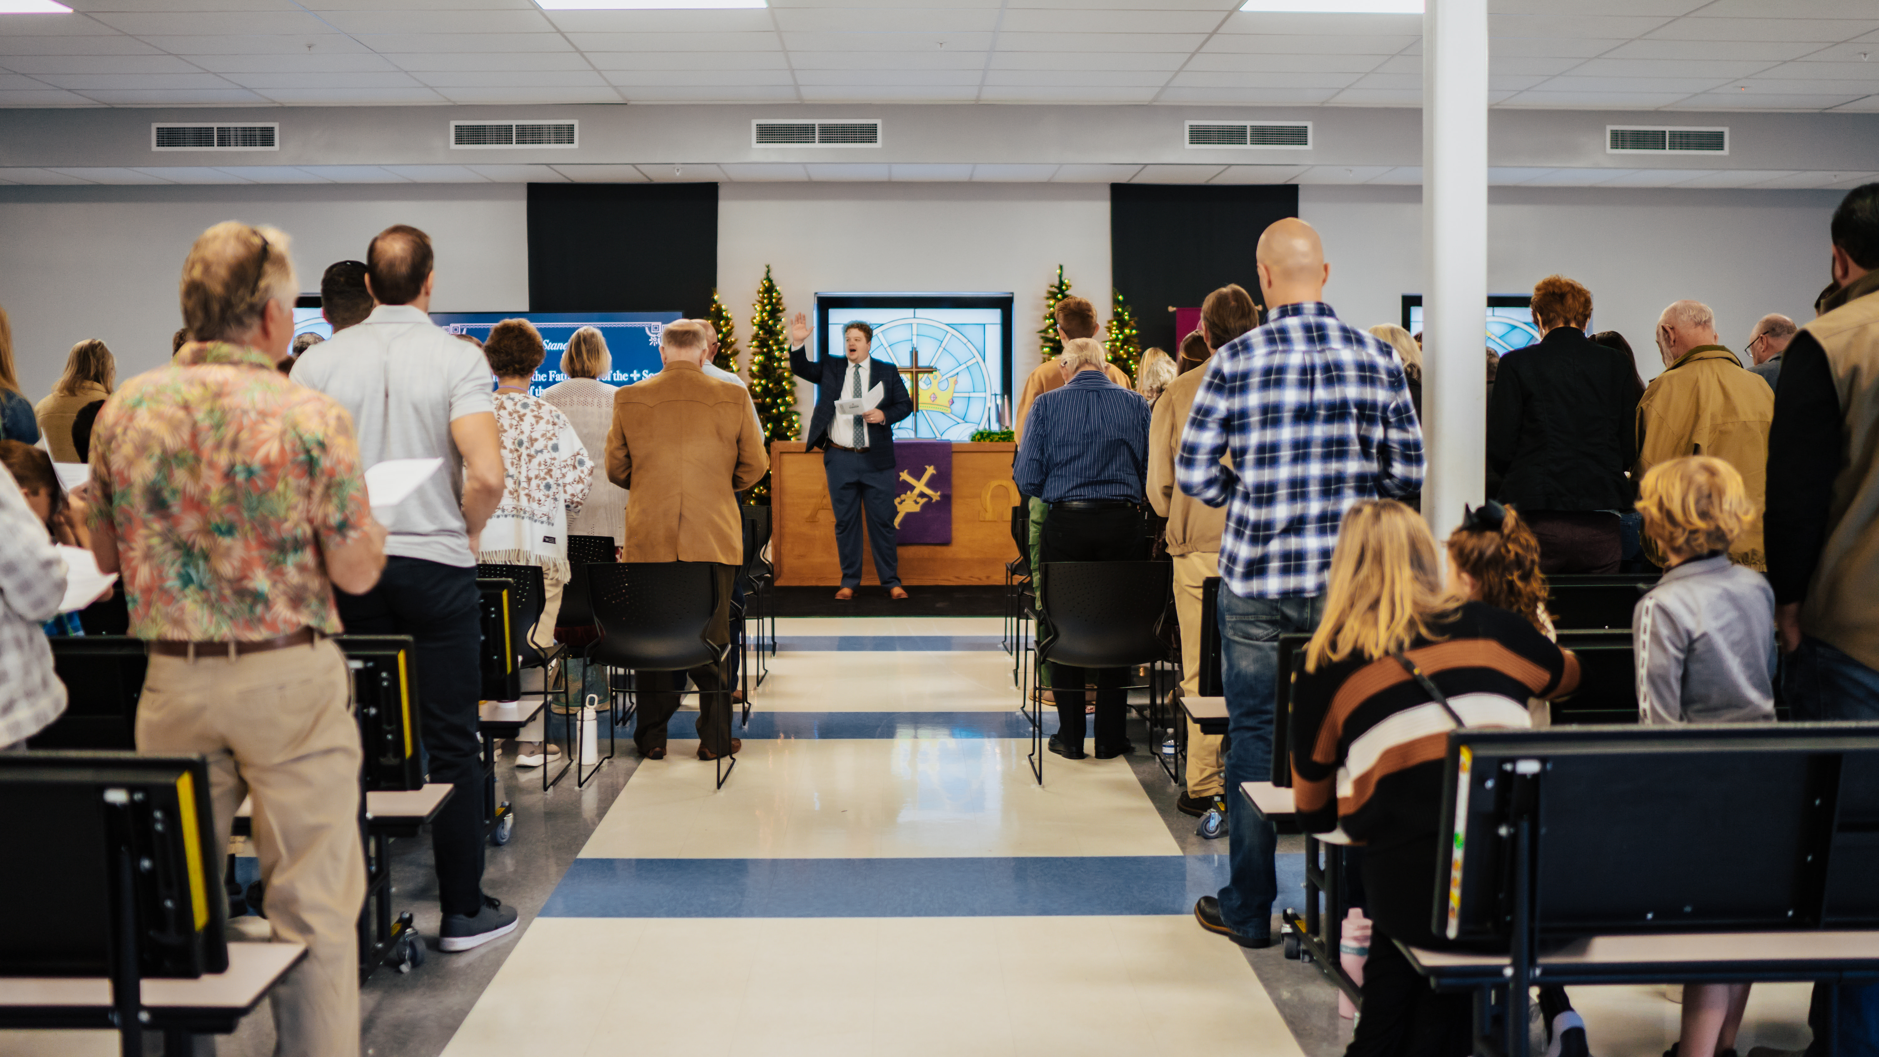
Public worship launch on December 8, 2024, at
Risen Savior in Parrish, Fla.
Notes:
Risen Savior, a home mission congregation in Parrish, Fla., launched public worship in the cafeteria of Parrish Charter Academy on Sunday, December 8, 2024. Nearly 90 people, including 18 first time visitors, gathered to be fed by God’s Word. This new outpost for the gospel is a second site of Risen Savior in Lakewood Ranch, Fla.
While they used social media and other marketing efforts to get the word out about their new church, every single visitor came because someone they knew personally invited them. What a powerful reminder that a simple invitation, shared within a trusted relationship, can make an eternal impact!

Slide 21
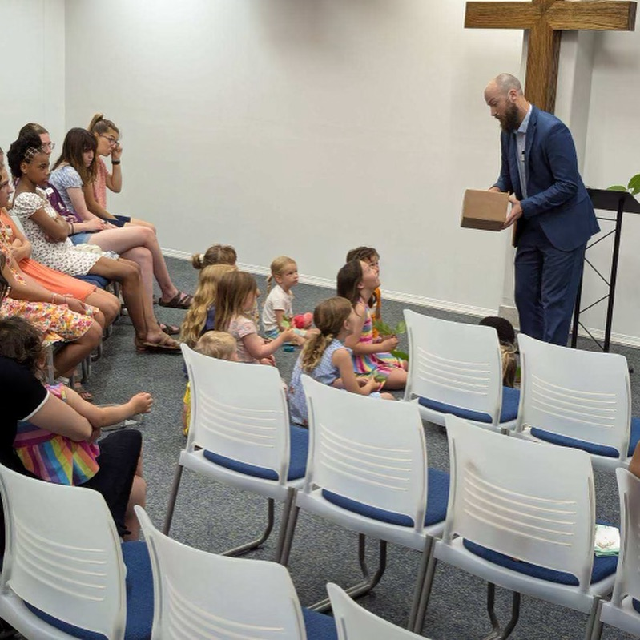
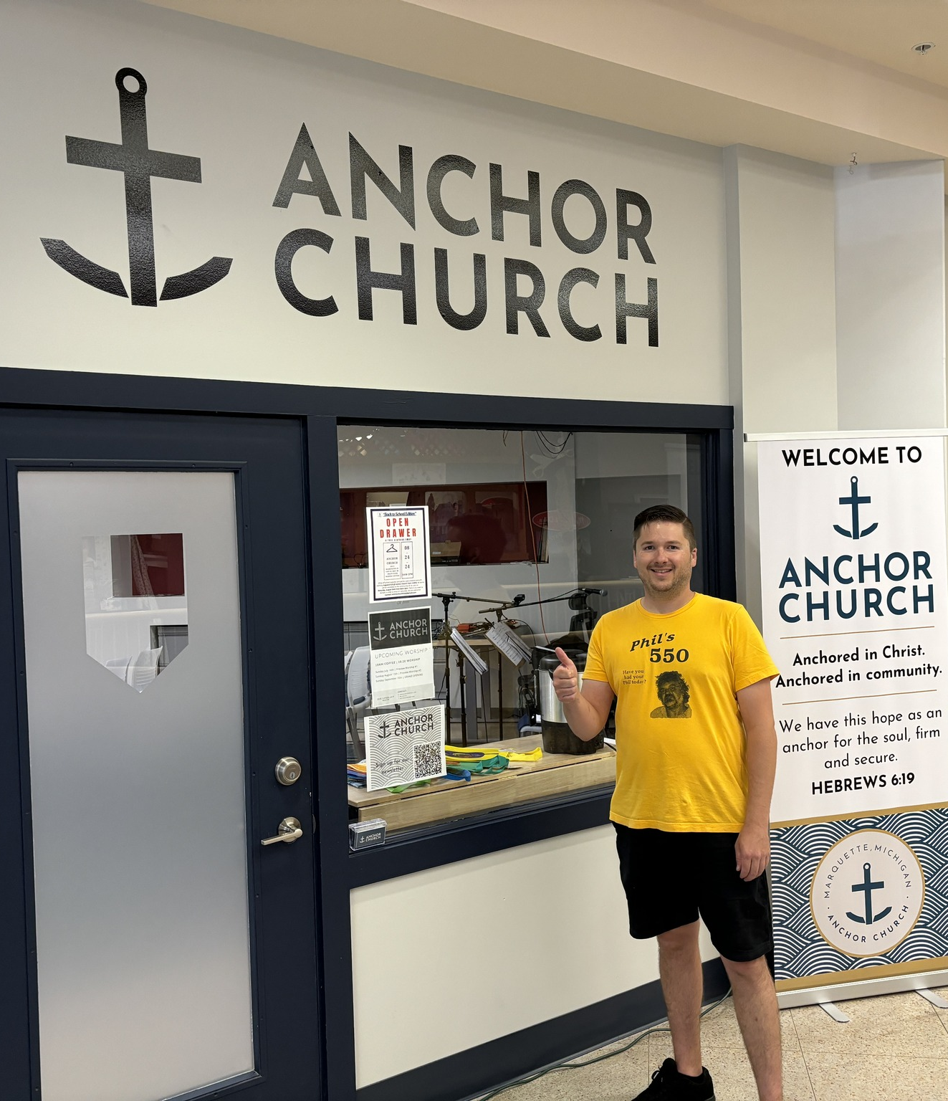
Worship launch in Marquette, Mich. September 15, 2024
Notes:
Marquette was approved as a new home mission start in Spring 2023. Marquette serves as the hub of the Upper Peninsula (U.P.) of Michigan, and 52% of the people in and around Marquette do not have a home church or attend a church. It is also home to 7,000 students at Northern Michigan University, a ripe opportunity for a Campus Ministry program. Learn more at https://wels100in10.net/new-starts/marquette-mi/.
Rev. Joseph Lindloff was installed as the new home missionary in Marquette on October 8, 2023. They have named their new church Anchor Church and found a 24/7 ministry center to lease in early 2024. They’ve hosted two “preview services” over the summer in preparation for their grand opening.

Slide 22
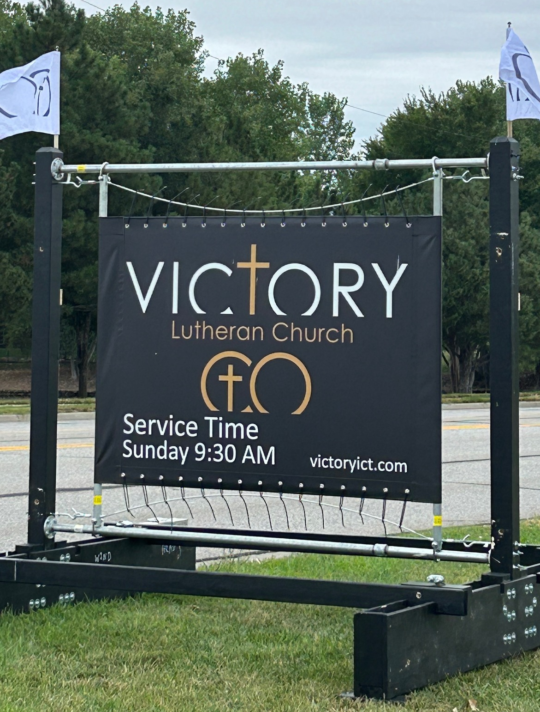
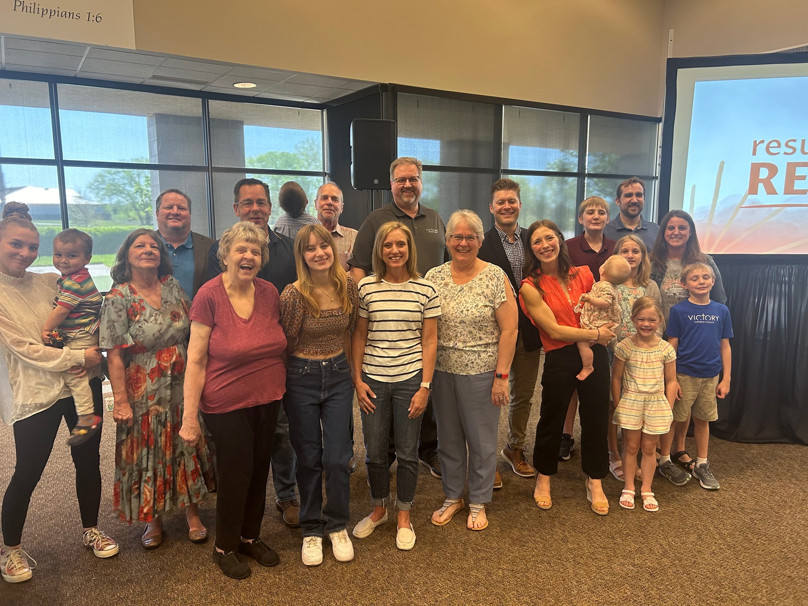
Grand opening on September 15, 2024, at Victory – Wichita, Kans.
Notes:
The new mission start on the east side of Wichita, Kansas, was approved as a new mission start in Spring 2022. Home Missionary Jacob Jenswold arrived in January 2023. This congregation is being daughtered by a core group from Messiah, a church on the west side of the city, in order to better serve the 650,000 people in the greater metropolitan area.

Slide 23
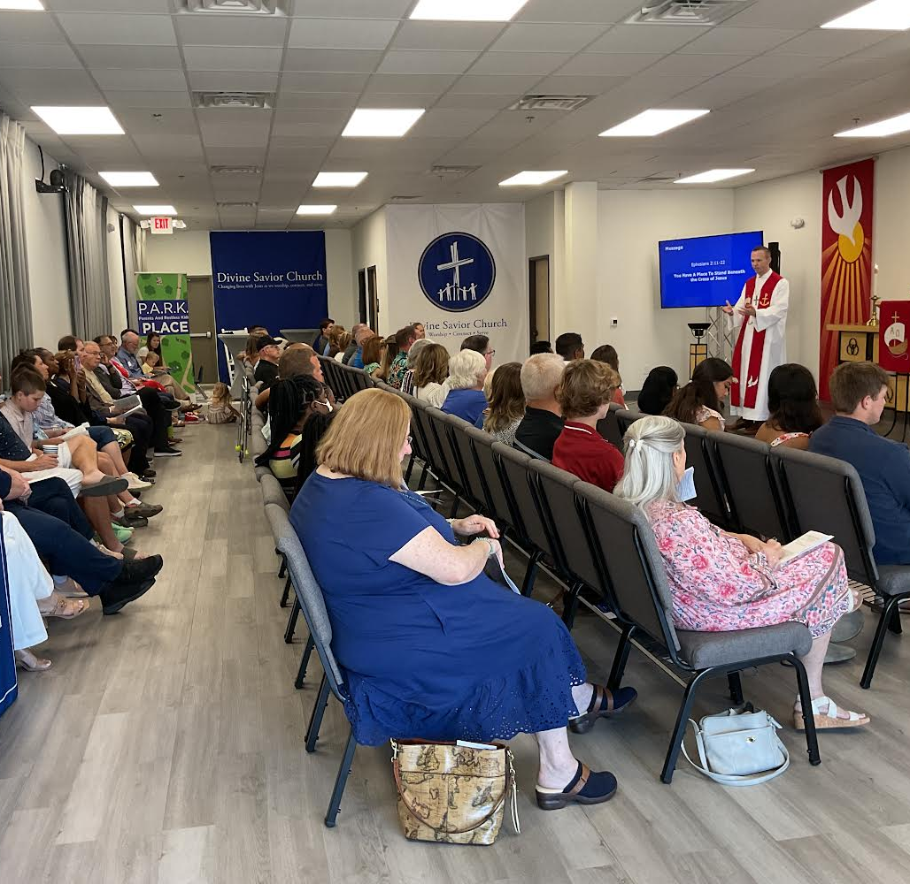
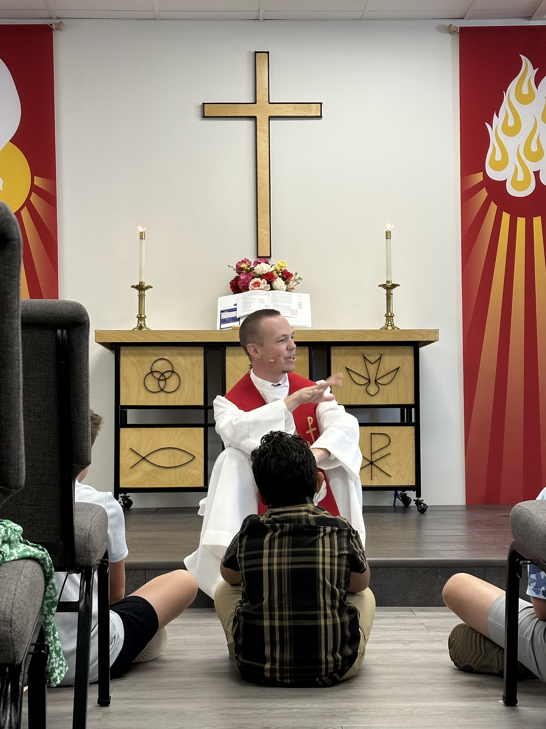
Public worship launch on September 8, 2024, at
Divine Savior – North Collin County, Tex.
Notes:
A core group of 15 members from Atonement in Plano, Tex., started a new church in North Collin County, a northern suburb of Dallas. They were approved as a new mission start in Spring 2023. Two of the top five fastest growing communities in the United States are in this target area. Divine Savior Ministries has committed to providing guidance and resources to the new mission and are planning build a Divine Savior Academy by year five of the mission start.
Caleb King was assigned from Wisconsin Lutheran Seminary in Mequon, Wis., in May 2023 to serve this new mission start. They had 71 guests join them for their opening worship and three musicians that participated in beautifying the service.
Learn more at https://wels100in10.net/new-starts/northcollincounty-tx/.

Slide 24
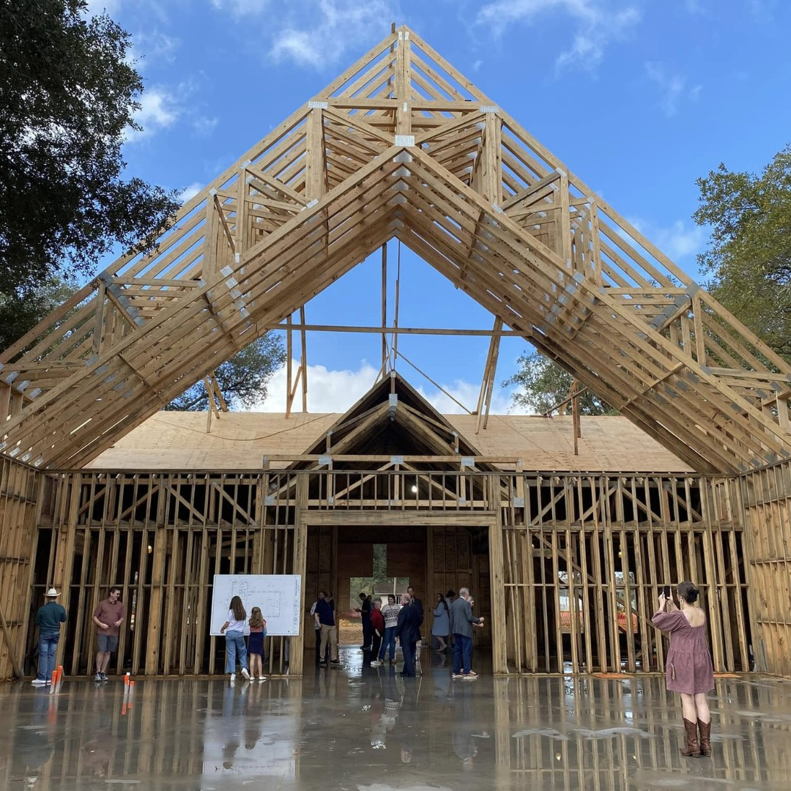
WELS Church Extension Fund A valuable partner of Home Missions
$209.8 million in total loan balances to over 190 WELS congregations
$6.9 million in matching grants to home mission churches since June 2023
$2.9 million in grants to WELS Home Missions since June 2023
Beam signing at TheMission in Willis, Texas, in Dec. 2024
Notes:
WELS Church Extension Fund (CEF) is a VALUABLE partner of WELS Home Missions and the churches it supports. CEF supports the spreading of the gospel by providing loans and grants to WELS home mission congregations.
WELS CEF is a wholly owned, self-supporting, subsidiary corporation of WELS. Individual WELS members, WELS congregations, and WELS affiliates can assist the synod’s mission outreach efforts by investing in WELS CEF investment certificates. Your investments fund the WELS CEF loan program. Gifts, bequests, and donations made to WELS CEF support the grant program.
WELS CEF provides home mission churches a 4-to-1 matching grant for initial land purchase based on their 10% down payment. They also provide a 2-to-1 matching grant on a home mission congregation’s 10% down payment for their facility construction project.
Since 1993, WELS CEF has provided $48.9 million of matching grants to mission congregations and $17 million of special grants directly to Home Missions.
Pictured: TheMission, a home mission congregation in Willis (Conroe), Texas, is anticipated to complete their new church building by July 2025. TheMission received loans and matching grants from WELS CEF.

Slide 25
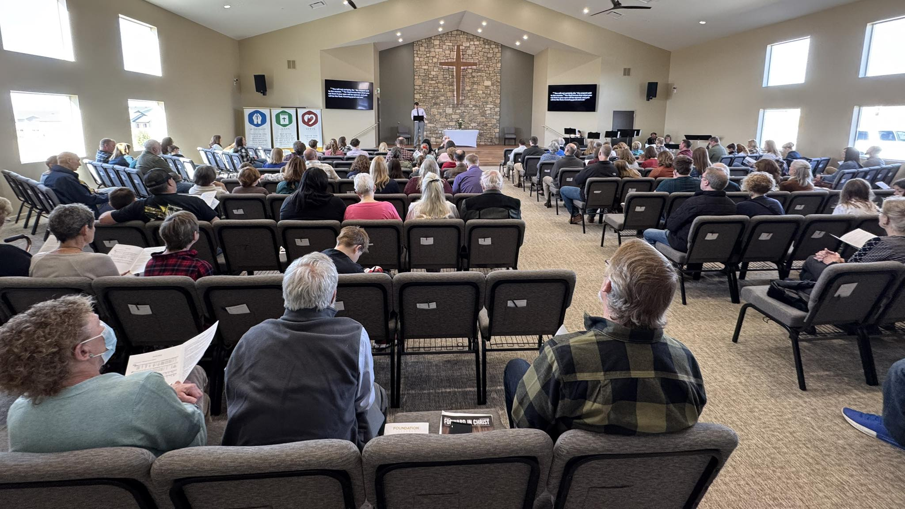
First worship service in new church - Peyton, Colo.
Notes:
Foundation Lutheran Church in Peyton, Colo., celebrated the groundbreaking for their new church building in April 2024. They worshipped in their new facility for the first time on March 23, 2025.
WELS Church Extension Fund provided over $700,000 in land and facility matching grants to Foundation Lutheran Church to assist in the construction of their facility. Learn more about how you can invest with WELS Church Extension Fund and simultaneously support Home Missions at wels.net/cef.

Slide 26
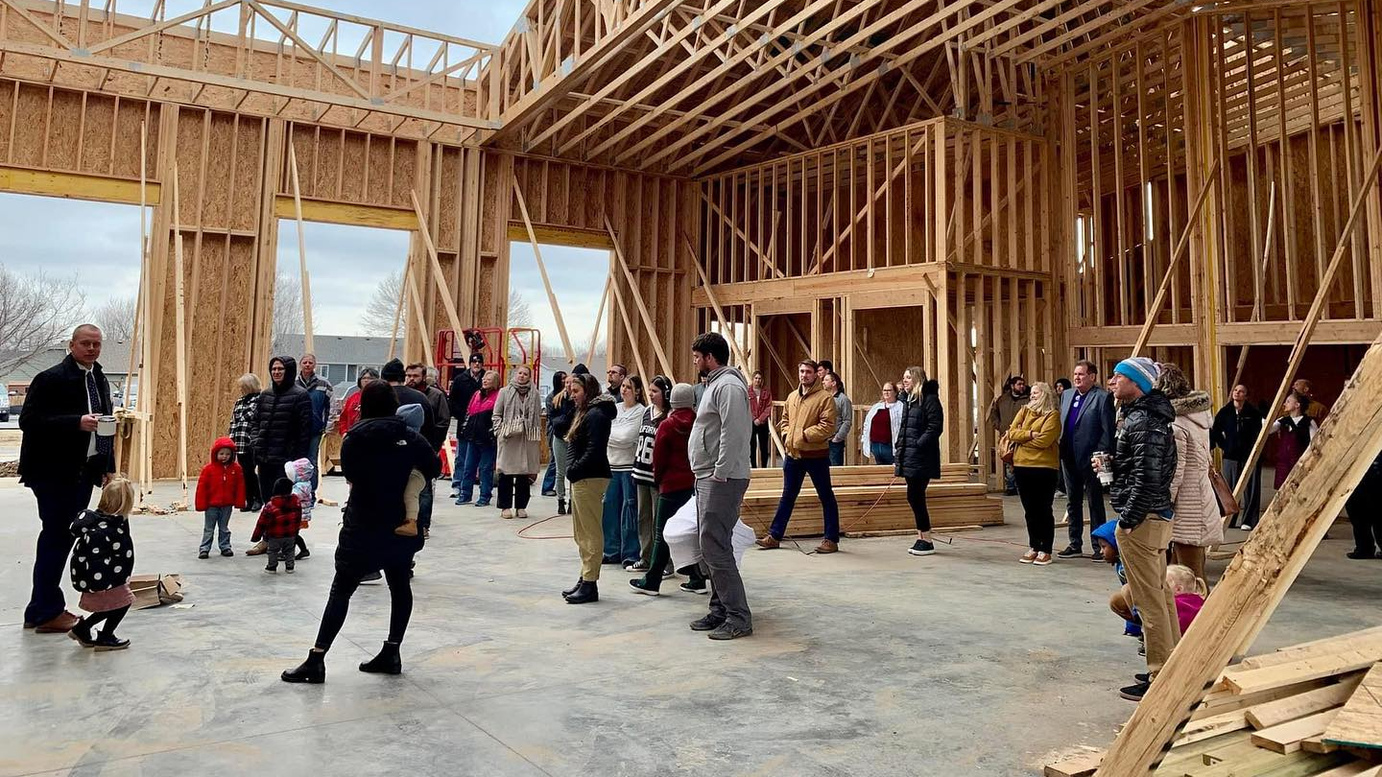
Beam signing event at Sure Foundation, Brandon, S.D. in November 2024.
Notes:
Sure Foundation held their first worship service in their new building on Easter Sunday (April 20, 2025). Sure Foundation received loans and matching grants from WELS Church Extension Fund.

Slide 27
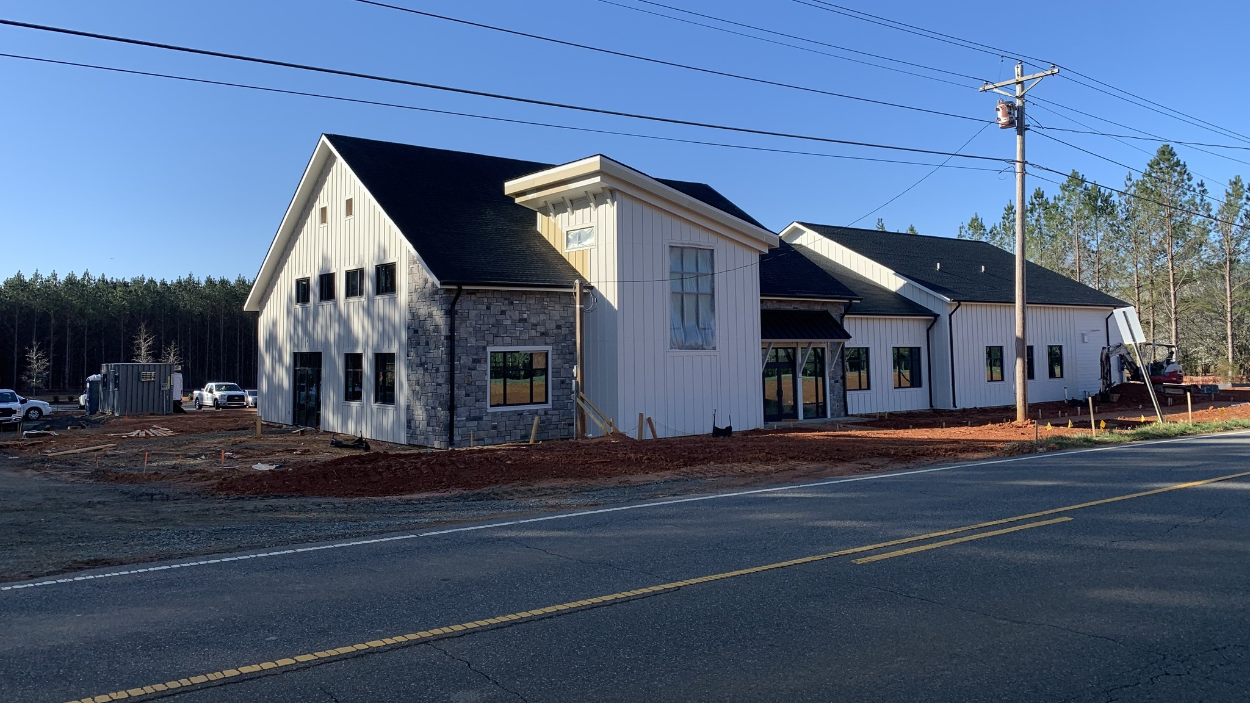
Construction progresses in Huntersville, N.C., after groundbreaking in Oct. 2024

Slide 28
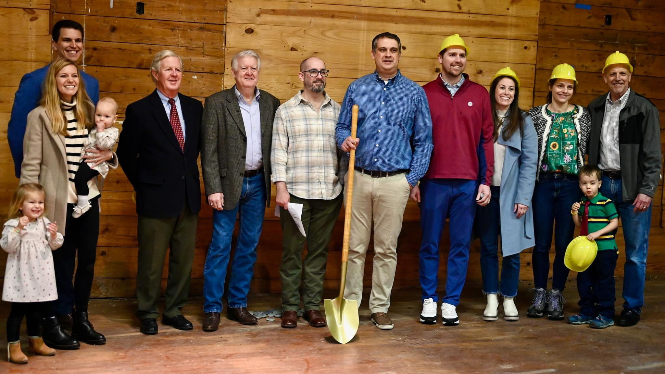
Hope in the Heights breaking ground on renovation of an old church in Houston, Texas
Notes:
Hope in the Heights in Houston, TX, closed in Fall 2023 on a Church of Christ building for sale that was built in 1927 and remodeled in the late 1950s. It is situated on its own block within a neighborhood in their target area. There is a large parking lot, ample street parking, and plenty of green space for kids to run around.
Thanks to the Church Extension Fund’s grant program for new missions, they get a 4:1 match on the land value and a 2:1 match for every dollar they spend on the remodel. Because of this, they can afford the necessary renovations. And because Church Extension Funds grants keep the cost down, they will be able to taper off of synod subsidy faster, which enables WELS to start more missions in the future. They hope to have the remodel completed by late 2024, when they will be able to move in and open their doors to the community.

Slide 29
High school graduations are approaching: Share student information with
WELS Campus Ministry!
Notes:
WELS Campus Ministry provides resources, support, and encouragement to WELS congregations that serve college students.
Almost every university in the United States and Canada has an assigned campus ministry contact pastor. Each contact pastor receives a list of WELS student that are attending their school. By sharing information with WELS Campus Ministry, these contact pastors know who the students are and can help them stay connected to Christ and strengthen their faith while at school.
We need your help in this process! Please work with the high school/college age students at your congregation and get them signed up with WELS Campus Ministry. Instructions on how to share student information can be found at wels.net/cmtoolkit, and you can encourage students to sign up directly at wels.net/college.

Slide 30
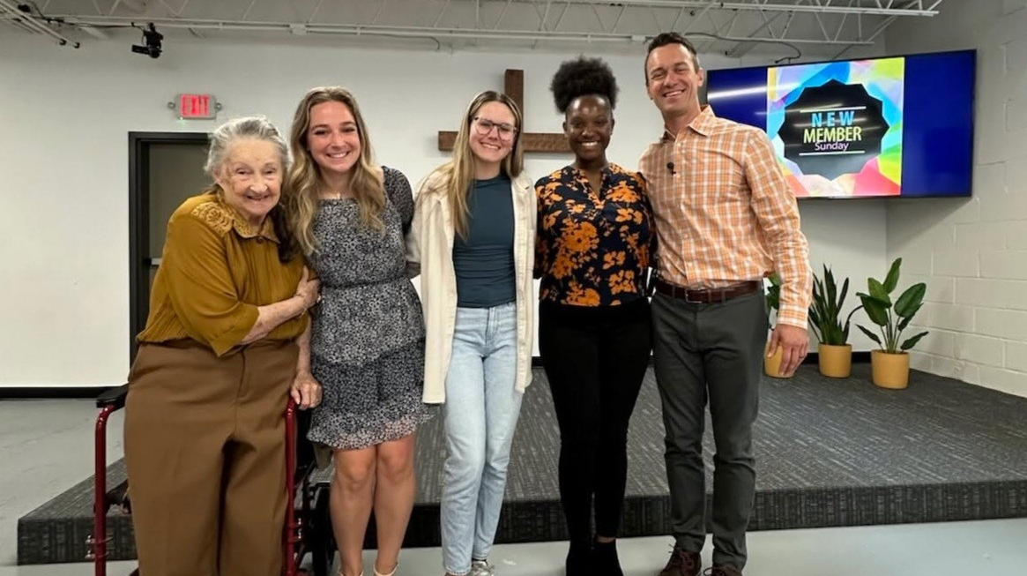
Outreach through Campus Ministry
Notes:
On Sunday March 30, 2025, Intown Lutheran Church welcomed three college students—Grace, Taylor, and Kennedi (pictured middle) as adult confirmands. These young women impressively completed our 12-lesson Bible Basics Class while also managing busy academic schedules and student-athlete responsibilities. All three of them are new to Lutheranism and very excited to be part of our church family!
Grace says: "Intown Lutheran Church not only gave me a place to learn straight from the Scripture and truly understand it, but it also gave me a new family of fellow Christians. This is a place where I can be myself and never feel alone, judged, or out of place."
Kennedi says: “Upon arriving in Georgia for college, I hoped to find a local church. Thankfully, a friend attending Intown invited me to the worship service one Sunday. Being exposed to the great teachings of the Good News and the kind fellowship, I decided to continue attending Intown and even join various Bible Study sessions each week. Now that I’m officially a member, I can say that the meaning of Intown Lutheran Church is to cultivate a body of God’s children and teach and learn the meaning and importance of His word so that we all grow in our faithful walk with Him.”
From Lucas Bitter, pastor at Intown, Atlanta, Ga.

Slide 31
Notes:
Pray: This is no small thing. Pray that the Lord of the church would provide workers. Pray for our WELS Home Missions leaders, our home missionaries, and our worker training schools as they recruit and train future missionaries. Pray that the Lord provides us with the financial support needed to do the work.
Get Involved: If you see nearby mission opportunities, talk with your district mission board to see what you or your congregation might do to get involved in this synod wide church planting effort. Encourage young men and women in your church to consider full-time ministry. Ask your pastor to keep our synod’s work in your congregational prayers and provide updates on a regular basis.
Give: You know the grace of our Lord Jesus Christ. He was rich, yet he became poor so that through his poverty we might become rich (2 Corinthians 8:9). God’s generosity has resulted in the riches of forgiveness, peace, joy, and hope. Let that move you to give generously to your local congregation, to your synod through your church, and to this initiative.
Encourage people to check out the website: Learn more and stay up to date on progress at wels.net/100in10.

Slide 32
Notes:
WELS Mission Journeys provides an opportunity for all WELS members to walk together in the Great Commission. Through short- or long-term service opportunities in WELS mission fields at home and abroad, members can engage in Christian service. While volunteering, the learning and sharing of outreach ideas will allow individuals and teams to explore how they can use their God-given abilities to engage in outreach activities in their local communities upon their return home. With the Lord’s blessing, these trips will inspire a lifelong journey of service and outreach for all who volunteer.
Learn more at wels.net/missionjourneys.

Slide 33
Notes:
Speakers: District Mission Board members, Home Missionaries, Mission Counselors, and other Home Missions representatives are willing and able to present on the 100 missions in 10 years initiative at your next church Mission Festival, LWMS circuit rally, school assembly, or small group gathering. Contact your local District Mission Board OR fill out a request at wels.net/speaker-request to find a speaker for your event this fall.
Social Media: Follow us on Facebook and Instagram @WELSmissions
E-Mails: Subscribe to weekly Missions Blogs and quarterly Missions Update E-Newsletters at wels.net/subscribe.
Faces of Faith: The 6th annual edition of Faces of Faith is now available. This is a great overview of the work we’re doing in Home, World, and Joint Missions, and you can learn more about the 100 missions in 10 years initiative in this magazine.
It is available online and by request at wels.net/facesoffaith. Any congregation OR LWMS circuit is welcome to request up to 50 copies of the magazine, and we are also offering 100 Missions in 10 Years brochures and large home and world mission maps (24” x 36”) free of charge. Note – Faces of Faith is automatically sent to any congregation hosting a Mission Festival.

Slide 34
Notes:
Saturday, June 14, 2025 | Wisconsin Lutheran Seminary, Mequon, Wis.
Register today for Taste of Missions, a celebration of gospel outreach and the commissioning of new home and world missionaries. The event begins with a special worship service, where we’ll joyfully send these missionaries to share Christ’s love around the globe.
Following the service, enjoy ethnic cuisine from mission fields, connect with fellow attendees, and hear firsthand accounts from missionaries about their work. Explore mission displays, participate in interactive activities, and ask questions during a panel discussion for deeper insights into the joys and challenges of mission work.
The worship service is free and open to all. Registration is $15 per person for those who wish to receive food tickets. Children 13 and under attend for free. If you can’t attend in person, tune into the livestream and join us virtually!
Learn more and register at tasteofmissions.com

Slide 35
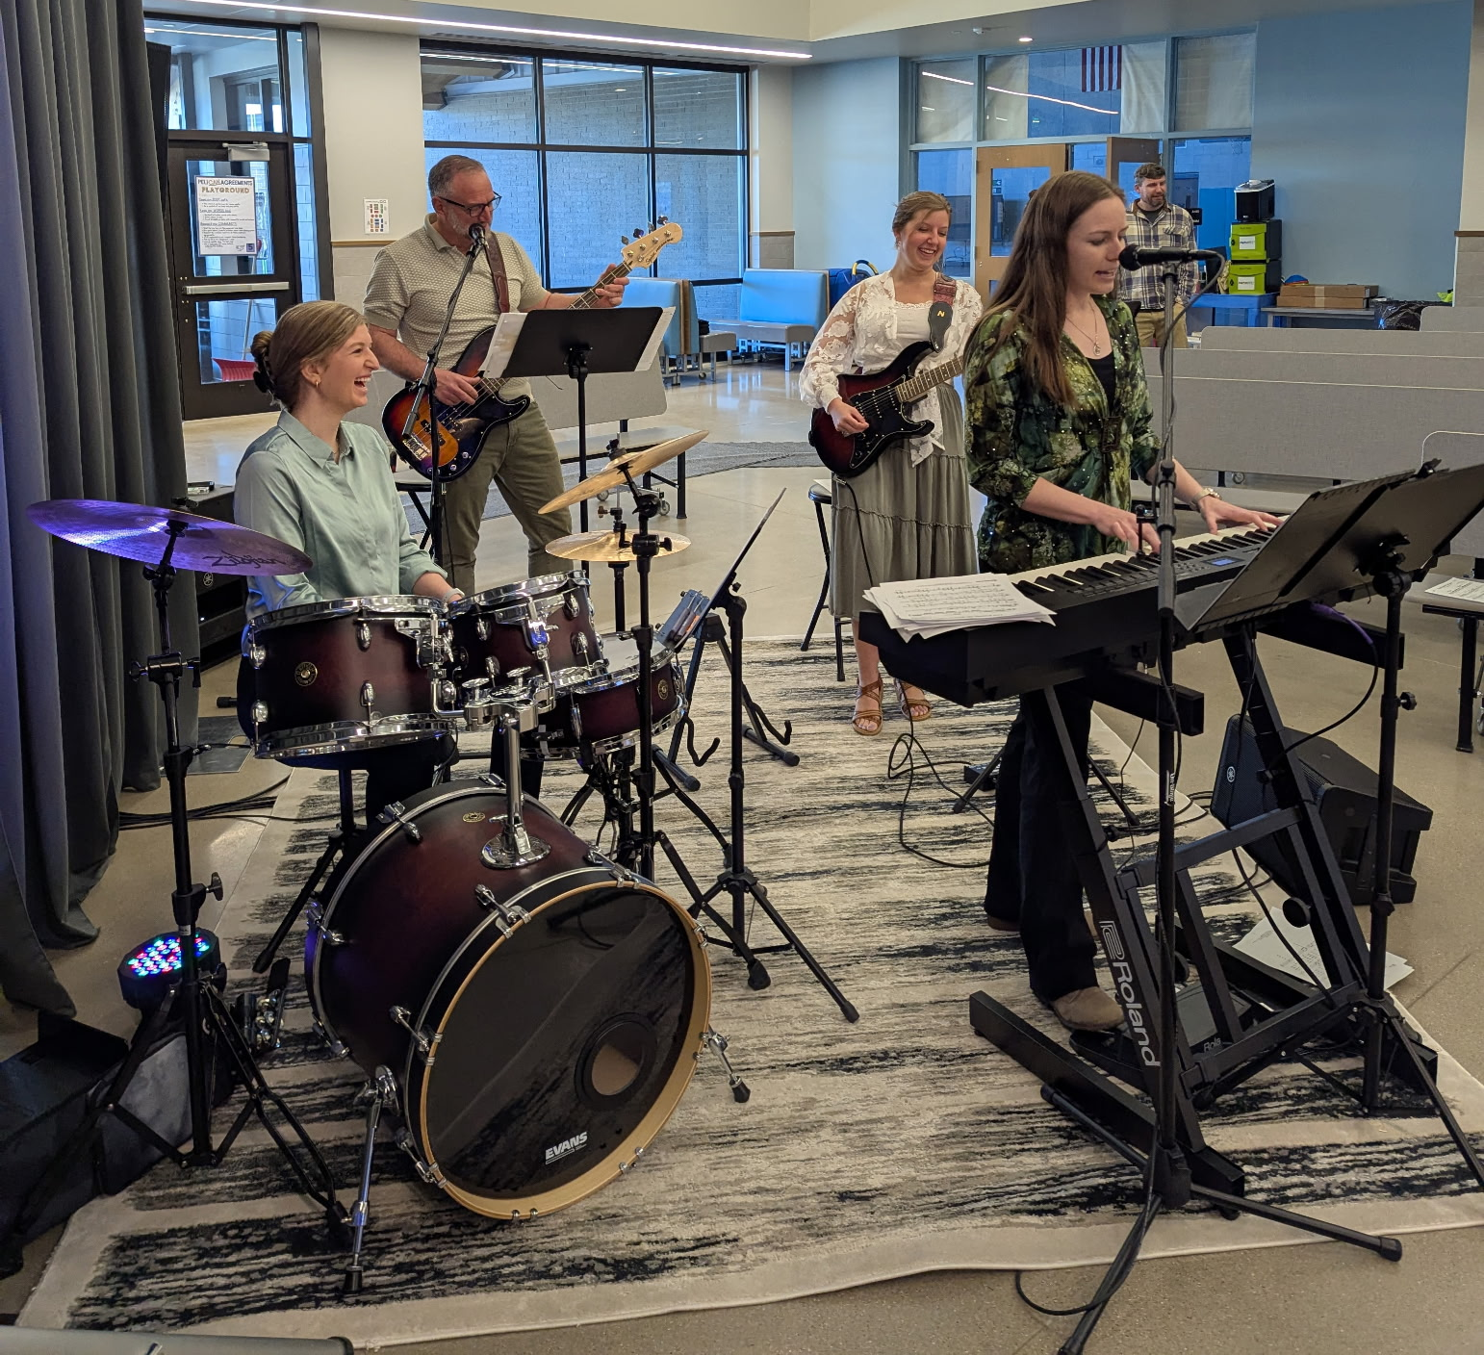
Support musical assistance grants as part of the Taste of Missions offering
Notes:
WELS is asking for gifts musical assistance grants for home mission congregations as part of the Taste of Missions offering.
Home mission congregations are not always blessed with a pipe organ or even a piano. They often use portable equipment such as electronic keyboards or computer-generated music with large speakers. WELS Home Missions offers additional grants of up to $2,000 to home mission churches that are looking to purchase keyboards and other instruments, sound equipment, software, etc., to enhance their worship services. Here are a couple examples of how these grants have been used in the past:
CrossView Church in Windsor, Colo., began holding public worship services on March 3, 2024. Every Sunday, they set up and take down their worship space at a local elementary school. The worship team had been using their own instruments, which led to significant wear and tear due to the frequent setup, takedown, and weekly practice sessions. To address this issue, CrossView received a $2,000 musical assistance grant. This grant allowed them to purchase a new keyboard, drum set, and transportation cases, which are stored in their portable church trailer. This has helped reduce the wear and tear on the members’ personal instruments.
After investing in landscaping and exterior improvements, Prince of Peace in Thousand Oaks, Calif., is preparing to host community and outreach events this summer and fall, including the relaunch of its outdoor worship services. These services were vital during COVID, welcoming neighbors and bringing in new members. A $2,000 musical assistance grant is allowing Prince of Peace to purchase a new electric piano for use at these outdoor services.
Cross of Christ in Las Cruces, N.M., is striving to enrich their member’s worship experiences through music. With a $2,000 musical assistance grant, alongside $1,250 of their own local support, they were able to replace their old digital piano and purchase some additional percussion instruments and music stands.
Your financial support of musical assistance grants helps WELS home mission congregations enhance their worship services and outreach efforts. Please consider partnering in this grant program to help home mission churches create meaningful worship experiences that welcome and inspire their members and communities.

Slide 36
GIVE GENEROUSLY!
Notes:
We confidently ask you to consider giving generously to this amazing opportunity to expand our efforts to share the saving gospel right here in our own backyard. This is a BIG challenge. An impossible one you might say. But we prepare and we plan, and we ask God to bless it. Trusting in the Lord, we boldly move forward knowing God will bless us and his kingdom.
You can support this effort by giving a gift online at wels.net/100in10gift; through the QR code on the slide; sending a check with the 100 Missions in 10 Years in the memo line to WELS, Attn: Gift Processing, N16W23377 Stone Ridge Drive, Waukesha, WI 53188; or through appreciated assets (e.g., stock) or from your IRA by calling 800-827-5482. Thank you for your support!

Slide 37
Notes:
Try something that is so hard, that if it succeeds, people will have to say God did this.
We submit all our plans to Him, for He is the Lord of the Church, and we are only servants. We’re trusting God to do immeasurably more than all we ask or imagine.

