Slide 1
Notes:
At the 2021 Synod Convention, delegates enthusiastically approved a WELS Home Missions initiative to plant 100 home mission churches and enhance 75 ministries in 10 years beginning in 2023. During the same time, we want to support 75 enhancement grants to help existing congregations reach more souls, often in other cultures.

Slide 2
Notes:
WELS Home Missions plants new churches and assists mission-minded congregations in the United States, Canada, and English-speaking West Indies. Home Missions currently supports 157 congregations with financial subsidy or district mission board/mission counselor assistance, with 32 of those being cross-cultural mission congregations. Home Missions also provides over 45 campus ministries with financial support, while assisting hundreds of other congregations that serve college students around the United States and Canada.

Slide 3
This is a big goal. Why start 100 new home missions?
Our Savior directs us to reach more souls with the good news. This initiative isn’t as much about planting more churches as it is about sharing the gospel of Jesus Christ. It’s about Christ’s mission to his church. It’s about aggressively reaching lost souls.
Notes:
Why are we doing this?

Slide 4
To reach more people like Lauren
Notes:
Link to Video: https://vimeo.com/694678056

Slide 5
How are we going to do this?
100 Mission in 10 Years
Notes:
Some might wonder if we’re just throwing a number out there without really thinking this through. What about manpower? What about money? Is this goal realistic?

Slide 6
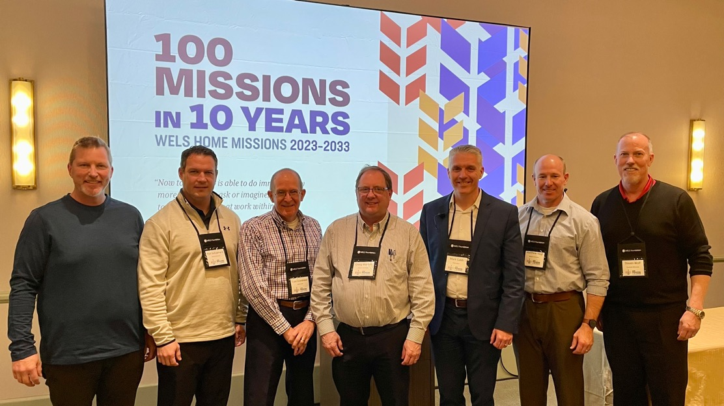
Home Missions Task Force
Missionaries
Money
Internal Operations and Resources
The report included 55 recommendations
Notes:
The WELS Board for Home Missions formed a task force (pictured) to carefully and thoroughly address questions and concerns regarding manpower, money, and more. Their work has already been rewarding. It’s clear that we have men and women in all areas of ministry of our synod who are dedicated to this initiative. They want to do their part in reaching more souls with the gospel. In fact, we can see how we stand on the shoulders of present and past leaders who have encouraged and supported worker training, home missions, world missions, and all the other important areas of our synod.
Task Force Subcommittees:
Board for Home Missions Executive Committee (BHM EC)
Board for Home Missions/District Mission Boards (BHM/DMB)
Defunding
Coaching
Ministry Affiliates
Mission Counselors
Church Extension Fund (CEF)
Synod Support
Mission Pastors
Center for Mission and Ministry (CMM) Staff
The ten subcommittees' findings can be summarized into three main categories: Missionaries, Money, Internal Operations and Resources. Full reports from their subcommittees have been presented to the Board for Home Missions (BHM).

Slide 7
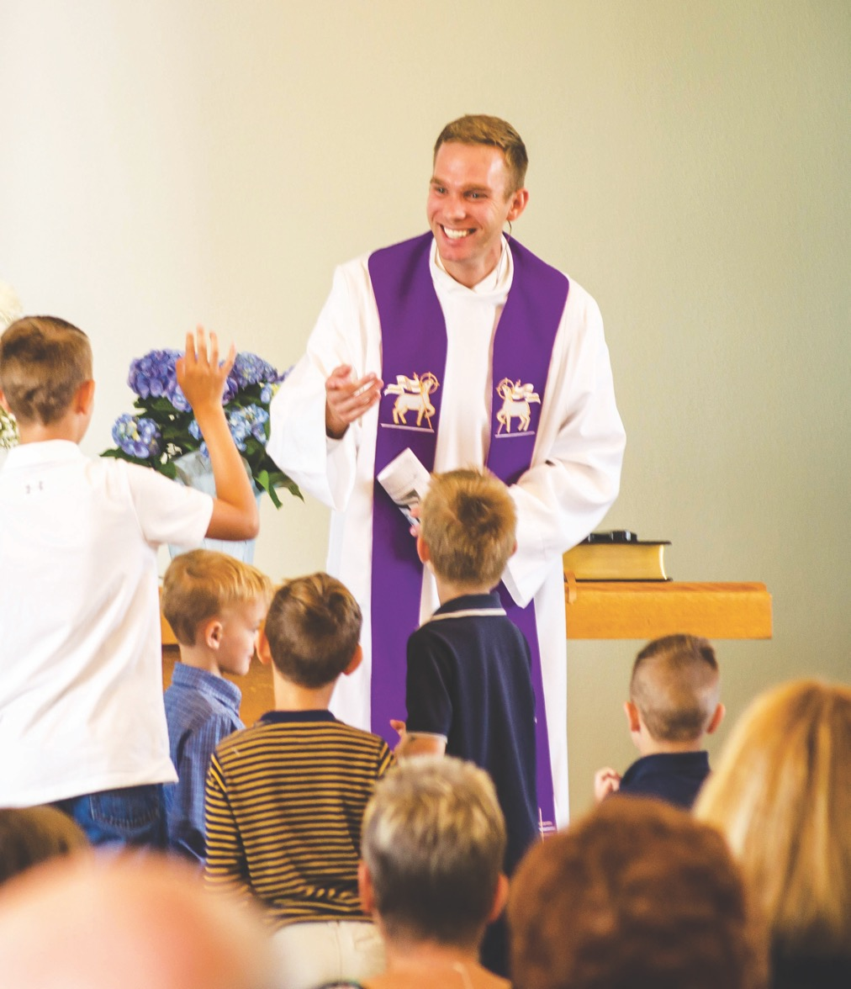
We don’t have enough pastors for our current churches, why should we start more?
Martin Luther College and Wisconsin Lutheran Seminary classes are the largest we’ve seen in awhile.
We pray 100 in 10 helps with recruitment.
40 different churches are considering closing their doors. As churches close, vacancies will also decline.
Notes:
The harvest is plentiful, but the workers are few. Ask the Lord of the harvest, therefore, to send out workers into his harvest field. – Luke 10:2
We’re experiencing that reality with about 140 vacancies throughout our synod. And now, as we plan to open 100 missions in 10 years, one of the biggest challenges is finding the workers to send into the harvest fields. While we pray that the Lord of the harvest would send out workers, we also know he answers our prayers through the faithful work of his people.
Pre-seminary student enrollment at Martin Luther College and class sizes at Wisconsin Lutheran Seminary are some of the largest we’ve seen in a while.
We pray that the excitement of starting new home mission churches will assist with recruitment efforts.
On the flip side, WELS Congregational Services is currently working with around 40 different churches who are considering closing their doors for a variety of reasons. In the past decade, WELS lost congregations in eight out of the ten years. As churches close, vacancies will also decline.
Let us pray that the Lord provides more future leaders, called workers, and home missionaries as he continues to grow his church!

Slide 8
How are we going to fund this ambitious initiative?
Home Missions currently funds about six new home missions per year. We would be looking to increase that number to around 10 new missions per year.
Additional funds:
Increased Congregation Mission Offerings (CMO) allocation
Synod reserves
Proceeds from closing WELS churches
Generous gifts from WELS members
Notes:
At the rate Home Missions is opening missions right now (approx. six new missions/three ministry enhancements per year), projected expenses over the next 10 years would be $90M. Forecasts are based on an average of $1M in subsidy for every new start over 12 years and an average of $150,000 in subsidy for a mission enhancement over 4 years.
By increasing that number to 10 new missions and 7.5 enhancements per year, we’d be looking at an additional $40M in expenses over 10 years. Total expenses would be $130M.
WELS leadership has already committed $3 million in synod reserves to a ministry opportunity fund that will disperse $750,000 per year for the next four years in support of this initiative.

Slide 9
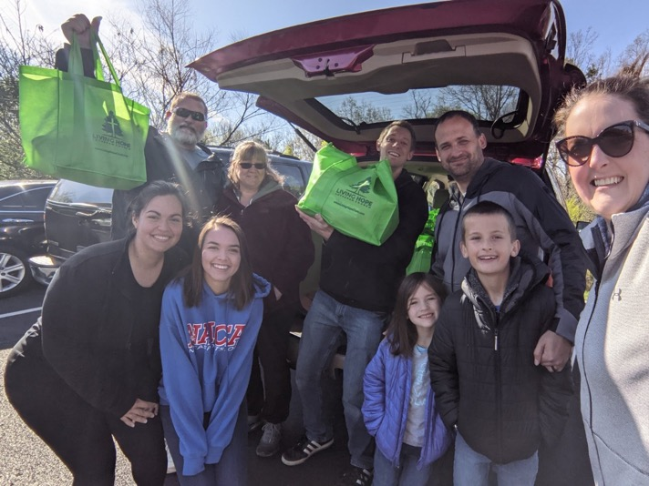
Do we have the manpower and resources to pull this off?
Continued encouragement and support to District Mission Boards (DMBs), the heart and core of Home Missions
Home Missions administration, Mission Counselors, and Missions staff are in place to support growth
Encouraging home mission congregations to partner with affiliated ministries to support ministry
Notes:
Other Task Force recommendations:
Continued training for all DMB members
Allow DMBs to expand their board when needed; encourage succession plans
All DMBs have a pipeline for new mission starts
Compile a list of affiliated ministries that could be assets to DMBs and their missions

Slide 10
How does our synod plant churches?
100 Mission in 10 Years
Notes:
So how does it work?

Slide 11
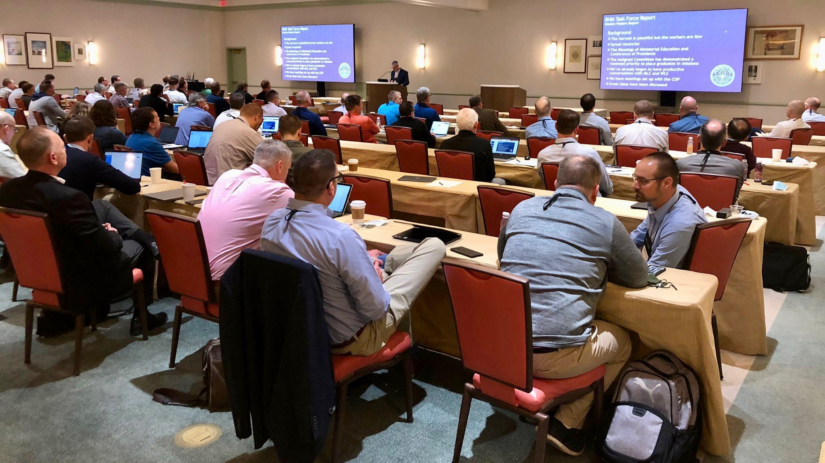
District Mission Boards (DMB)
The heart and core of Home Missions
Notes:
FOR PRESENTERS: I would recommend including a group photo of the DMB where you’re presenting for this slide.
District mission boards (DMB) are the heart and core of Home Missions. They are the “boots on the ground” as they support existing home mission churches and work with area congregations to identify locations to plant new churches throughout their district. This group of 2-4 pastor and 2-4 laymen volunteers helps build a solid foundation for each new mission start and shepherds these new churches and their pastors on their path from starting a new mission to being a self-supporting church. Learn more at wels100in10.net/timeline/dmb.

Slide 12
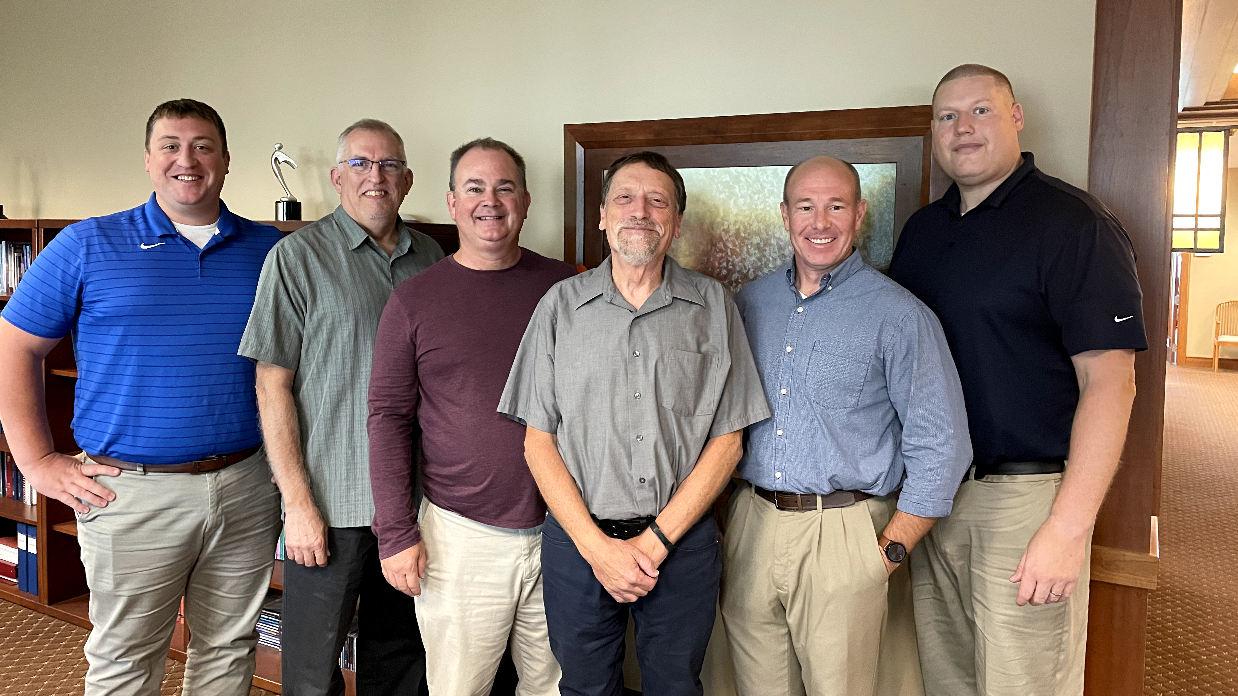
Mission Counselors: Guiding mission congregations and assisting District Mission Boards
Notes:
District mission boards (DMBs) and home mission churches are supported by three home mission counselors. They work with the DMBs to find, evaluate, and develop new home mission locations. They also provide onsite assistance to home mission congregations and counseling and training to the new missionaries who are called to serve them. This support is crucial in guiding mission churches on the way to becoming self-supporting congregations. WELS Home Missions also works with three specialized mission counselors that assist congregations with Hispanic, Asian, and Campus Ministry outreach.
Pictured (from left to right):
Rev. Neil Birkholz, North American Asian Ministry Consultant
Rev. Tim Flunker, Hispanic Outreach Consultant
Rev. Wayne Uhlhorn, Mission Counselor
Rev. Mark Birkholz, Mission Counselor
Rev. Matt Vogt, Mission Counselor,
Rev. Dan Lindner, Campus Ministry Mission Counselor

Slide 13
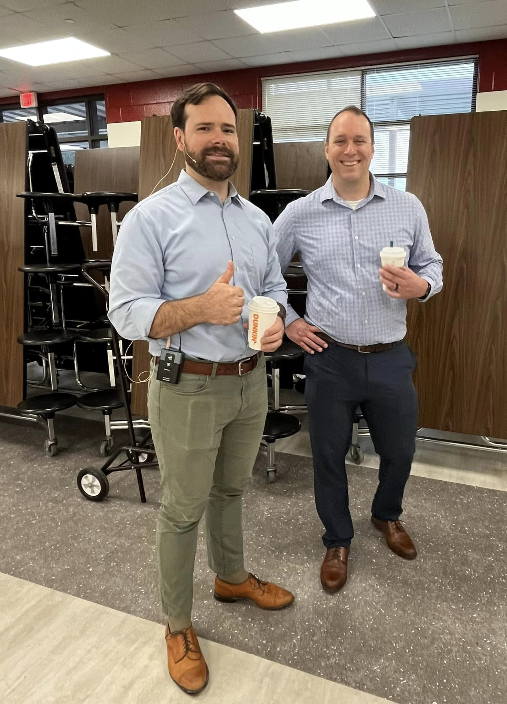
Church Planter Intensive and coaching program
Notes:
Pictured:
Left: Church Planter Intensive, August 2023
Right: Home Missionary Cale Mead (left) from Christ the Rock in Canton, GA, with his mentor Steven Prahl (Foundation, Payton, CO) during a visit leading up to their worship launch in October 2023.
New church planters are not left to fend on their own!
Brand new church planters gather with experienced home missionaries for a Church Planter Intensive at Carbon Valley Lutheran Church in Firestone, Colo. The next one is scheduled for August 2024. Experienced church planter and Home Missionary Jared Oldenburg (Eternal Rock – Castle Rock, CO) developed the program and Home Missionary Matt Rothe (The Way – Fredericksburg, VA) now leads the program. This extended weekend seminar encourages and equips pastors who are called to plant brand new home mission churches. The purpose of this event is to:
Talk through church planting principals.
Be a sounding board to new missionaries and their unique situations.
Give the missionary a chance to think about all aspects of starting a church
Encourage the missionary to make decisions and plans based on the core group, community and place God has placed him. In other words, don’t copy, but instead learn to lead intuitively.
Help the missionary establish some big picture benchmarks/activities.
Offer encouragement by openly sharing what it’s like to be a church planter
Provide the opportunity for a new missionary to network with other missionaries.
After the intensive, new church planters are paired with a coach from an established mission church to guide them for their first two years of launching a new church. Home Missionary Joel Schulz (Divine Savior – Delray Beach, FL) leads that portion of the program.
Both the Church Planter Intensive and the coaching program are sponsored and encouraged by WELS Home Missions.
“As much as Church Planter Intensive was able to ground me, set our ministry on a good path, and send us out with valuable information, the coaching program is now my lifeline in an ongoing way. My coach is the most-accessible avenue to bounce ideas off, get input from, and help me grow as a pastor.” – Rev. Joe Lindloff, church planter in Marquette, Mich.

Slide 14
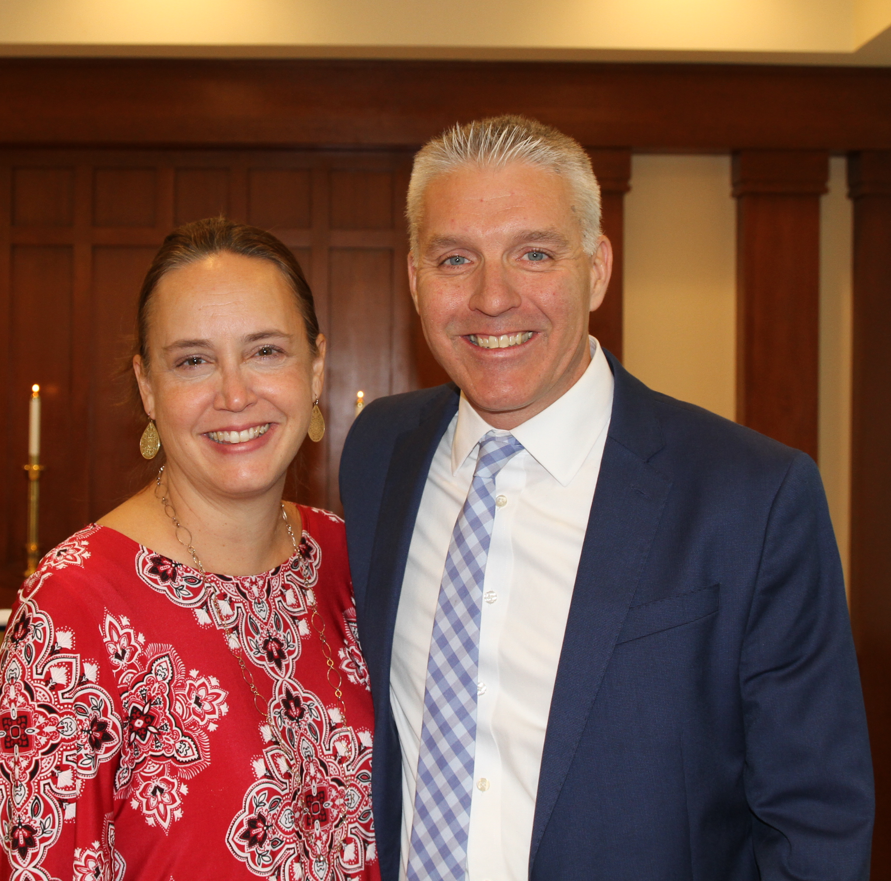
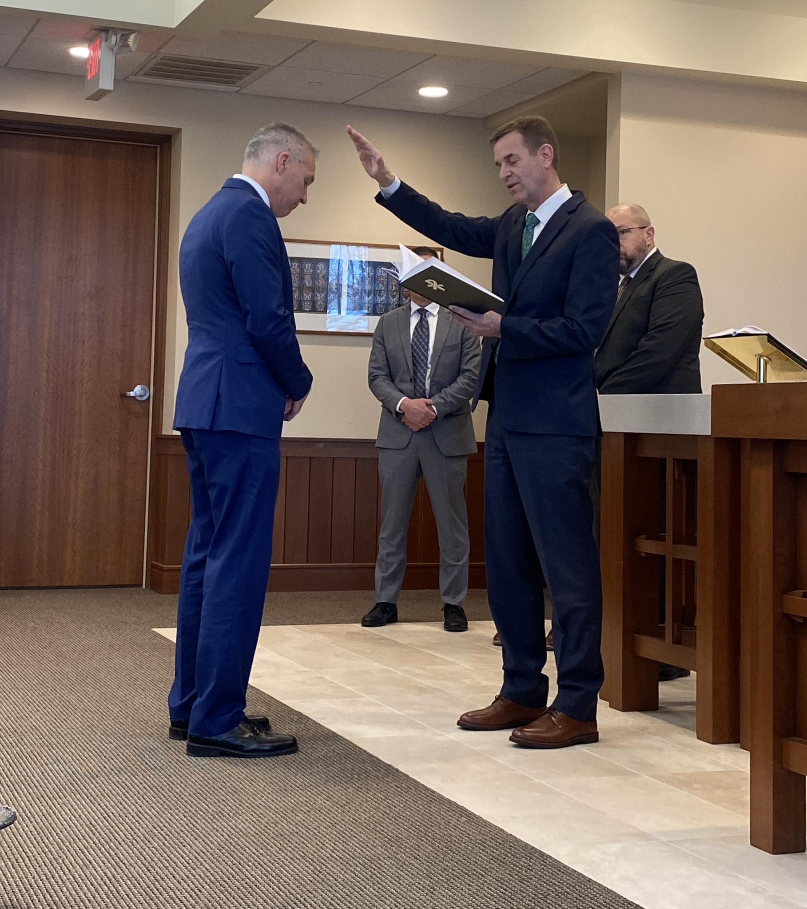
New Home Missions administrator
Rev. Mark Gabb
Notes:
WELS Missions welcomes Mark Gabb as the new administrator for WELS Home Missions. Gabb began serving in this role in January following a vacancy in the position since spring 2022, when previous administrator Keith Free accepted a call to parish ministry. Gabb was formally installed as the Home Missions administrator Wed., Jan. 31, at the WELS Center for Mission and Ministry weekly chapel service. Gabb is not new to the work of WELS Home Missions. He has served as a member of the Board for Home Missions for ten years and as chairman for three, taking on additional leadership responsibilities during the vacancy.

Slide 15
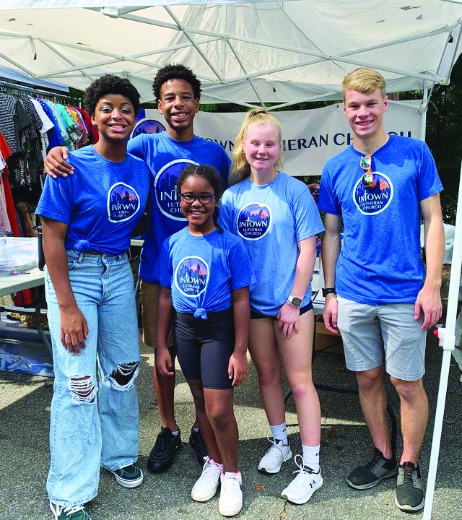
Life of a Home Mission church
No community is the same. No core group is the same. No soul is the same. But we know that all people have the same need for a savior from sin.
Notes:
No community is the same. No core group is the same. No soul is the same. But we know that all people have the same need for a Savior from sin. Those differences mean that no home mission church starts the same way or follows the same path to maturity. However, we pray that all WELS home mission churches contribute in their own unique way to the ultimate outcome: winning souls for Jesus through the proclamation of the gospel.

Slide 16
Notes:
Where it all begins.
When an area with possible mission potential is identified, the local WELS members work with their DMB and mission counselor to survey the area. They look at demographic data, explore the area, and conduct personal interviews with community members, local government leaders, other church leaders, etc. At that point they determine if the mission location is a viable option and begin to document potential mission strategies.
At the same time, attention is given to “planting a mission mindset to plant missions”. The core group meets for evangelism/mission-themed Bible studies, they often participate in evangelism training by Praise and Proclaim, and they begin diving into community outreach events to begin making a name for themselves in the community and to practice their personal evangelism.
Once ready, the core group will work with their DMB and mission counselor to begin developing their new start request and full ministry plan.

Slide 17
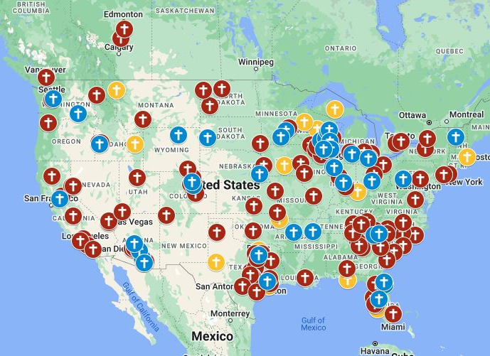
Exploratory missions in your district
Notes:
View our interactive Google map found at wels100in10.net to see where your district mission board is exploring outreach in your district. Anything in “blue” indicates an exploratory mission. District mission boards and mission counselors work with exploratory missions to develop a core group of members and begin Bible study and initial outreach before coming to the Board for Home Missions for official home mission status. These missions are not currently approved but are preparing the groundwork needed for their formal ministry request to the Board for Home Missions. Each request is thoroughly vetted and either prioritized, deferred, or denied. Prioritized requests are authorized as funding is available. Please note that there might be some exploratory missions on this list that will not end up receiving home mission status after the review process.

Slide 18
Taking light to the darkness in Windsor, Colo.
Notes:
A core group of WELS members in Windsor, Colo., are committed to “making disciples of all nations” right in their own backyard. Hear how they’ve been partnering with WELS Home Missions to plant a new church in their community, all in an effort to take the light to the darkness in Windsor, Colo.
Link: https://vimeo.com/754821385

Slide 19
Notes:
The District Mission Board (DMB) and mission counselor works with potential home missions to develop a new start ministry request that gets submitted to the WELS Board for Home Missions (BHM).
A new start ministry request takes quite a bit of time and is quite comprehensive. Some of the things required include:
A full ministry plan, including a proposed timeline for the first year of ministry, community engagement strategies, and specific outreach opportunities
Defined core group: who will be assisting this effort and the spiritual and ministry gifts that each person brings to the mission
Potential temporary worship and/or office space options
A 12-year subsidy projection form with budget for the first three years, including an estimate of future land/construction costs.
One a new home missionary is called/assigned, he works with the core group to perfect their ministry and outreach plan and pick a name for their new church.

Slide 20
Spring 2024 New Starts:
Bend, Oregon
Cedar Lake, Indiana
Conway, Arkansas
Easley, South Carolina
Williston, North Dakota
Notes:
On April 18–19, 2024, WELS Board for Home Missions approved 12 new missions and enhancements for the synodwide 100 Missions in 10 Years initiative.

Slide 21
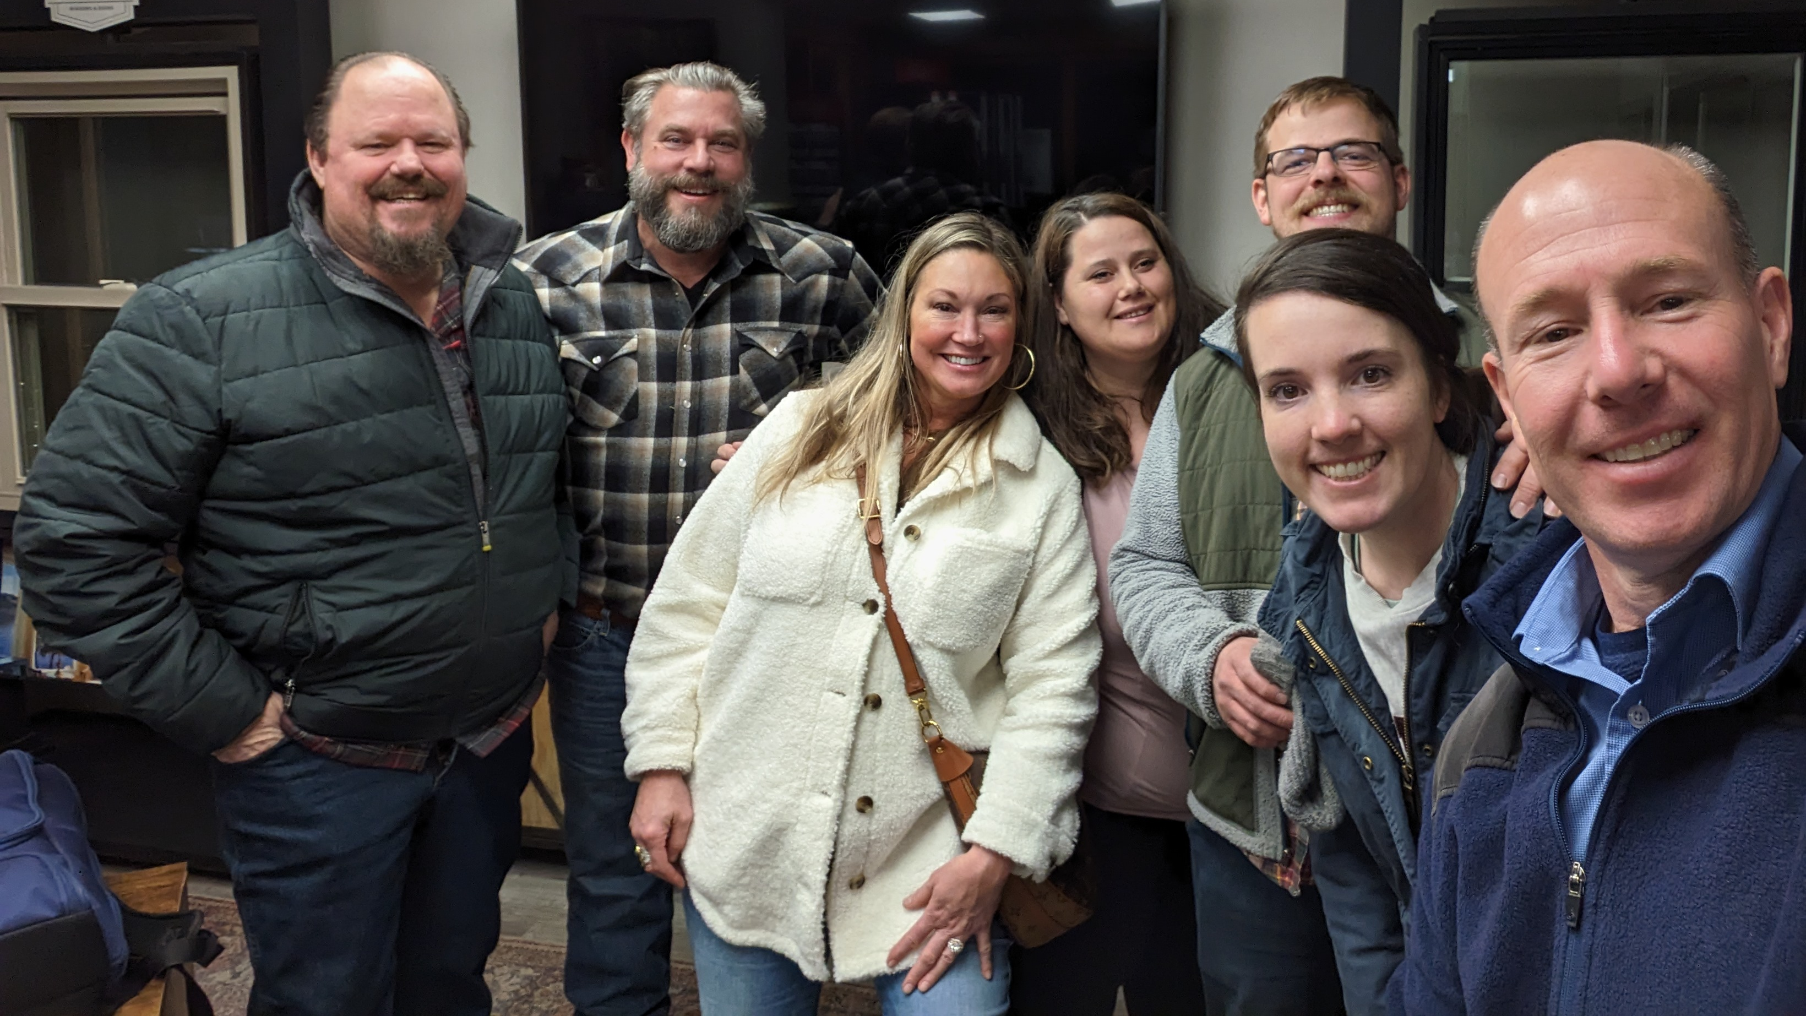
New Start – Bend, Oregon
Notes:
New Start: Bend was identified in 2020 as the second-fastest growing city in the U.S. A core group of eight families has been gathering twice a month for Bible study and planning as they plant a church in an area where 62 percent of people are not involved with any religious community.
Rev. Thad Bitter accepted the call to serve this new mission start in June 2024.
Learn more: https://wels100in10.net/new-starts/bend-or/

Slide 22
New Start – Cedar Lake, Indiana
Notes:
New Start: Members from Trinity and Zion in Crete, Ill., have formed a core group to plant a new mission in nearby Cedar Lake. This area of northwest Indiana is growing rapidly as Chicago commuters look for cheaper alternatives to living in Illinois.
Learn more: https://wels100in10.net/new-starts/cedarlake-in/

Slide 23
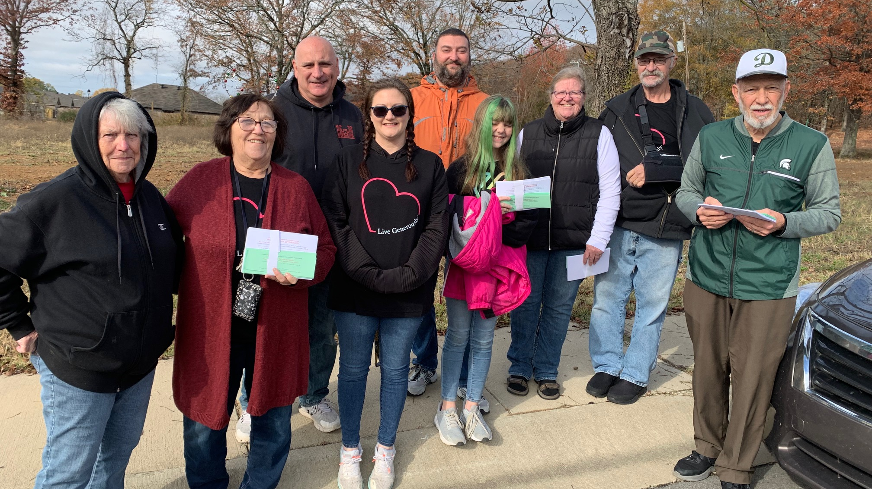
New Start – Conway, Arkansas
Notes:
New Start: Conway is a growing college town in the northwest of Little Rock with no WELS presence. A group of 19 WELS members has been gathering at a local hotel on Sundays for worship and Bible study with a part-time retired pastor and getting involved in the community as it prepares to launch a brand-new church.
Rev. Clayton Fury was assigned from Wisconsin Lutheran Seminary to serve this new mission start in May 2024.
Learn more: https://wels100in10.net/new-starts/conway-ar/

Slide 24
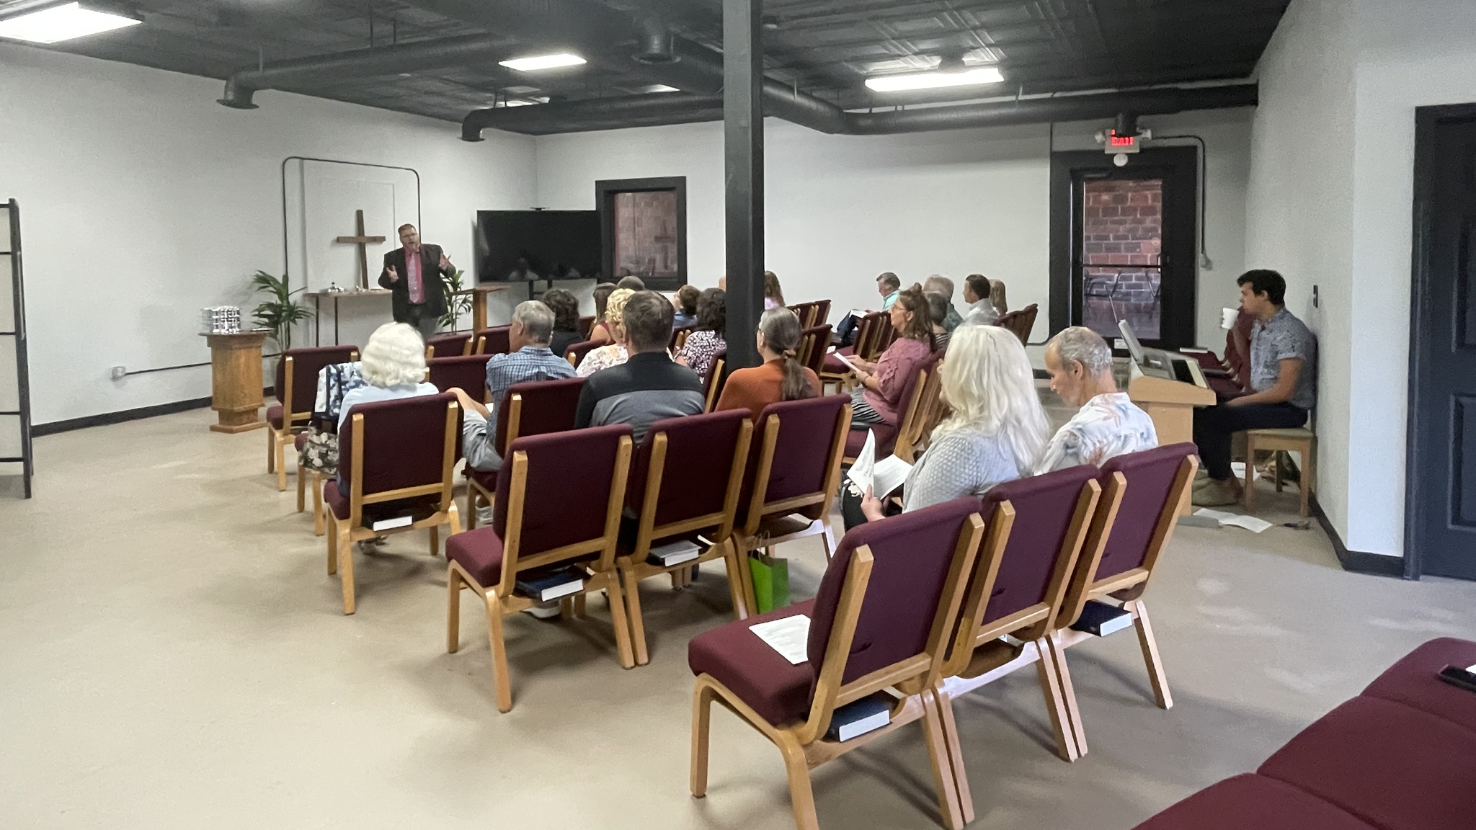
New Start – Easley, South Carolina
Notes:
New Start: Since 2016 Abiding Peace in Simpsonville, S.C., has been exploring the option of starting a second site in the greater Greenville area that includes Easley and Powdersville. Abiding Peace is currently offering worship and Bible study and getting involved in community events from a leased “homebase” in Easley as it evaluates where a future, permanent site might be established with a new missionary at the helm.
Rev. Michael Quandt accepted the call to serve this new mission start in July 2024.
Learn more: https://wels100in10.net/new-starts/easley-sc/

Slide 25
New Start – Williston, North Dakota
Notes:
New Start: The core group in Williston has been gathering for 15 years, now under the name Lamb of God Lutheran Church. It rents a full-time ministry center where members worship weekly online with the WELS church in Bismarck, N.D., and conduct outreach. Members look forward to reaching out with the gospel with a full-time missionary at the helm.
Learn more: https://wels100in10.net/new-starts/williston-nd/

Slide 26
Spring 2024 Enhancements:
Calvary, Dallas, TX
Crossroads, Chicago, IL (Restart)
Faith, Prior Lake, MN
Good Shepherd, Plymouth, WI
Northdale, Tampa, FL
St. Marcus, Milwaukee, WI
St. Paul, Calgary, AB, Canada
Notes:
Calvary, Dallas, TX: Calvary will receive short-term support from Home Missions to call a second pastor who will be focused on outreach and connecting with unchurched early childhood and school families and the many other prospects Calvary has identified in the booming Lake Highlands area of Dallas.
Rev. Benjamin Schone accepted the call to serve as the outreach pastor in July 2024.
Crossroads, Chicago, IL (Restart): Crossroads is looking to restart its ministry on the north side of Chicago after COVID restrictions hurt its ministry and took away its worship location in a local elementary school. With Home Missions support, members look to position Crossroads as a permanent fixture in the neighborhood, enabling them to expand ministry to better serve the needs of the community.
Faith, Prior Lake, MN: Faith has developed a relationship with a standalone early childhood center that bought a portion of its vacant land and built a new facility across the parking lot from the church. The center has agreed to let Faith develop the Bible curriculum for use at the center, and Home Missions funding will allow a part-time staff minister to lead Bible lessons, connect with parents, and coordinate Faith’s members to volunteer at the center on a regular basis.
Good Shepherd, Plymouth, WI: Plymouth is a stable town in northern Wisconsin with 9,000 residents. Good Shepherd will receive short-term support to kickstart outreach efforts once again to take advantage of the gospel outreach opportunities the Lord is providing.
Rev. Eli Steinbrenner was assigned from Wisconsin Lutheran Seminary to serve this mission restart in May 2024. He was installed on July 14, 2024.
Northdale, Tampa, FL: Northdale is in a growing area of north Tampa, which has seen a large influx of Spanish-speakers move into the community. Northdale’s academy reflects this demographic shift, as 25 percent of its student body comes from a Spanish-speaking family. Short-term Home Missions support will allow Northdale to call a Spanish-speaking pastors to take advantage of these outreach opportunities.
St. Marcus, Milwaukee, WI: St. Marcus is looking for support to fund a “campus shepherd” at its third school campus, which serves 300 children, most of whom are unchurched. This person would be connecting with the parents of school children, overseeing the spiritual instruction of the kids on that campus, organizing baptism efforts, leading chapels, and supporting staff. This position will also be responsible for coordinating evangelism efforts across the three campuses.
St. Paul, Calgary, AB, Canada: St. Paul is located in one of the most diverse areas in Canada. The immediate neighborhood around St. Paul is 50 percent immigrants and includes people from India, the Philippines, Pakistan, Africa, and the Middle East. Home Missions support will allow St. Paul to hire two part-time workers to assist the pastor in discipleship, community outreach, service/volunteer coordination, and other cross-cultural mission efforts.
Learn more about these enhancements at wels100in10.net/category/enhancement/.

Slide 27
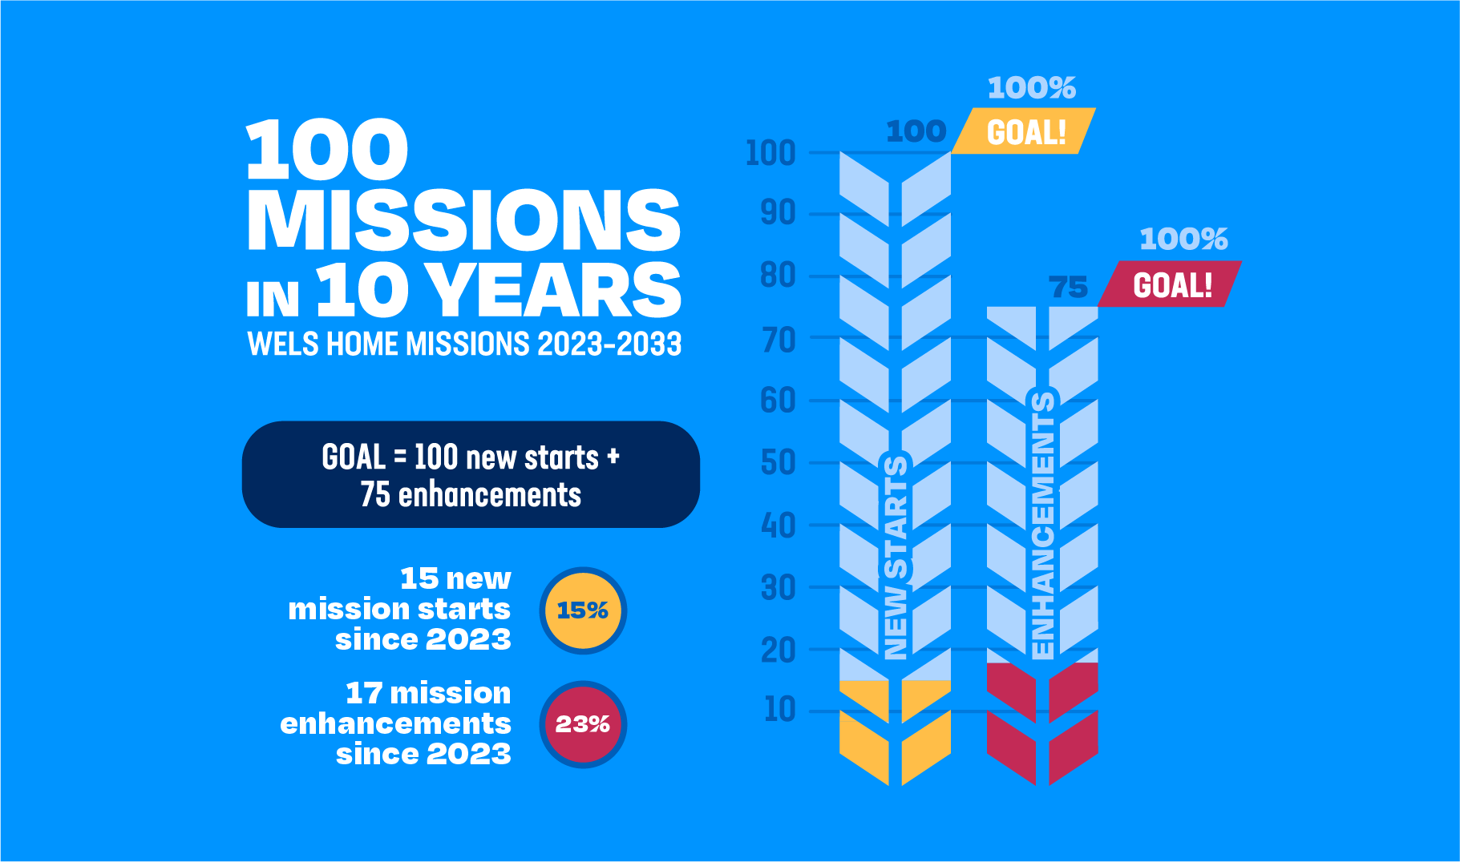
Notes:
Follow along! Watch each year as we track our progress towards our goal of 100 new starts and 75 enhancements in the next 10 years. Learn more about each approved mission by visiting our website at wels100in10.net.

Slide 28
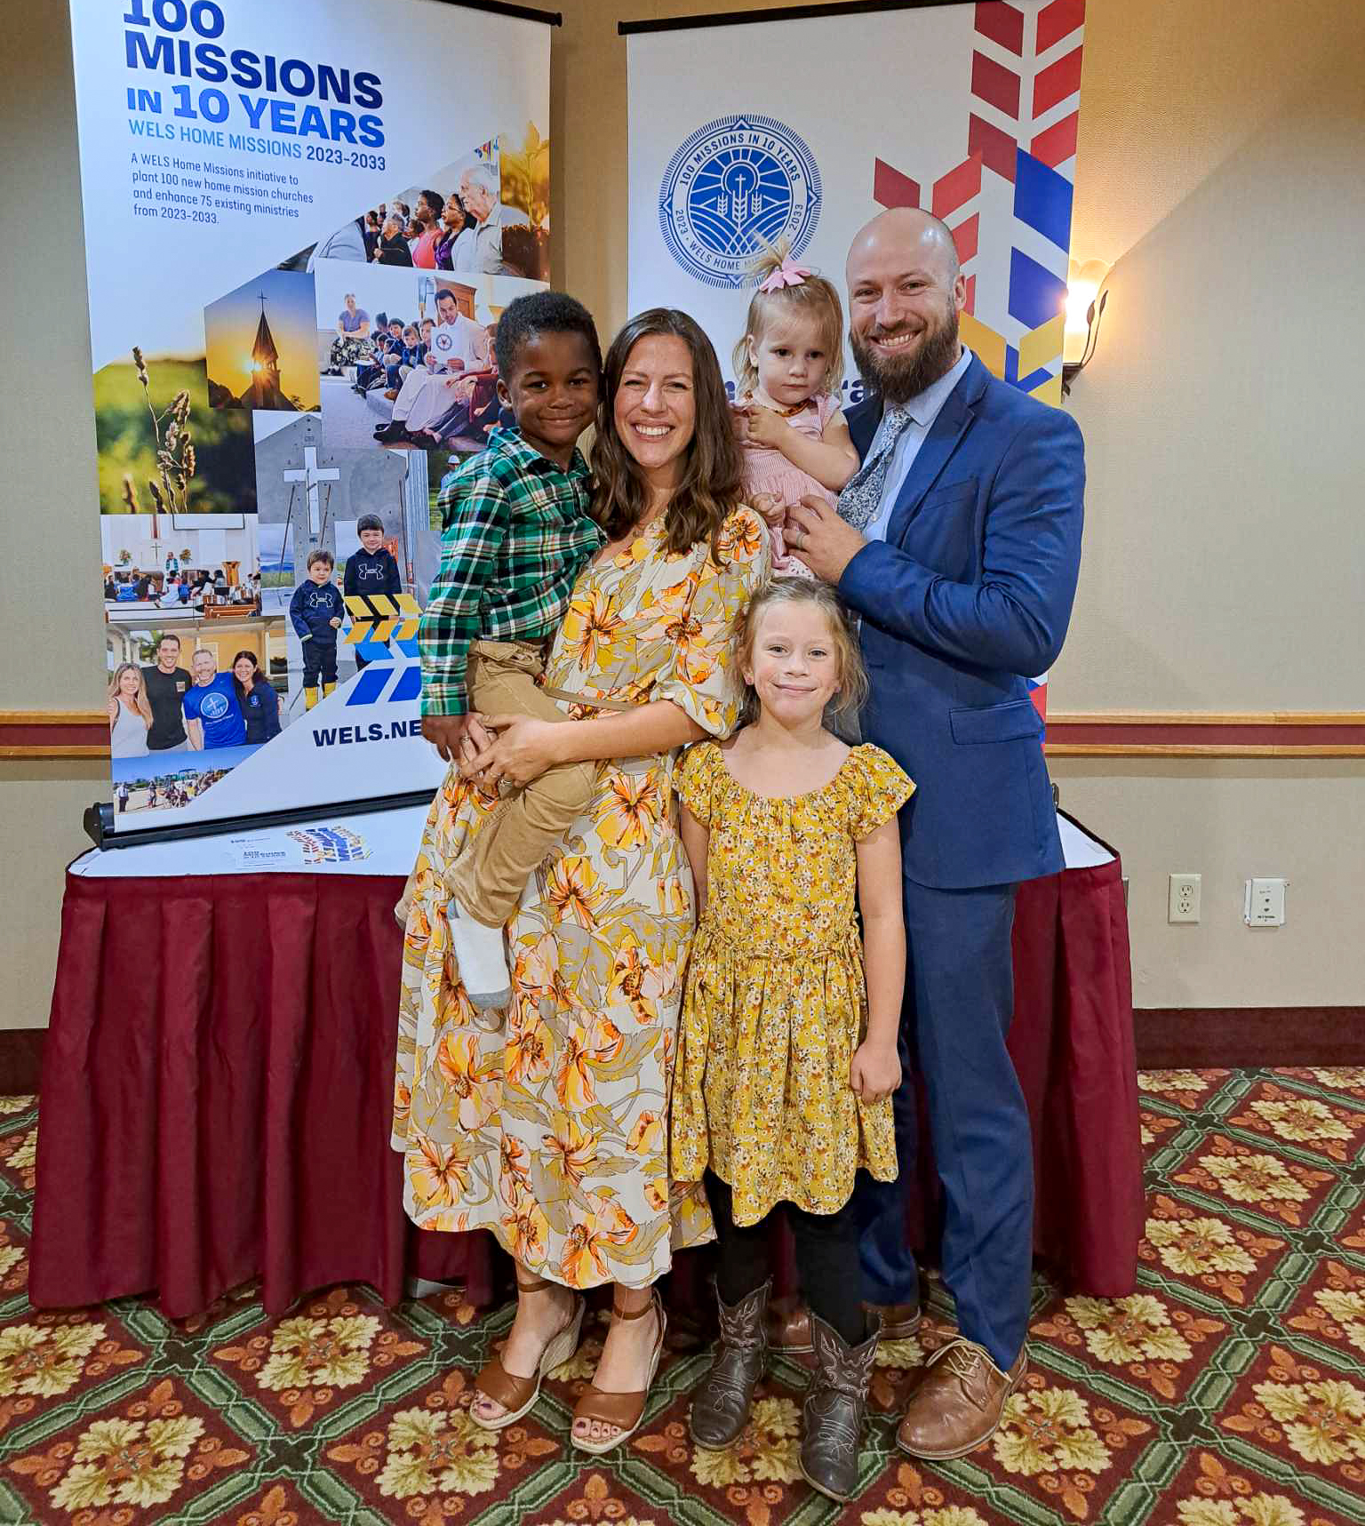
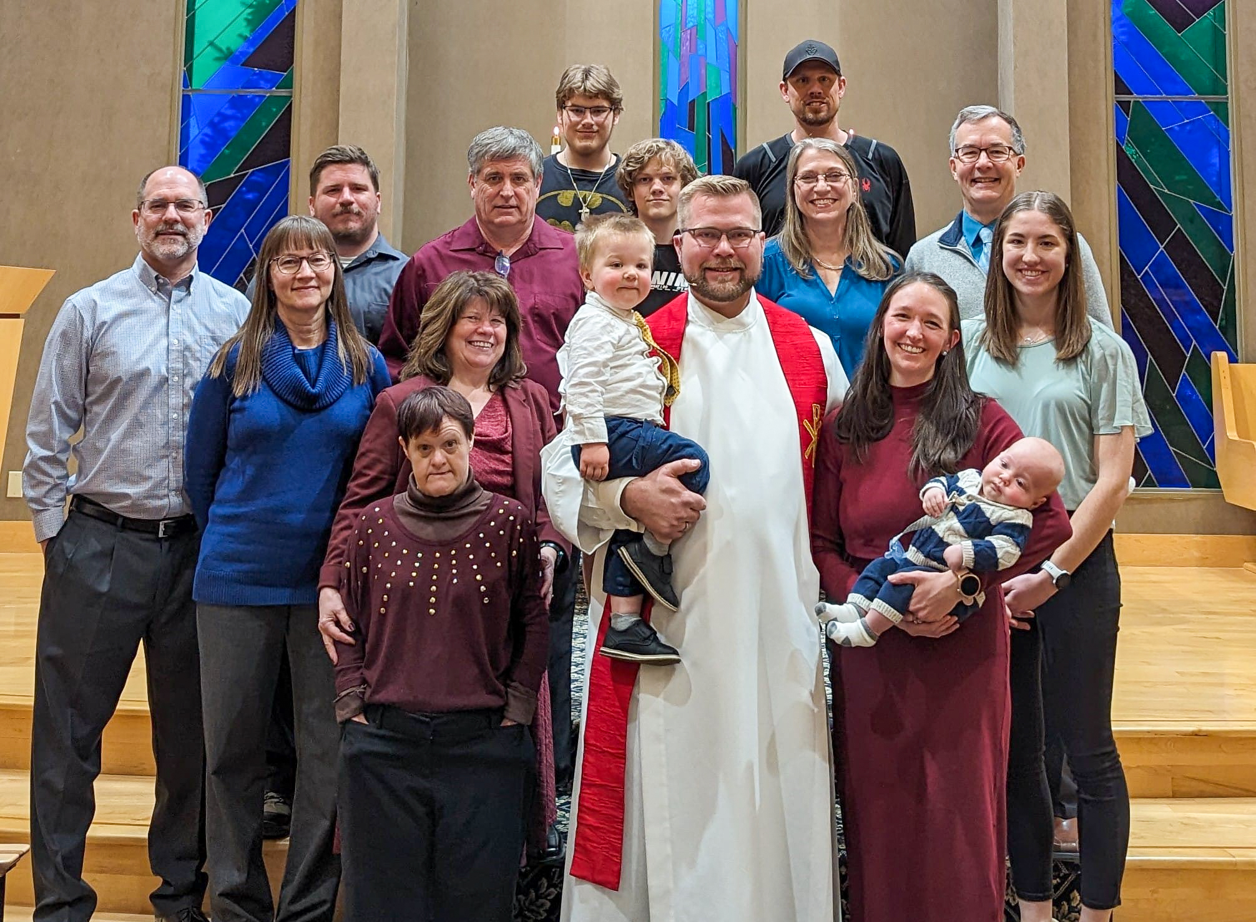
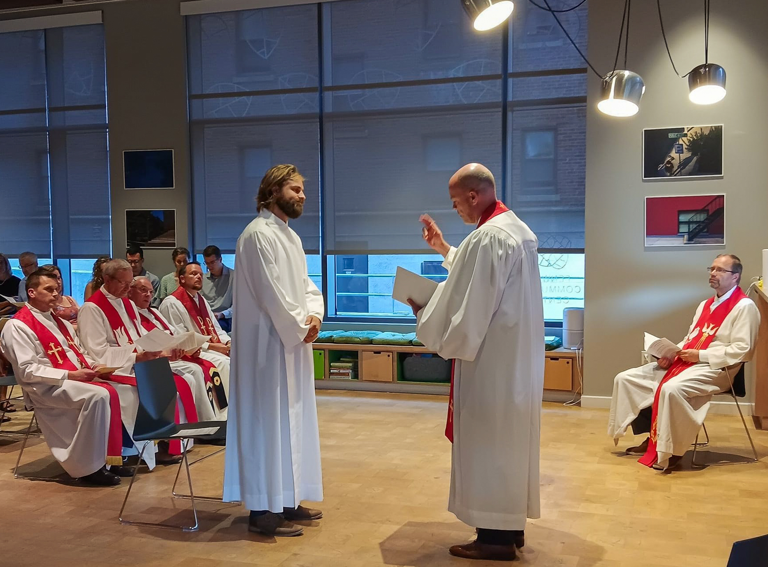
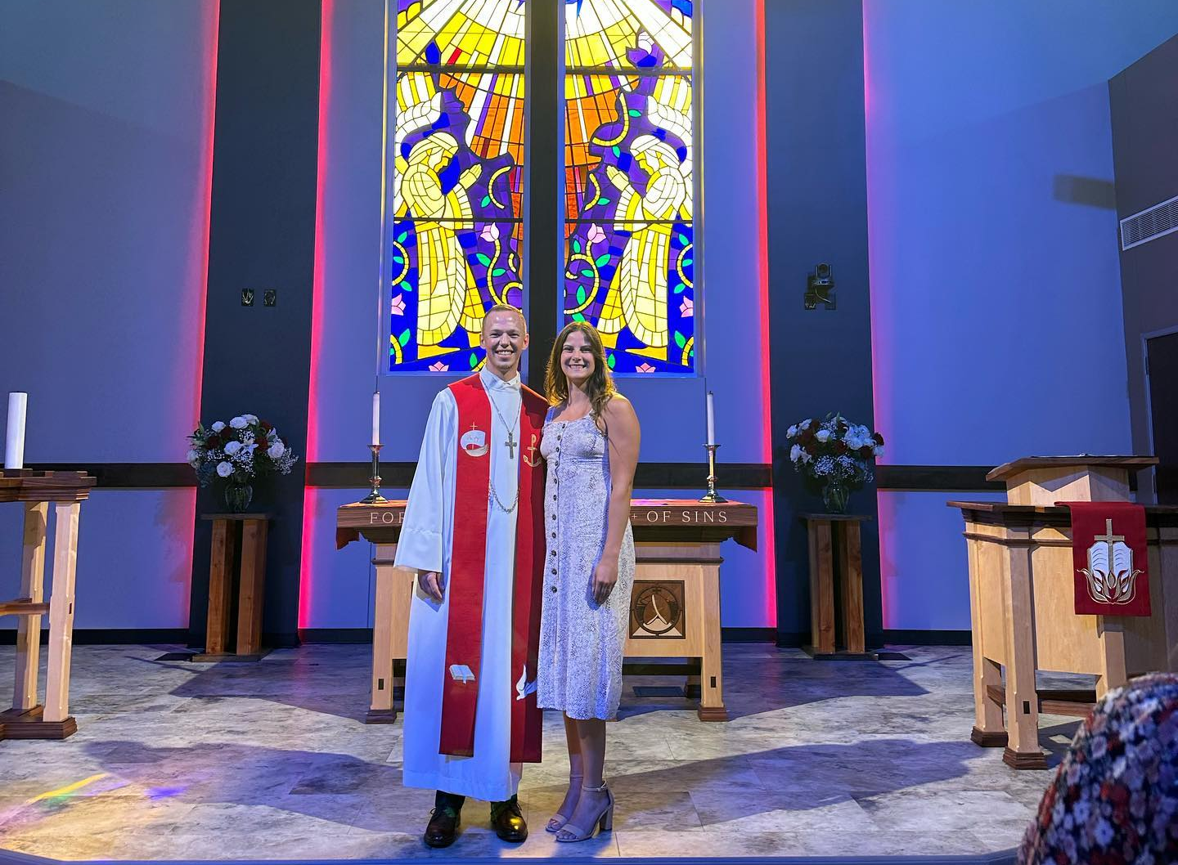
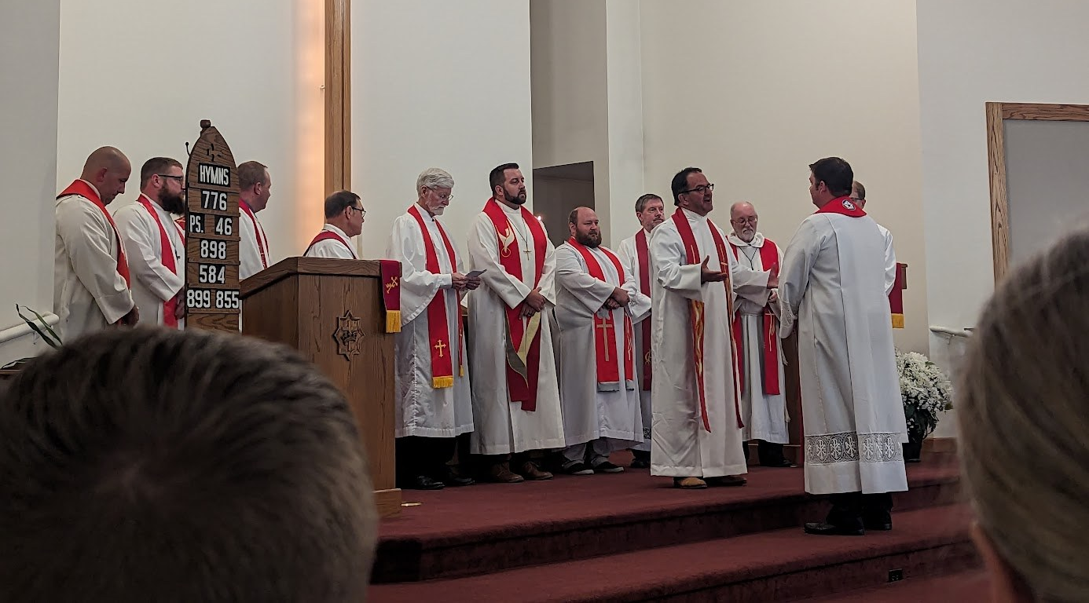
All 10 new mission starts from 2023 now have a home missionary!
Notes:
ALL positions filled!
Bentonville, Arkansas (New start) – Rev. Ross Chartrand
Boston, Massachusetts (New start) – Rev. Joshua Koelpin
Beautiful Savior, Cincinnati, Ohio (Multi-site) – Rev. Jacob Ungemach
Idaho Falls, Idaho (New start) – Rev. Paul Krueger
Kalispell, Montana (New start) – Rev. Josh Schroeder
Kronenwetter, Wisconsin (New start) – Rev. Frederic Berger
Marquette, Michigan (New start) – Rev. Joe Lindloff
North Collin County, Texas (New start) – Rev. Caleb King
Panama City Beach, Florida (Multi-Site) – Rev. Evan Chartrand
Buffalo, Wyoming (New start) - Rev. Fred Casper

Slide 29
Notes:
Most often, worship doesn’t begin right away. The core group takes time to continue their outreach and build a name for themselves in the community. This allows the group time to explore locations for worship in a rented space, purchase the needed equipment to set up and take down every Sunday, and have “preview services” with their core group before a formal grand opening/launch worship.

Slide 30
The right place at the perfect time: Clark’s story
Notes:
Foundation in Folsom, Calif., has been worshiping in local parks since launching public worship during the COVID pandemic. Clark Woods was in the right place at the perfect time to hear the message of free grace, forgiveness, and peace in Jesus when he most desperately needed it.
Clark is just one example of how God brings people to his Word in his perfect timing.
Link: https://vimeo.com/763929919

Slide 31
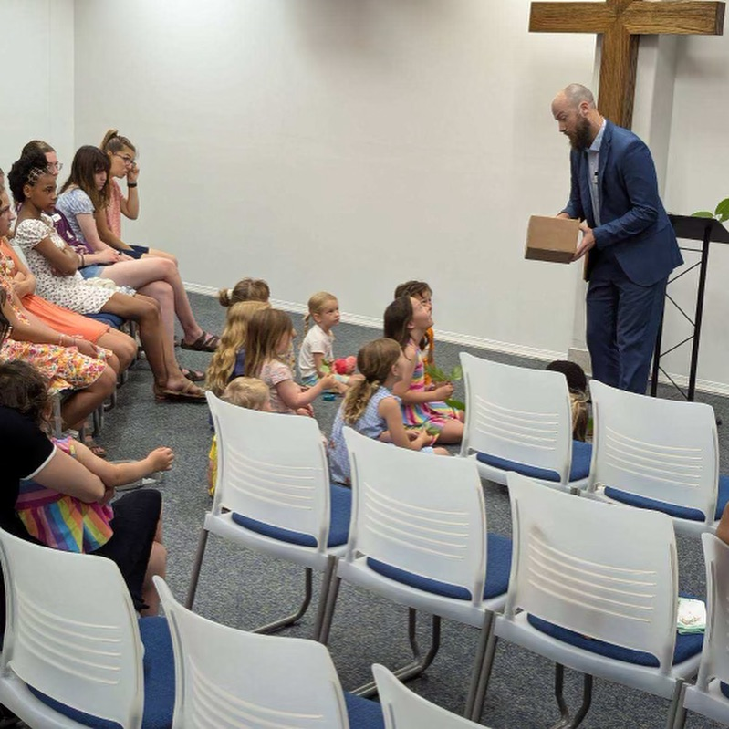
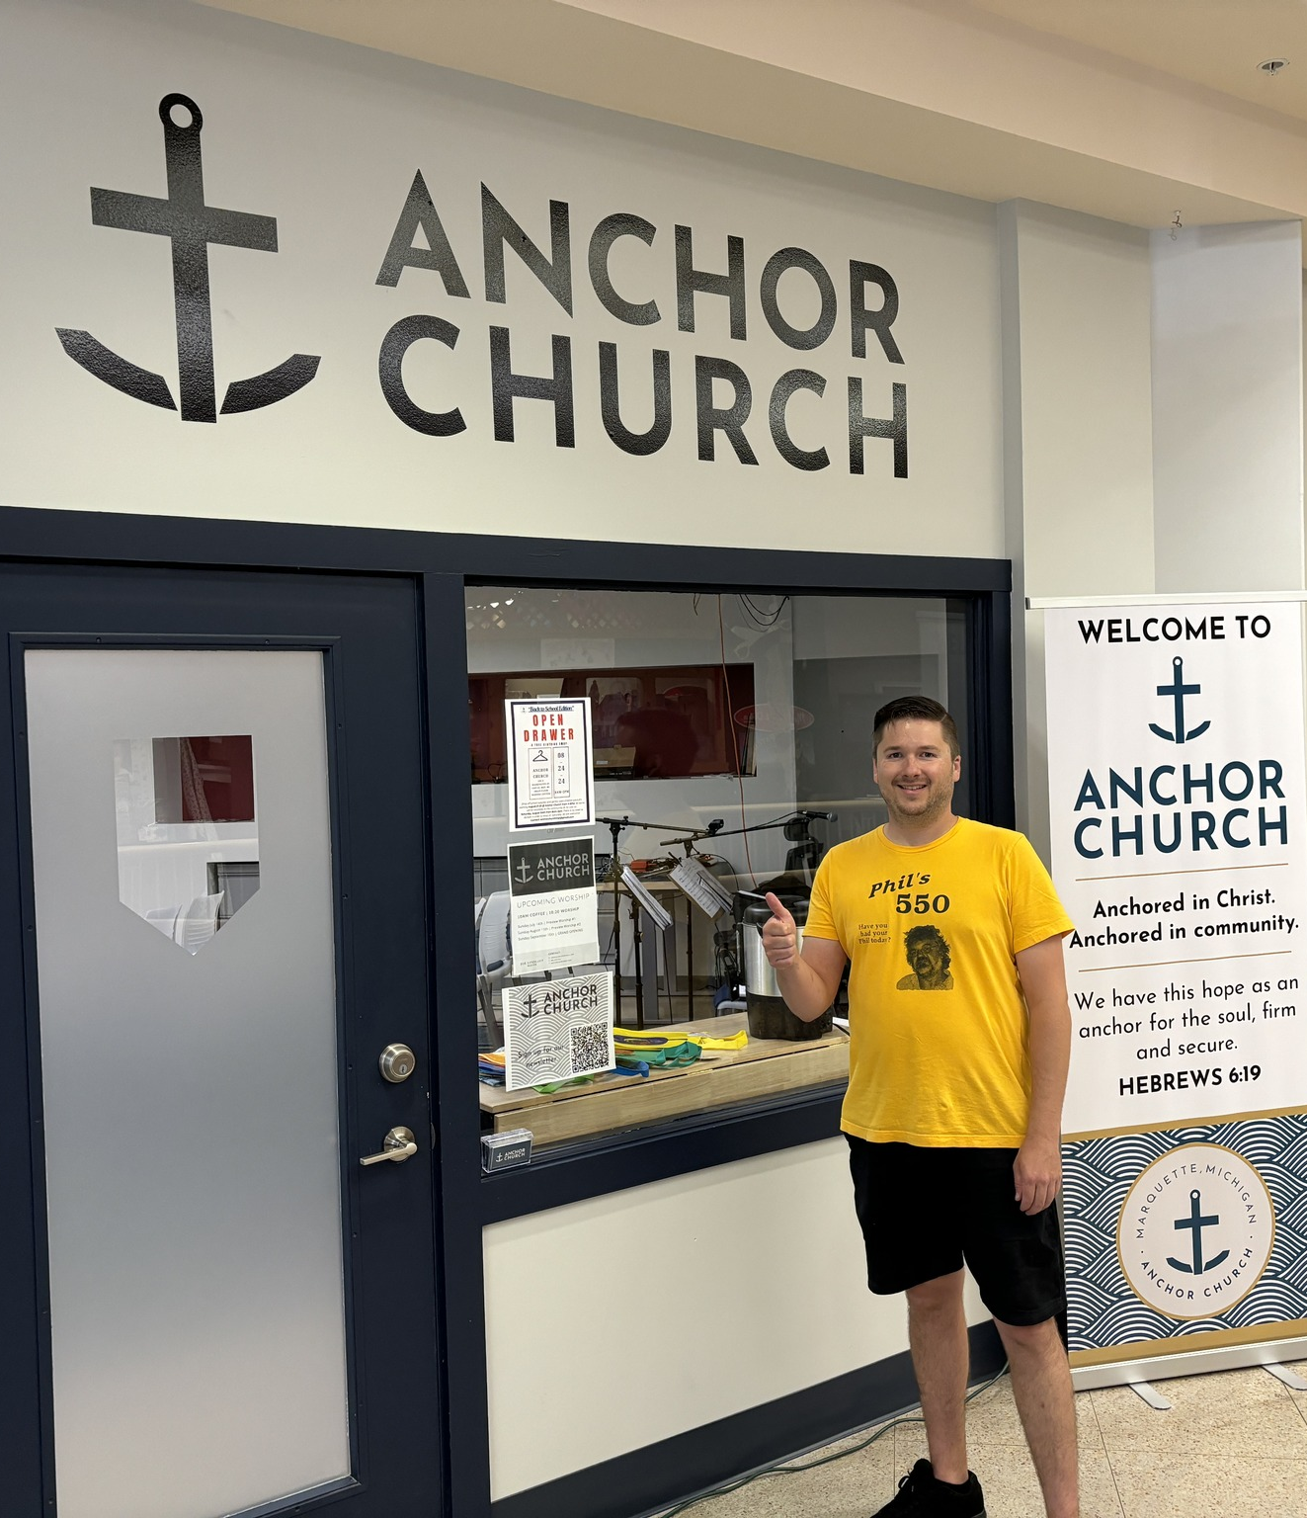
Worship launch in Marquette, Mich. September 15, 2024
Notes:
Marquette was approved as a new home mission start in Spring 2023. Marquette serves as the hub of the Upper Peninsula (U.P.) of Michigan, and 52% of the people in and around Marquette do not have a home church or attend a church. It is also home to 7,000 students at Northern Michigan University, a ripe opportunity for a Campus Ministry program. Learn more at https://wels100in10.net/new-starts/marquette-mi/.
Rev. Joseph Lindloff was installed as the new home missionary in Marquette on October 8, 2023. They have named their new church Anchor Church and found a 24/7 ministry center to lease in early 2024. They’ve hosted two “preview services” over the summer in preparation for their grand opening.

Slide 32
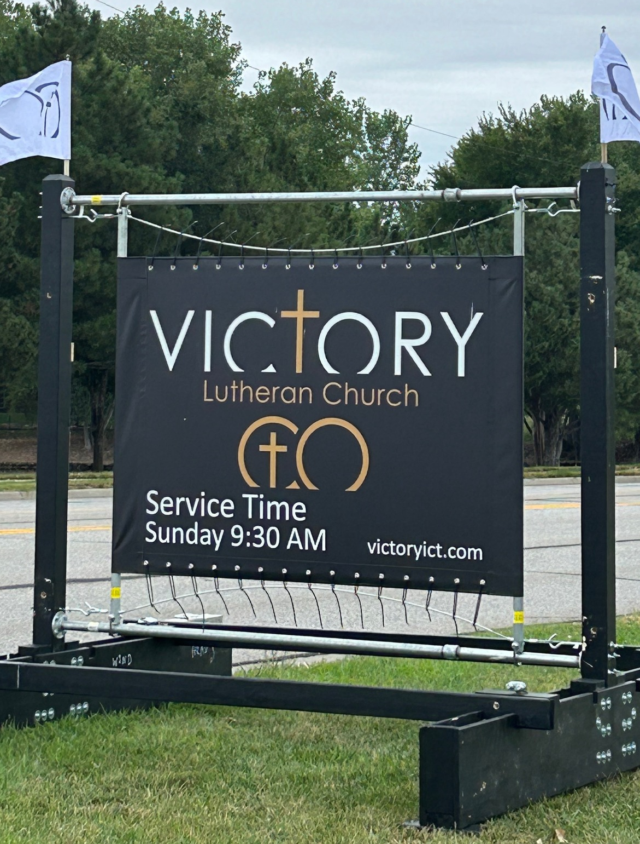
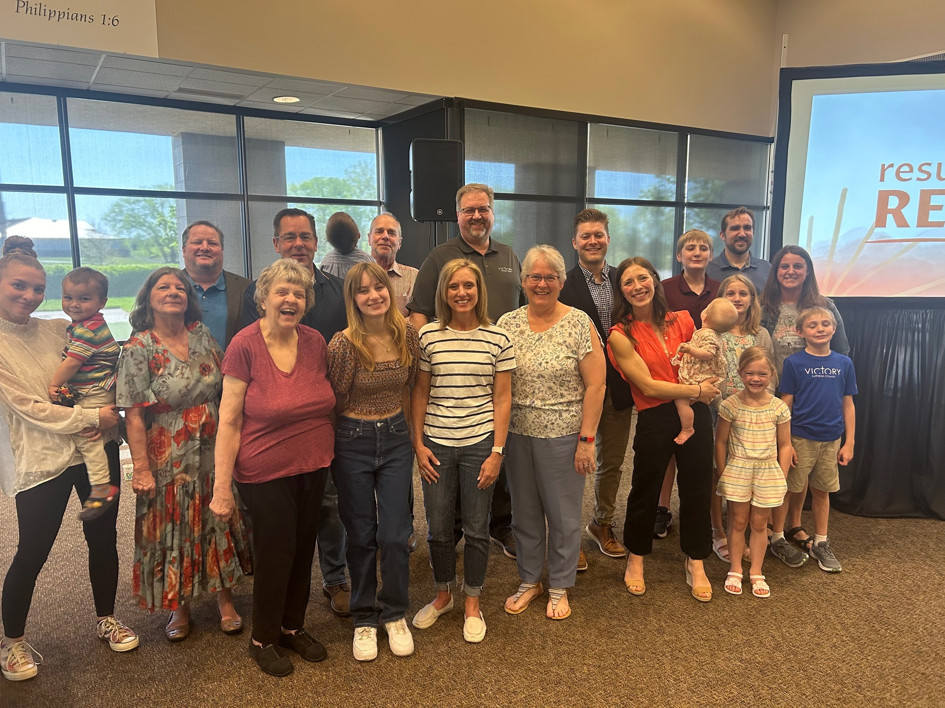
Grand opening on September 15, 2024, at Victory – Wichita, Kans.
Notes:
The new mission start on the east side of Wichita, Kansas, was approved as a new mission start in Spring 2022. Home Missionary Jacob Jenswold arrived in January 2023. This congregation is being daughtered by a core group from Messiah, a church on the west side of the city, in order to better serve the 650,000 people in the greater metropolitan area.

Slide 33
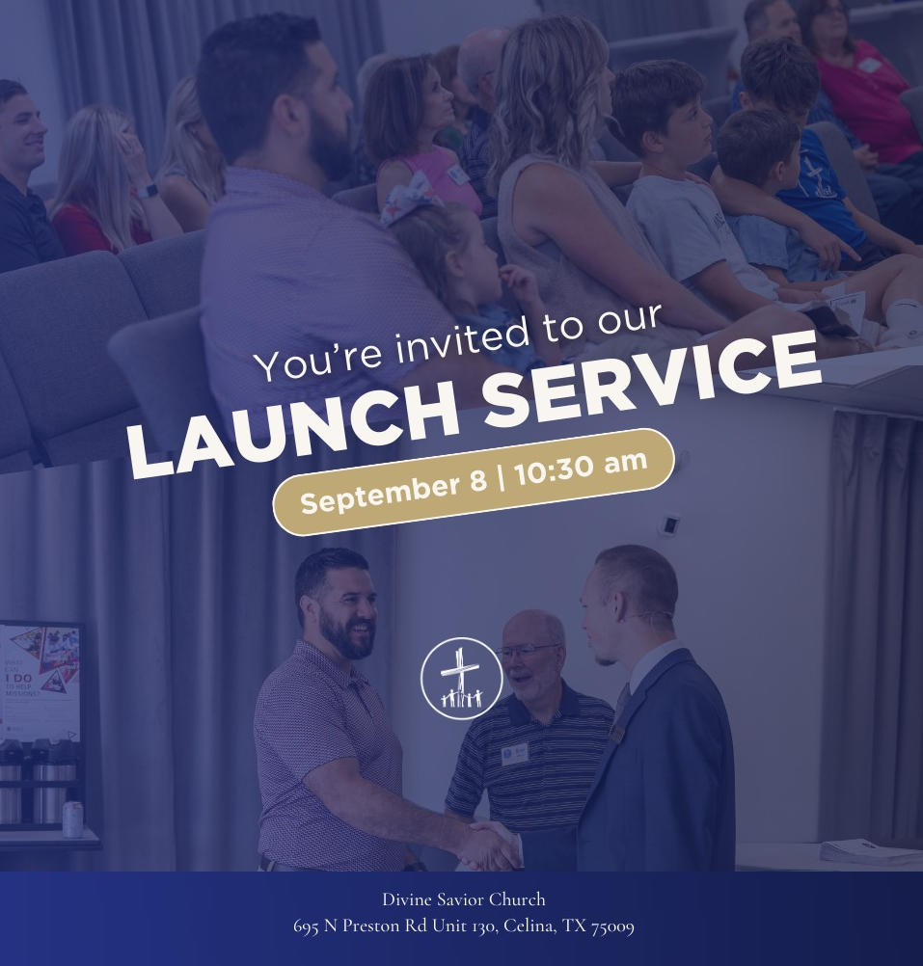
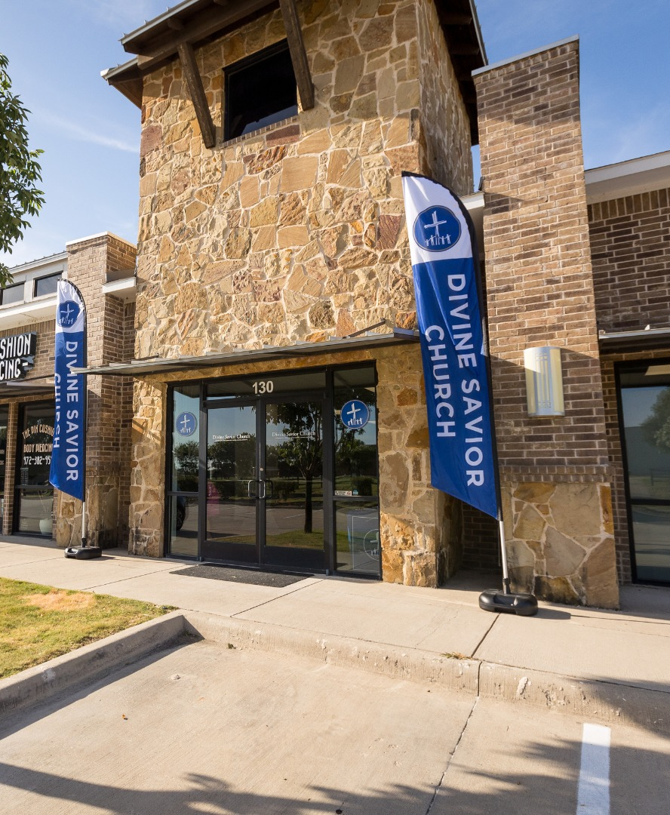
Public worship launch on September 8, 2024, at
Divine Savior – North Collin County, Tex.
Notes:
A core group of 15 members from Atonement in Plano, Tex., are starting a new church in North Collin County, a northern suburb of Dallas. They were approved as a new mission start in Spring 2023. Two of the top five fastest growing communities in the United States are in this target area. Divine Savior Ministries has committed to providing guidance and resources to the new mission and are planning build a Divine Savior Academy by year five of the mission start.
Caleb King was assigned from Wisconsin Lutheran Seminary in Mequon, Wis., in May 2023 to serve this new mission start. In the year since Missionary King’s arrival in North Collin County, the core group has been working to get to know the community and spread awareness of their new church through events such as Bible and Brews, Movie Night on the Square, Pool Parties, community service events such as grocery canvassing and trash pickup, and more.
Learn more at https://wels100in10.net/new-starts/northcollincounty-tx/.

Slide 34
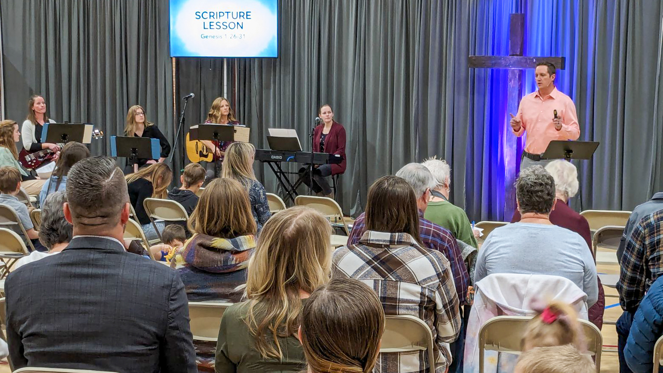
Grand opening at CrossLife, Windsor, Colo.
Notes:
On March 3, CrossView Church in Windsor, Colo., launched its public worship. This home mission plant was approved in 2022 and welcomed more than 85 guests to its opening worship service.
Home Missionary Stephen Koelpin arrived in January 2023 to work with the core group and prepare for their official launch. They received a donated trailer from a home mission church in Arizona and items for their portable church from the nearby home mission church in Castle Rock, Colo. After renting a local elementary school to host worship, the group held four preview services starting in January 2024 in preparation for launch. You can learn more about what the core group in Windsor did to prepare to start their church in this special video: wels100in10.net/lightindarkness

Slide 35
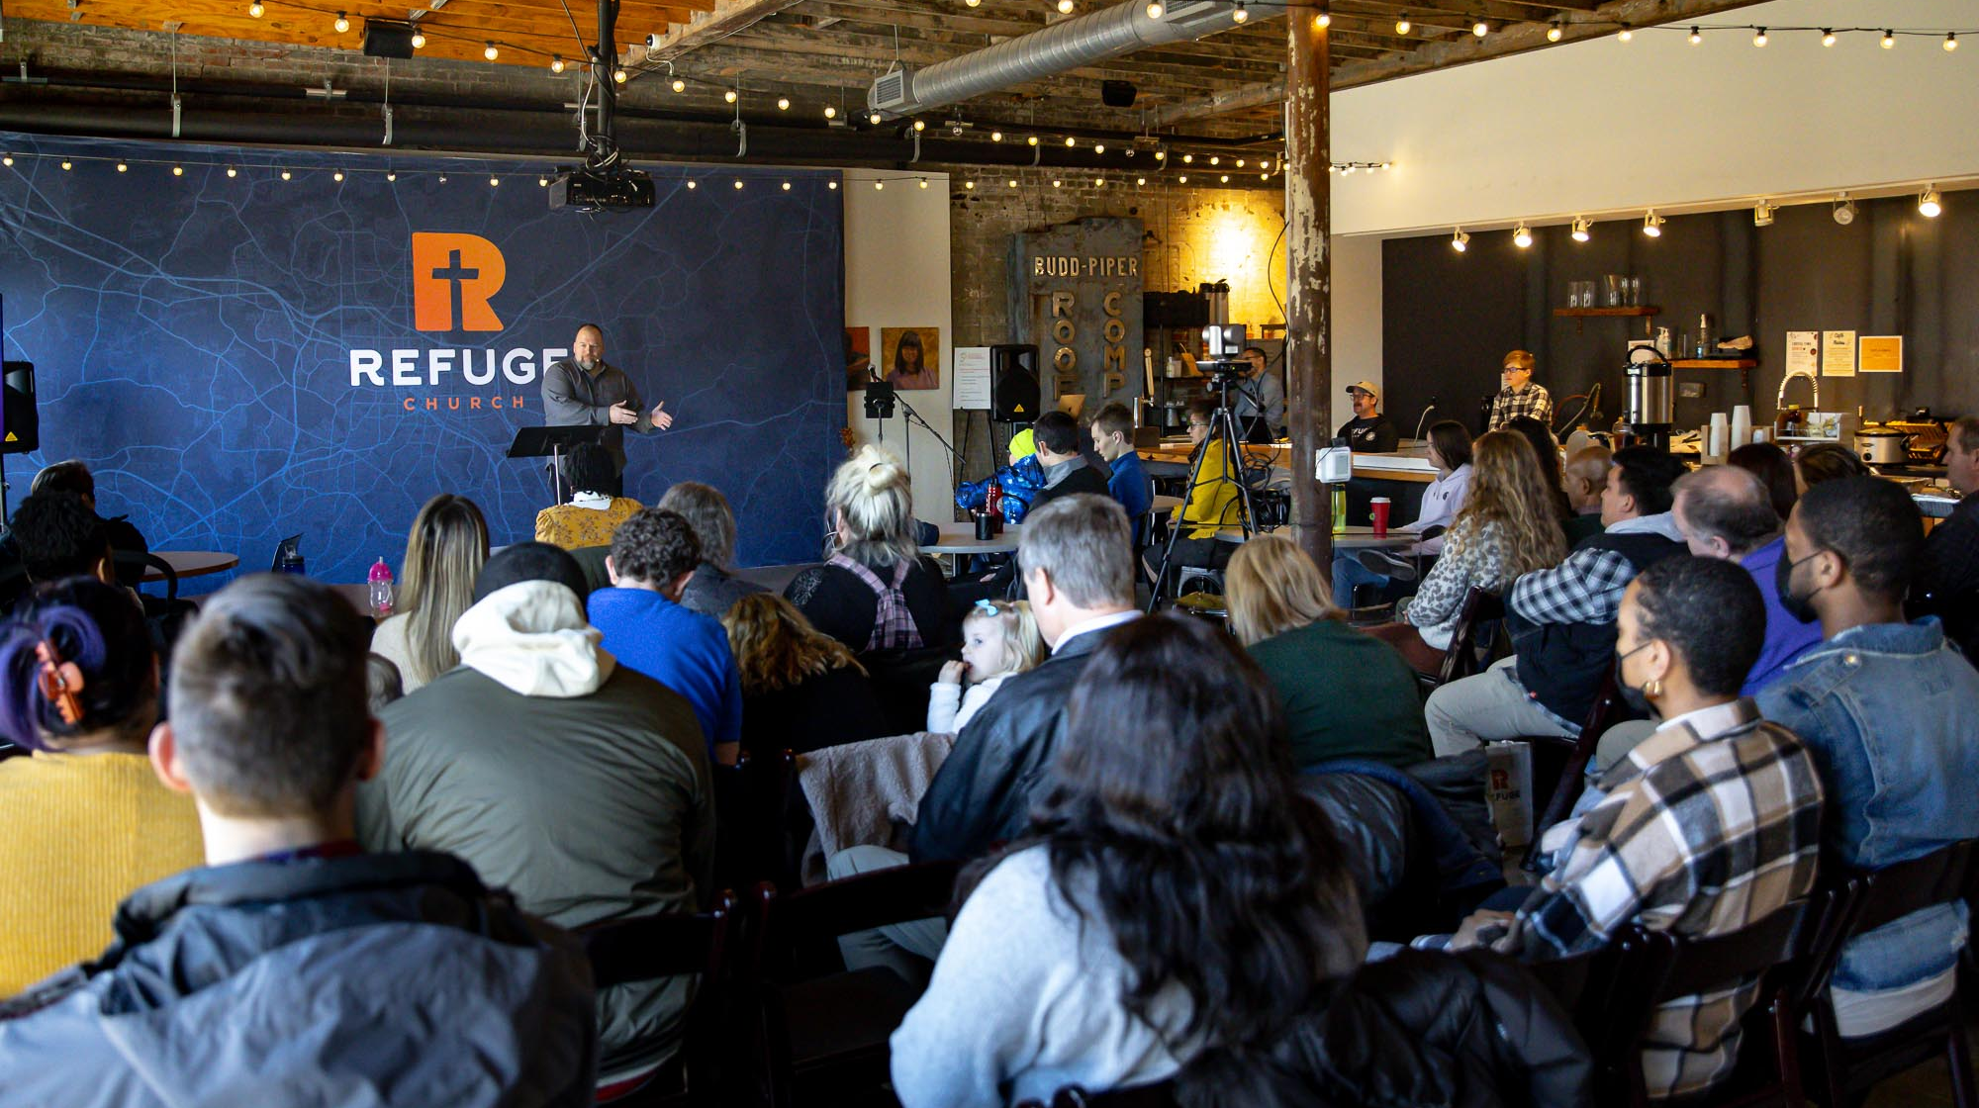
Worship launch in Durham, N.C. January 21, 2024
Notes:
Rev. Doug Lange was called to plant a new home mission church in Durham, N.C., in 2021. In the June 2023 WELS Connection, we saw Refuge in the early stages of development where they began to plan their ministry and look for opportunities to share Jesus with their community. Through many prayers, extensive planning, and outreach, God blessed their efforts, and they launched public worship on January 21 at a coworking space in downtown Durham.

Slide 36
Notes:
It can be hard to grow your ministry and fellowship opportunities when you only have access to a rented facility on Sundays or grow out of your existing worship space. As church membership grows, the home mission begins exploration to buy land or purchase an existing facility and perhaps remodel it to better serve their ministry needs.

Slide 37
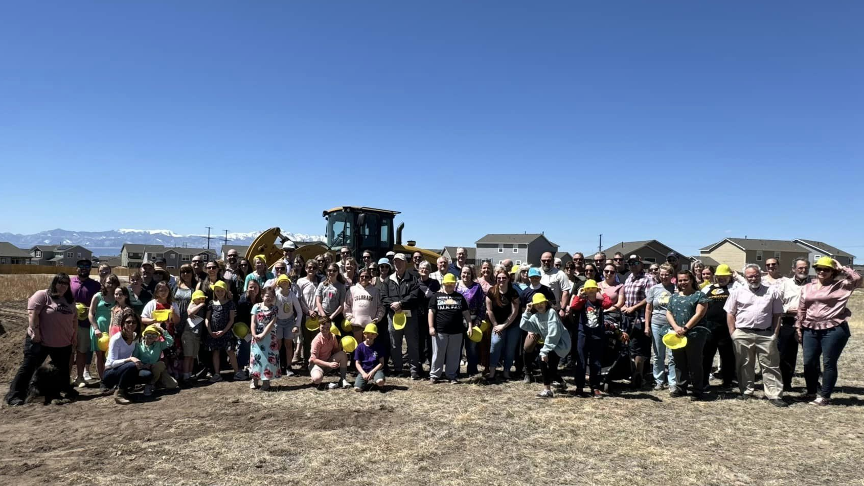
Groundbreaking for a new church in Peyton, CO
Notes:
Foundation Lutheran Church in Peyton, Colo., celebrated the groundbreaking for their new church building in April 2024.
WELS Church Extension Fund provided over $700,000 in land and facility matching grants to Foundation Lutheran Church to assist in the construction of their facility. Learn more about how you can invest with WELS Church Extension Fund and simultaneously support Home Missions at wels.net/cef.

Slide 38
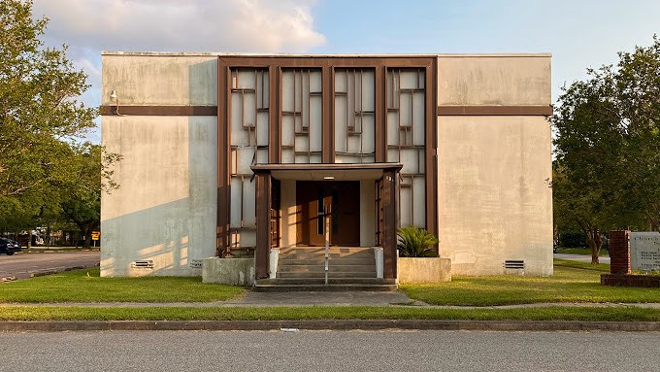
Buying and renovating an old church in Houston, TX
Notes:
Hope in the Heights in Houston, TX, closed in Fall 2023 on a Church of Christ building for sale that was built in 1927 and remodeled in the late 1950s. It is situated on its own block within a neighborhood in their target area. There is a large parking lot, ample street parking, and plenty of green space for kids to run around.
Thanks to the Church Extension Fund’s grant program for new missions, they get a 4:1 match on the land value and a 2:1 match for every dollar they spend on the remodel. Because of this, they can afford the necessary renovations. And because Church Extension Funds grants keep the cost down, they will be able to taper off of synod subsidy faster, which enables WELS to start more missions in the future. They hope to have the remodel completed by late 2024, when they will be able to move in and open their doors to the community.

Slide 39
Notes:
What an exciting time in the life of a home mission church! Once land or a facility is purchased, building/construction begins to make it into a facility that the church can use to conduct their ministry.

Slide 40
Grace for the unforgivable: Roy’s story
Notes:
Palabra de Vida, a cross-cultural ministry in Detroit, Mich., is doing the hard work of establishing themselves in the community and developing longevity for their ministry. Roy Mendoza played a part in that work.
WELS home mission churches across North America are opening their doors to people with all different kinds of life stories, but who all have the same need for God’s love. . . people like Roy Mendoza. Even through he committed crimes the world might view as unforgivable, God’s great grace changed Roy’s life.
Link: https://vimeo.com/777084948

Slide 41
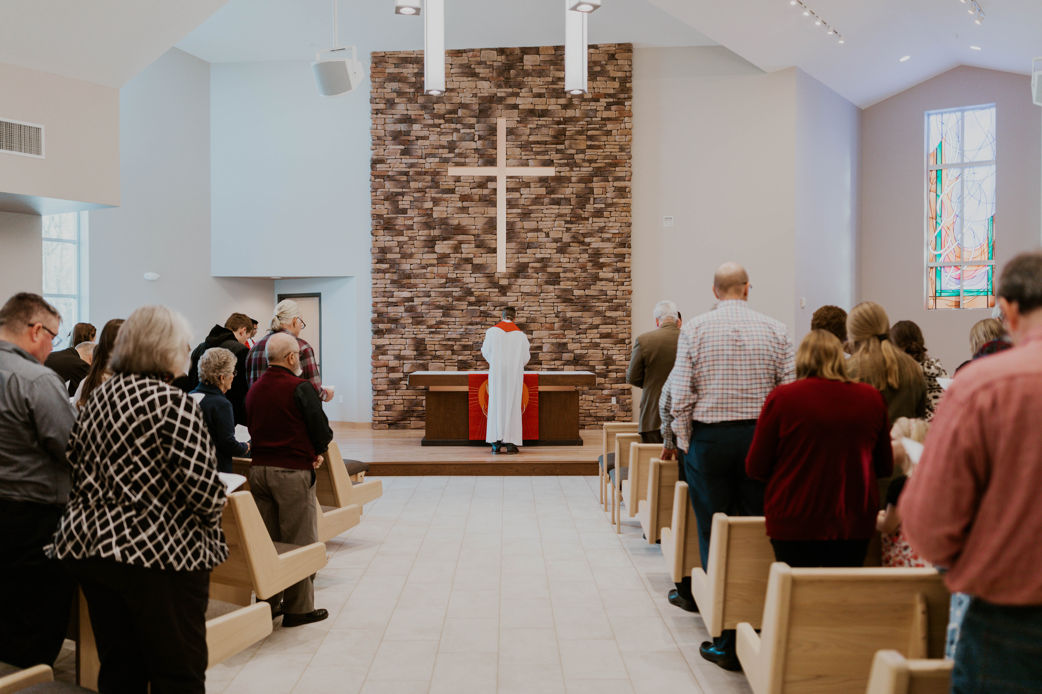
WELS Church Extension Fund A valuable partner of Home Missions
Fiscal Years 2022-2024:
$16.4 million in loans to home mission churches
$5.6 million in matching grants to home mission churches
$3.7 million in grants to WELS Home Missions
Building dedication at Good News in Mt. Horeb, Wis., Feb. 19, 2023
Notes:
WELS Church Extension Fund (CEF) is a VALUABLE partner of WELS Home Missions and the churches it supports. CEF supports the spreading of the gospel by providing loans and grants to WELS home mission congregations.
WELS CEF is a wholly owned, self-supporting, subsidiary corporation of WELS. Individual WELS members, WELS congregations, and WELS affiliates can assist the synod’s mission outreach efforts by investing in WELS CEF investment certificates. Your investments fund the WELS CEF loan program. Gifts, bequests, and donations made to WELS CEF support the grant program.
WELS CEF provides home mission churches a 4-to-1 matching grant for initial land purchase based on their 10% down payment. They also provide a 2-to-1 matching grant on a home mission congregation’s 10% down payment for their facility construction project.
Other stats:
Over 2,900 WELS members, congregations, and affiliates have entrusted WELS CEF with $103.8 million in member investments.
$37.5 million of matching grants to mission congregations and $7.7 million of special grants to Home Missions have been provided by WELS CEF since 1993.
Pictured: Good News, a home mission congregation in Mt. Horeb, WI, dedicated their new church on February 19, 2023. Good News received a $2,550,000 loan from Church Extension Fund and matching grants totaling $747,914 for their building project.

Slide 42
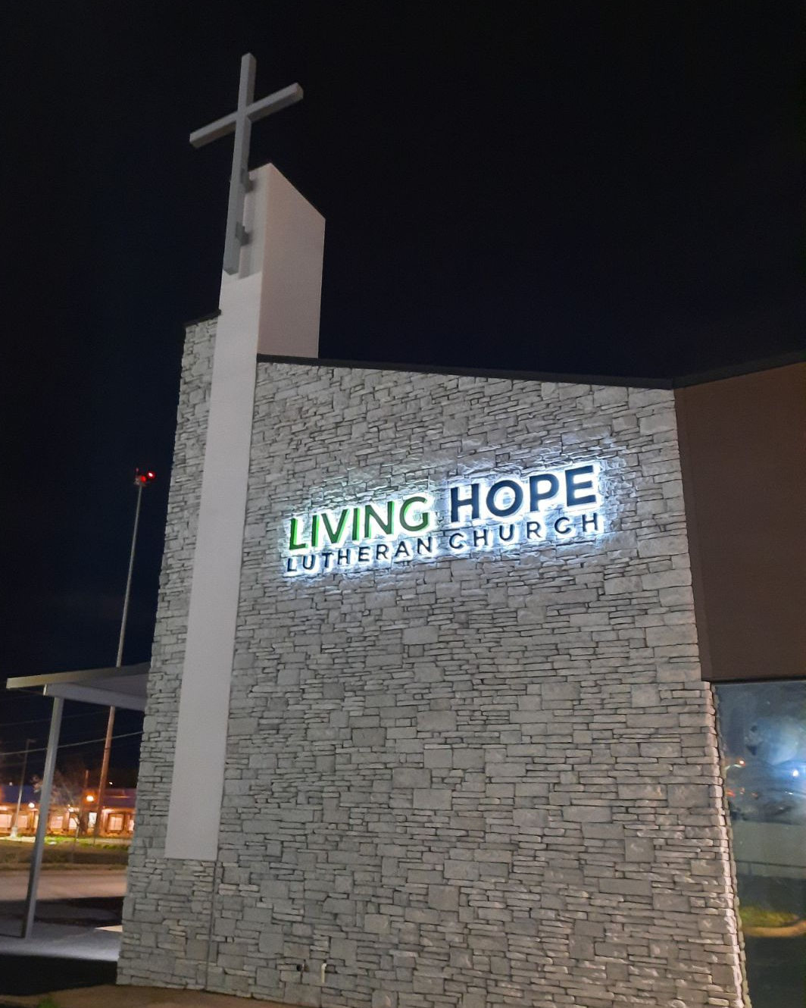
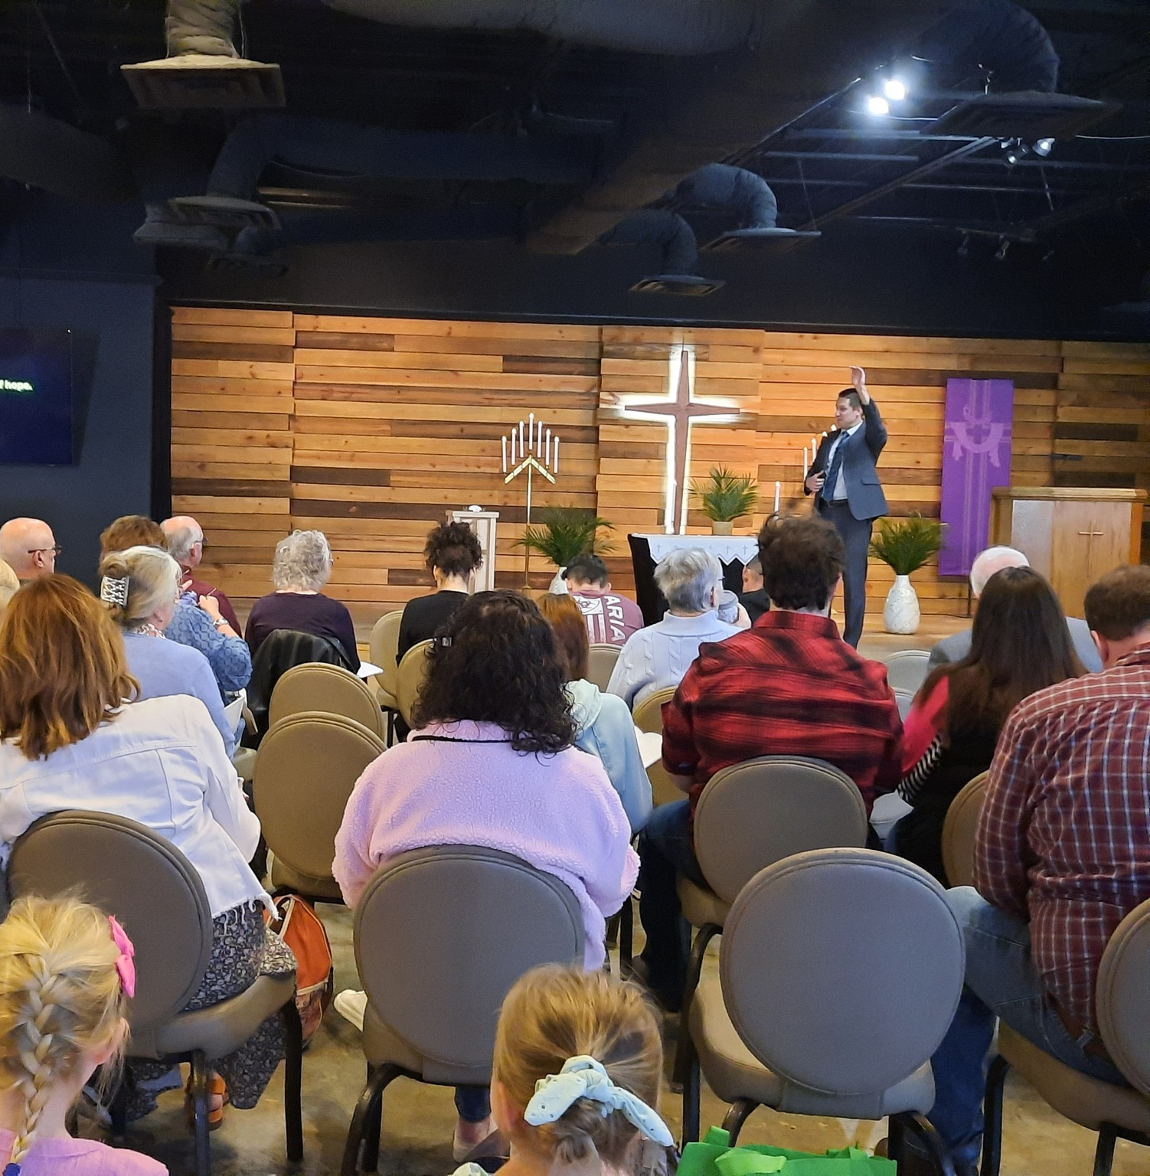
Grand re-opening in renovated worship space Living Hope, Chattanooga, TN
Notes:
On March 24, Living Hope Lutheran Church in Chattanooga, Tenn., celebrated the grand re-opening of their newly renovated facility. Living Hope began as a new home mission in May 2017 and has worshiped in a movie theater, hotel conference room, and a university campus church since then. Thanks to over $350,000 in matching land and facility grants and a loan from WELS Church Extension Fund, the congregation purchased their current facility in December 2021. Now, their newly renovated space is complete and equipped to serve their congregation and community.

Slide 43
Notes:
The work isn’t done once the home mission has their own church building. The home mission has even more opportunities to expand their ministries from their new home base. As the church grows in numbers and spiritual maturity, it is the prayer that higher local support for the church frees up Home Missions resources to allow us to plant other missions.

Slide 44
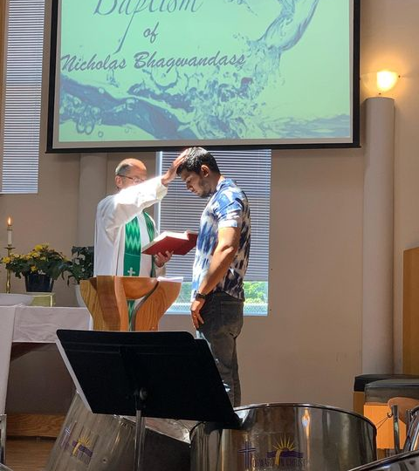
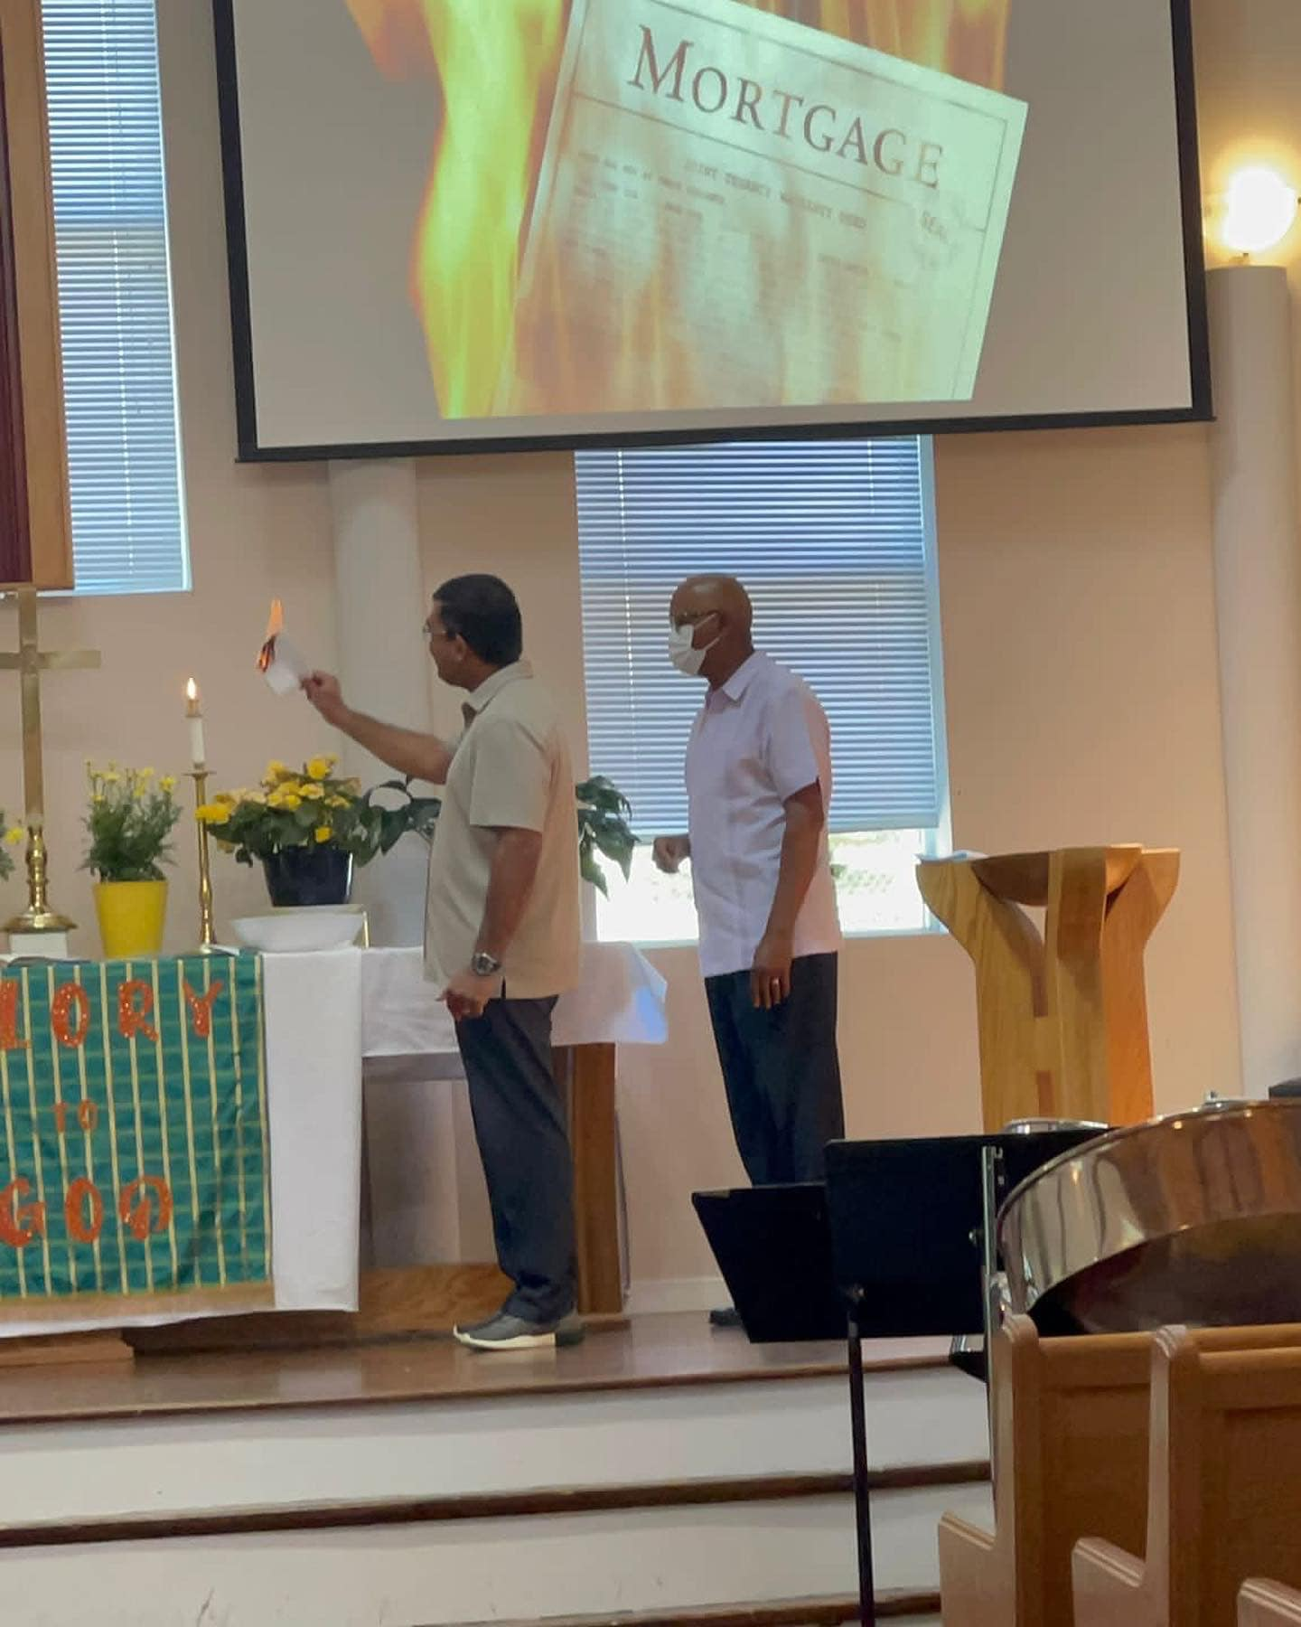
Growth at Hope Lutheran Church in Toronto
Notes:
Hope Lutheran Church has been reaching out to a diverse community in Toronto, Ontario, Canada, as a home mission congregation since their inception in 1990. They recently celebrated the burning of their mortgage and were fully self-supporting by July 2024.

Slide 45
Share student information with
WELS Campus Ministry!
Notes:
Campus Ministry programs are a great way to enhance ministry and reach out to a new demographic that desperately needs the gospel.
WELS Campus Ministry, a ministry of WELS Home Missions, provides resources, support, and encouragement to WELS congregations that serve college students. These congregations are vital in connecting college students with fellow Christians, strengthening their faith with the gospel, and encouraging them to share that faith with other college students.
Almost every university in the United States and Canada has an assigned campus ministry contact pastor. Each contact pastor receives a list of WELS student that are attending their school. By sharing information with WELS Campus Ministry, these contact pastors know who the students are and can help them stay connected to Christ and strengthen their faith while at school.
We need your help in this process! Please work with the high school/college age students at your congregation and get them signed up with WELS Campus Ministry. Instructions on how to share student information was shared as supplemental information in your District Convention resources, and you can encourage students to sign up directly at wels.net/college.

Slide 46
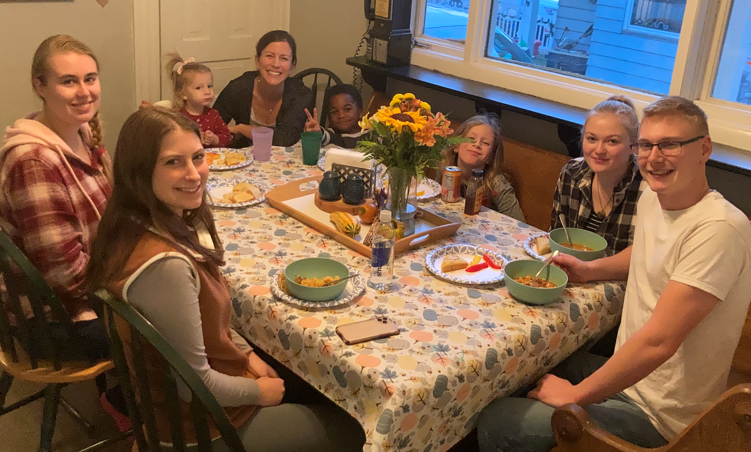
Growth in WELS Campus Ministry
Notes:
Left: Christ Our Refuge in Waco, TX, a home mission congregation that started public worship in 2022 received funding to start a Campus Ministry program. They hosted a Campus Ministry retreat with WELS students from Texas A&M and Baylor in February 2023.
Right: The new mission in Marquette, MI, that was approved in the first batch of new missions towards our goal of starting 100 new missions in the next 10 years. They are actively reaching out to students at Northern Michigan University as part of their outreach strategy.

Slide 47
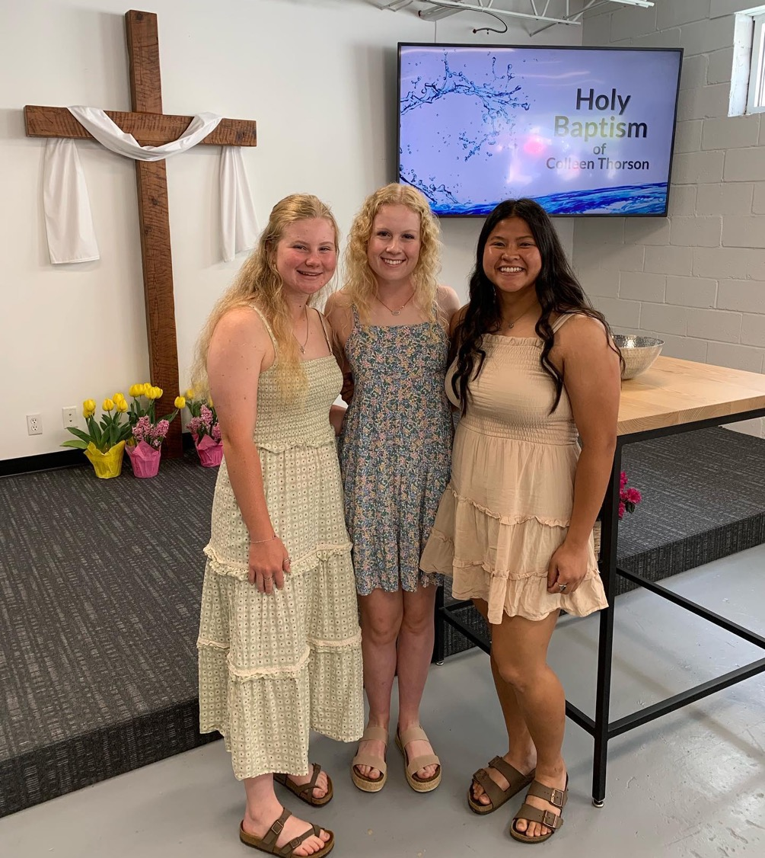
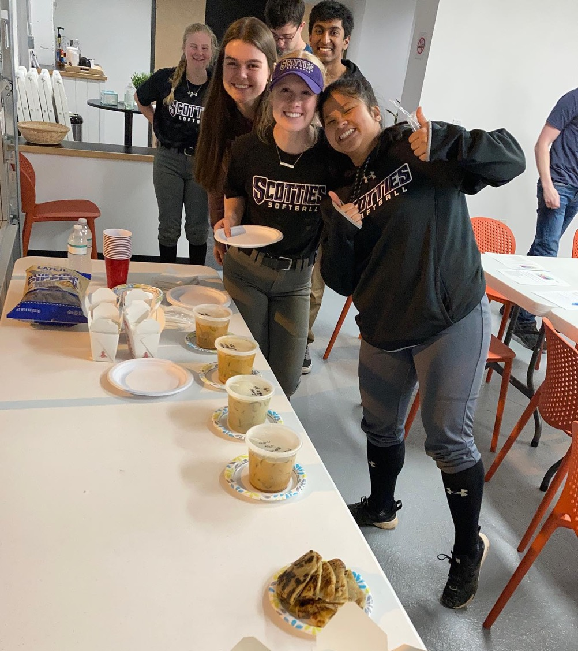
Outreach through Campus Ministry
Notes:
One Sunday in August, Colleen and Megan walked into our church for the first time. We learned that they were freshmen, roommates, and members of the softball team at Agnes Scott College here in Atlanta. We also learned that while Megan is a WELS member from Houston, Tex., Colleen had never attended a worship service in her life. They continued to attend worship regularly and quickly became staple attendees of our Tuesday night Campus Ministry Bible Study, bringing lots of laughter and joy, and often several other softball team members with them.
In January 2022 they asked, “Would it be possible for Colleen to have communion?” When I welcomed Colleen to join the Bible basics class we had just started, they high-fived in excitement. Colleen diligently attended our weeknight class, working around her busy school and sports schedule and squeezing in makeup lessons over Zoom during her free hours.
In April 2022, Colleen was baptized and confirmed as a Lutheran. Later in the service she came up to receive Communion. Standing beside her, with a huge smile on her face, was her roommate Megan. Colleen and Megan illustrate the “double blessing” of our Campus Ministry Program. It gives WELS members a chance to grow in their faith and share that faith with others!
From Lucas Bitter, home missionary at Intown Lutheran Church in Atlanta, Ga.

Slide 48
Notes:
While seeing a home mission church become self-supporting is a great thing, we’re MOST thankful for the souls that they have been able to reach with the gospel!

Slide 49
Complete joy over guilt: Marta and Wojtek’s story
Notes:
Divine Savior in Delray Beach, Fla., started off as a WELS home mission congregation and has been fully self-supporting since 2015. When their school started to experience significant growth, they received Home Missions support to call a staff ministry to connect new school families with the church. Hear how Marta and Wojtek experienced the joy of the gospel for the first time after sending their son to school at Divine Savior.
Link: https://vimeo.com/785279561

Slide 50
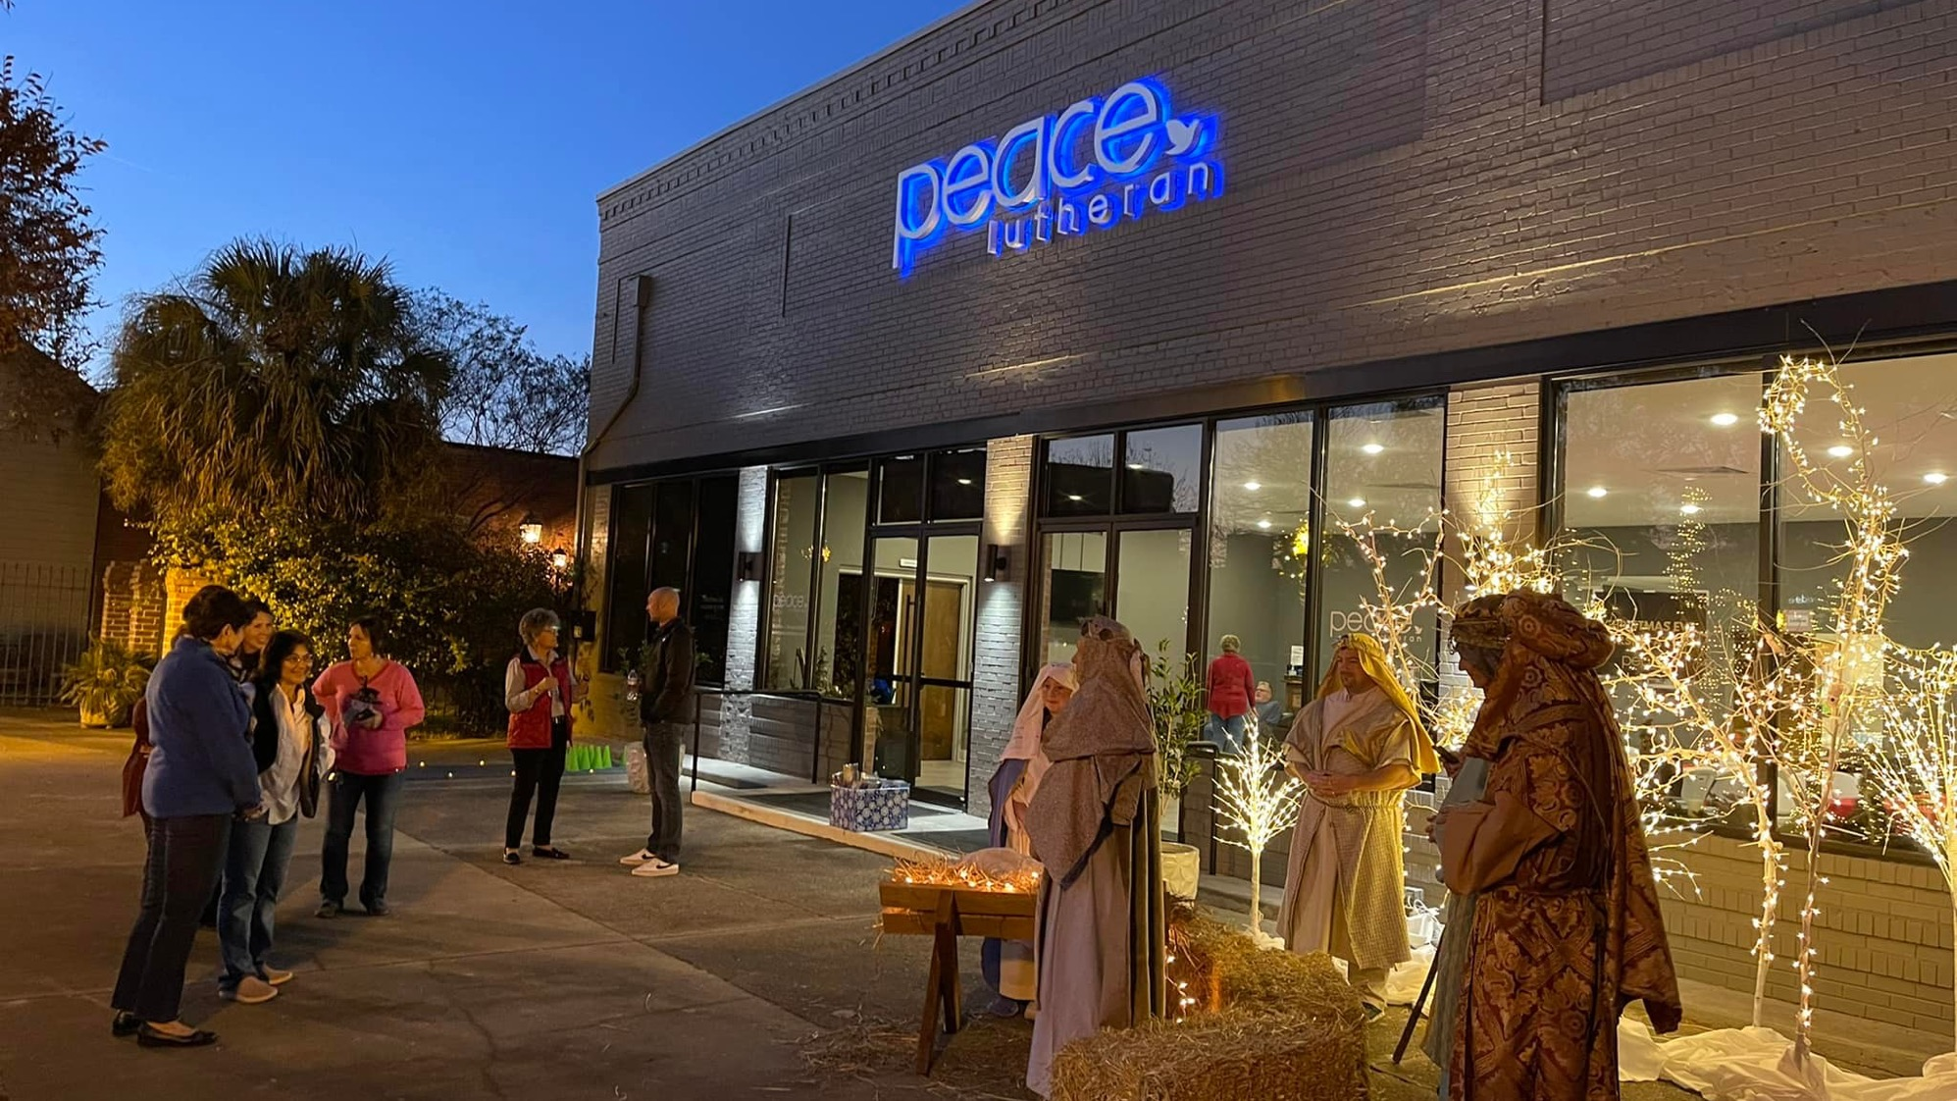
Peace – Aiken, South Carolina
Fully self-supported after eight years
Notes:
Peace in Aiken, SC, started with just a handful of people in December of 2013 and two years later was blessed to find a building downtown and refurbished it for their worship space. This 152-soul congregation confirmed 13 adults in the past year and are averaging 111 in worship each week. Peace is officially off Home Mission subsidy as of July 2022, which means they met their initial eight-year goal.

Slide 51
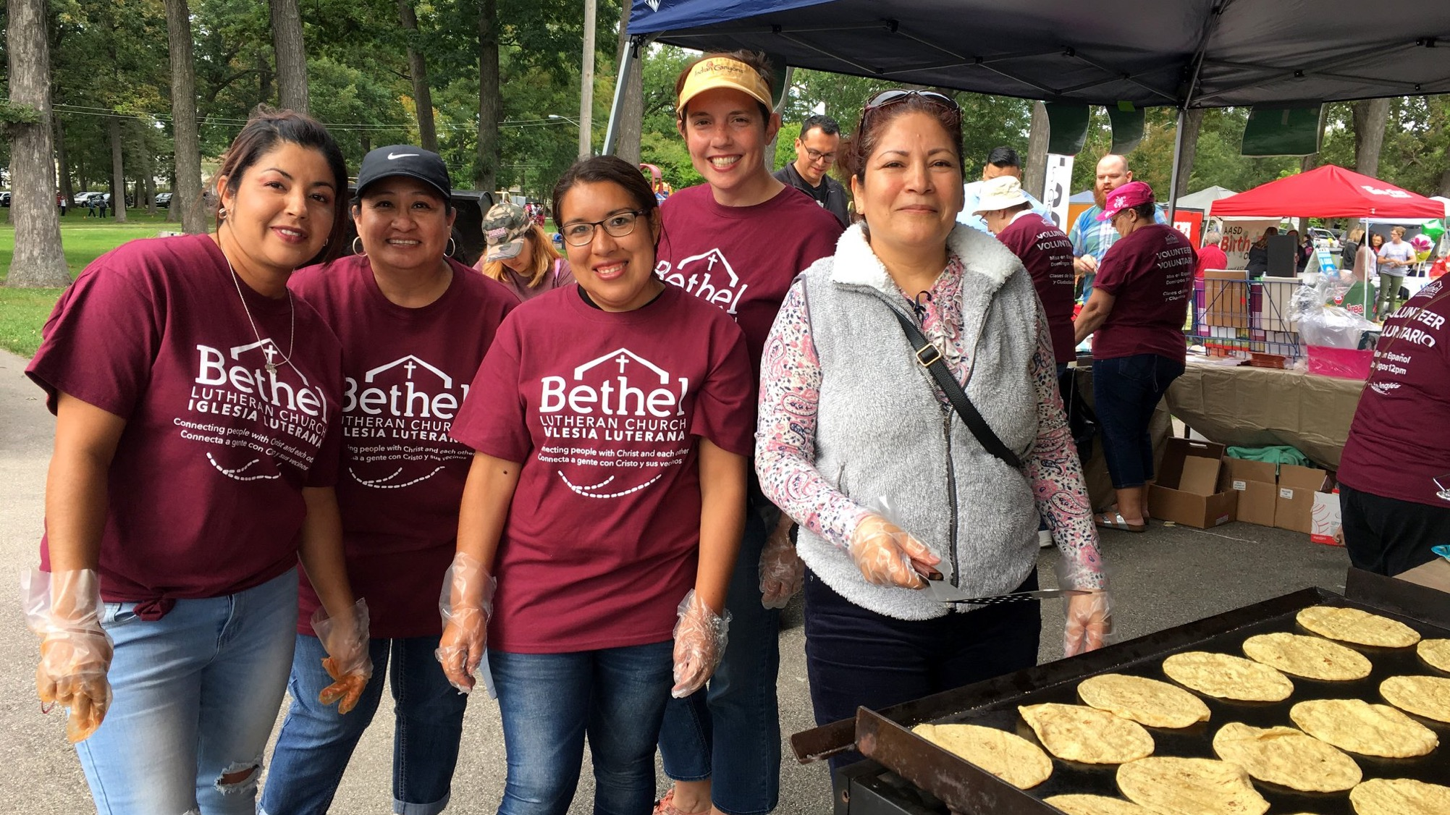
Thriving Hispanic ministry at Bethel in Menasha, Wisconsin
Notes:
Pictured: Members from Bethel Lutheran Church in Menasha, WI, at their small taco kiosk during Latinofest.
Bethel in Menasha, WI, received approval as a home mission enhancement in 2014 as they looked to reach out to their Hispanic neighbors with the gospel message. They began regular worship in Spanish in 2015. They are now self-supporting but continue to benefit from the support offered by their district mission board and mission counselor.

Slide 52
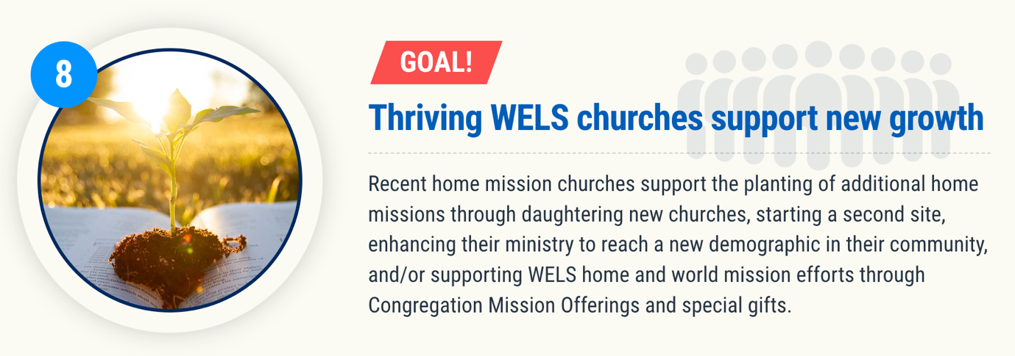
Notes:
It’s never just about planting one church. It’s about aggressively reaching lost souls. God can use the planting one church to multiply outreach efforts.

Slide 53
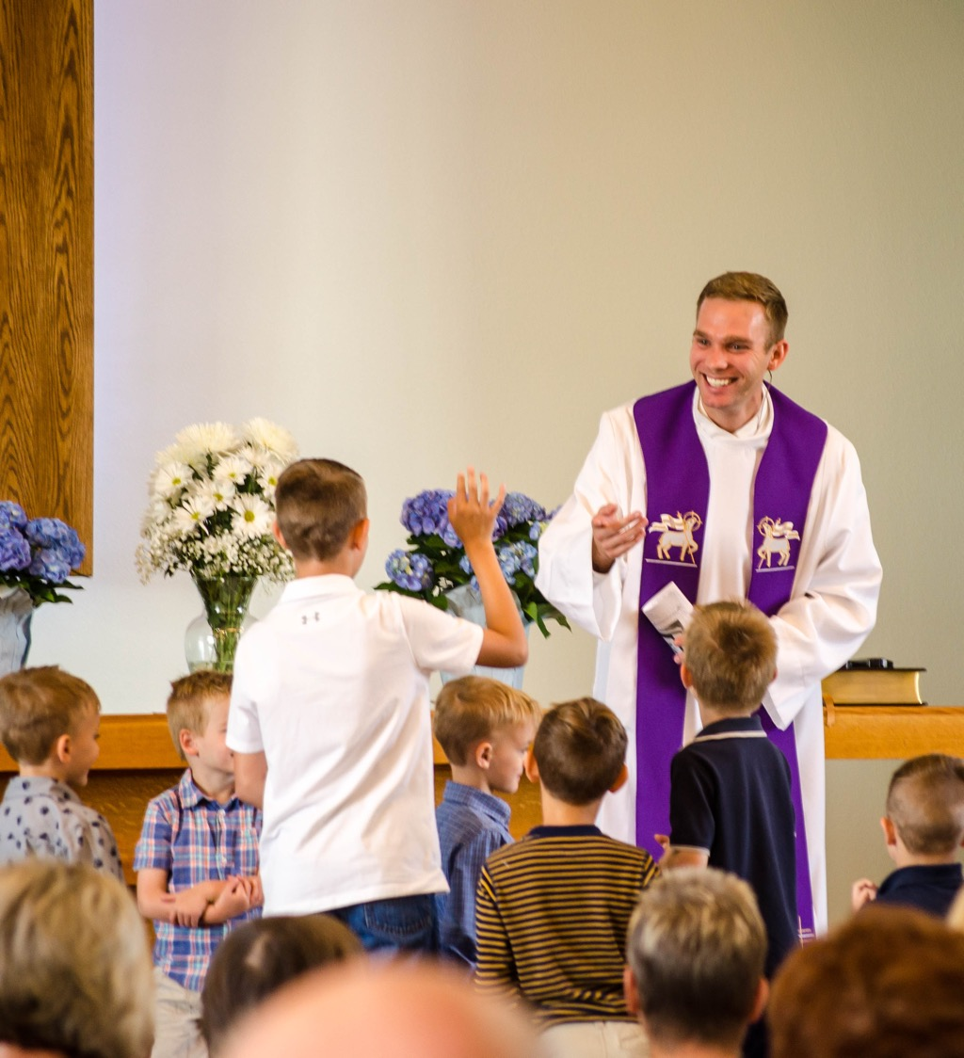
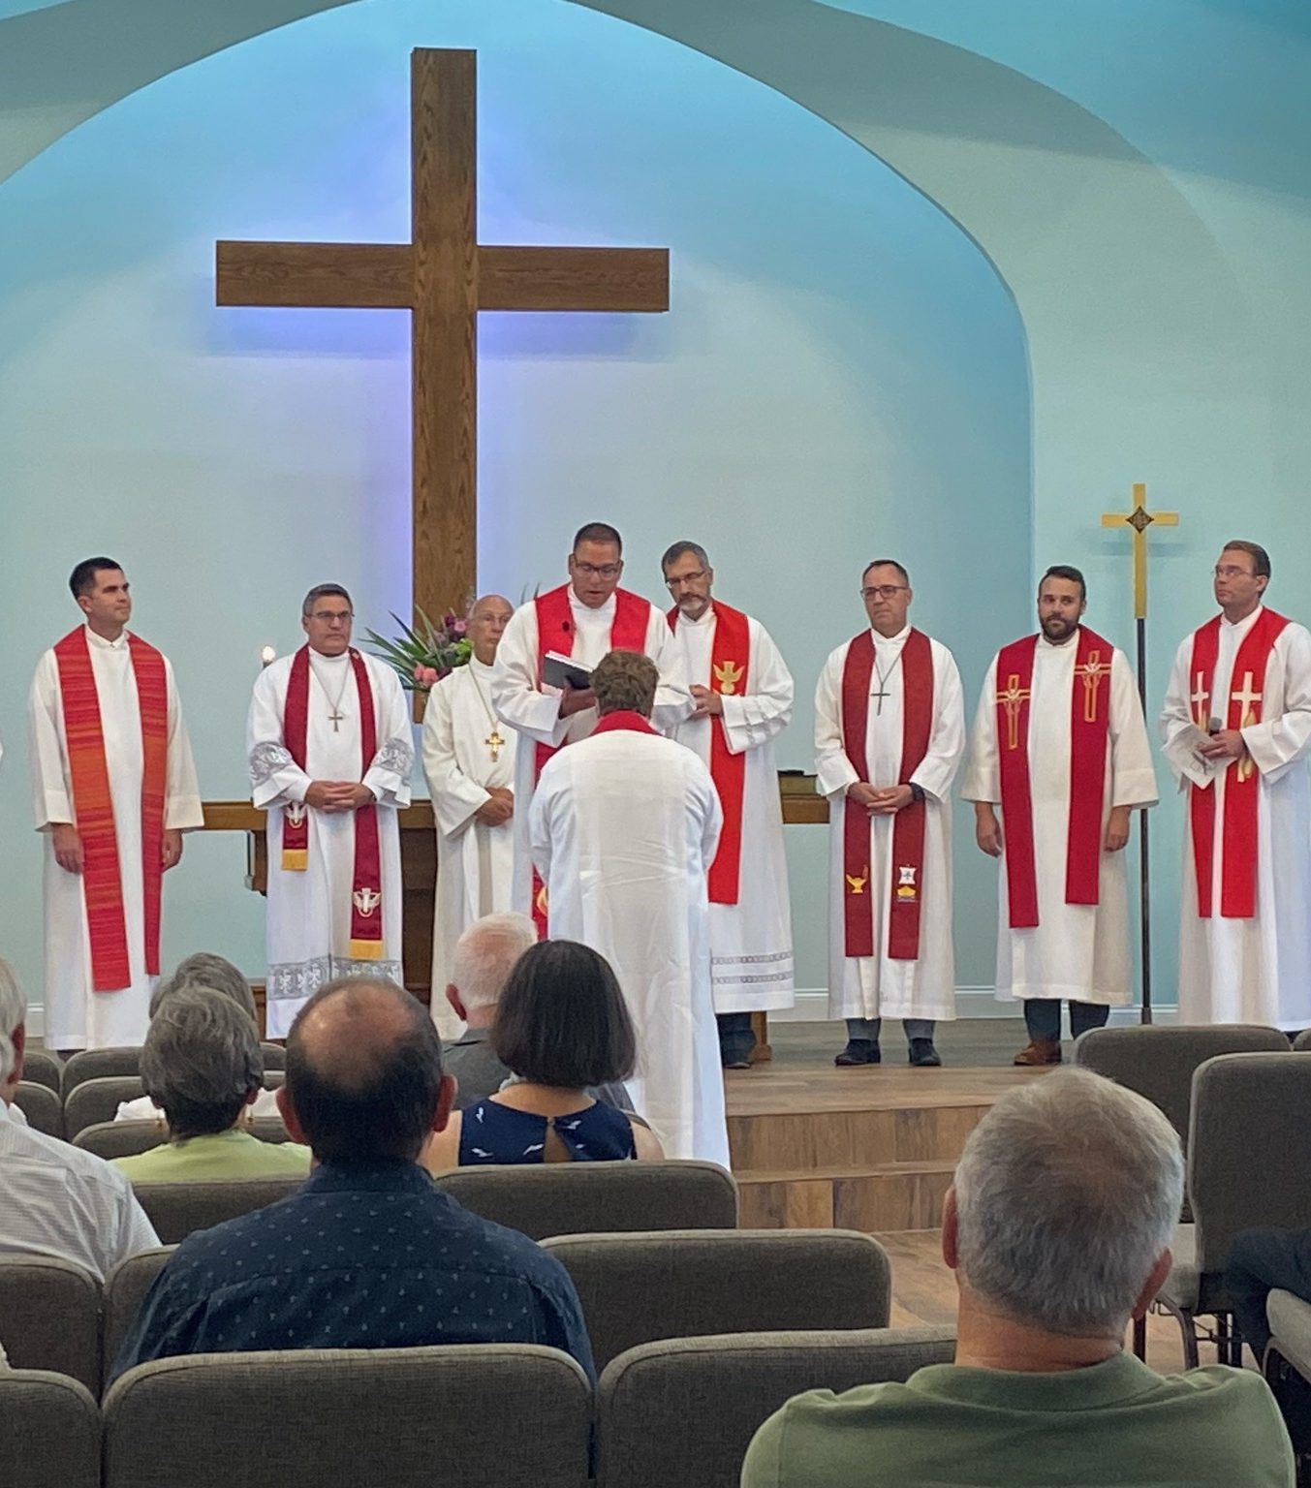
Former Home Mission
New Start
Notes:
Established congregations that started as new home mission plants can daughter more churches!
Risen Savior in Lakewood Ranch, FL, (home missionary Caleb Free pictured left) was approved as a home mission in 2016. They recently became self-supporting and partnered with Ascension in Sarasota, Fla., to start and support a new mission plant in Parrish, FL.
New home missionary Ben Balge (pictured left) is installed to lead the new church in Parrish. 20,000 to 30,000 homes are expected to be built there in the next 10 years. This new church will be reaching out with the gospel to a community that is 85 percent unchurched.

Slide 54
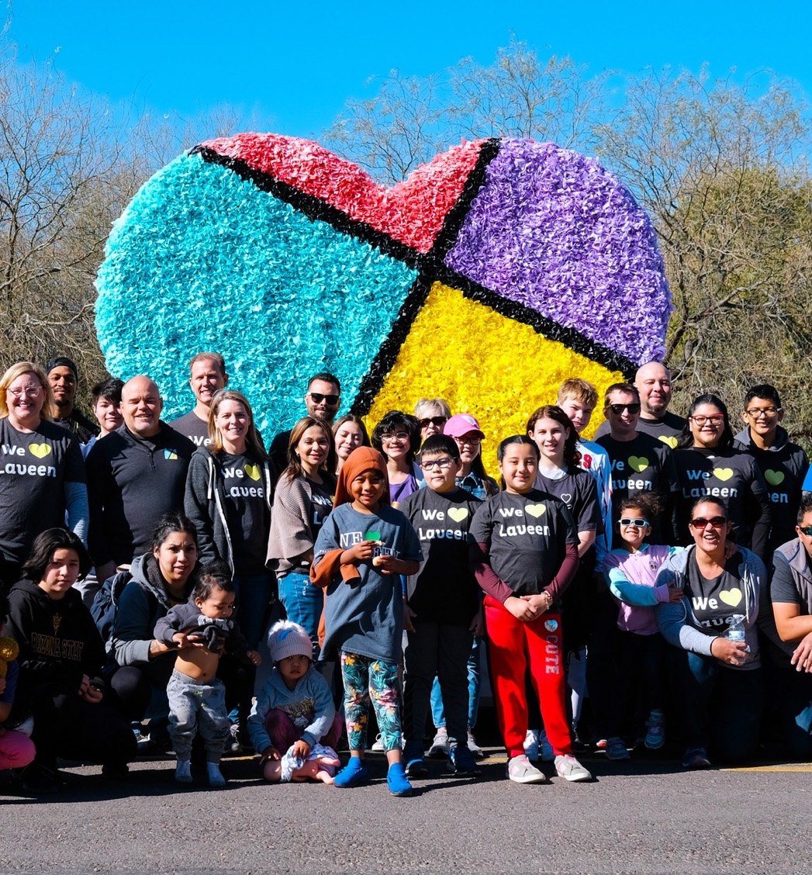
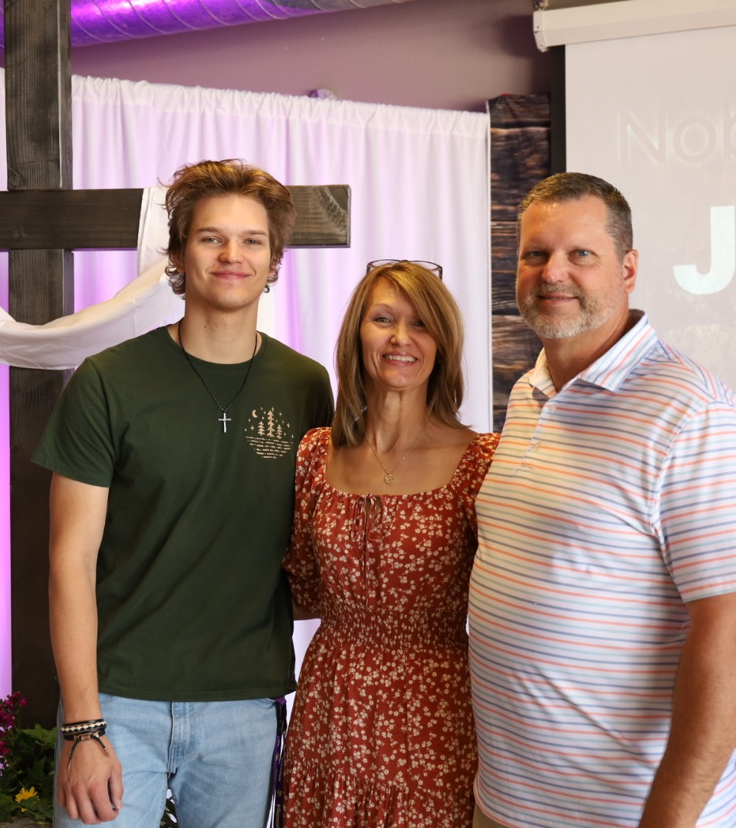
Former Home Mission
Second site
Notes:
Established congregations that started as new home mission plants can start second sites!
Crosswalk Lutheran Church was a home mission plant in downtown Phoenix (pictured left). In 2018, they received approval to start a second site in nearby Midtown (Easter worship pictured right).

Slide 55
Self-Supporting Congregation
Enhancing a ministry
Notes:
Established congregations that started as new home mission plants can enhance a ministry! Churches can request short-term, additional funding from Home Missions to enhance a ministry at their current congregation. This extra boost could mean the ability to call an additional pastor or staff minister, starting a new cross-cultural ministry, or even restarting a church where members have renewed their efforts to go with the gospel into their community.
Divine Savior in Sienna, Tex., called a second staff minister or pastor to assist in youth and family ministry. Divine Savior Academy currently has 280 students enrolled with 360 anticipated next school year. A second full-time worker will help them connect school families with the church, as many school families do not currently have a church home.

Slide 56
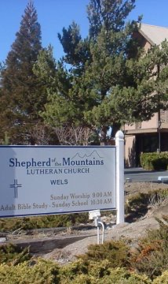
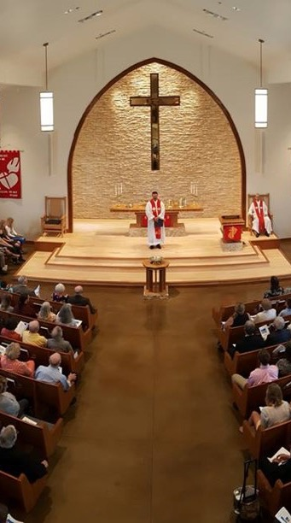
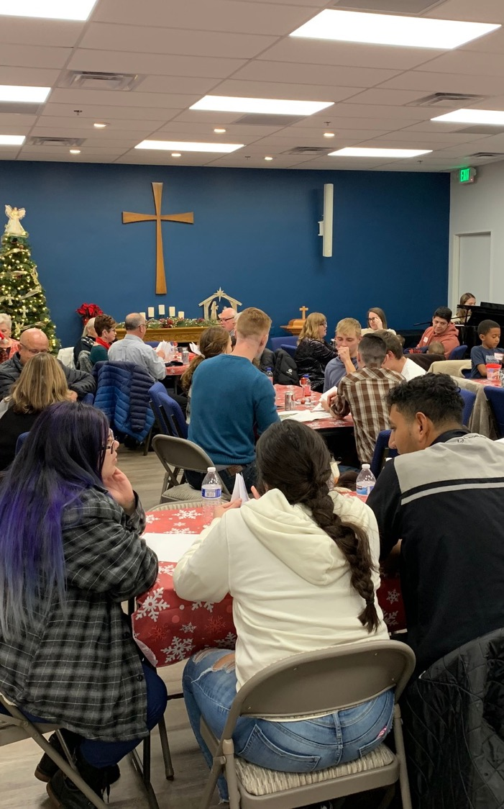
Shepherd of the Mountains Reno, NV
The Springs Sparks, NV
Light of the Valleys
Reno, NV
Notes:
The 120 members at Shepherd of the Mountain were outreach minded. And they knew they didn’t want one big mega church – they wanted to surround the greater Reno area with 4-5 churches to better reach the various communities. They started with The Springs in Sparks, NV, that started around 2008. Fast-forward to 2018… The Springs is completely self-supporting and settling into their new church building, and they partner with Shepherd of the Mountains to start a third site in Reno. Light of the Valleys is now a subsidized home mission church worshiping in a rented storefront, and growing rapidly.
100 Missions in 10 Years isn’t just about the 100. It’s about the hundreds and prayerfully THOUSANDS of churches that are started from those original 100, and ultimately the HUNDREDS of THOUSANDS of individuals that can be impacted by the proclamation of the gospel.

Slide 57
Notes:
Pray: This is no small thing. Pray that the Lord of the church would provide workers. Pray for our WELS Home Missions leaders, our home missionaries, and our worker training schools as they recruit and train future missionaries. Pray that the Lord provides us with the financial support needed to do the work.
Get Involved: If you see nearby mission opportunities, talk with your district mission board to see what you or your congregation might do to get involved in this synod wide church planting effort. Encourage young men and women in your church to consider full-time ministry. Ask your pastor to keep our synod’s work in your congregational prayers and provide updates on a regular basis.
Give: You know the grace of our Lord Jesus Christ. He was rich, yet he became poor so that through his poverty we might become rich (2 Corinthians 8:9). God’s generosity has resulted in the riches of forgiveness, peace, joy, and hope. Let that move you to give generously to your local congregation, to your synod through your church, and to this initiative.
Encourage people to check out the website: Learn more and stay up to date on progress at wels.net/100in10.

Slide 58
PRAY!
Lord, you know that countless souls are still searching for the peace that transcends all understanding. You have commissioned us to find the lost and have equipped us with your Word and Sacraments and your faithful promises. You assure us that you are able to do immeasurably more than all we ask or imagine. Confident of these truths, we humbly and boldly ask for your rich blessing upon the 100 missions in 10 years initiative. Bless our current missionaries and the fields that they serve. Provide ample manpower, money, and ministry resources. Grant wisdom, strength, perseverance, and joy to all involved in this effort. In all we do, move us to see and do our part in spreading the gospel so that more may know your saving peace, all to your glory. Amen.
Notes:
Please pray together.

Slide 59
GET INVOLVED!
Talk with your pastor and/or district mission board to see what you or your congregation might do to get involved in this synodwide church planting effort.
Encourage young men and women in your church to consider full-time ministry
Ask you pastor to keep our synod’s work in your congregational prayers and provide updates on a regular basis.
Learn more at wels100in10.net/getinvolved.
Notes:
This initiative is about aggressively and confidently doing the work that God has called all of us to do. Here are some ways to get out there and help!

Slide 60
Notes:
The COVID-19 pandemic disrupted many of the short-term mission trips coordinated through Mission Journeys, but the program is back up and running! Domestic mission trips are now available, and international mission trips will begin soon. Apply today and consider how your church, campus ministry, or other group might be able to walk together in the Great Commission through a short-term mission trip.
Mission Journeys is also looking for additional host congregations! If your congregations would be interested in hosting a Mission Journeys team, you can fill out an application form online.
Learn more, read FAQs, and sign up to host or send a team at wels.net/missionjourneys/

Slide 61
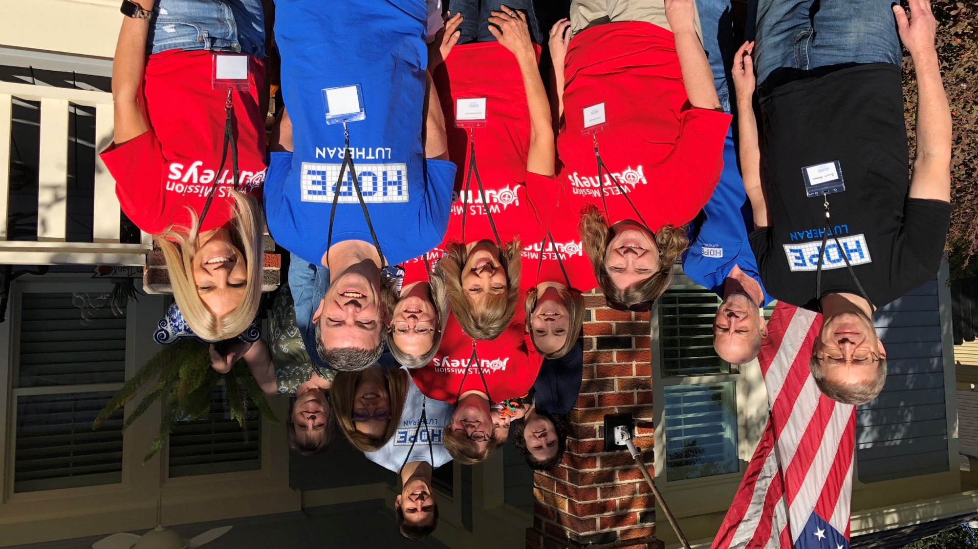
St. Matthew’s,
Oconomowoc, WI,
to Houston, TX
Domestic mission trips are up and running!
Notes:
A WELS Mission Journeys team from St. Matthew's Lutheran Church & School in Oconomowoc, WI, traveled to Hope in the Heights, a WELS home mission congregation in Houston, TX, to assist in their outreach efforts in November 2021. Praise and Proclaim Ministries led evangelism training on Friday night, and the group put what they learned into practice on Saturday by sharing the Good News of Jesus around the community.

Slide 62
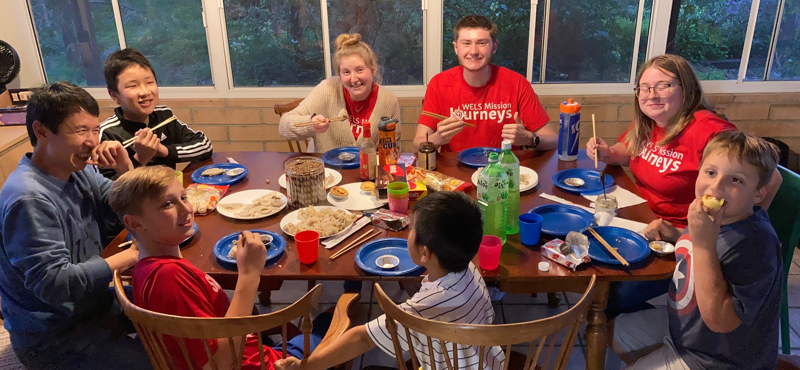
Long-term Volunteer Opportunities
Notes:
Mission Journeys, under the leadership of WELS Home Missions, is starting a pilot program to give more individuals the opportunity to share their faith through a long-term volunteer opportunity. Mission Journeys wants to place mission-oriented individuals in strategic locations to assist in forming and developing quality core groups, the building blocks in starting new home missions. A core group is the local group that does the work of meeting, praying, outreach, planning, and evangelism.
We’re looking for individuals that love Jesus and can communicate that love with other people. They’ll need patience, flexibility, and a spirit of adventure. This would be a tent ministry, where the individual would have a job outside of the ministry to support themselves. This could include remote work, a local job, or some combination. Mission Journeys, as a part of this pilot project, will work with the individual for possible financial assistance in moving or other expenses.
WELS Home Missions provides each location with a proven plan on starting. Each location has a home mission counselor to assist in planning and coordinating ministry ideas. The core groups also worship with a pastor twice a month. This pilot program is designed to give an individual with a heart for missions the opportunity to work on the ground floor of a mission start.
For additional information, please contact Mission Journeys Coordinator, Shannon Bohme, at shannon.bohme@wels.net.

Slide 63
Notes:
Speakers: District Mission Board members, Home Missionaries, Mission Counselors, and other Home Missions representatives are willing and able to present on the 100 missions in 10 years initiative at your next church Mission Festival, LWMS circuit rally, school assembly, or small group gathering. Contact your local District Mission Board OR fill out a request at wels.net/speaker-request to find a speaker for your event this fall.
Social Media: Follow us on Facebook and Instagram @WELSmissions
E-Mails: Subscribe to weekly Missions Blogs and quarterly Missions Update E-Newsletters at wels.net/subscribe.
Faces of Faith: The 6th annual edition of Faces of Faith is now available. This is a great overview of the work we’re doing in Home, World, and Joint Missions, and you can learn more about the 100 missions in 10 years initiative in this magazine.
It is available online and by request at wels.net/facesoffaith. Any congregation OR LWMS circuit is welcome to request up to 50 copies of the magazine, and we are also offering 100 Missions in 10 Years brochures and large home and world mission maps (24” x 36”) free of charge. Note – Faces of Faith is automatically sent to any congregation hosting a Mission Festival.

Slide 64
Notes:
Save the date for Taste of Missions, happening on Saturday, June 14, 2025!
This family-friendly event, held at Wisconsin Lutheran Seminary in Mequon, Wis., and online, will give all WELS members a “taste of missions”, no matter where you might be around the world. The event kicks off with a special worship service where we will commission new home and world missionaries. Sample ethnic cuisine from some of our mission fields while enjoying fellowship and presentations from home and world missionaries alike. View displays, participate in outdoor family-friendly activities, and ask questions about the ups and downs of mission work. We hope you can join us!

Slide 65
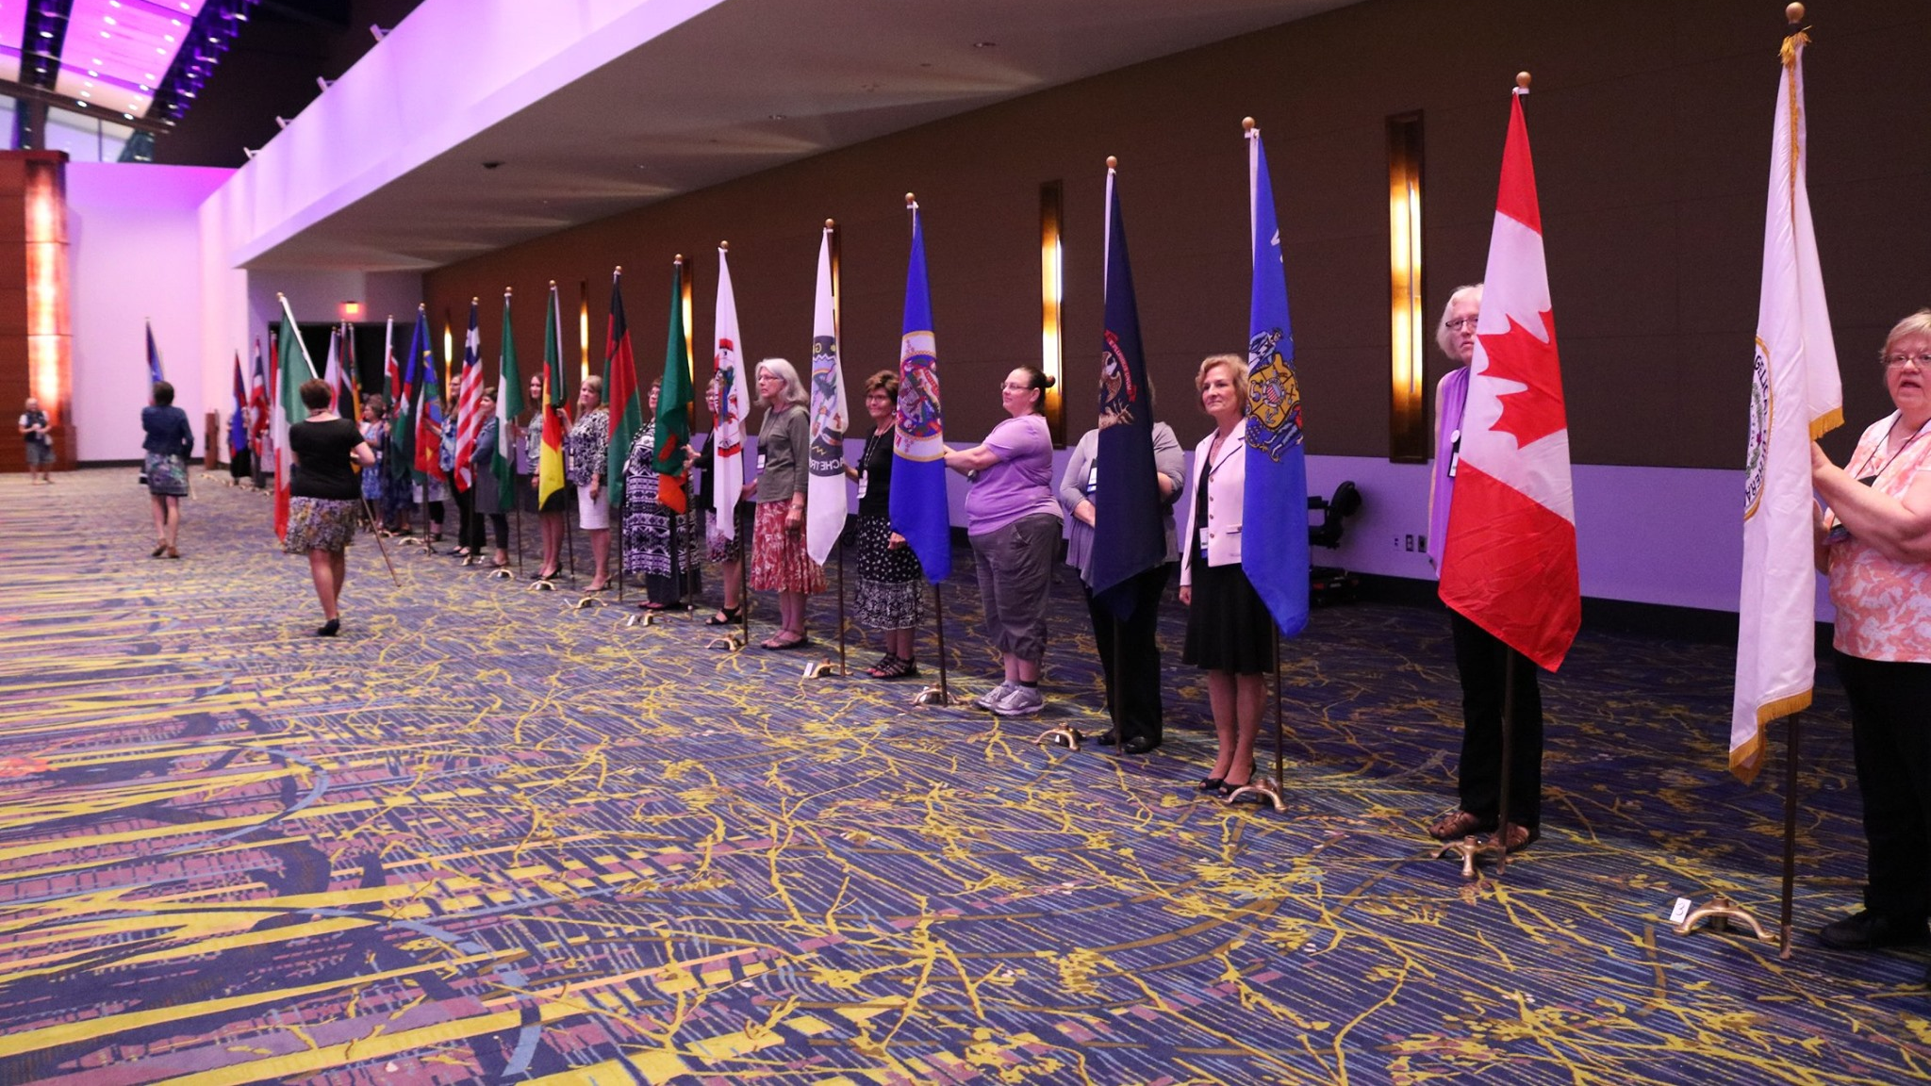
A valuable partner of WELS Missions
Notes:
LWMS is women dedicated to serving Jesus by increasing awareness of, interest in, and support of the mission outreach of the Wisconsin Evangelical Lutheran Synod (WELS). They are valuable partners of WELS Home Missions and the 100 Missions in 10 Years effort. They offer an annual convention during the last full weekend in June, where hundreds of women (and the men who love them) gather to learn about and support WELS Home, World, and Joint Mission work. Each of the 60 regional circuits of LWMS offer semi-annual circuit rallies where mission-minded women come together to encourage one another in spiritual growth and mission awareness. They are usually held in the spring and the fall. These are a wonderful opportunity to meet or join with women for worship, fellowship, and learning about missions at home and around the world.
Learn more about LWMS and how you can get involved at lwms.org.

Slide 66
GIVE GENEROUSLY!
Notes:
We confidently ask you to consider giving generously to this amazing opportunity to expand our efforts to share the saving gospel right here in our own backyard. This is a BIG challenge. An impossible one you might say. But we prepare and we plan, and we ask God to bless it. Trusting in the Lord, we boldly move forward knowing God will bless us and his kingdom.
You can support this effort by giving a gift online at wels.net/100in10gift; through the QR code on the slide; sending a check with the 100 Missions in 10 Years in the memo line to WELS, Attn: Gift Processing, N16W23377 Stone Ridge Drive, Waukesha, WI 53188; or through appreciated assets (e.g., stock) or from your IRA by calling 800-827-5482. Thank you for your support!

Slide 67
Notes:
Try something that is so hard, that if it succeeds, people will have to say God did this.
We submit all our plans to Him, for He is the Lord of the Church, and we are only servants. We’re trusting God to do immeasurably more than all we ask or imagine.

Slide 68
One soul at a time
Notes:
Video link: https://vimeo.com/952367165

Slide 69
Notes:
Learn more and stay up-to-date on progress at wels.net/100in10.

