Slide 1
Notes:
At the 2021 Synod Convention, delegates enthusiastically approved a WELS Home Missions initiative to plant 100 home mission churches and enhance 75 ministries in 10 years beginning in 2023. During the same time, we want to support 75 enhancement grants to help existing congregations reach more souls, often in other cultures.

Slide 2
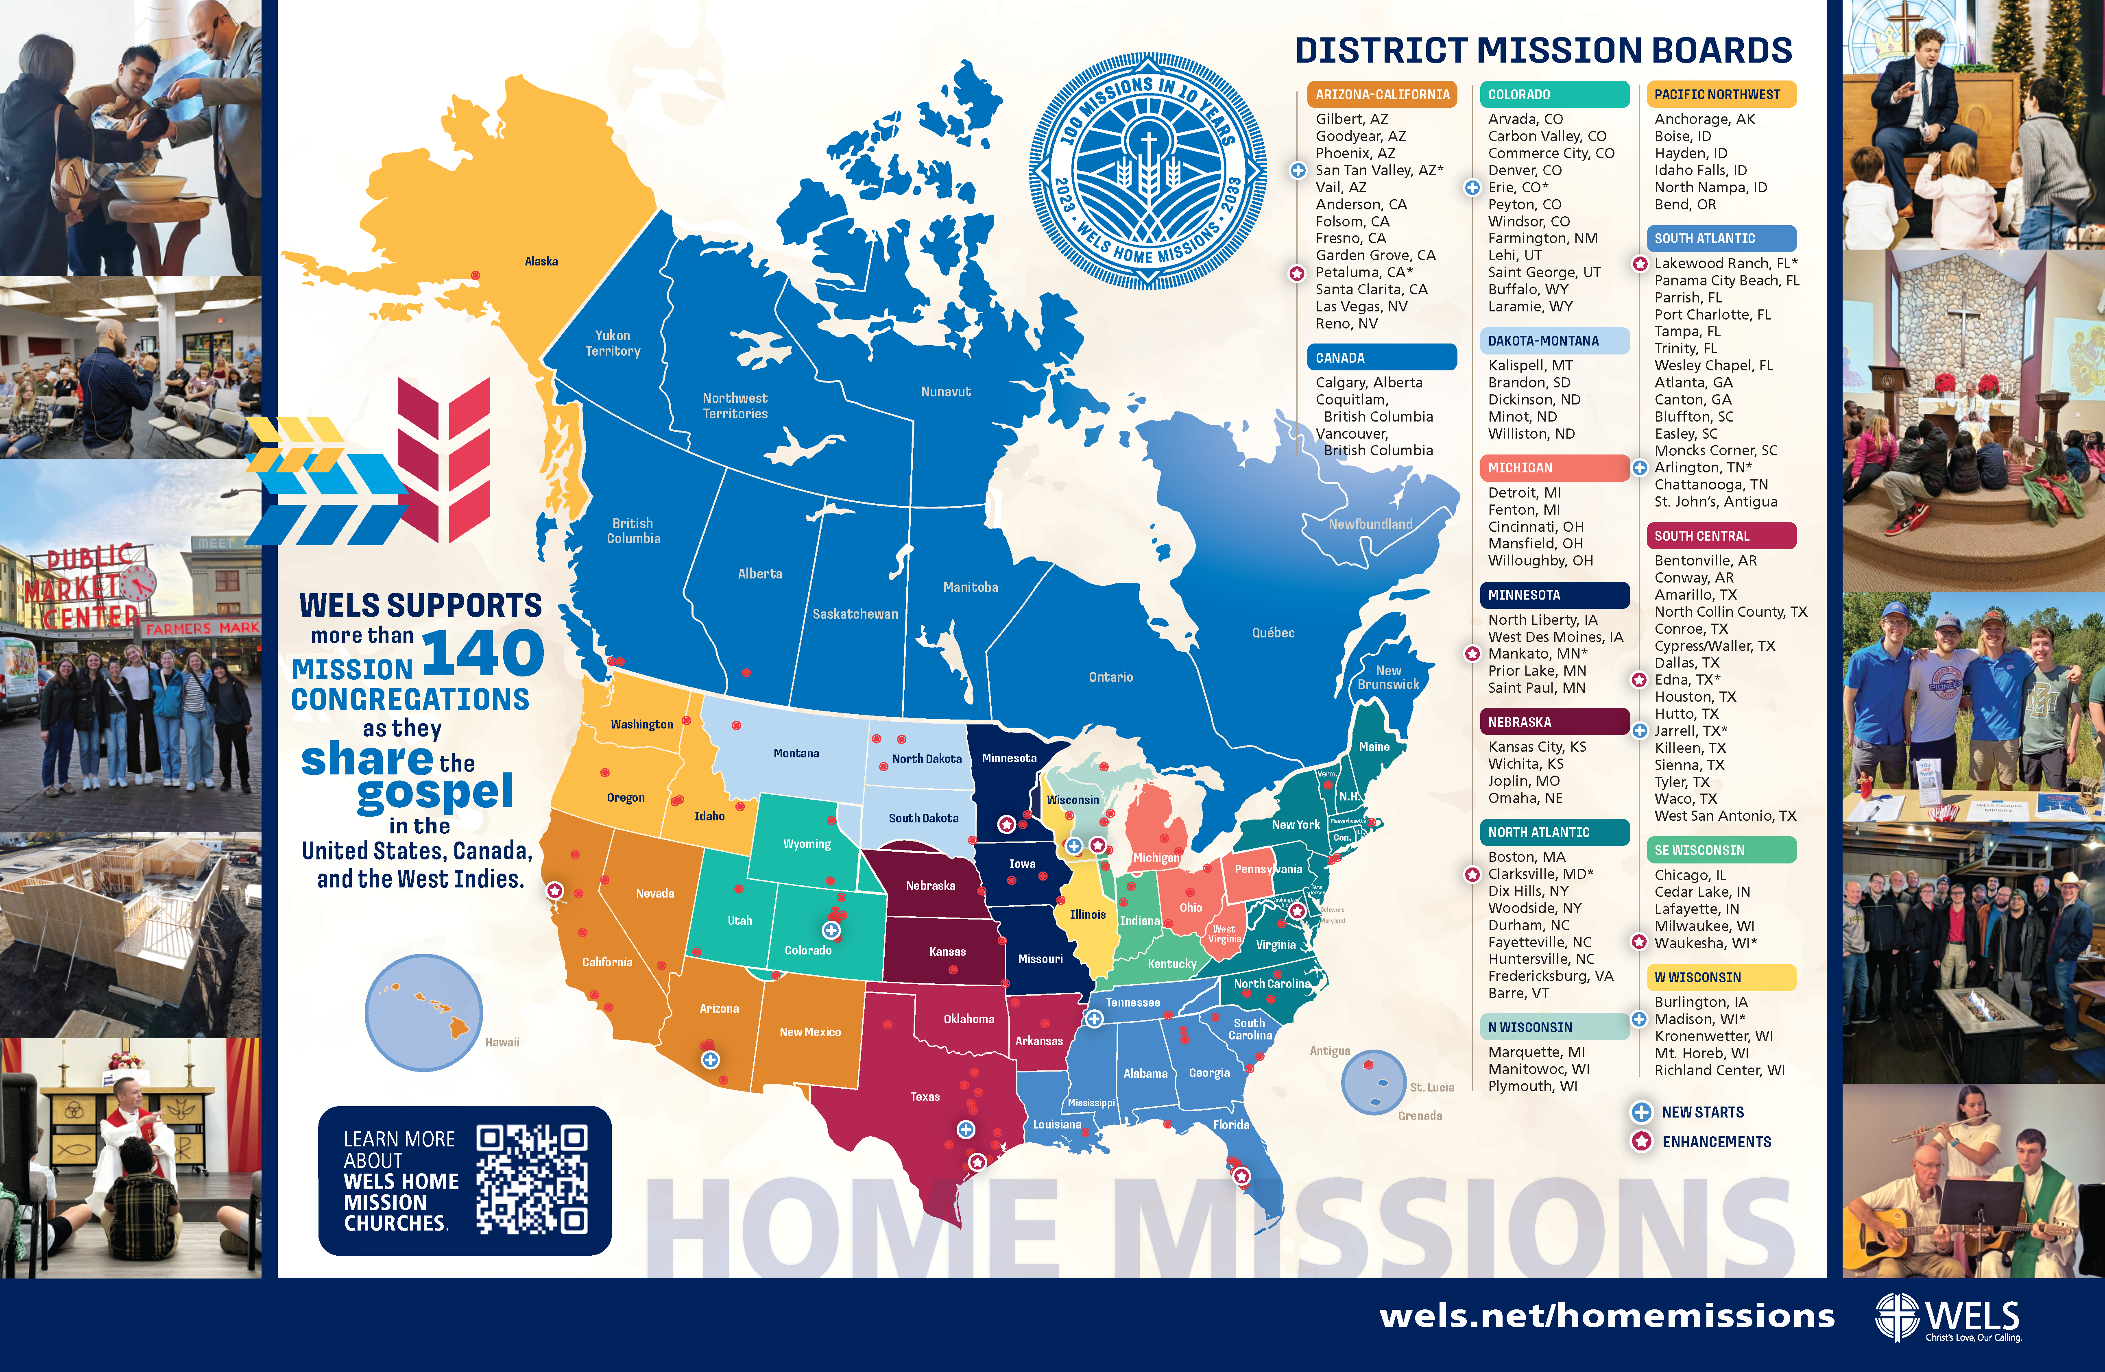
Notes:
WELS Home Missions is blessed to plant churches and assist mission-minded congregations across North America. Home Missions currently supports 151 congregations with financial subsidy or district mission board/mission counselor assistance, with 30 of those being cross-cultural mission congregations. Home Missions also provides nearly 50 campus ministries with financial support, while assisting hundreds of other congregations that serve college students around the United States and Canada.

Slide 3

This is a big goal. Why start 100 new home missions?
Our Savior directs us to reach more souls with the
good news. This initiative isn’t as much about planting more churches as it is about sharing the gospel of
Jesus Christ. It’s about Christ’s mission to his church.
It’s about aggressively reaching lost souls.
Notes:
Why are we doing this?

Slide 4
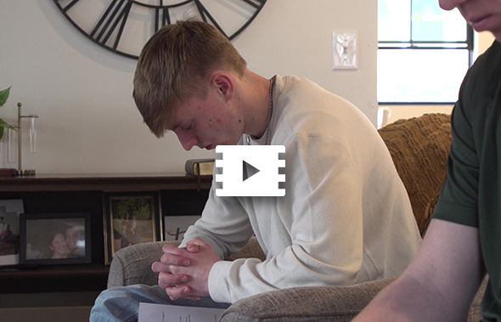
Reaching people like Jett
Notes:
The 100 Missions in 10 Years initiative isn’t as much about planting more churches but about sharing the gospel of Jesus Christ. It’s about aggressively reaching lost souls. It’s about Christ’s mission to his church.
As we continue to work towards our goal, we will be featuring more stories of the “Faces of Faith” reached with the gospel message through home mission congregations. Our congregations continue to be beacons of light in our communities and throughout the world! Beacons of light that have eternal impact on people just like Jett.
Video link: https://vimeo.com/1090129335?share=copy

Slide 5

Notes:
The “Christ through us” Long-Range Strategic Plan was adopted at the 2025 Synod Convention. This issues-based strategic plan names four strategic priorities—Culture, Congregations, Commission, and Calling. Each priority offers a rationale for its urgency, followed by goals—tangible steps showing how, by God’s grace, we will meet these trials. Priorities frame the struggles; goals forge the path.
The congregations of WELS form the vital backbone that supports our shared gospel efforts. WELS congregations are beacons of light and truth in their communities, proclaiming the life-giving gospel to a dying world. However, these congregations are not only local gospel outposts but also the foundation of the synod’s broader ministry efforts. Through their offerings, they sustain worldwide missions and the planting of new churches. Through their nurture, they identify and encourage the future called workers who will serve the next generation. Through their witness, they embody the love of Christ who reconciled us to God.

Slide 6
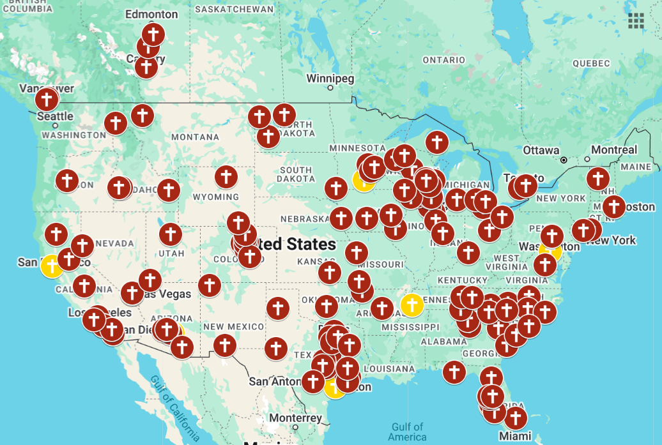
U.S. population: 340 million
WELS current reach:
2% = 6.8 million
WELS’ long-range plan:
Increase WELS' reach to 3%
Notes:
WELS Home Missions plays a critical role in the “Congregations” priority. Two goals were identified related to WELS Home Missions:
Support ministry enhancement efforts: Every WELS congregation faces a distinct blend of opportunities and challenges, shaped by shifting ministry contexts. Some will seek to enhance or revitalize their current mission efforts, particularly if their ministry context has changed. Others will explore regional collaboration, shared ministry, or consolidation to amplify their gospel reach. Still others will prayerfully consider the objectives of their childhood ministries, including Lutheran schools: discipleship, outreach, or both. They will seek to ensure such childhood ministries are sustainable long term. Our goal is to offer support to WELS congregations in whatever ministry enhancement effort they choose to undertake for Christ’s glory. When asked, we will help them assess their strategies, providing the encouragement, advice, and resources that can help them plan and implement efforts that enhance their outreach and discipleship ministries.
Expand WELS’ reach through strategic church planting: Driven by Christ’s reconciling love, we are called to bring the gospel to every corner. Yet America’s shifting landscape—marked by growing diversity and population drift—leaves millions beyond the reach of WELS’ gospel witness, with only two percent living near our congregations. This gap cries out for action, as souls hunger for the hope of reconciliation in regions where confessional Lutheran ministry is rare. Planting new churches not only meets this need but fortifies our synod’s backbone for enduring mission impact.
At this point in time, two 2% of the U.S. population currently lives within a 15-minute drive of a WELS congregation. One of the SMART (Specific, Measurable, Achievable, Relevant, and Time-Bound) objectives being set for the ministry of Home Missions was to increase that reach to 3% of the U.S. population.

Slide 7
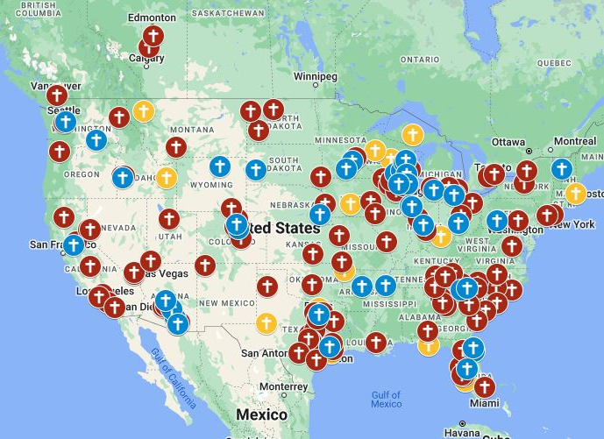
2% 3%
+3.4 million
10.2 million
Notes:
If we were to accomplish that goal in the next 10 years, that would allow WELS to increase their reach from 6.8 million to 10.2 million people.

Slide 8


Supporting home mission churches
100 Mission in 10 Years
Notes:
So how does it work?

Slide 9
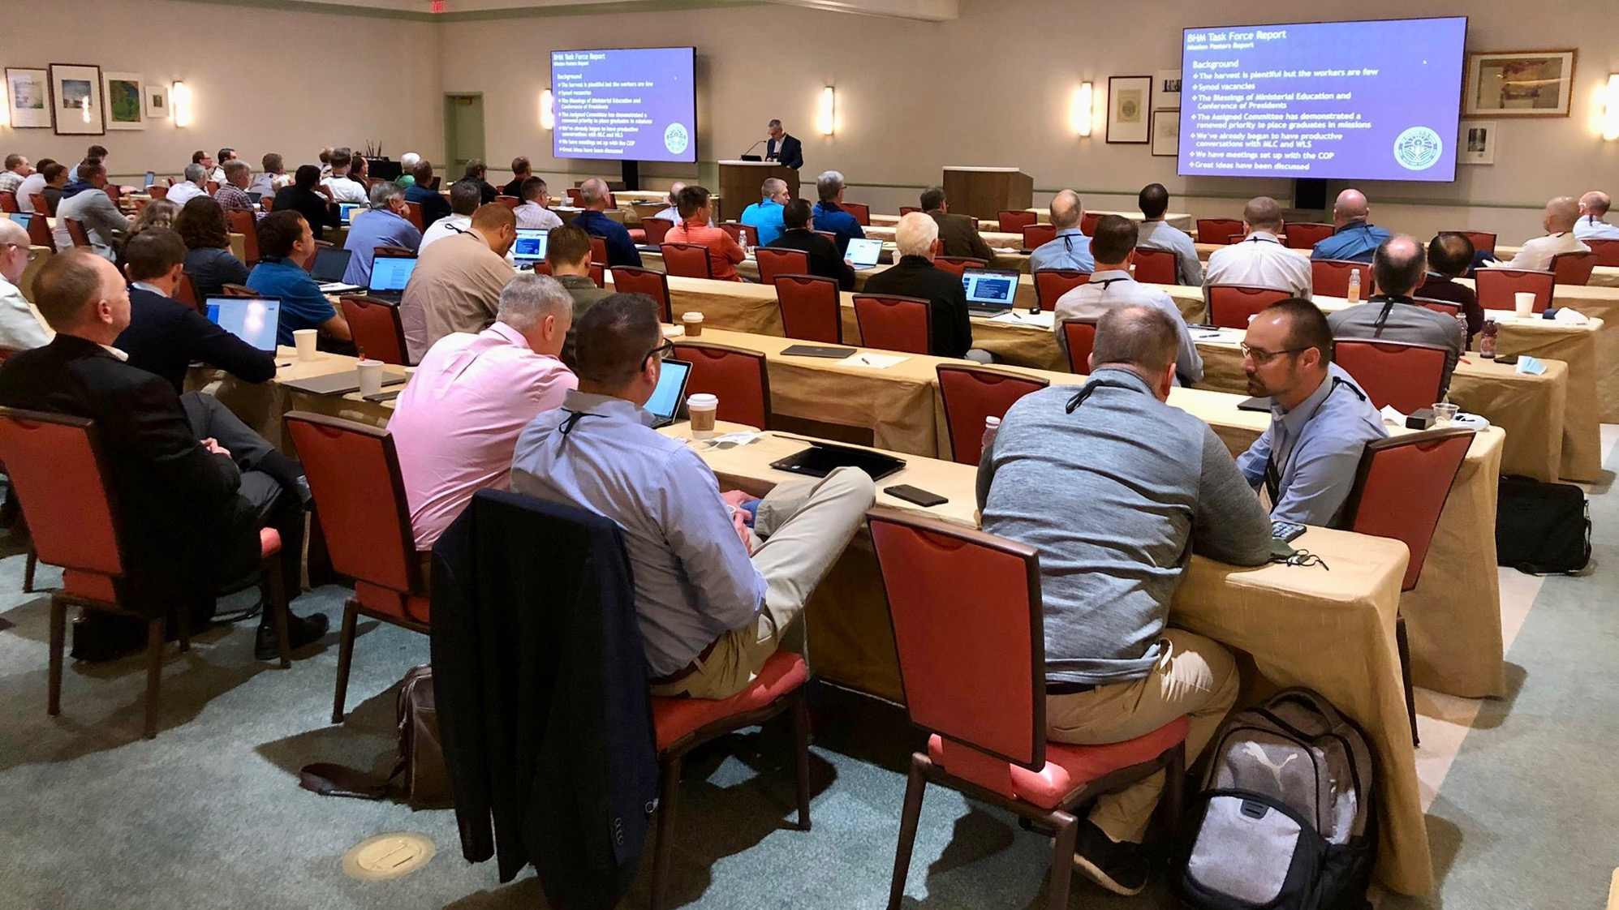

District Mission Boards (DMB)
The heart and core of Home Missions
Notes:
FOR PRESENTERS: I would recommend including a group photo of the DMB where you’re presenting for this slide.
District mission boards (DMB) are the heart and core of Home Missions. They are the “boots on the ground” as they support existing home mission churches and work with area congregations to identify locations to plant new churches throughout their district. This group of 2-4 pastor and 2-4 laymen volunteers helps build a solid foundation for each new mission start and shepherds these new churches and their pastors on their path from starting a new mission to being a self-supporting church. Learn more at wels100in10.net/timeline/dmb.

Slide 10
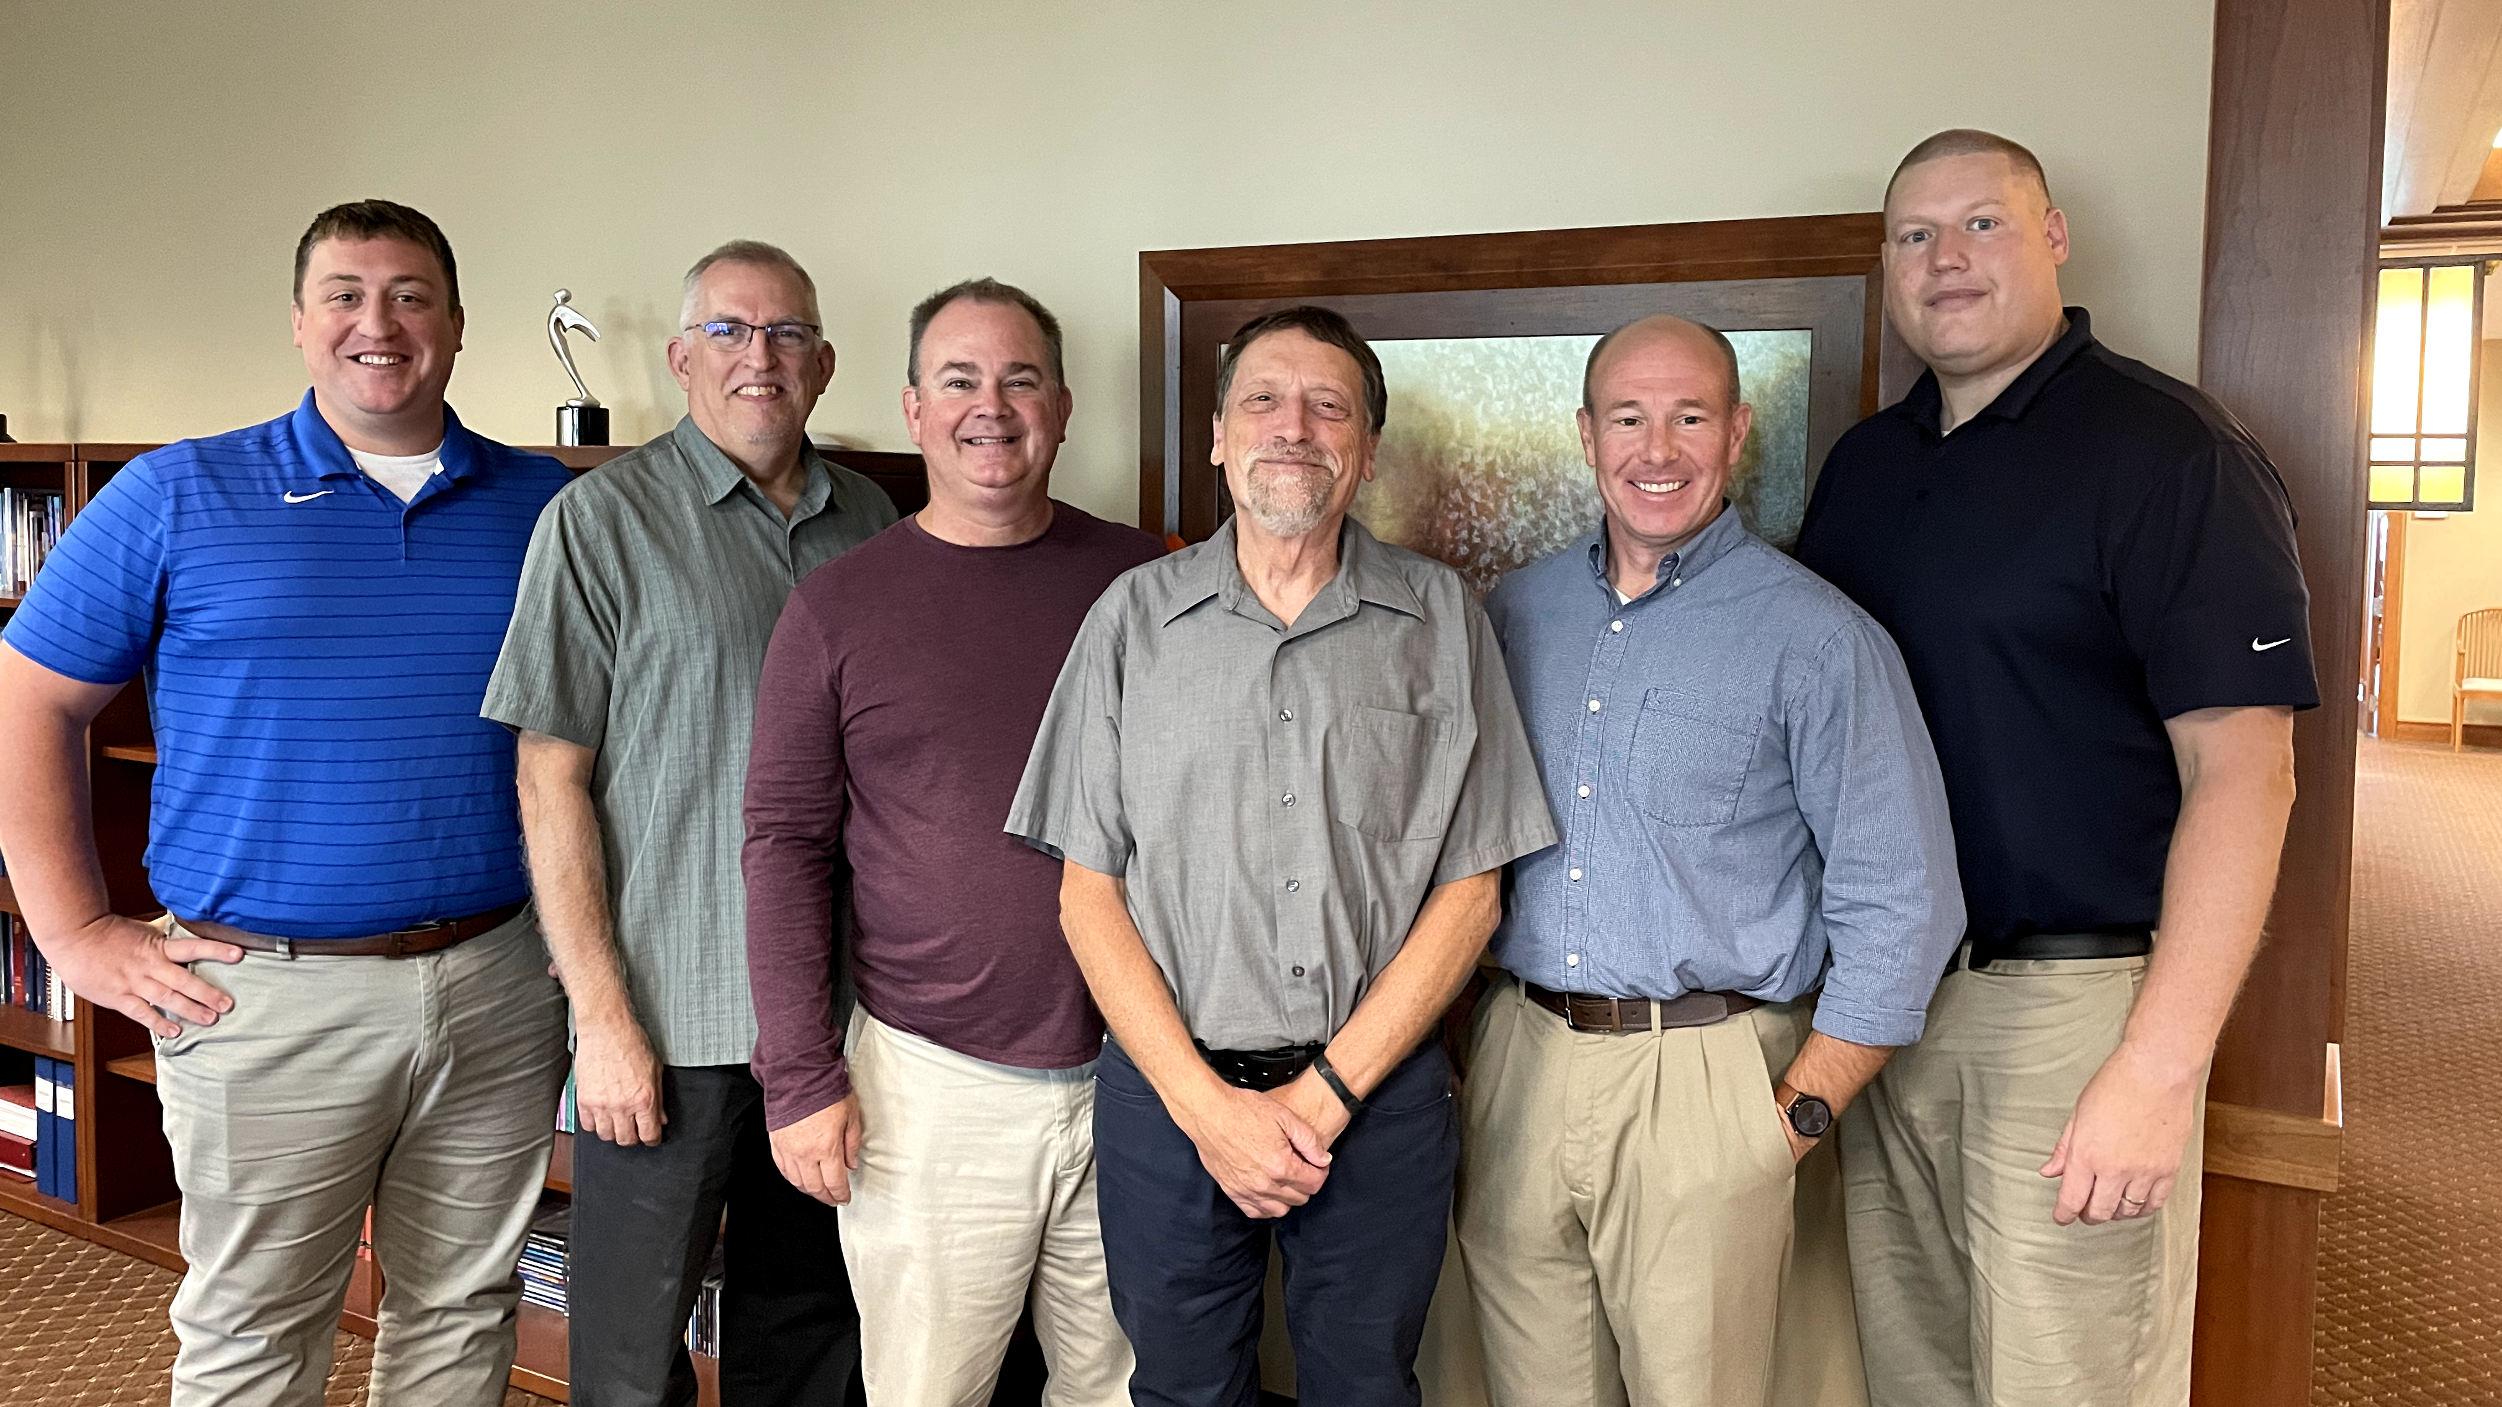
Mission Counselors: Guiding mission congregations and assisting District Mission Boards
Notes:
District mission boards (DMBs) and home mission churches are supported by three home mission counselors. They work with the DMBs to find, evaluate, and develop new home mission locations. They also provide onsite assistance to home mission congregations and counseling and training to the new missionaries who are called to serve them. This support is crucial in guiding mission churches on the way to becoming self-supporting congregations. WELS Home Missions also works with three specialized mission counselors that assist congregations with Hispanic, Asian, and Campus Ministry outreach.
Pictured (from left to right):
Rev. Neil Birkholz, North American Asian Ministry Consultant
Rev. Tim Flunker, Hispanic Outreach Consultant
Rev. Wayne Uhlhorn, Mission Counselor
Rev. Mark Birkholz, Mission Counselor
Rev. Matt Vogt, Mission Counselor,
Rev. Dan Lindner, Campus Ministry Mission Counselor

Slide 11
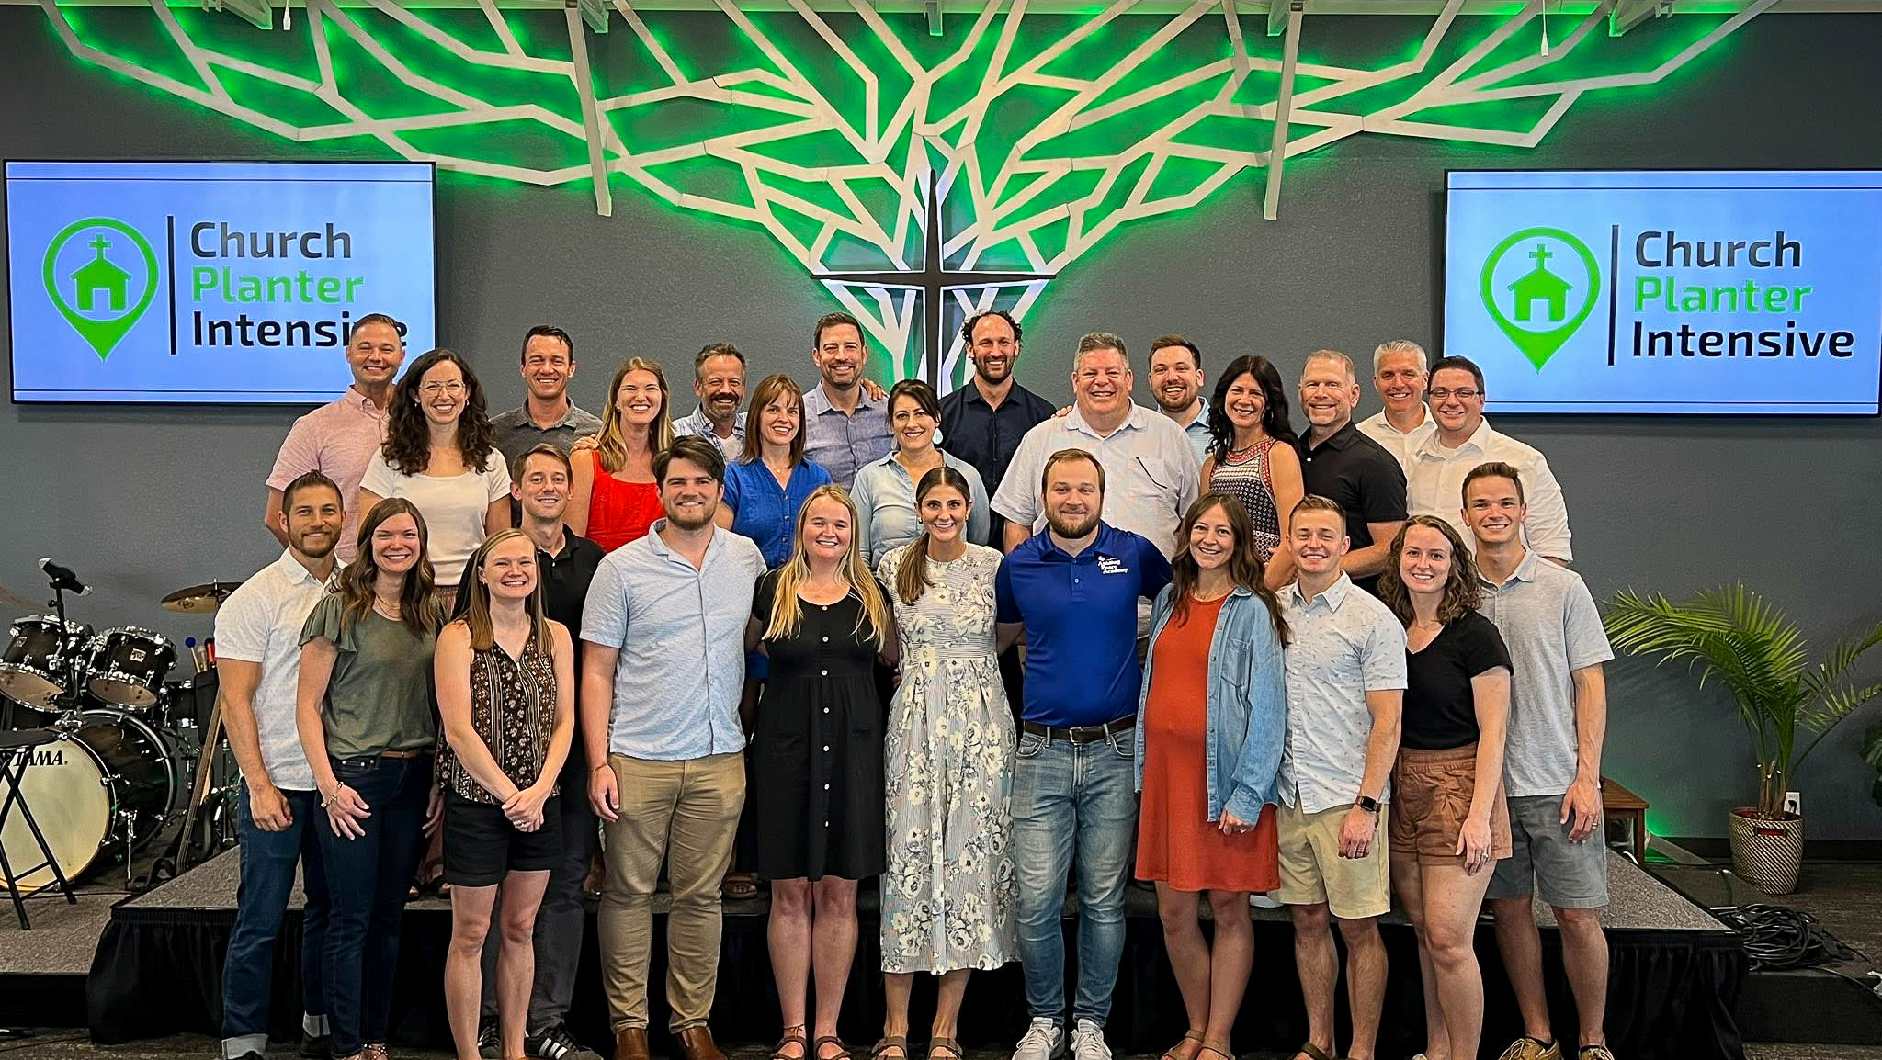
Equipping new missionaries – Church Planter Intensive and coaching program
Notes:
New church planters are not left to fend on their own!
A group of six home missionaries and other experienced church planters gathered together at Carbon Valley Lutheran Church in Firestone, Colo., for the Church Planter Intensive weekend July 23-27. Experienced church planter Jared Oldenburg (Eternal Rock – Castle Rock, Colo.) developed the program and Home Missionary Matt Rothe (The Way – Fredericksburg, Va.) now leads the training. This extended weekend seminar encourages and equips pastors who are called to plant brand new home mission churches. The purpose of this event is to:
Talk through church planting principals.
Be a sounding board to new missionaries and their unique situations.
Give the missionary a chance to think about all aspects of starting a church
Encourage the missionary to make decisions and plans based on the core group, community and place God has placed him. In other words, don’t copy, but instead learn to lead intuitively.
Help the missionary establish some big picture benchmarks/activities.
Offer encouragement by openly sharing what it’s like to be a church planter
Provide the opportunity for a new missionary to network with other missionaries.
After the intensive, new church planters are paired with a coach from an established mission church to guide them for their first two years of launching a new church. Home Missionary Joel Schulz (Divine Savior – Delray Beach, Fla.) leads that portion of the program.
Both the Church Planter Intensive and the coaching program are sponsored and encouraged by WELS Home Missions.
“As much as Church Planter Intensive was able to ground me, set our ministry on a good path, and send us out with valuable information, the coaching program is now my lifeline in an ongoing way. My coach is the most-accessible avenue to bounce ideas off, get input from, and help me grow as a pastor.” – Rev. Joe Lindloff, church planter in Marquette, Mich.

Slide 12
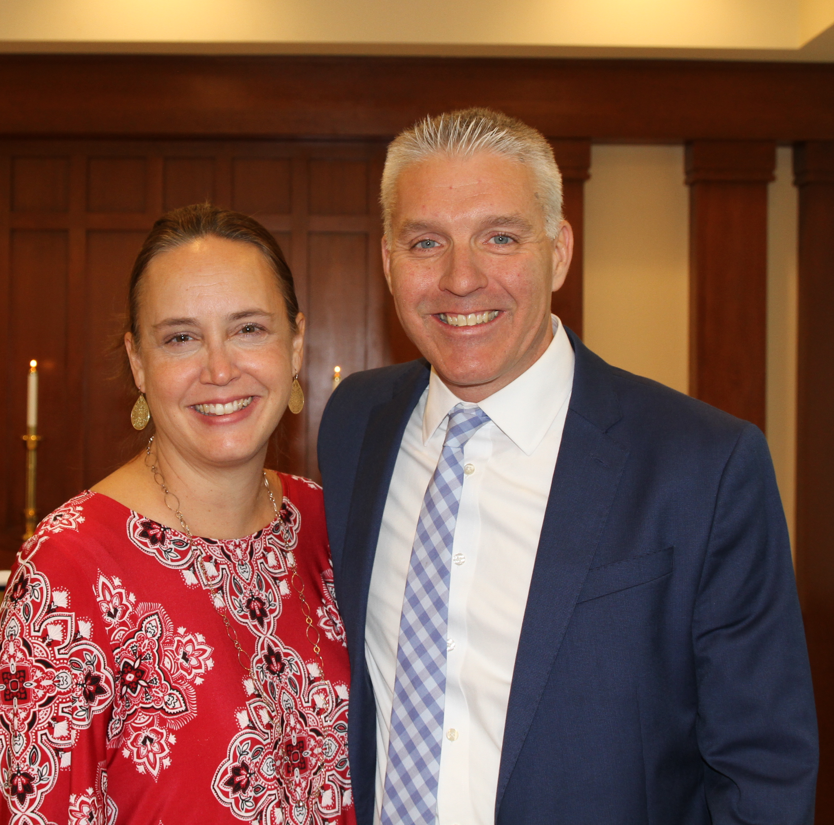
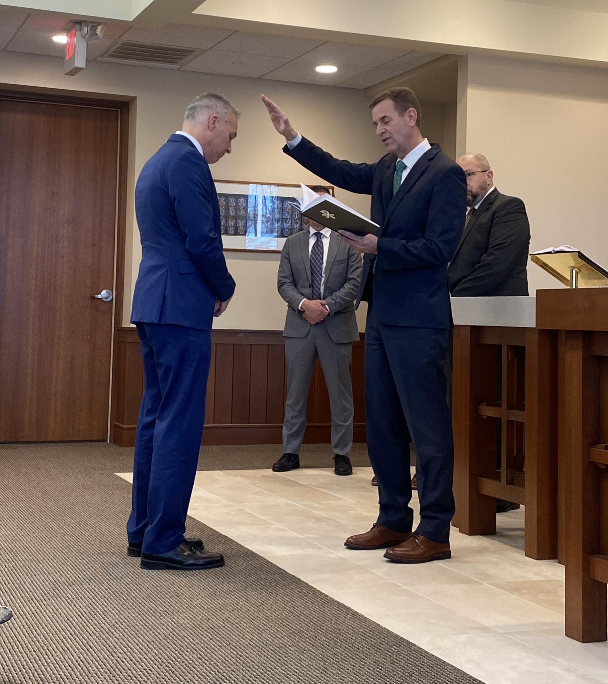
Home Missions administrator
Rev. Mark Gabb
Notes:
WELS Missions welcomed Mark Gabb as the new administrator for WELS Home Missions. Gabb began serving in this role in January 2024 following a vacancy in the position since spring 2022, when previous administrator Keith Free accepted a call to parish ministry. Gabb was formally installed as the Home Missions administrator Wed., Jan. 31, at the WELS Center for Mission and Ministry weekly chapel service. Gabb is not new to the work of WELS Home Missions. He has served as a member of the Board for Home Missions for ten years and as chairman for three, taking on additional leadership responsibilities during the vacancy.

Slide 13

Exploratory missions
in your district
Notes:
View our interactive Google map found at wels100in10.net to see where your district mission board is exploring outreach in your district. Anything in “blue” indicates an exploratory mission. District mission boards and mission counselors work with exploratory missions to develop a core group of members and begin Bible study and initial outreach before coming to the Board for Home Missions for official home mission status. These missions are not currently approved but are preparing the groundwork needed for their formal ministry request to the Board for Home Missions. Each request is thoroughly vetted and either prioritized, deferred, or denied. Prioritized requests are authorized as funding is available. Please note that there might be some exploratory missions on this list that will not end up receiving home mission status after the review process.

Slide 14

Fall 2025 New Starts:
Altoona, Wis.
Buffalo, N.Y.
Naples, Fla.
Olathe, Kan.
The Sandhills, N.C.
West Richland, Wash.
Wilmington, N.C.
Notes:
On Sept. 18-19, WELS Board for Home Missions approved seven new mission starts toward the synodwide 100 Missions in 10 Years initiative. This is thanks to the generous gifts received over the past year.

Slide 15
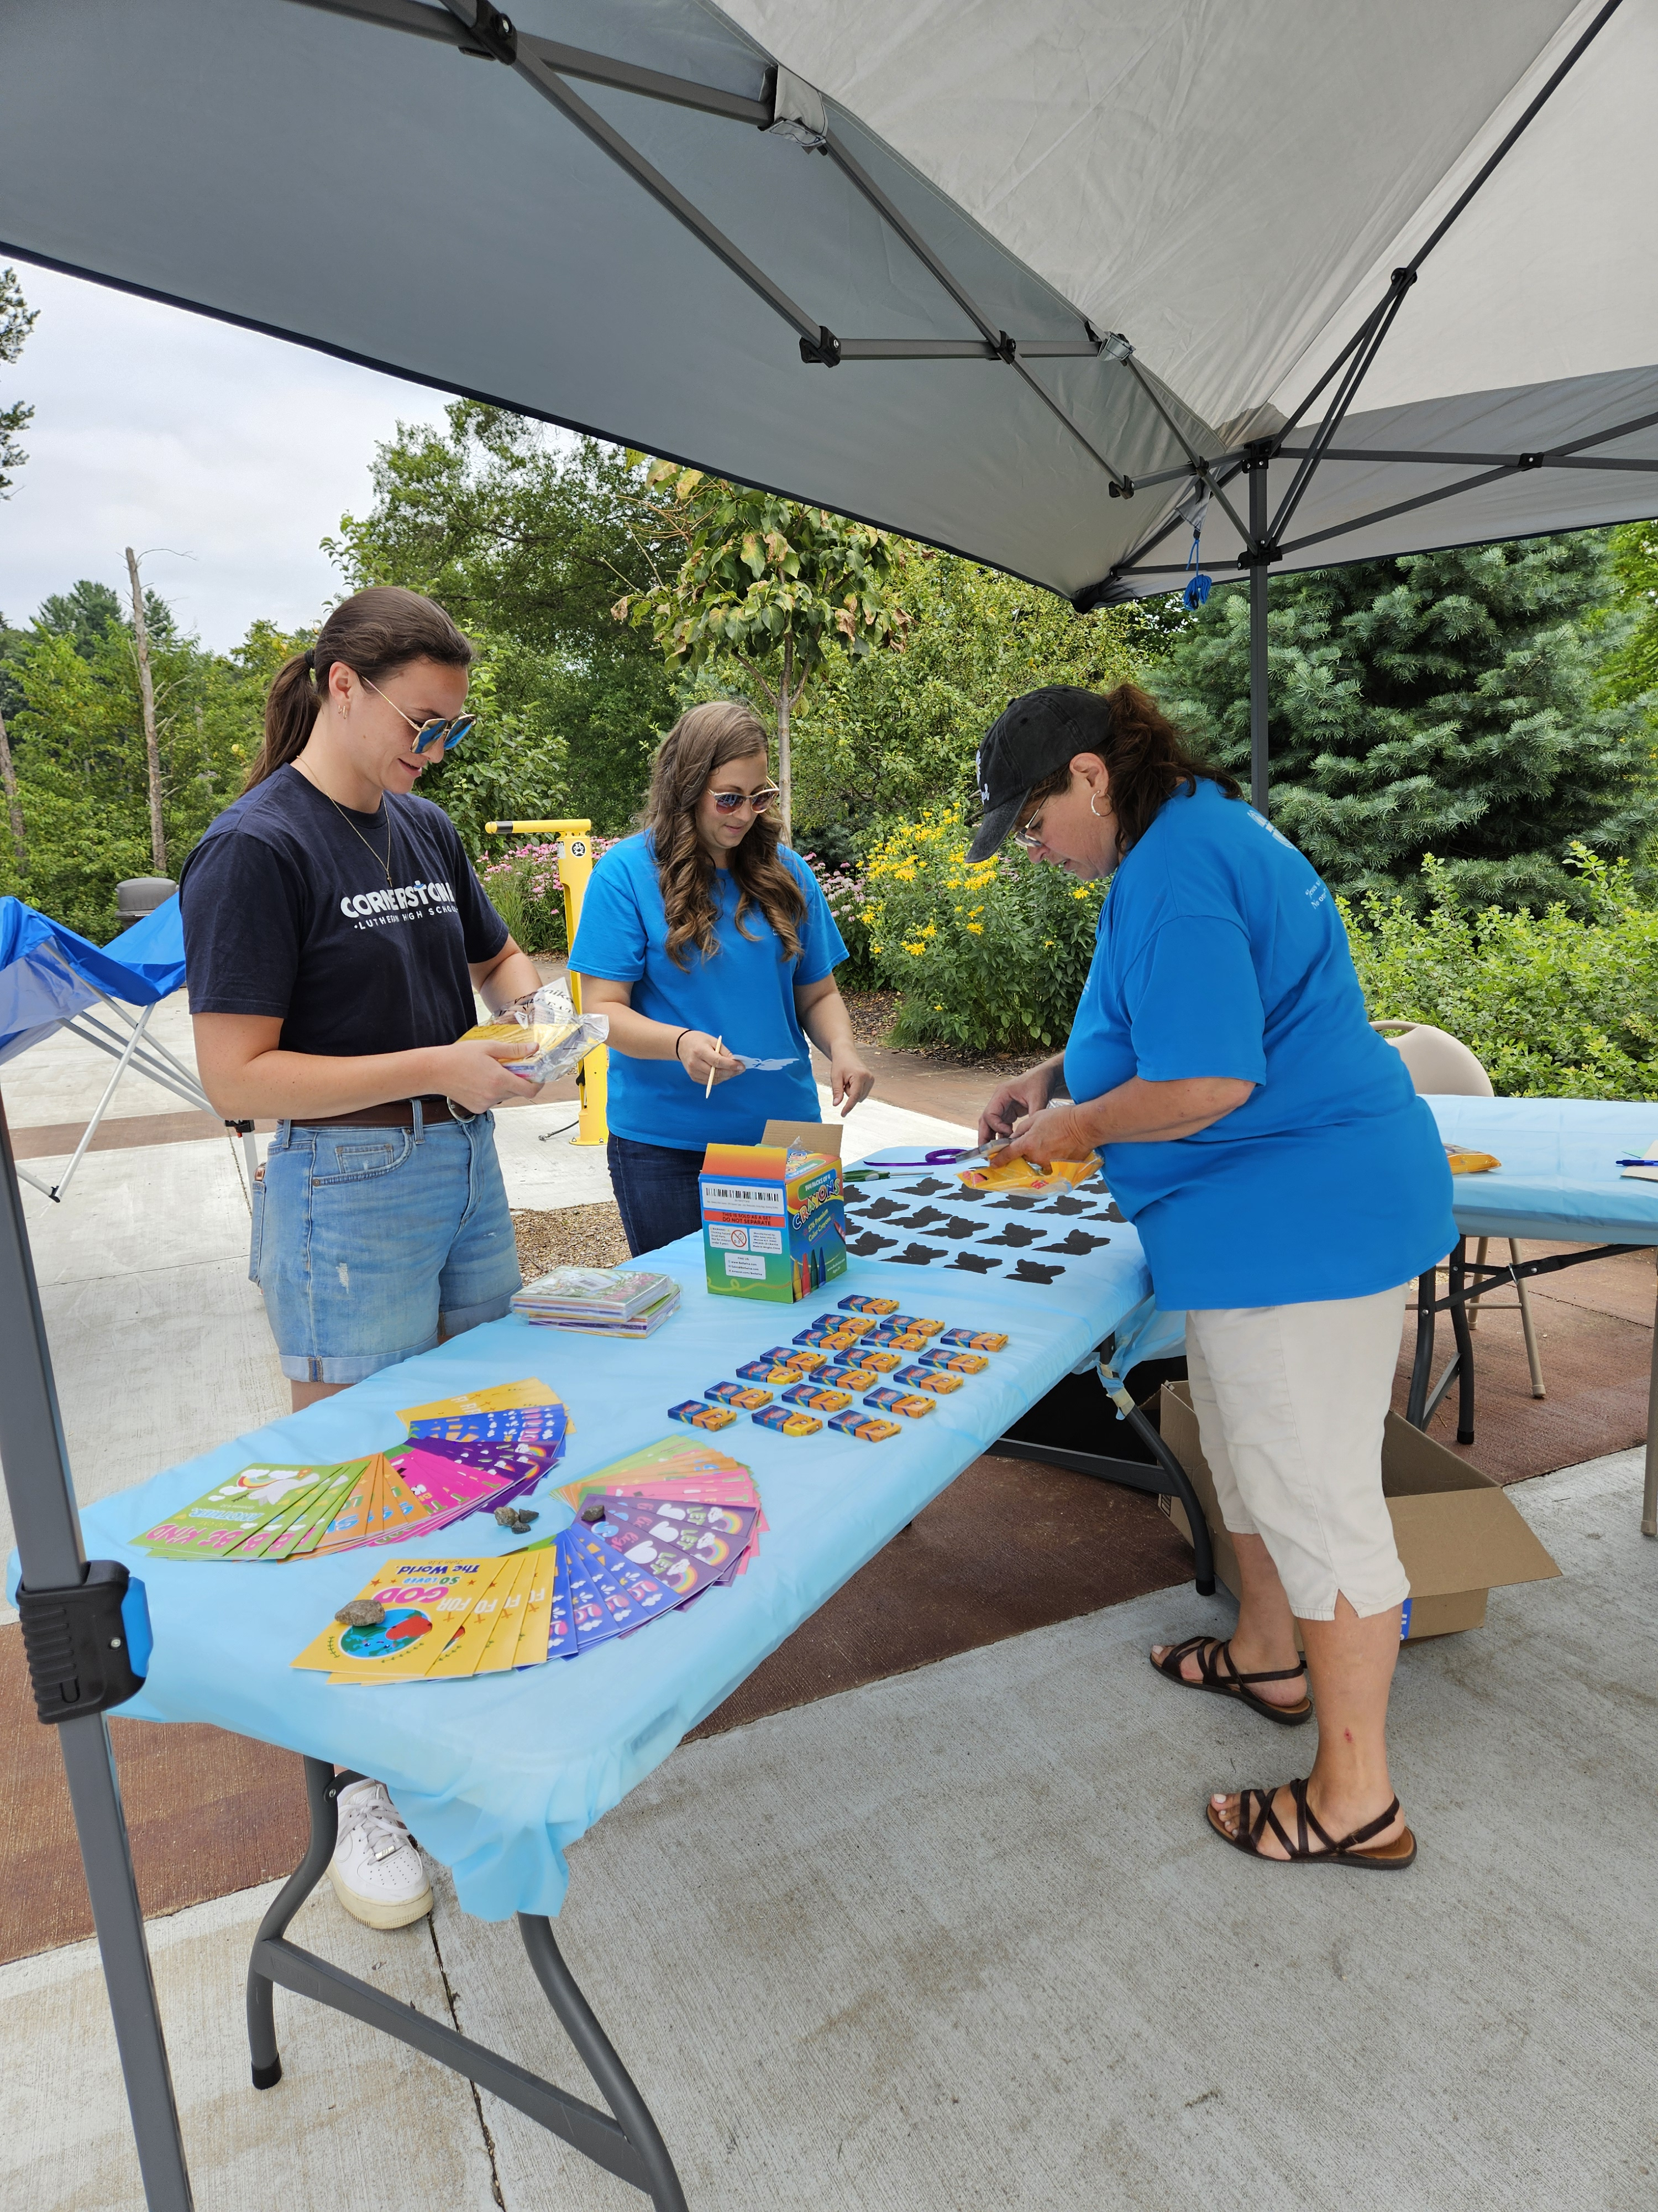
New Start – Altoona, Wis.
Notes:
Located just east of Eau Claire, Altoona is one of the fastest-growing communities in western Wisconsin. With a population nearing 10,000 and projected to grow by 3 percent annually, Altoona attracts young families, professionals, and retirees seeking a small-town feel with access to urban amenities. The Western Wisconsin District Mission Board has been working closely with a core group from St. Mark in Eau Claire since early 2023. This group has been active hosting community events, launching monthly devotional services, and building a growing prospect list. With strong local support, a clear ministry plan, and a heart for outreach, the Altoona mission is poised to bring the gospel to a community eager for connection and truth.

Slide 16
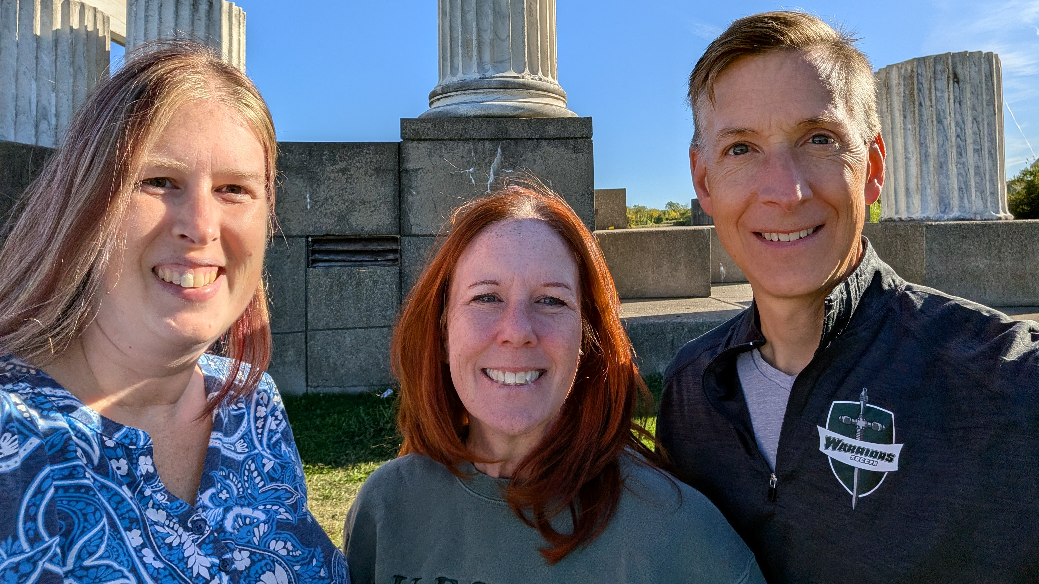
New Start – Buffalo, N.Y.
Notes:
As one of the largest metro areas in the United States without a WELS church, Buffalo presents a unique and urgent opportunity for gospel outreach. The target area—Kenmore, North Buffalo, and Tonawanda—has about 95,000 residents within a 2-mile radius. A dedicated core group has begun gathering for Bible study and outreach, laying the groundwork for a new church plant. With Buffalo’s affordable housing, expanding job market, and a population eager for spiritual connection, the mission team is excited to build relationships and share the hope of Christ with the community.

Slide 17
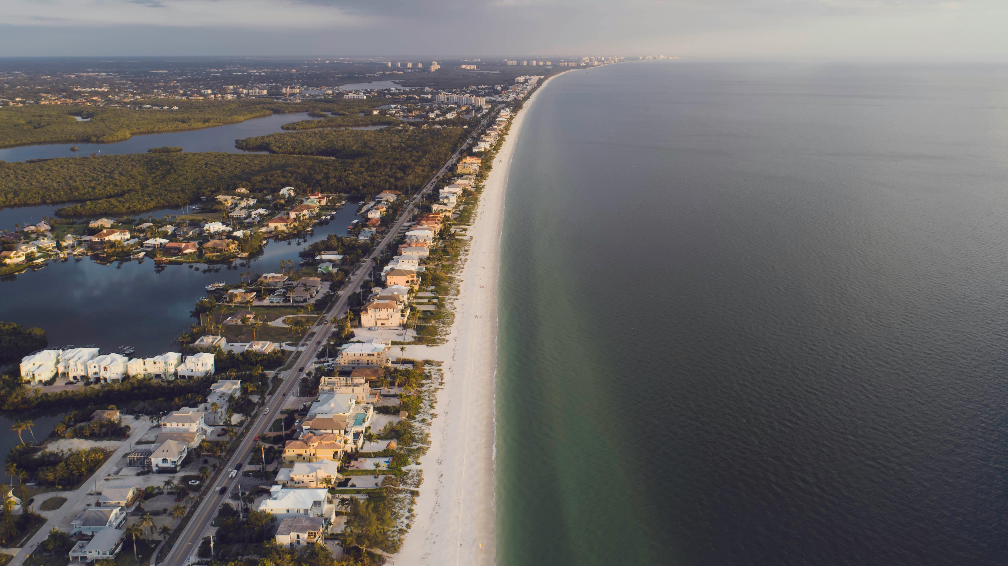
New Start – Naples, Fla.
Notes:
Naples, consistently ranked among the best places to live and retire in the United States, is experiencing rapid growth and demographic change. The district mission board and mission counselor have made multiple visits—talking with locals, meeting community leaders, and learning about the area’s needs. A significant portion of residents are unchurched and eager for spiritual connection. With strong financial support and a clear plan, the mission is ready to hit the ground running—focused on reaching out, making connections, and sharing the hope of Christ with a growing and diverse community.

Slide 18
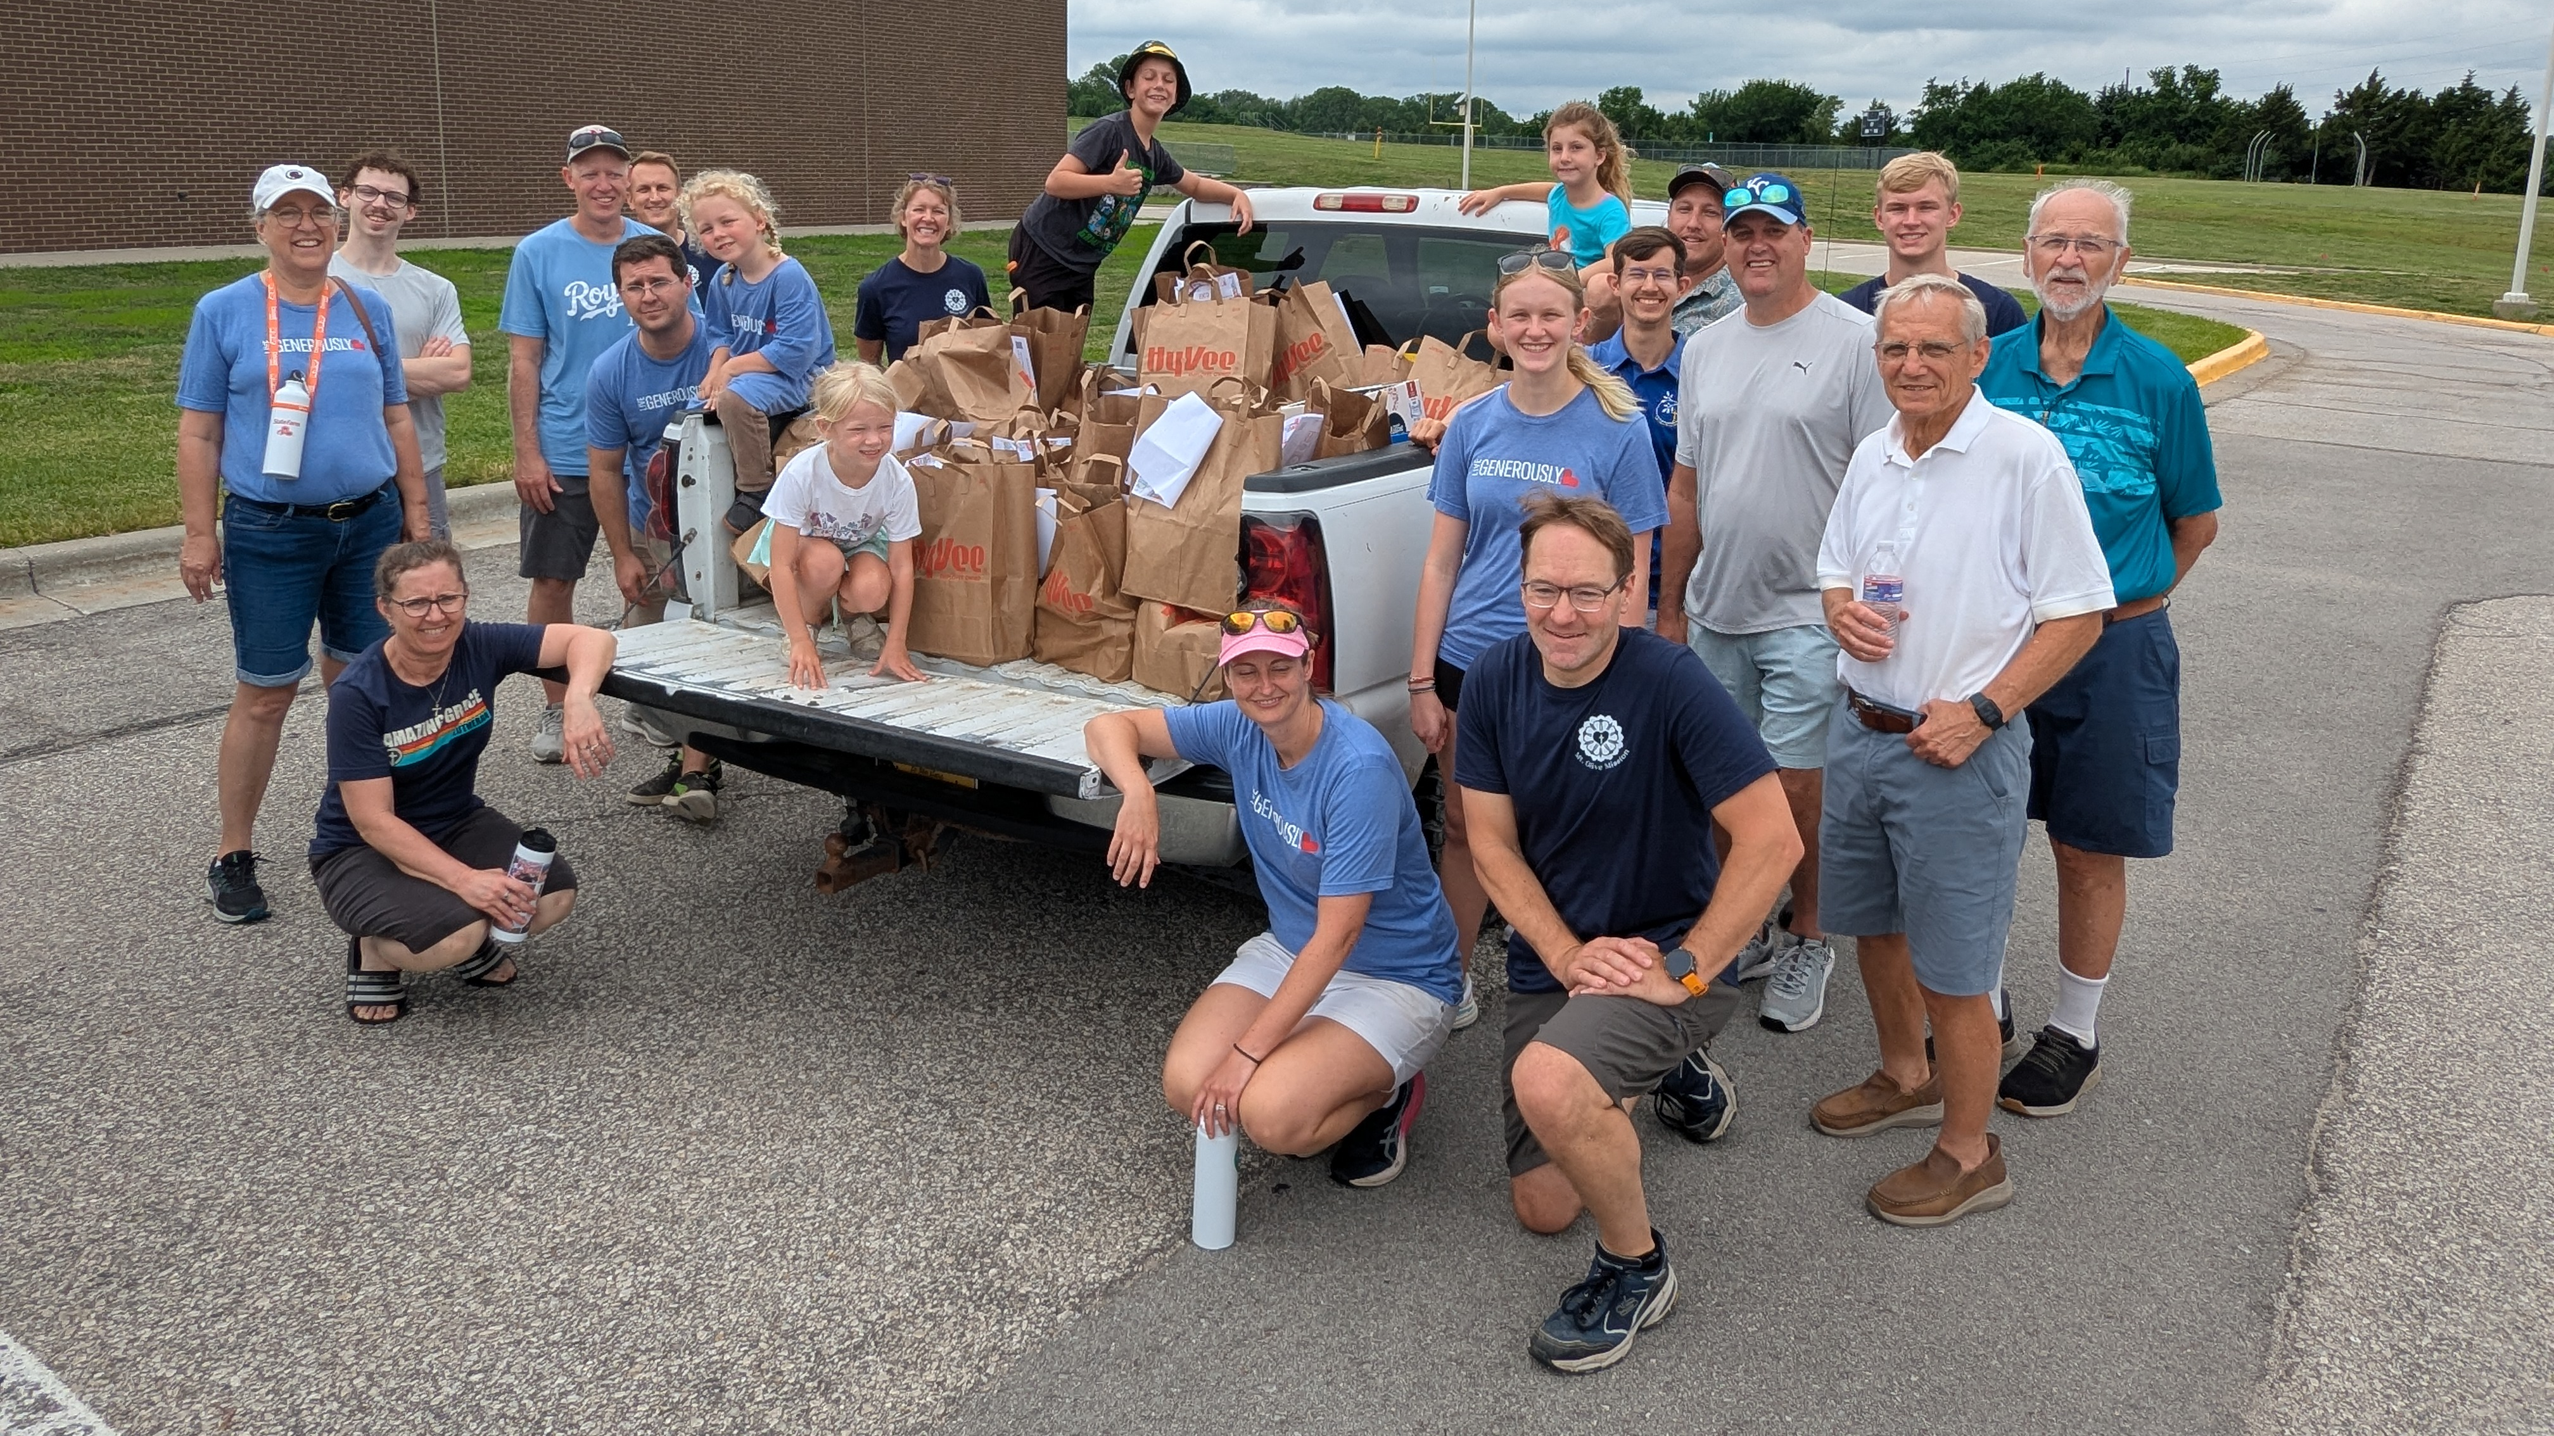
New Start – Olathe, Kan.
Notes:
Olathe, located in the fast-growing southwest Kansas City metro area, has seen its population surge with continued growth expected. Major employers have fueled this expansion, making Olathe one of the most affordable and family-friendly cities in the nation. The Nebraska District Mission Board has been working with Mt. Olive in Overland Park, Kan., to establish a new mission, gathering a dedicated core group and hosting regular Bible studies and planning meetings. With strong support from Mt. Olive and a clear vision for outreach, the Olathe mission is poised to reach many new families with the gospel.

Slide 19
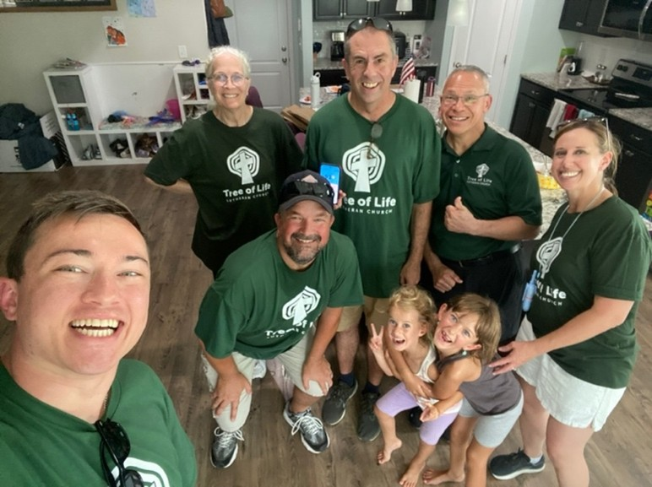
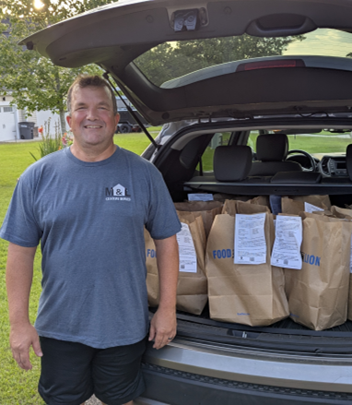
New Start – The Sandhills, N.C.
Notes:
The Sandhills area of North Carolina is experiencing steady growth as both retirees and young families move into the area, with major investments like Amazon’s new data center fueling local development. With close proximity to Fort Bragg—the world’s largest military base—the region also attracts commissioned military personnel who often choose to make the Sandhills their permanent home. The effort is being led by a core group from Tree of Life in Cary, N.C. The team has begun regular outreach and canvassing, building momentum and a growing prospect list in a region where confessional Lutheran churches are few.

Slide 20
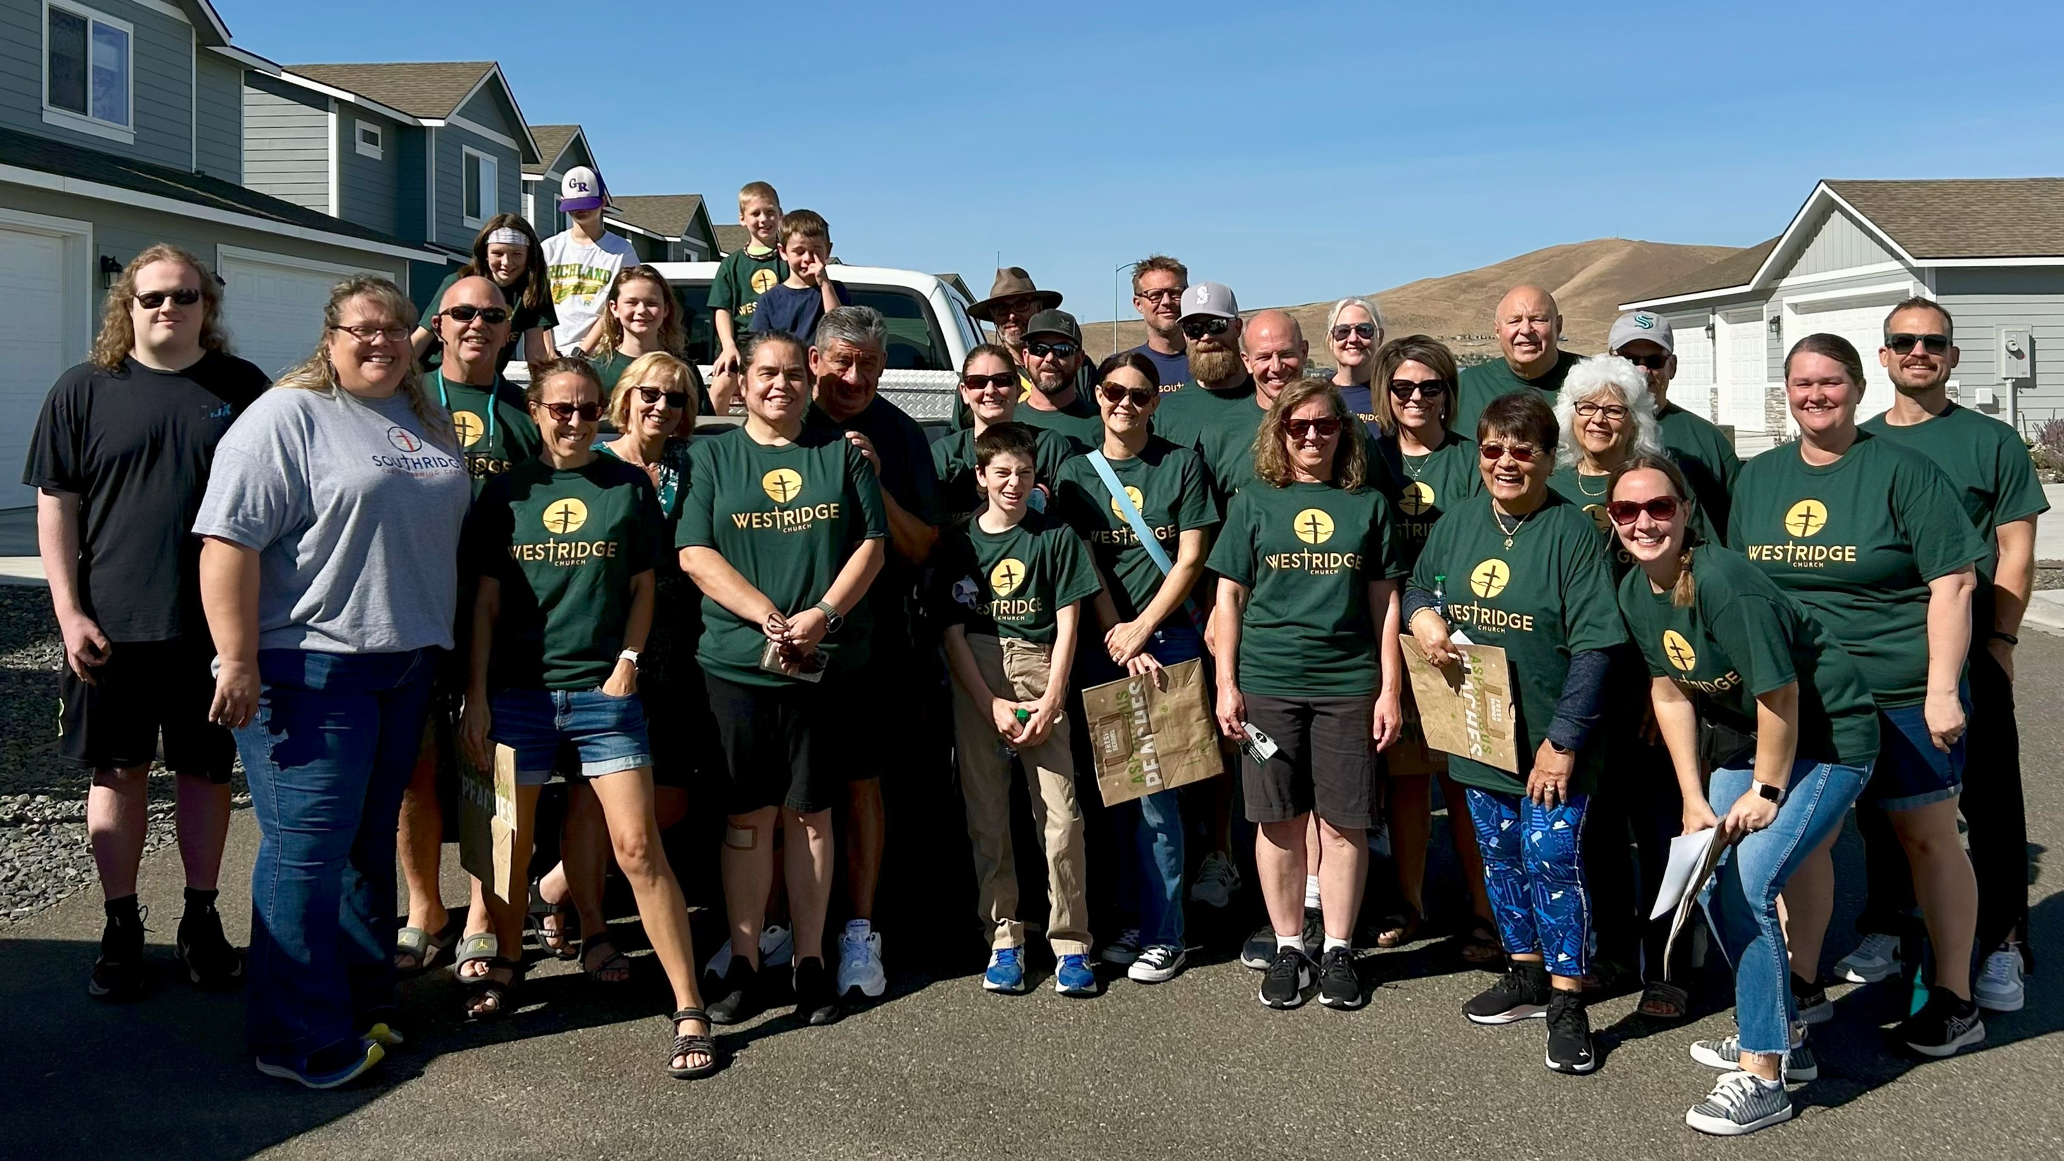
New Start – West Richland, Wash.
Notes:
West Richland, located just outside the Tri-Cities, is experiencing rapid growth as families and professionals move in for its strong job market and quality schools. Since 2024, the Pacific Northwest District Mission Board has been working with a committed core group of members from Southridge Church in Kennewick to establish a second site in West Richland. The group has already begun outreach through community service activities and fellowship events. With continued momentum and support, the new mission aims to launch regular worship and ministry activities in 2025.

Slide 21
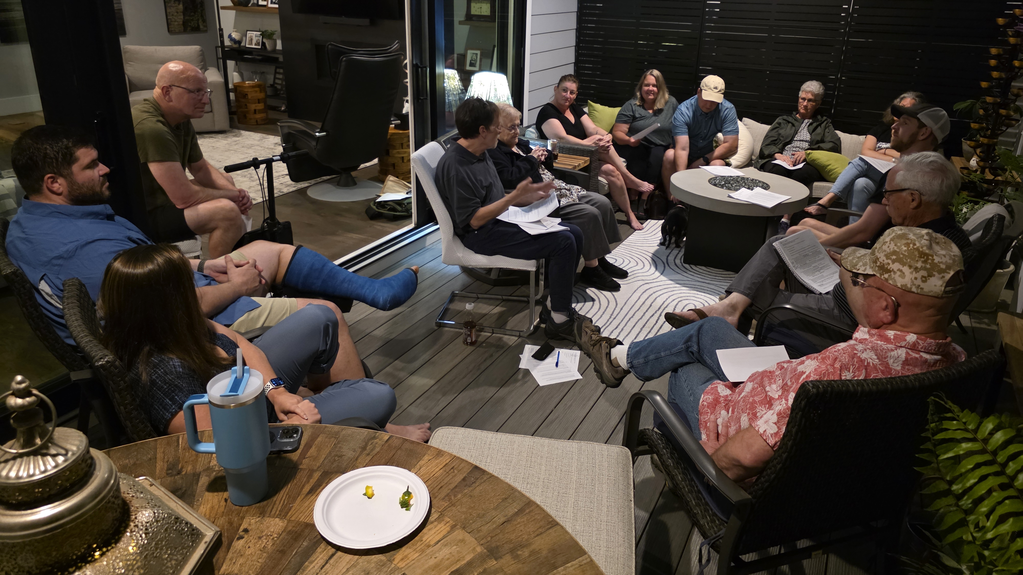
New Start – Wilmington, N.C.
Notes:
Wilmington’s northeast neighborhoods are seeing a surge of new families and rapid development, making this area one of the fastest-growing corners of North Carolina. A core group of 18 people from Ascension in Jacksonville, N.C., meets regularly for Bible study and planning. With no WELS church nearby and easy access along U.S. 17, the group is laying the foundation for a welcoming church that blends in-person and online worship, Bible instruction, and plenty of community service.

Slide 22
Spring 2025 New Starts:
Arlington, Tenn.
Erie, Colo.
Jarrell, Texas
Madison, Wis.
San Tan Valley, Ariz.
Notes:
On April 3–4, WELS Board for Home Missions approved five new mission starts and six enhancements toward the synodwide 100 Missions in 10 Years initiative.
Each of the five new starts is backed by a mature, mission-minded core group that has been actively sharing the gospel in their communities—even before seeking formal support. That kind of groundwork helps lay a strong foundation for long-term gospel ministry.

Slide 23
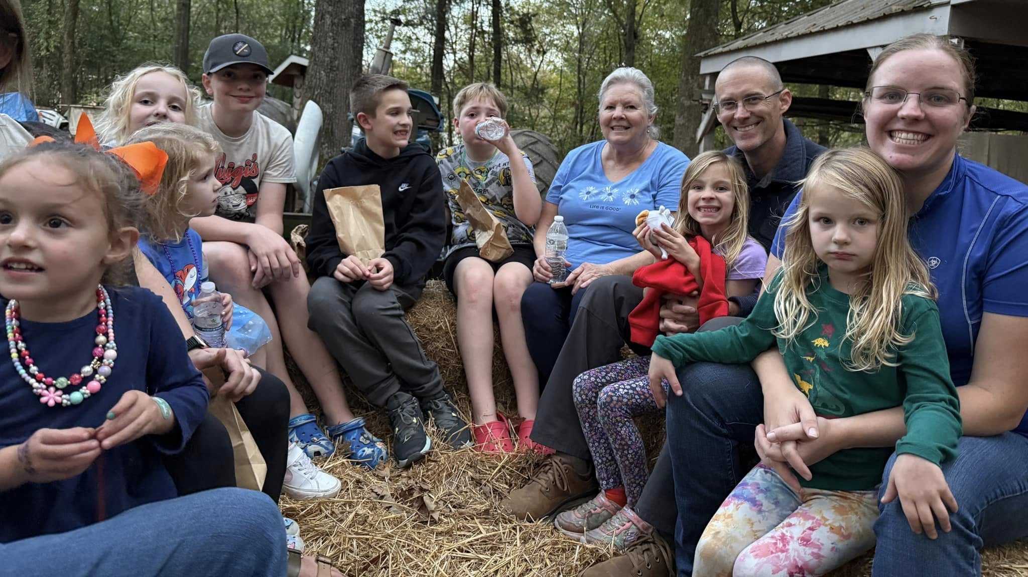
New Start – Arlington, Tenn.
Notes:
Arlington, located 25 miles northwest of Memphis, is on the brink of rapid growth with Ford Motor Company set to build a new plant for electric truck production. Since 2022, the South Atlantic District Mission Board has been working with a dedicated group of 60 members and Pastor Jim Turriff from Gloria Dei, Memphis, who plan to relocate and establish a fresh start in Arlington under a new name.

Slide 24
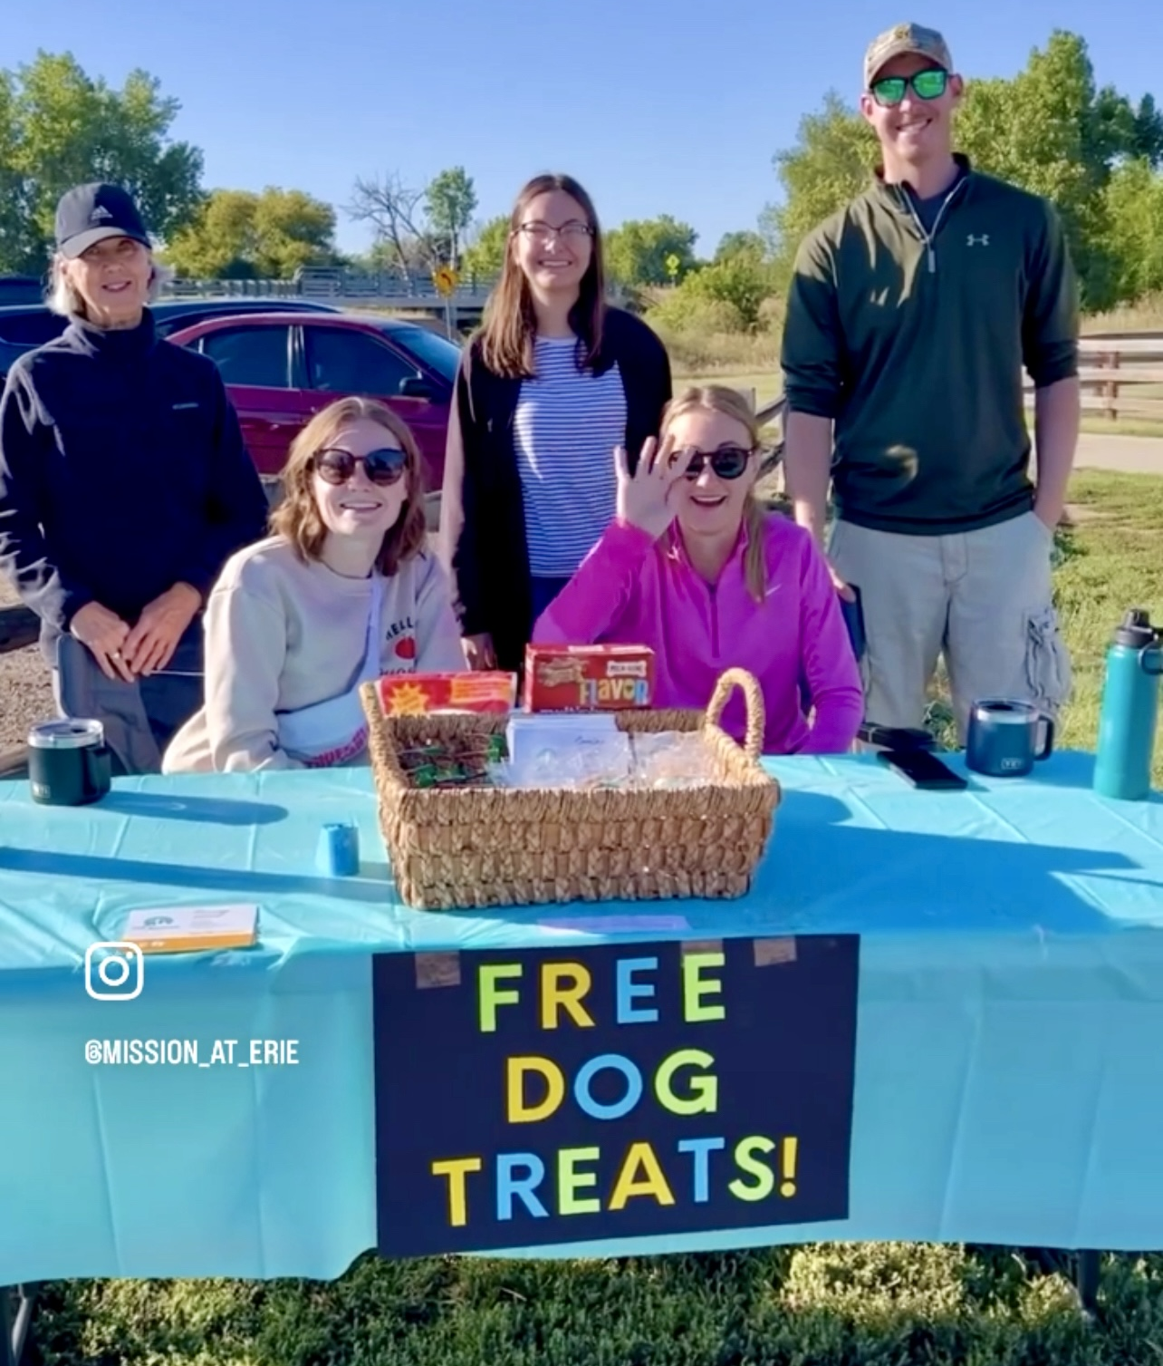
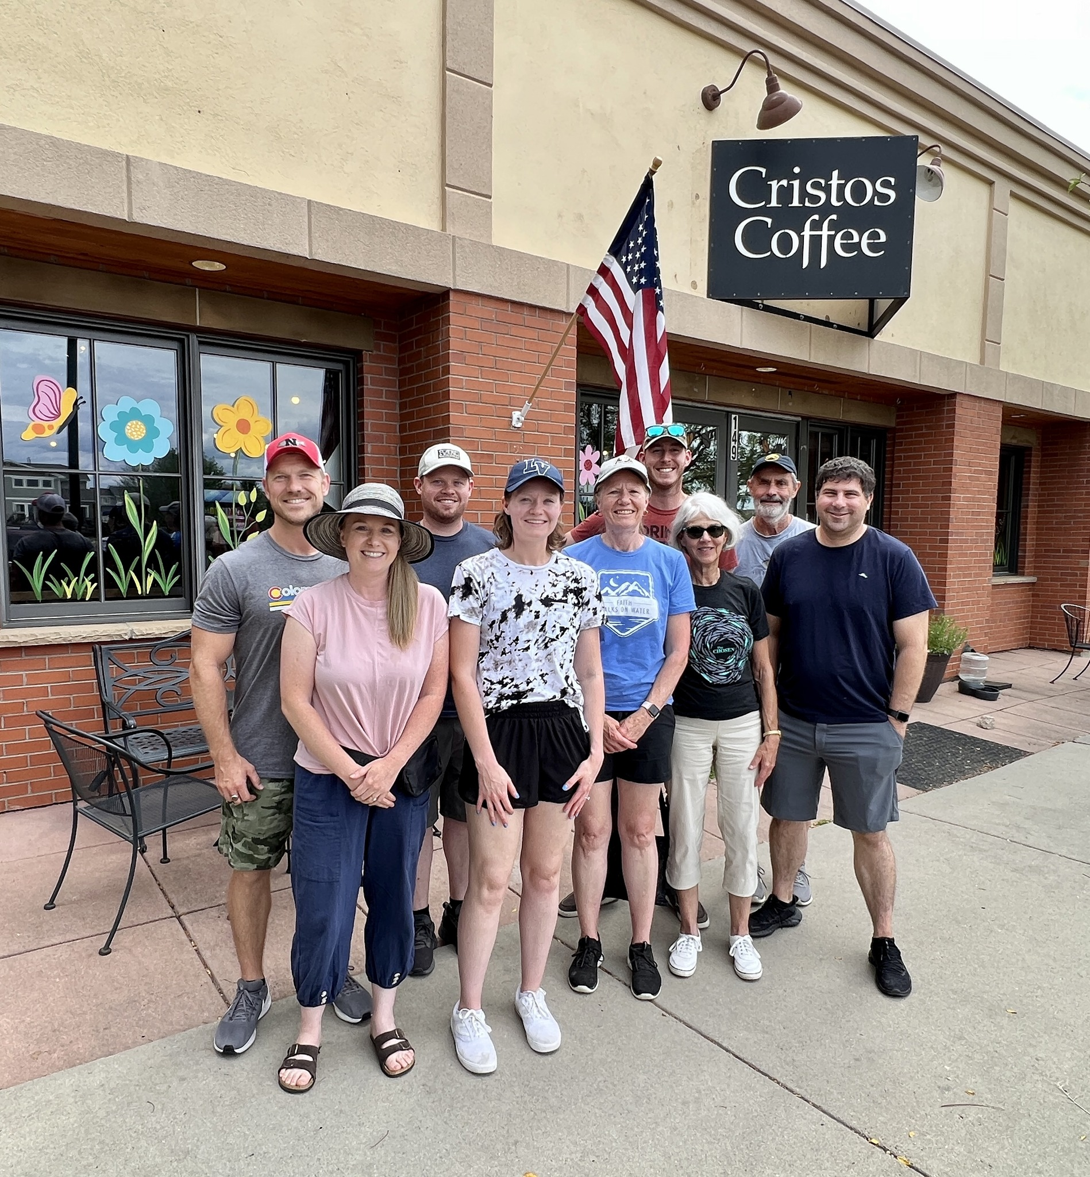
New Start – Erie, Colo.
Notes:
Erie, located 30 miles north of Denver, has experienced a 55 percent population increase from 2010 to 2020, with continued growth expected. The Colorado District Mission Board began exploring this area in 2022. A core group of 10 adults has been gathering for fellowship and Bible study while attending local festivals to share its plans for a new church. So far, 25 people have expressed interest in learning more about the mission efforts.

Slide 25
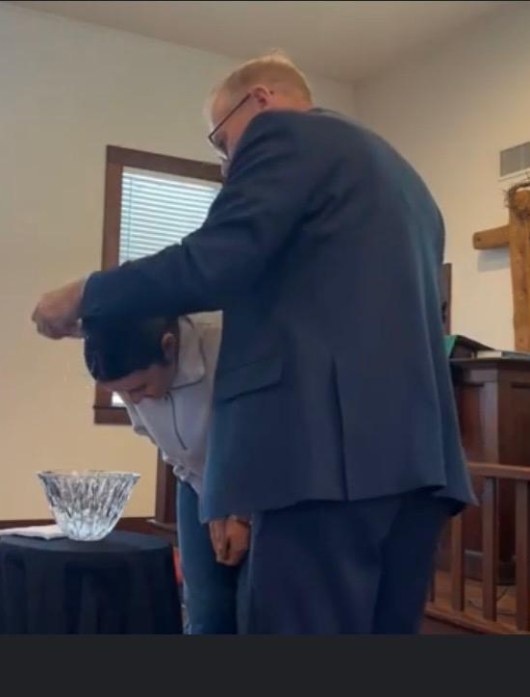
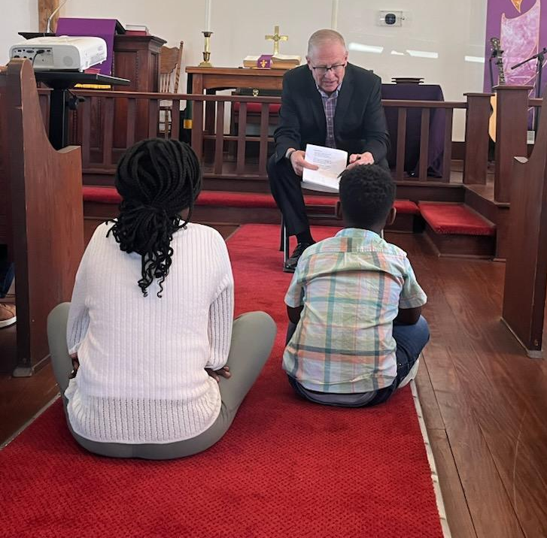
New Start – Jarrell, Texas
Notes:
Jarrell is a rapidly growing town located 44 miles north of Austin in northern Williamson County. The county has seen its population surge from 426,000 in 2010 to 671,000 in 2022, with continued growth expected. For the past three years, Pastor Don Patterson has been working with a core group of 11, which began holding weekly worship in October 2024. The group has identified 90 prospects, many of whom they connected with by volunteering in the Jarrell Bible Community Food Pantry. The plan is to rent space for eight years before securing land and constructing a permanent church home.

Slide 26
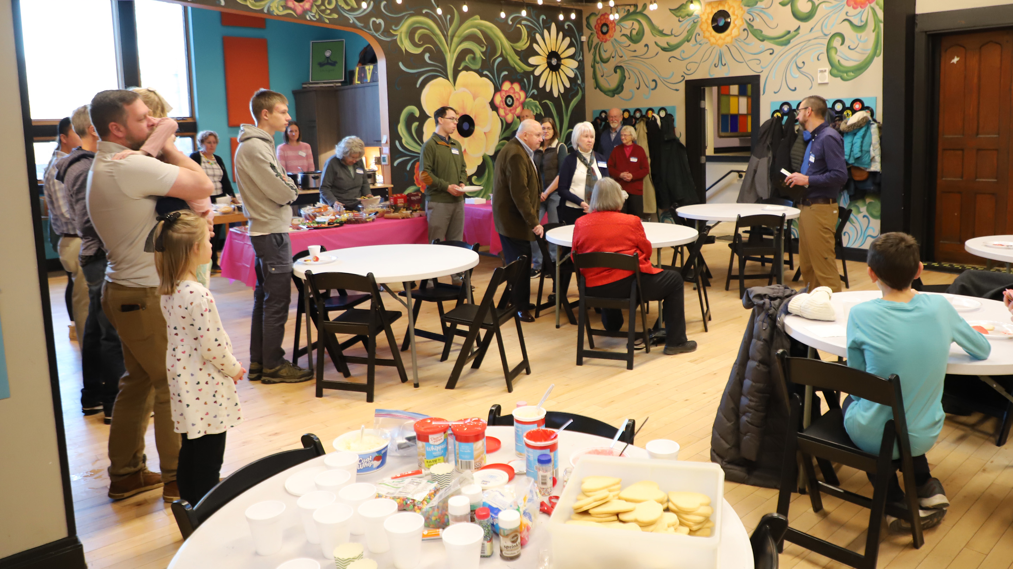
New Start – Madison, Wis.
Notes:
The center of Madison is expected to grow by 200,000 in future years, with many residents seeking an urban lifestyle. A core group of 14 adults, familiar with the area, has been working together since 2022—meeting regularly for Bible study and ministry planning—and has also secured a rental space for worship and community activities. Twenty prospects have expressed a strong interest in learning more about this new mission. A new mission plant in the center of urban Madison would allow WELS to reach an entirely new demographic.

Slide 27
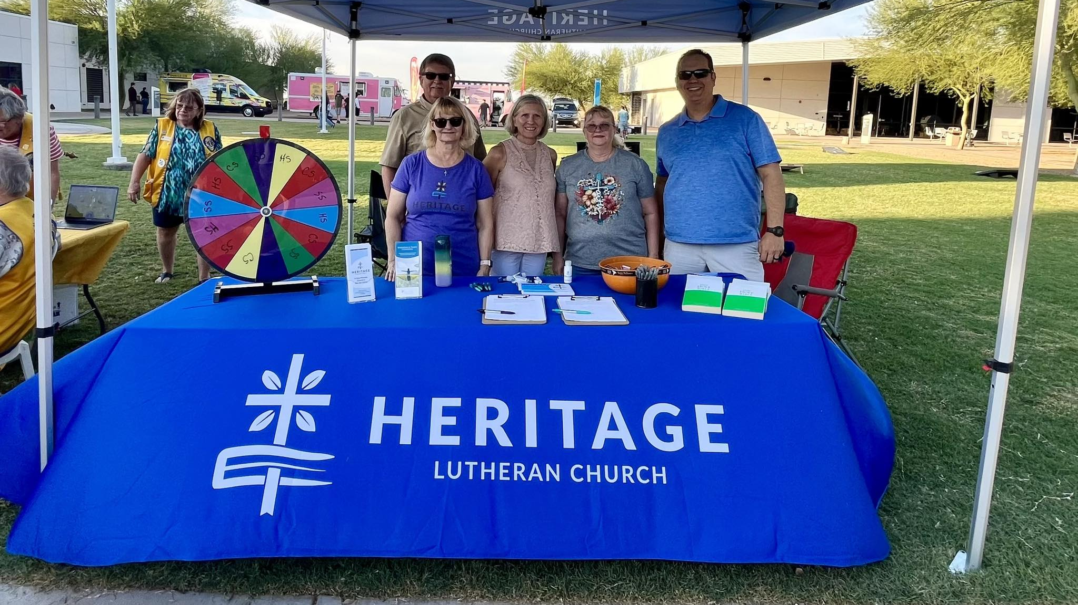
New Start – San Tan Valley, Ariz.
Notes:
Located on the eastern edge of Phoenix, San Tan Valley is experiencing rapid growth with no signs of slowing down. Since 2022, the Arizona-California District Mission Board has been working with Heritage in Gilbert, Ariz., to plant a new mission in the area. A core group of 26 adults has been gathering regularly for Bible study and community events, building connections and momentum. In October 2024, they began holding regular worship services and have already identified 127 prospects interested in learning more about the new church.

Slide 28
2025 Enhancements:
Christ, Clarksville, Md.(restart)
Living Word, Petaluma, Calif. (restart)
Living Word, Waukesha, Wis.
Redeemer, Edna, Texas
Risen Savior, Lakewood Ranch, Fla.
Saint Mark Mankato, Minn.
Notes:
Christ, Clarksville, Md. (restart): Christ in Clarksville, Md., is looking for short-term Home Missions support to revitalize its outreach efforts. Located in the Washington–Baltimore metropolitan area, the church is ideally positioned to reach a diverse community. Despite facing challenges due to an unexpected pastoral vacancy and after-effects of the pandemic, the core group remains dedicated and mission-minded. The church aims to grow both spiritually and numerically under the guidance of a full-time pastor.
Living Word, Petaluma, Calif. (restart): A dedicated core group of members at Living Word are excited to relaunch their outreach efforts with the addition of a full-time home missionary. Situated north of San Francisco, this growing community presents numerous outreach opportunities. Living Word is already actively engaging with the nearby Coast Guard, leading worship and Bible studies at a local senior center, hosting “Stay and Play” events for families, and managing a community garden on its property that fosters gospel conversations.
Living Word, Waukesha, Wis.: Strategically built across the street from the local high school, Living Word has experienced steady growth, with membership increasing by 20 percent since 2022. The congregation has welcomed 50 adult confirmations in the last four years. Now, with 400 names on its prospect list, Living Word will receive short-term Home Missions support to call a staff minister who will assist Pastor John Borgwardt in reaching high school families with the gospel and following up with prospective members.
Redeemer, Edna, Texas: Redeemer is a growing congregation with a mission-minded pastor leading the effort. Over the past three years, membership has increased by 26 percent, with 29 adult confirmations during that time. With 279 names on its prospect list and outreach opportunities expanding beyond what one pastor can manage, Redeemer is requesting short-term Home Missions support to call a second bilingual pastor to help connect with the growing community, both Spanish- and English-speakers, and continue reaching more people with the gospel.
Risen Savior, Lakewood Ranch, Fla.: Risen Savior is a thriving congregation in a rapidly growing community with a second site now established in Parrish, Fla. Since its beginning in 2016, the congregation has grown from 66 to 440 members, with 134 adult confirmations in the last three years alone. The church now has 350 families on its prospect list. To help manage the expanding outreach efforts, Risen Savior is requesting short-term Home Missions support to call a second pastor who will assist with these growing ministry opportunities.
Saint Mark Mankato, Minn.: Over the past three years, Saint Mark Mankato has experienced steady growth, with weekly worship attendance increasing from 97 to 130 and membership rising from 200 to 283. During this time, the congregation celebrated 24 adult confirmations, with even more expected. With 168 names on its prospect list, Saint Mark Mankato is seeking short-term Home Missions support to hire a manager of ministry, which would allow the pastor to dedicate more time to outreach and further strengthen this growing ministry.
Learn more about these enhancements at wels100in10.net/category/enhancement/.

Slide 29
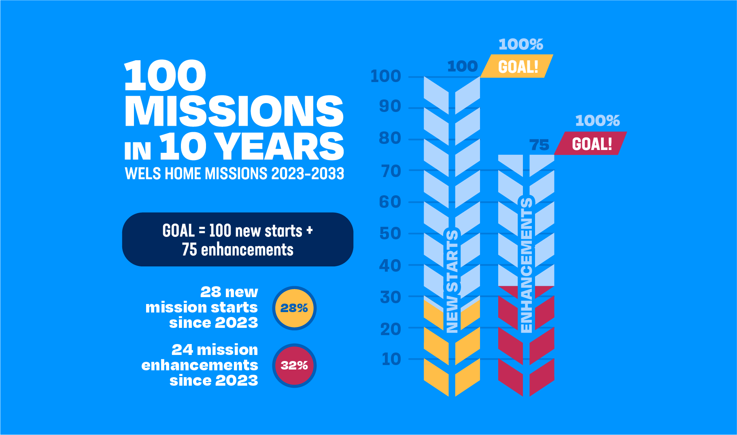
Notes:
Home Missions has limitless opportunities with a limited amount of resources. The Board for Home Missions is actively looking at ways to reduce costs, even in the current economic climate, so that more people can be reached with the gospel. It’s all about being faithful stewards of the resources God has given us. Home Missions will continue working diligently to aggressively reach the lost with the gospel while also being faithful stewards. We trust God will bless our efforts.

Slide 30
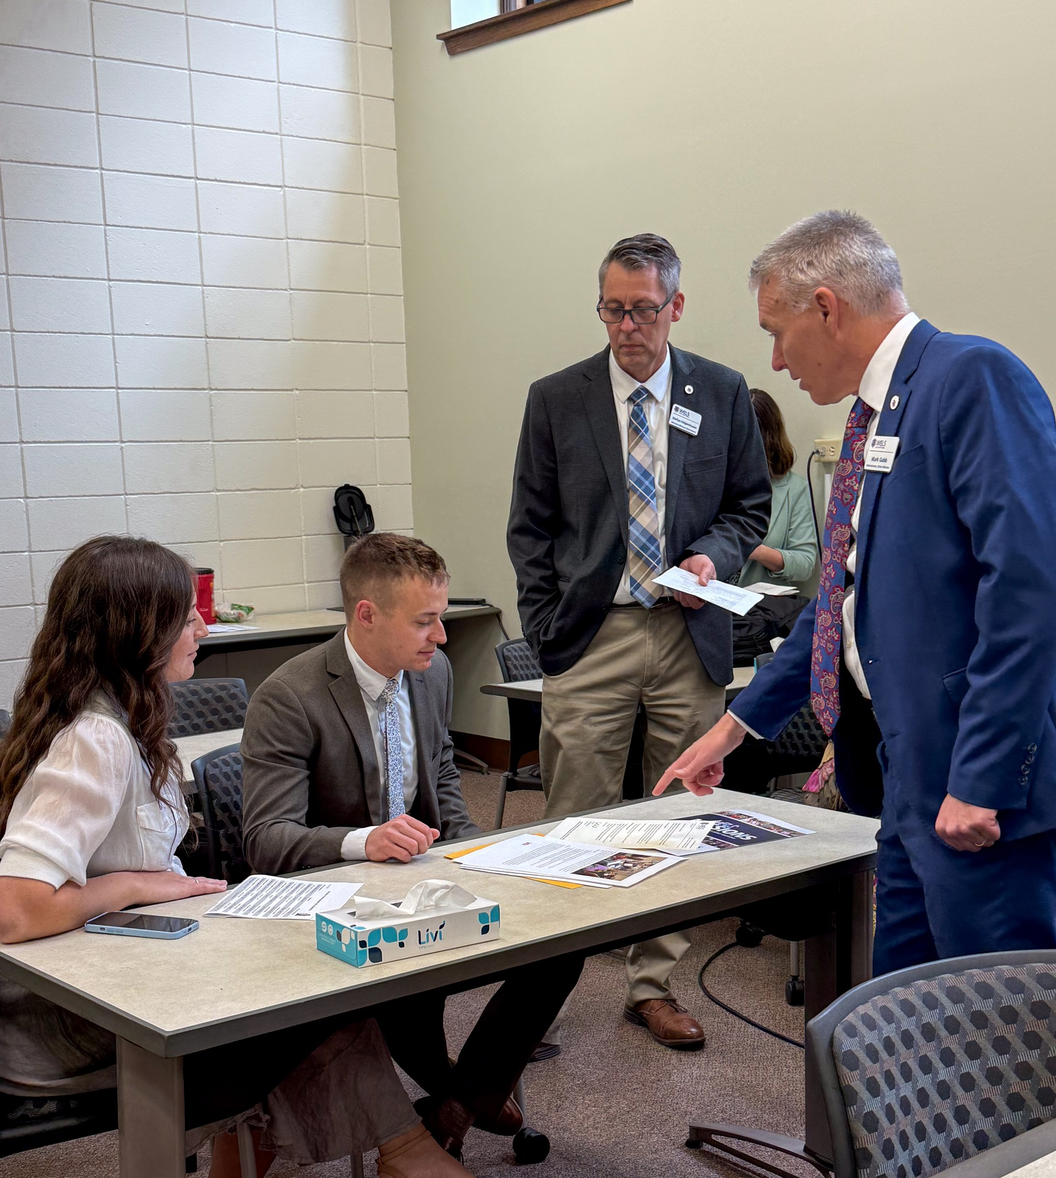
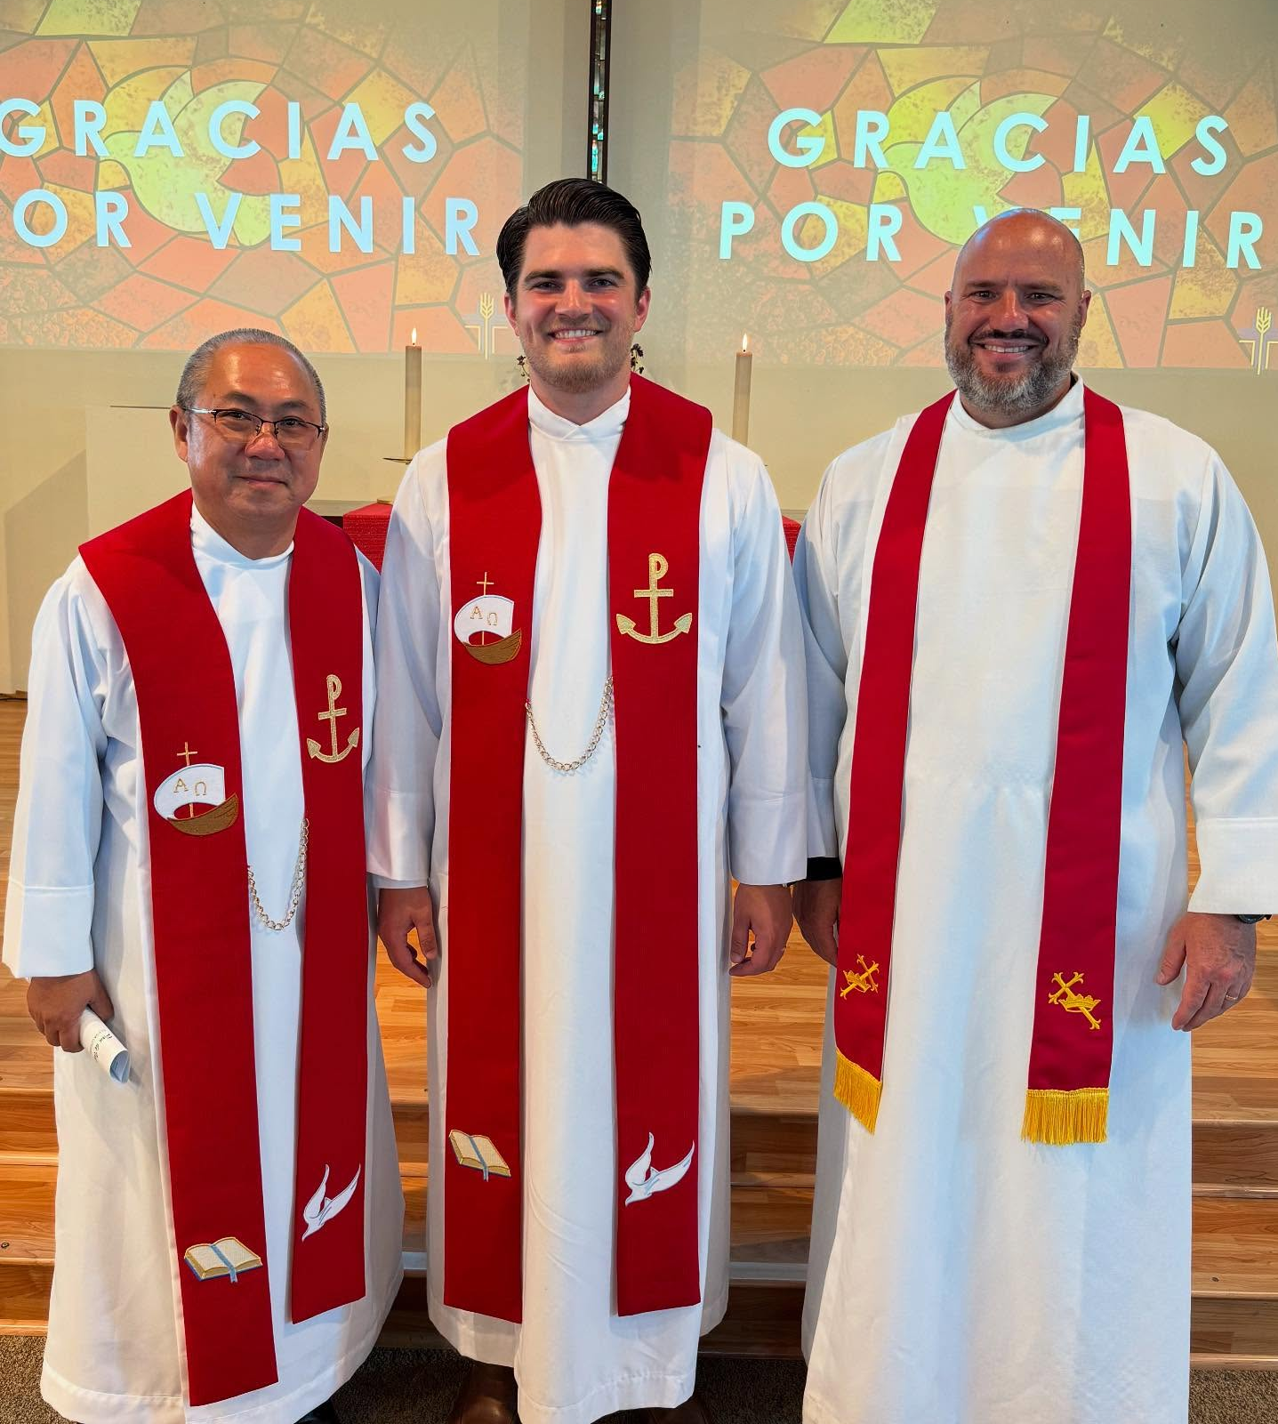
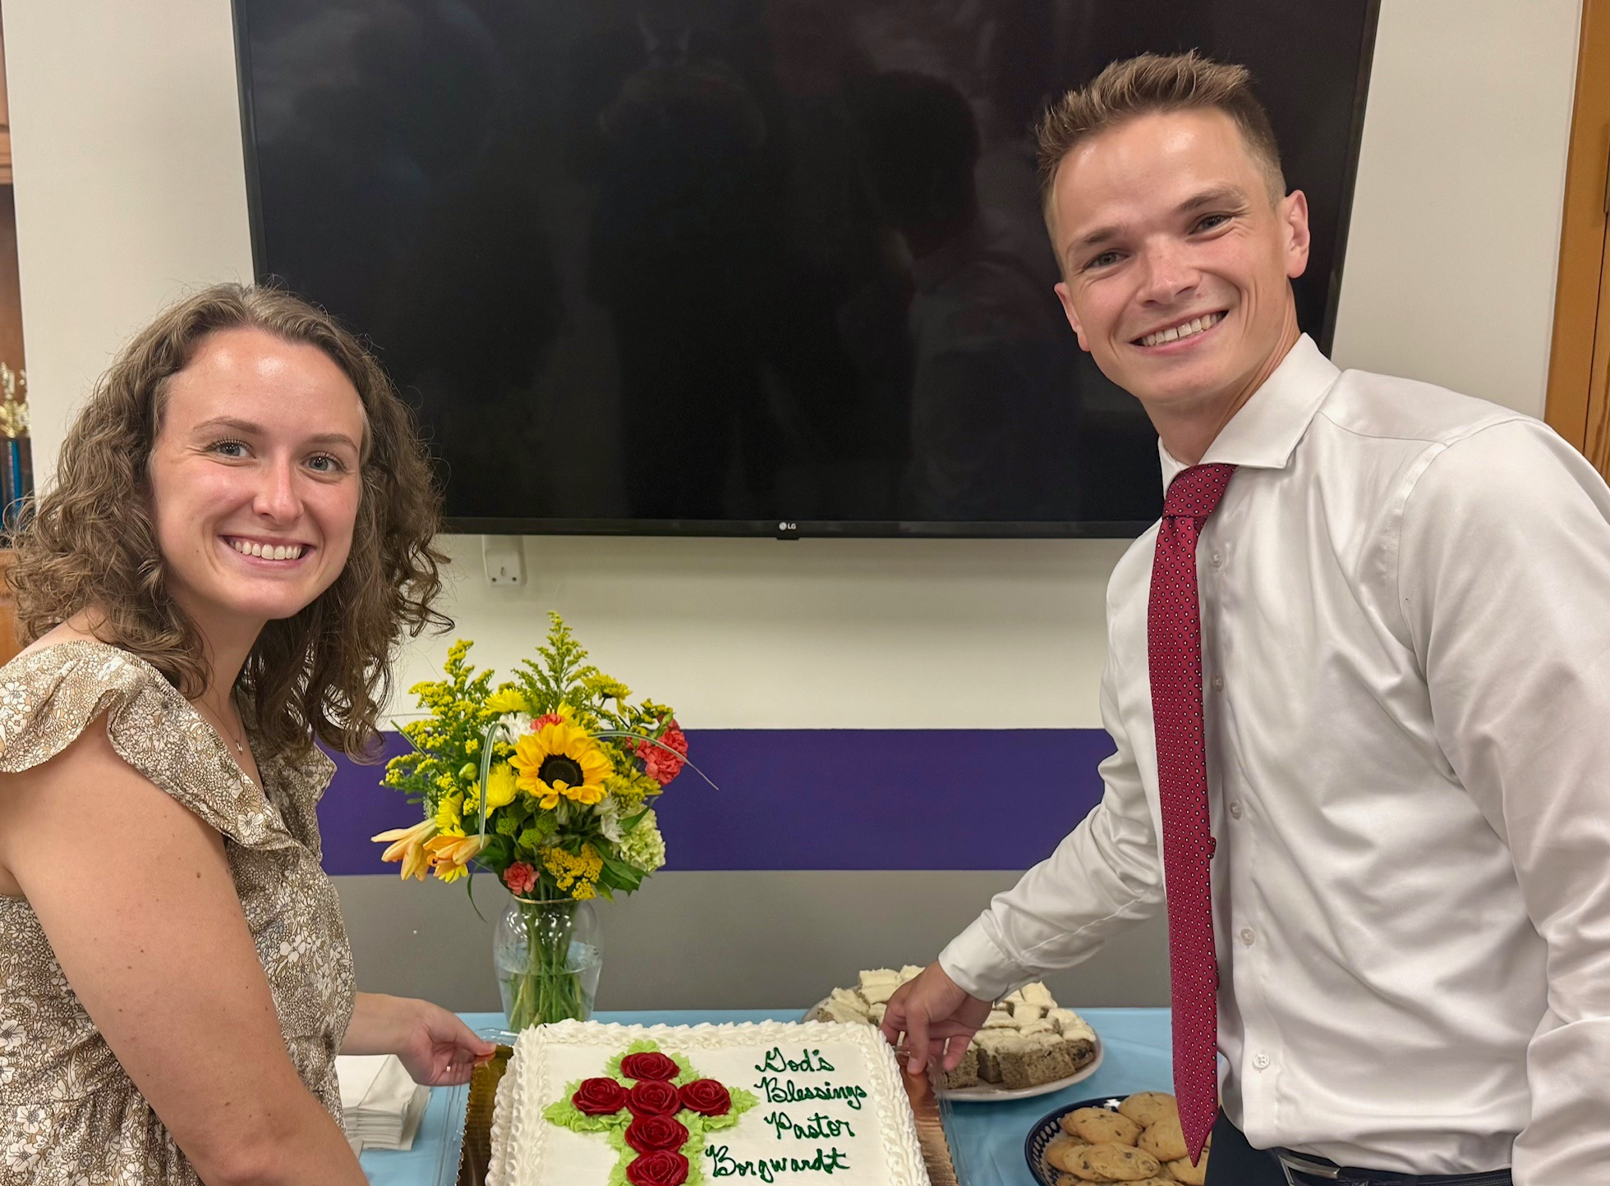
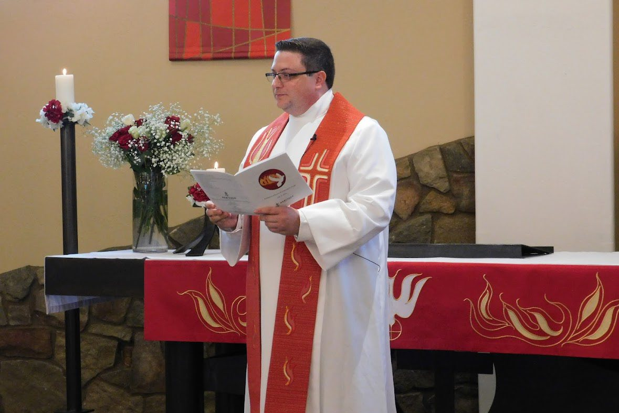
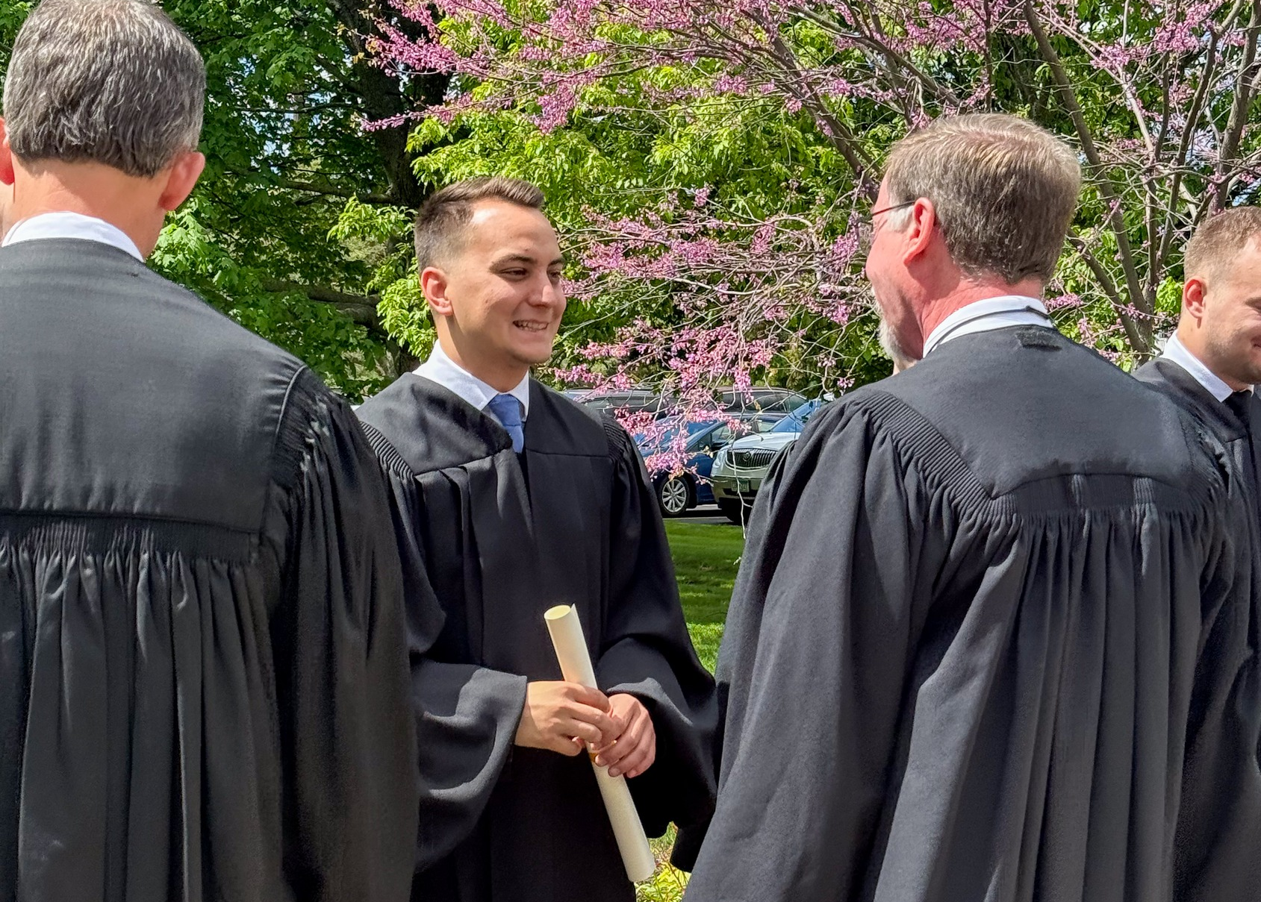
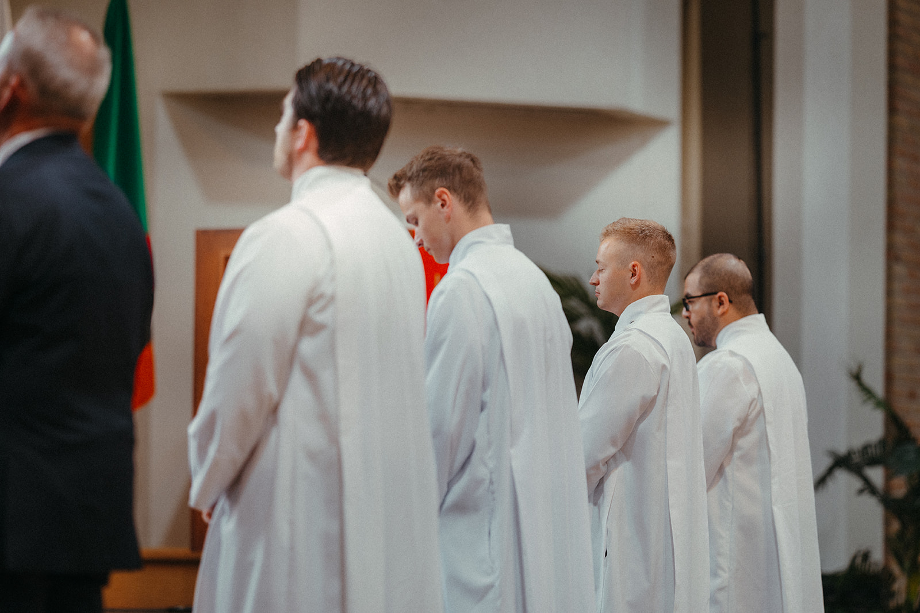
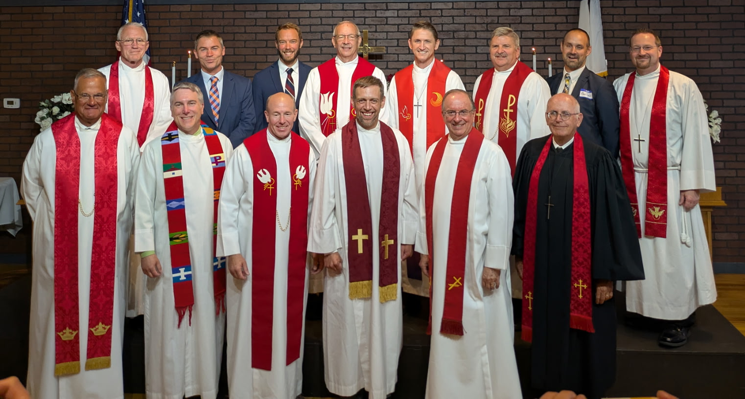
New home missionaries
Four commissioned at Taste of Missions on June 14
Notes:
2025 assignments
Rev. Jacob Bitter – Pan de Vida, Garden Grove, Calif. (Hispanic) – pictured top left
Rev. Jacob Borgwardt – Crossroads, Chicago, Ill. – pictured top right
Rev. Noah Satorius – Northdale, Tampa, Fla. (Hispanic)
Rev. Ethan Schultz – Lamb of God, Williston, N.D.
Rev. Nathaniel Stein – Christ, Clarksville, Md.
Rev. Phillip Valdez – Abiding Savior, Killeen, Texas
2025 calls accepted
Rev. Caleb Kurbis – New Mission Start, Erie, Colo.
Rev. Nathaniel Savage – New Mission Start, San Tan Valley, Ariz. – pictured middle right
Rev. John Raasch Sr. – Redemption, Saint George, Utah – pictured bottom right
Four of the new home missionaries were commissioned into their new fields of service at Taste of Missions on June 14, 2025. Watch a quick video recap and share this special commissioning video with your congregation to celebrate the sending out of new missionaries at https://wels.net/we-go-together-five-missionaries-commissioned-at-taste-of-missions/.

Slide 31
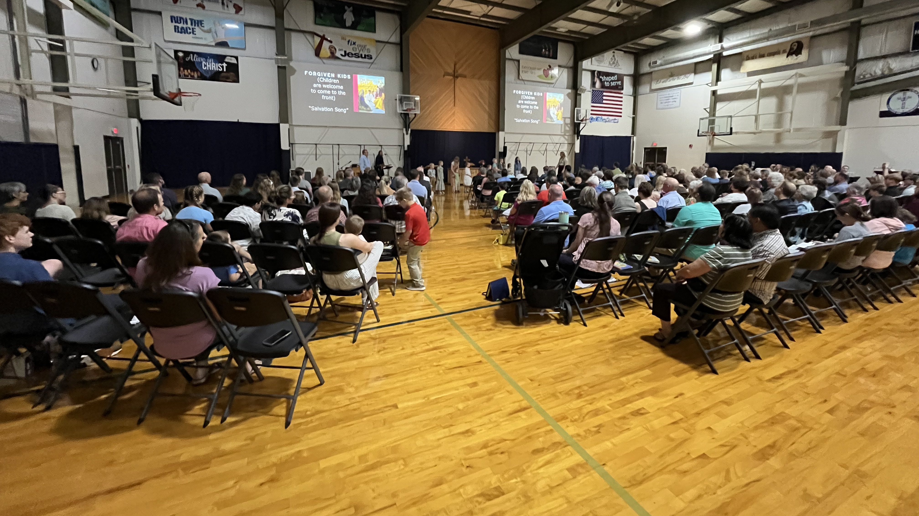
First public worship service – Sept. 14, 2025
Forgiven, Kronenwetter, Wis.
Notes:
On Sunday, September 14, 2025, Forgiven Lutheran Church in Kronenwetter, Wis., hosted their worship launch. Their worship launch took place in the Northland Lutheran High School gym, and they will continue to gather there each Sunday at 9:30 am. Kronenwetter was originally approved as a new mission start in 2023 as a part of the 100 missions in 10 years initiative.

Slide 32
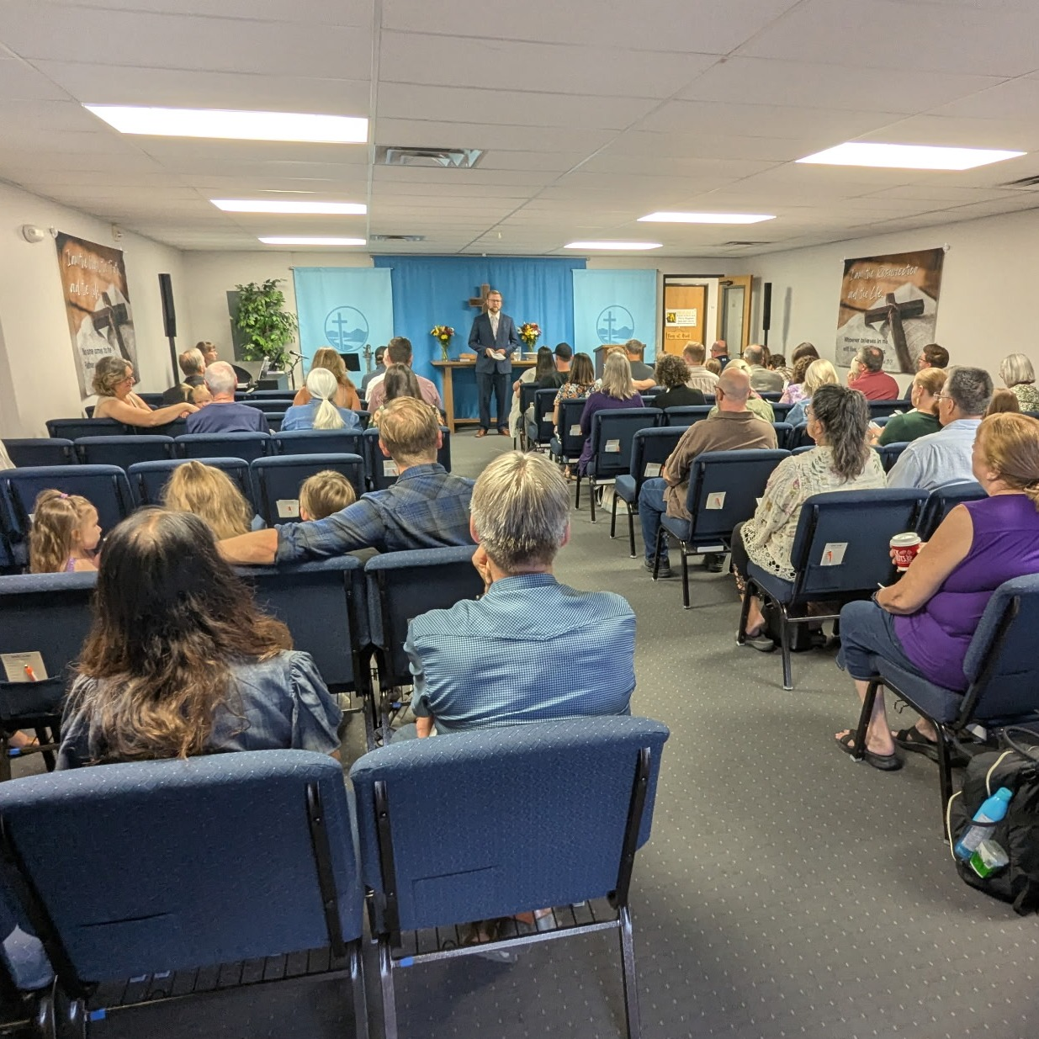
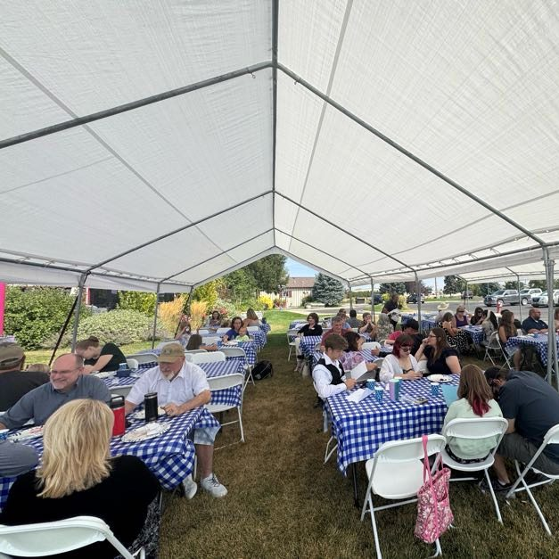
Grand opening on Aug. 24, 2025 at
Christ Alone, Ammon, Idaho
Notes:
On Sunday, August 24, Christ Alone Lutheran Church in Ammon (Idaho Falls), Idaho, hosted their grand opening and public worship launch! God blessed them with an overwhelming amount of support and excitement from the community.
This congregation was approved as a new mission start in spring 2023, the first year of the 100 Missions in 10 Years initiative.

Slide 33
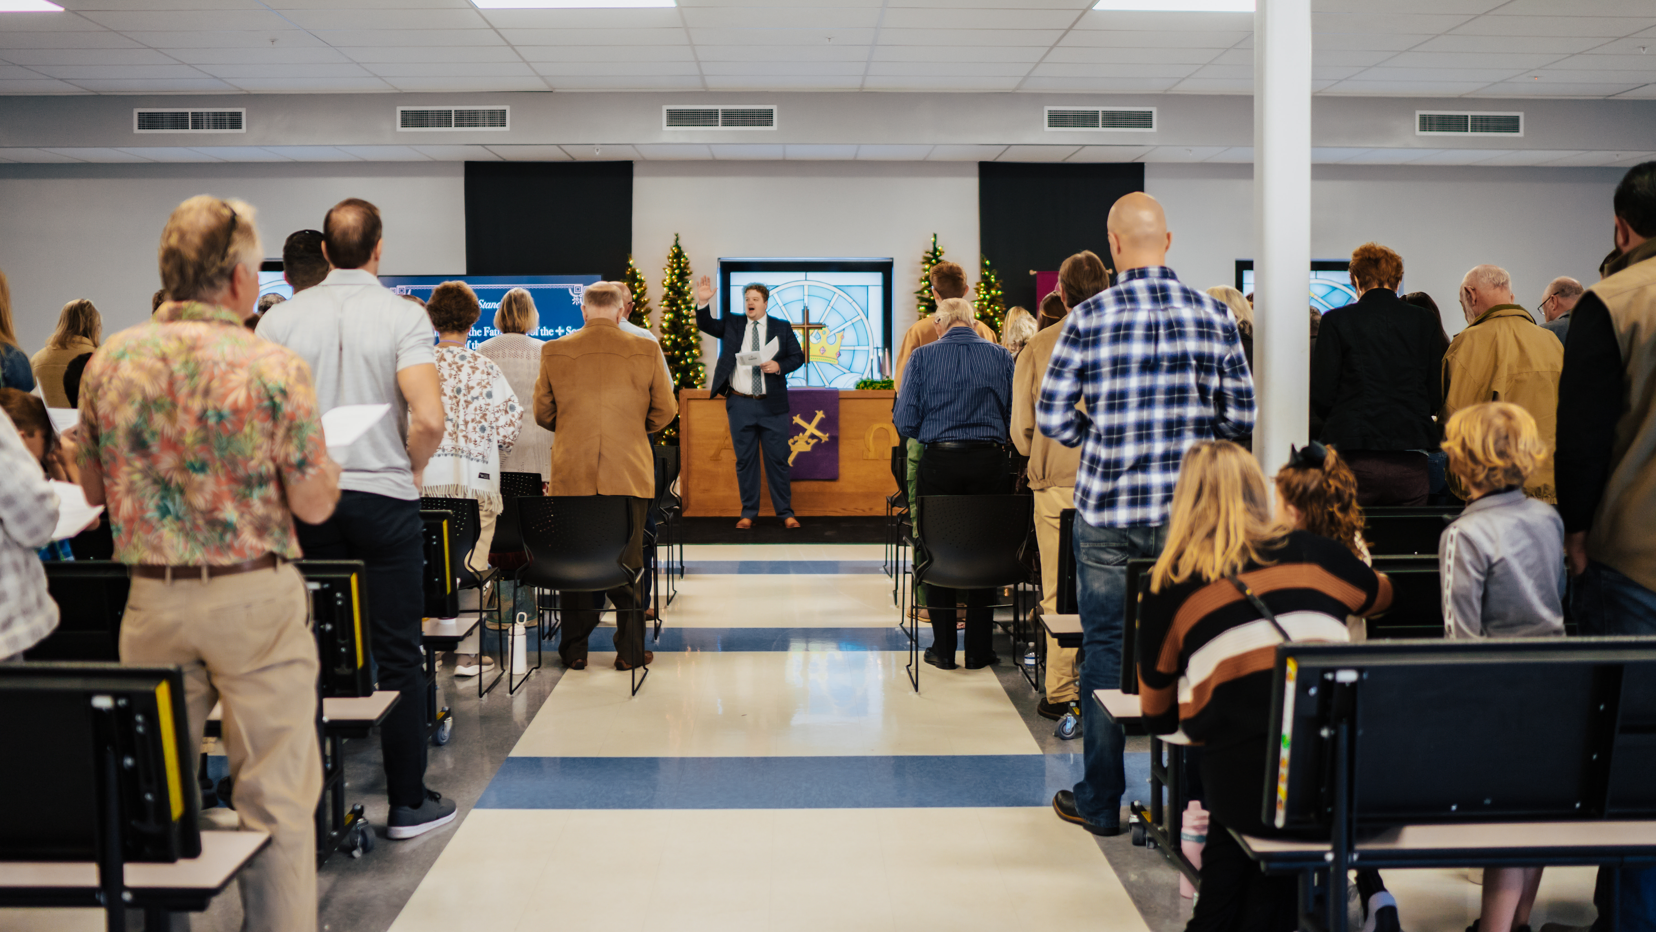
Public worship launch on December 8, 2024, at
Risen Savior in Parrish, Fla.
Notes:
Risen Savior, a home mission congregation in Parrish, Fla., launched public worship in the cafeteria of Parrish Charter Academy on Sunday, December 8, 2024. Nearly 90 people, including 18 first time visitors, gathered to be fed by God’s Word. This new outpost for the gospel is a second site of Risen Savior in Lakewood Ranch, Fla.
While they used social media and other marketing efforts to get the word out about their new church, every single visitor came because someone they knew personally invited them. What a powerful reminder that a simple invitation, shared within a trusted relationship, can make an eternal impact!

Slide 34
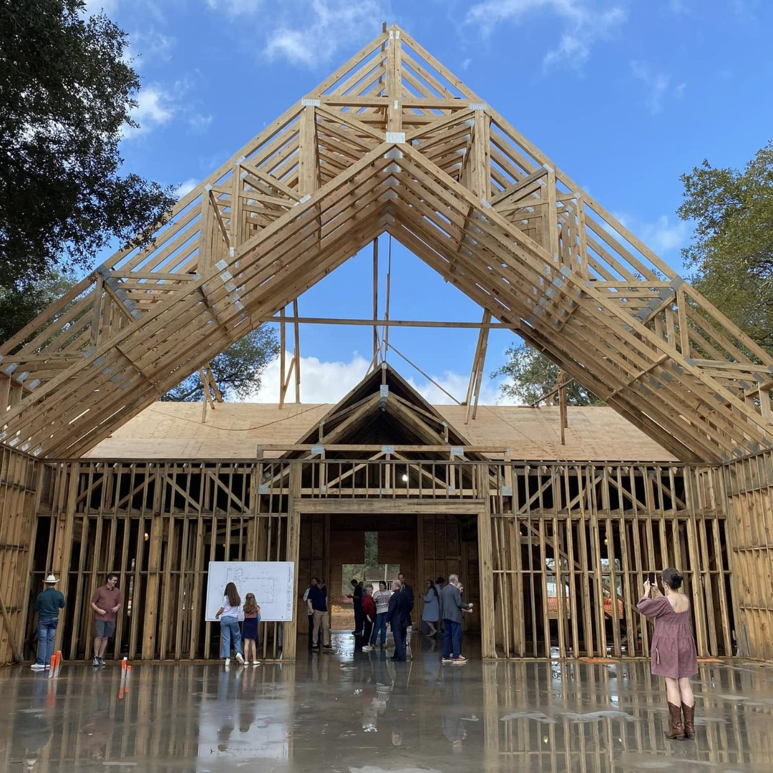

WELS Church Extension Fund
A valuable partner of Home Missions
$209.8 million in total loan balances to over 190 WELS congregations
$6.9 million in matching grants to home mission churches since June 2023
$2.9 million in grants to WELS
Home Missions since June 2023
Beam signing at TheMission in Willis, Texas, in Dec. 2024
Notes:
WELS Church Extension Fund (CEF) is a VALUABLE partner of WELS Home Missions and the churches it supports. CEF supports the spreading of the gospel by providing loans and grants to WELS home mission congregations.
WELS CEF is a wholly owned, self-supporting, subsidiary corporation of WELS. Individual WELS members, WELS congregations, and WELS affiliates can assist the synod’s mission outreach efforts by investing in WELS CEF investment certificates. Your investments fund the WELS CEF loan program. Gifts, bequests, and donations made to WELS CEF support the grant program.
WELS CEF provides home mission churches a 4-to-1 matching grant for initial land purchase based on their 10% down payment. They also provide a 2-to-1 matching grant on a home mission congregation’s 10% down payment for their facility construction project.
Since 1993, WELS CEF has provided $48.9 million of matching grants to mission congregations and $17 million of special grants directly to Home Missions.
Pictured: TheMission, a home mission congregation in Willis (Conroe), Texas, is anticipated to complete their new church building by July 2025. TheMission received loans and matching grants from WELS CEF.

Slide 35
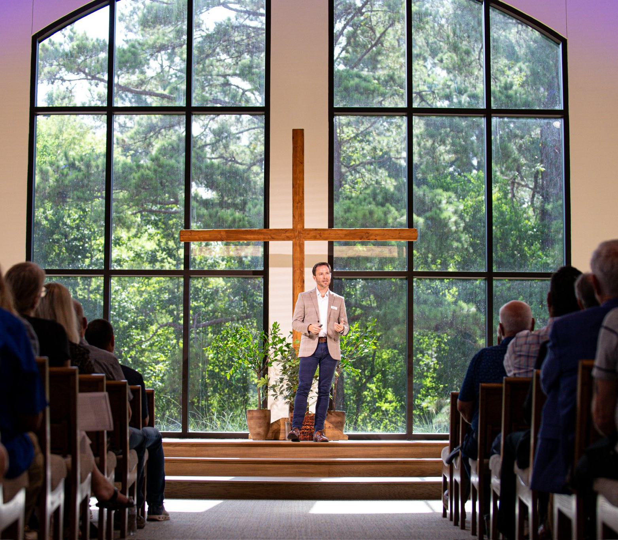
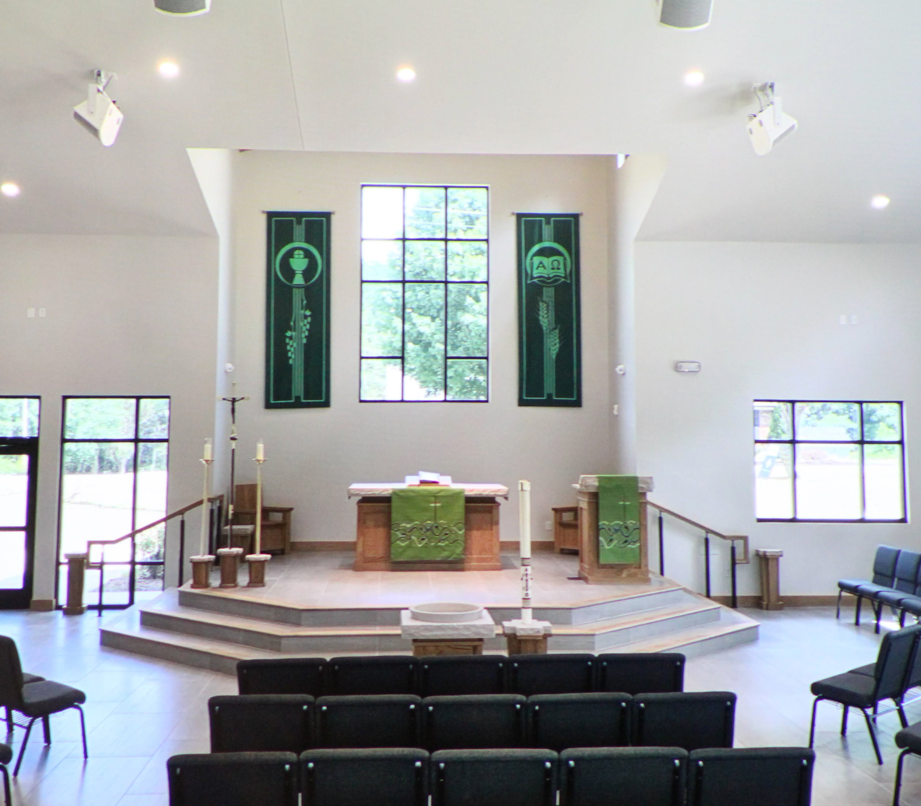
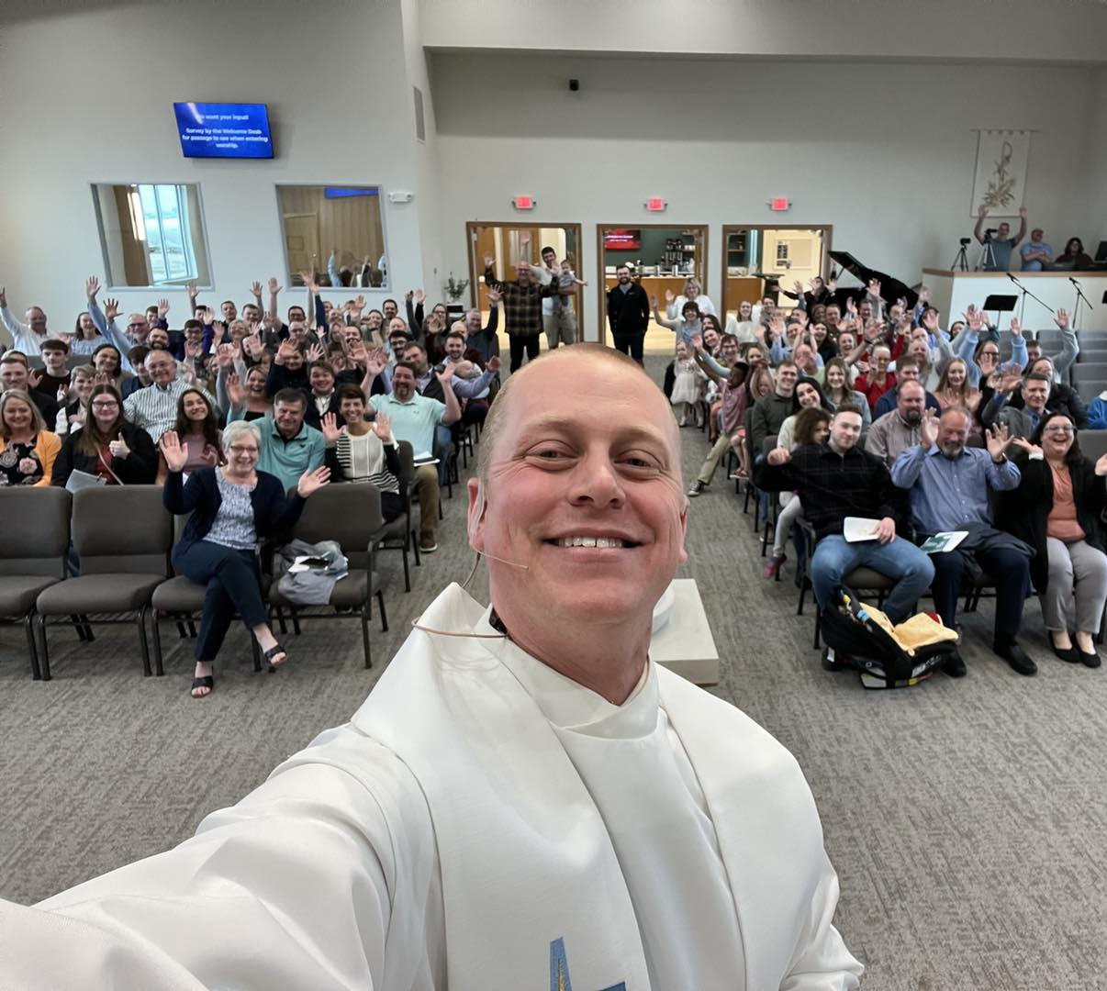
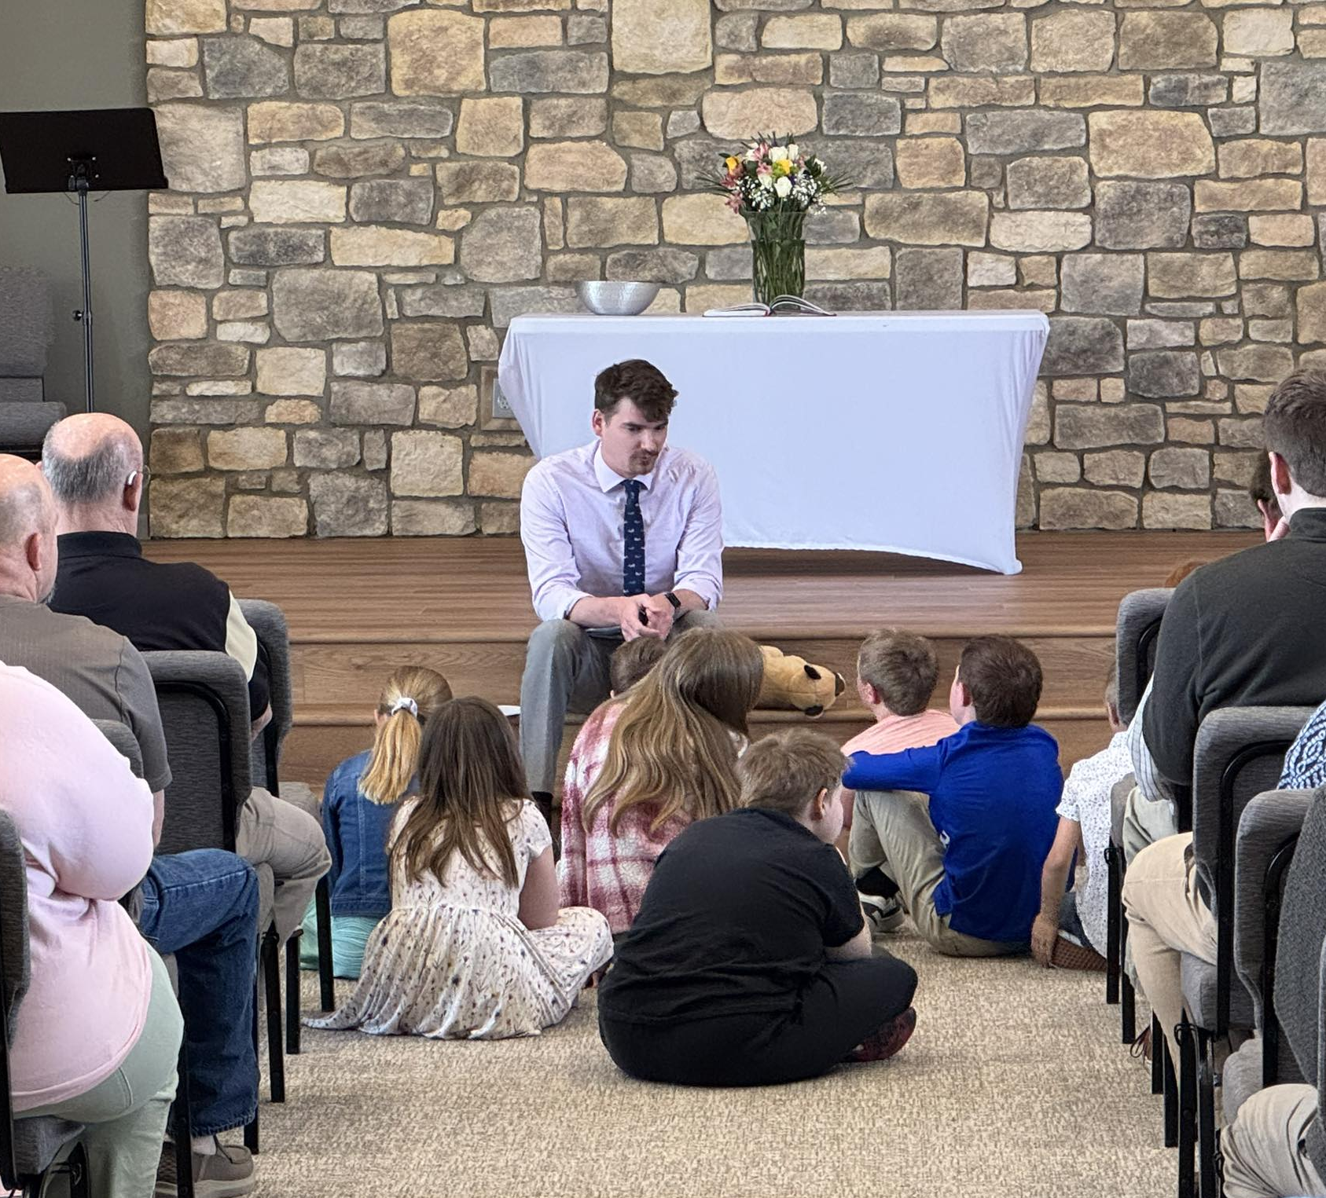
Home missions dedicate new buildings
TheMission – Willis (Conroe), Texas
Huntersville Lutheran Church, Huntersville, N.C.
Sure Foundation, Brandon, S.D.
Foundation, Peyton, Colo.
Notes:
TheMission in Willis (Conroe), Texas – August 17, 2025 (pictured top left)
TheMission has their first worship service in their new church building on Aug. 17, 2025.
Huntersville Lutheran Church in Huntersville, N.C. – July 26, 2025 (pictured top right)
On Saturday, July 26, 2025, Huntersville Lutheran Church in Cornelius, N.C., dedicated their new facility in a special worship service.
Sure Foundation in Brandon, S.D. – April 2025 (pictured bottom left)
In April 2025, Sure Foundation Lutheran Church in Brandon, S.D., celebrated the grand opening of their new church building and hosted a formal dedication worship service in July 2025.
Foundation in Peyton, Colo. – March 23, 2025 (pictured bottom right)
On March 23, 2025, Foundation Lutheran Church in Peyton, Colo., was able to have their first worship service in their brand-new church building.

Slide 36
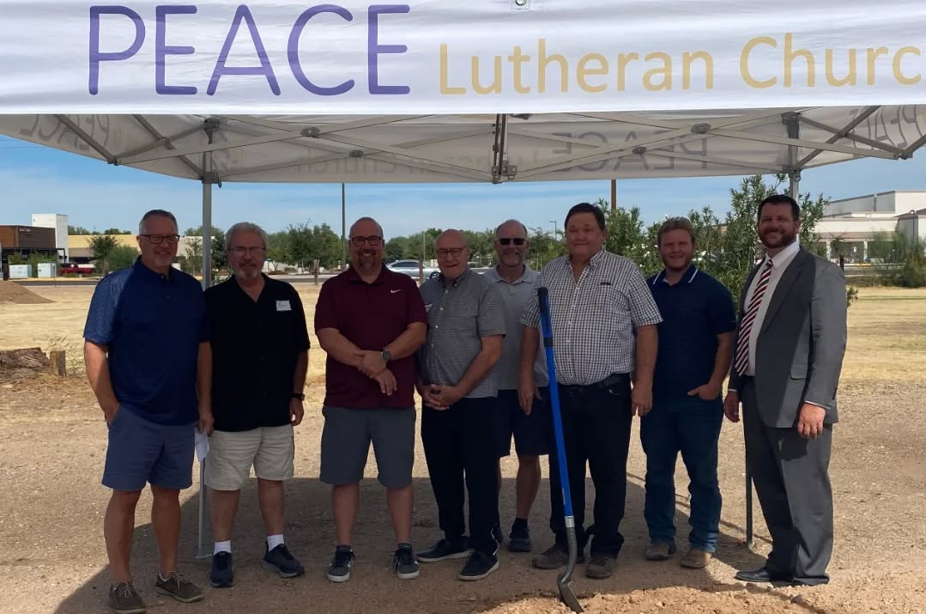
Peace, Gilbert, Ariz., broke ground on their new church in Oct. 2024
Notes:
The church expects to have occupancy of their new church building by the end of 2025.

Slide 37
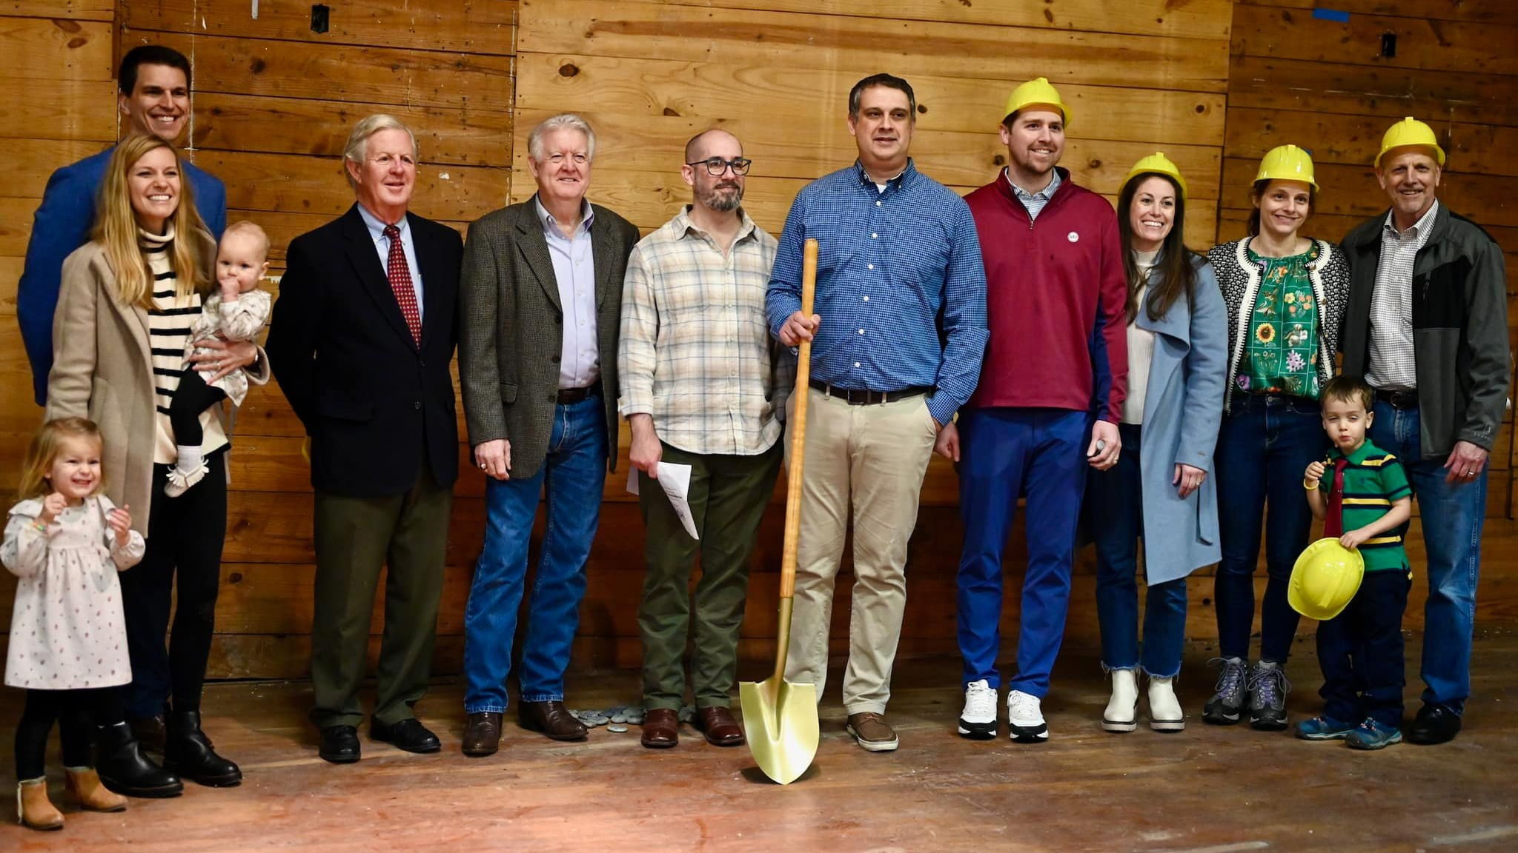
Hope in the Heights breaking ground on renovation of an old church in Houston, Texas
Notes:
Hope in the Heights in Houston, TX, closed in Fall 2023 on a Church of Christ building for sale that was built in 1927 and remodeled in the late 1950s. It is situated on its own block within a neighborhood in their target area. There is a large parking lot, ample street parking, and plenty of green space for kids to run around.
Thanks to the Church Extension Fund’s grant program for new missions, they get a 4:1 match on the land value and a 2:1 match for every dollar they spend on the remodel. Because of this, they can afford the necessary renovations. And because Church Extension Funds grants keep the cost down, they will be able to taper off of synod subsidy faster, which enables WELS to start more missions in the future. They hope to have the remodel completed by late 2024, when they will be able to move in and open their doors to the community.

Slide 38

High school graduations are approaching:
Share student information with
WELS Campus Ministry!
Notes:
WELS Campus Ministry provides resources, support, and encouragement to WELS congregations that serve college students.
Almost every university in the United States and Canada has an assigned campus ministry contact pastor. Each contact pastor receives a list of WELS student that are attending their school. By sharing information with WELS Campus Ministry, these contact pastors know who the students are and can help them stay connected to Christ and strengthen their faith while at school.
We need your help in this process! Please work with the high school/college age students at your congregation and get them signed up with WELS Campus Ministry. Instructions on how to share student information can be found at wels.net/cmtoolkit, and you can encourage students to sign up directly at wels.net/college.

Slide 39
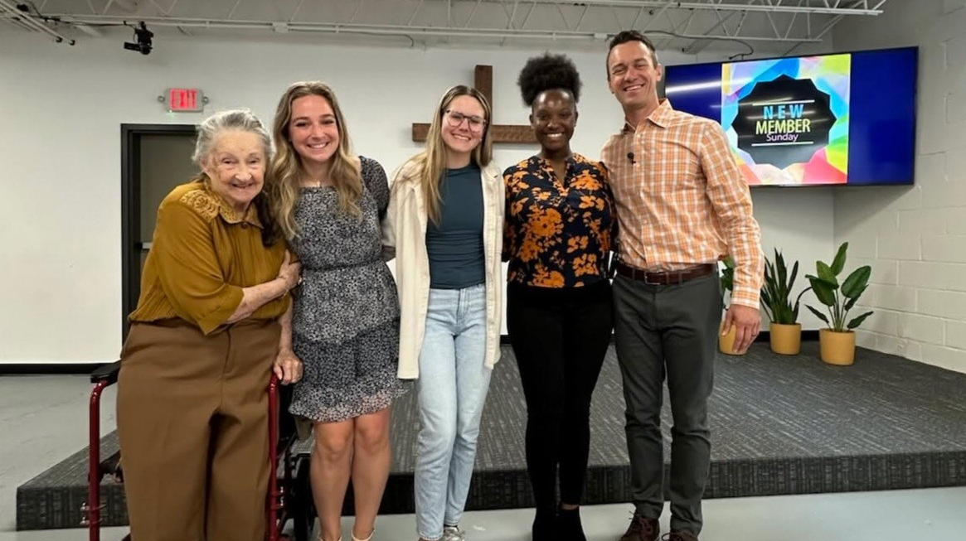
Outreach through Campus Ministry
Notes:
On Sunday March 30, 2025, Intown Lutheran Church welcomed three college students—Grace, Taylor, and Kennedi (pictured middle) as adult confirmands. These young women impressively completed our 12-lesson Bible Basics Class while also managing busy academic schedules and student-athlete responsibilities. All three of them are new to Lutheranism and very excited to be part of our church family!
Grace says: "Intown Lutheran Church not only gave me a place to learn straight from the Scripture and truly understand it, but it also gave me a new family of fellow Christians. This is a place where I can be myself and never feel alone, judged, or out of place."
Kennedi says: “Upon arriving in Georgia for college, I hoped to find a local church. Thankfully, a friend attending Intown invited me to the worship service one Sunday. Being exposed to the great teachings of the Good News and the kind fellowship, I decided to continue attending Intown and even join various Bible Study sessions each week. Now that I’m officially a member, I can say that the meaning of Intown Lutheran Church is to cultivate a body of God’s children and teach and learn the meaning and importance of His word so that we all grow in our faithful walk with Him.”
From Lucas Bitter, pastor at Intown, Atlanta, Ga.

Slide 40

Notes:
Pray: This is no small thing. Pray that the Lord of the church would provide workers. Pray for our WELS Home Missions leaders, our home missionaries, and our worker training schools as they recruit and train future missionaries. Pray that the Lord provides us with the financial support needed to do the work.
Get Involved: If you see nearby mission opportunities, talk with your district mission board to see what you or your congregation might do to get involved in this synod wide church planting effort. Encourage young men and women in your church to consider full-time ministry. Ask your pastor to keep our synod’s work in your congregational prayers and provide updates on a regular basis.
Give: You know the grace of our Lord Jesus Christ. He was rich, yet he became poor so that through his poverty we might become rich (2 Corinthians 8:9). God’s generosity has resulted in the riches of forgiveness, peace, joy, and hope. Let that move you to give generously to your local congregation, to your synod through your church, and to this initiative.
Encourage people to check out the website: Learn more and stay up to date on progress at wels.net/100in10.

Slide 41

Notes:
WELS Mission Journeys provides an opportunity for all WELS members to walk together in the Great Commission. Through short- or long-term service opportunities in WELS mission fields at home and abroad, members can engage in Christian service. While volunteering, the learning and sharing of outreach ideas will allow individuals and teams to explore how they can use their God-given abilities to engage in outreach activities in their local communities upon their return home. With the Lord’s blessing, these trips will inspire a lifelong journey of service and outreach for all who volunteer.
Learn more at wels.net/missionjourneys.

Slide 42
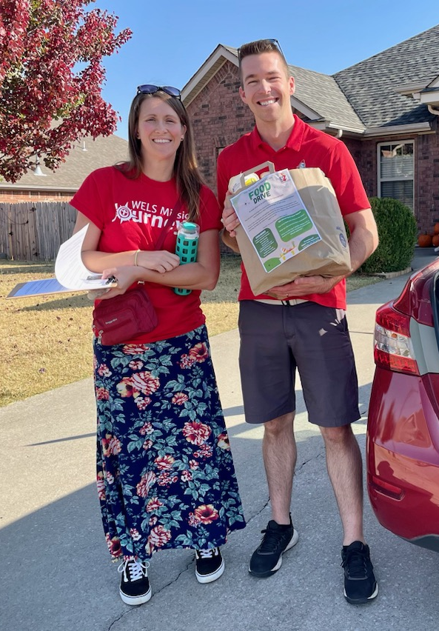
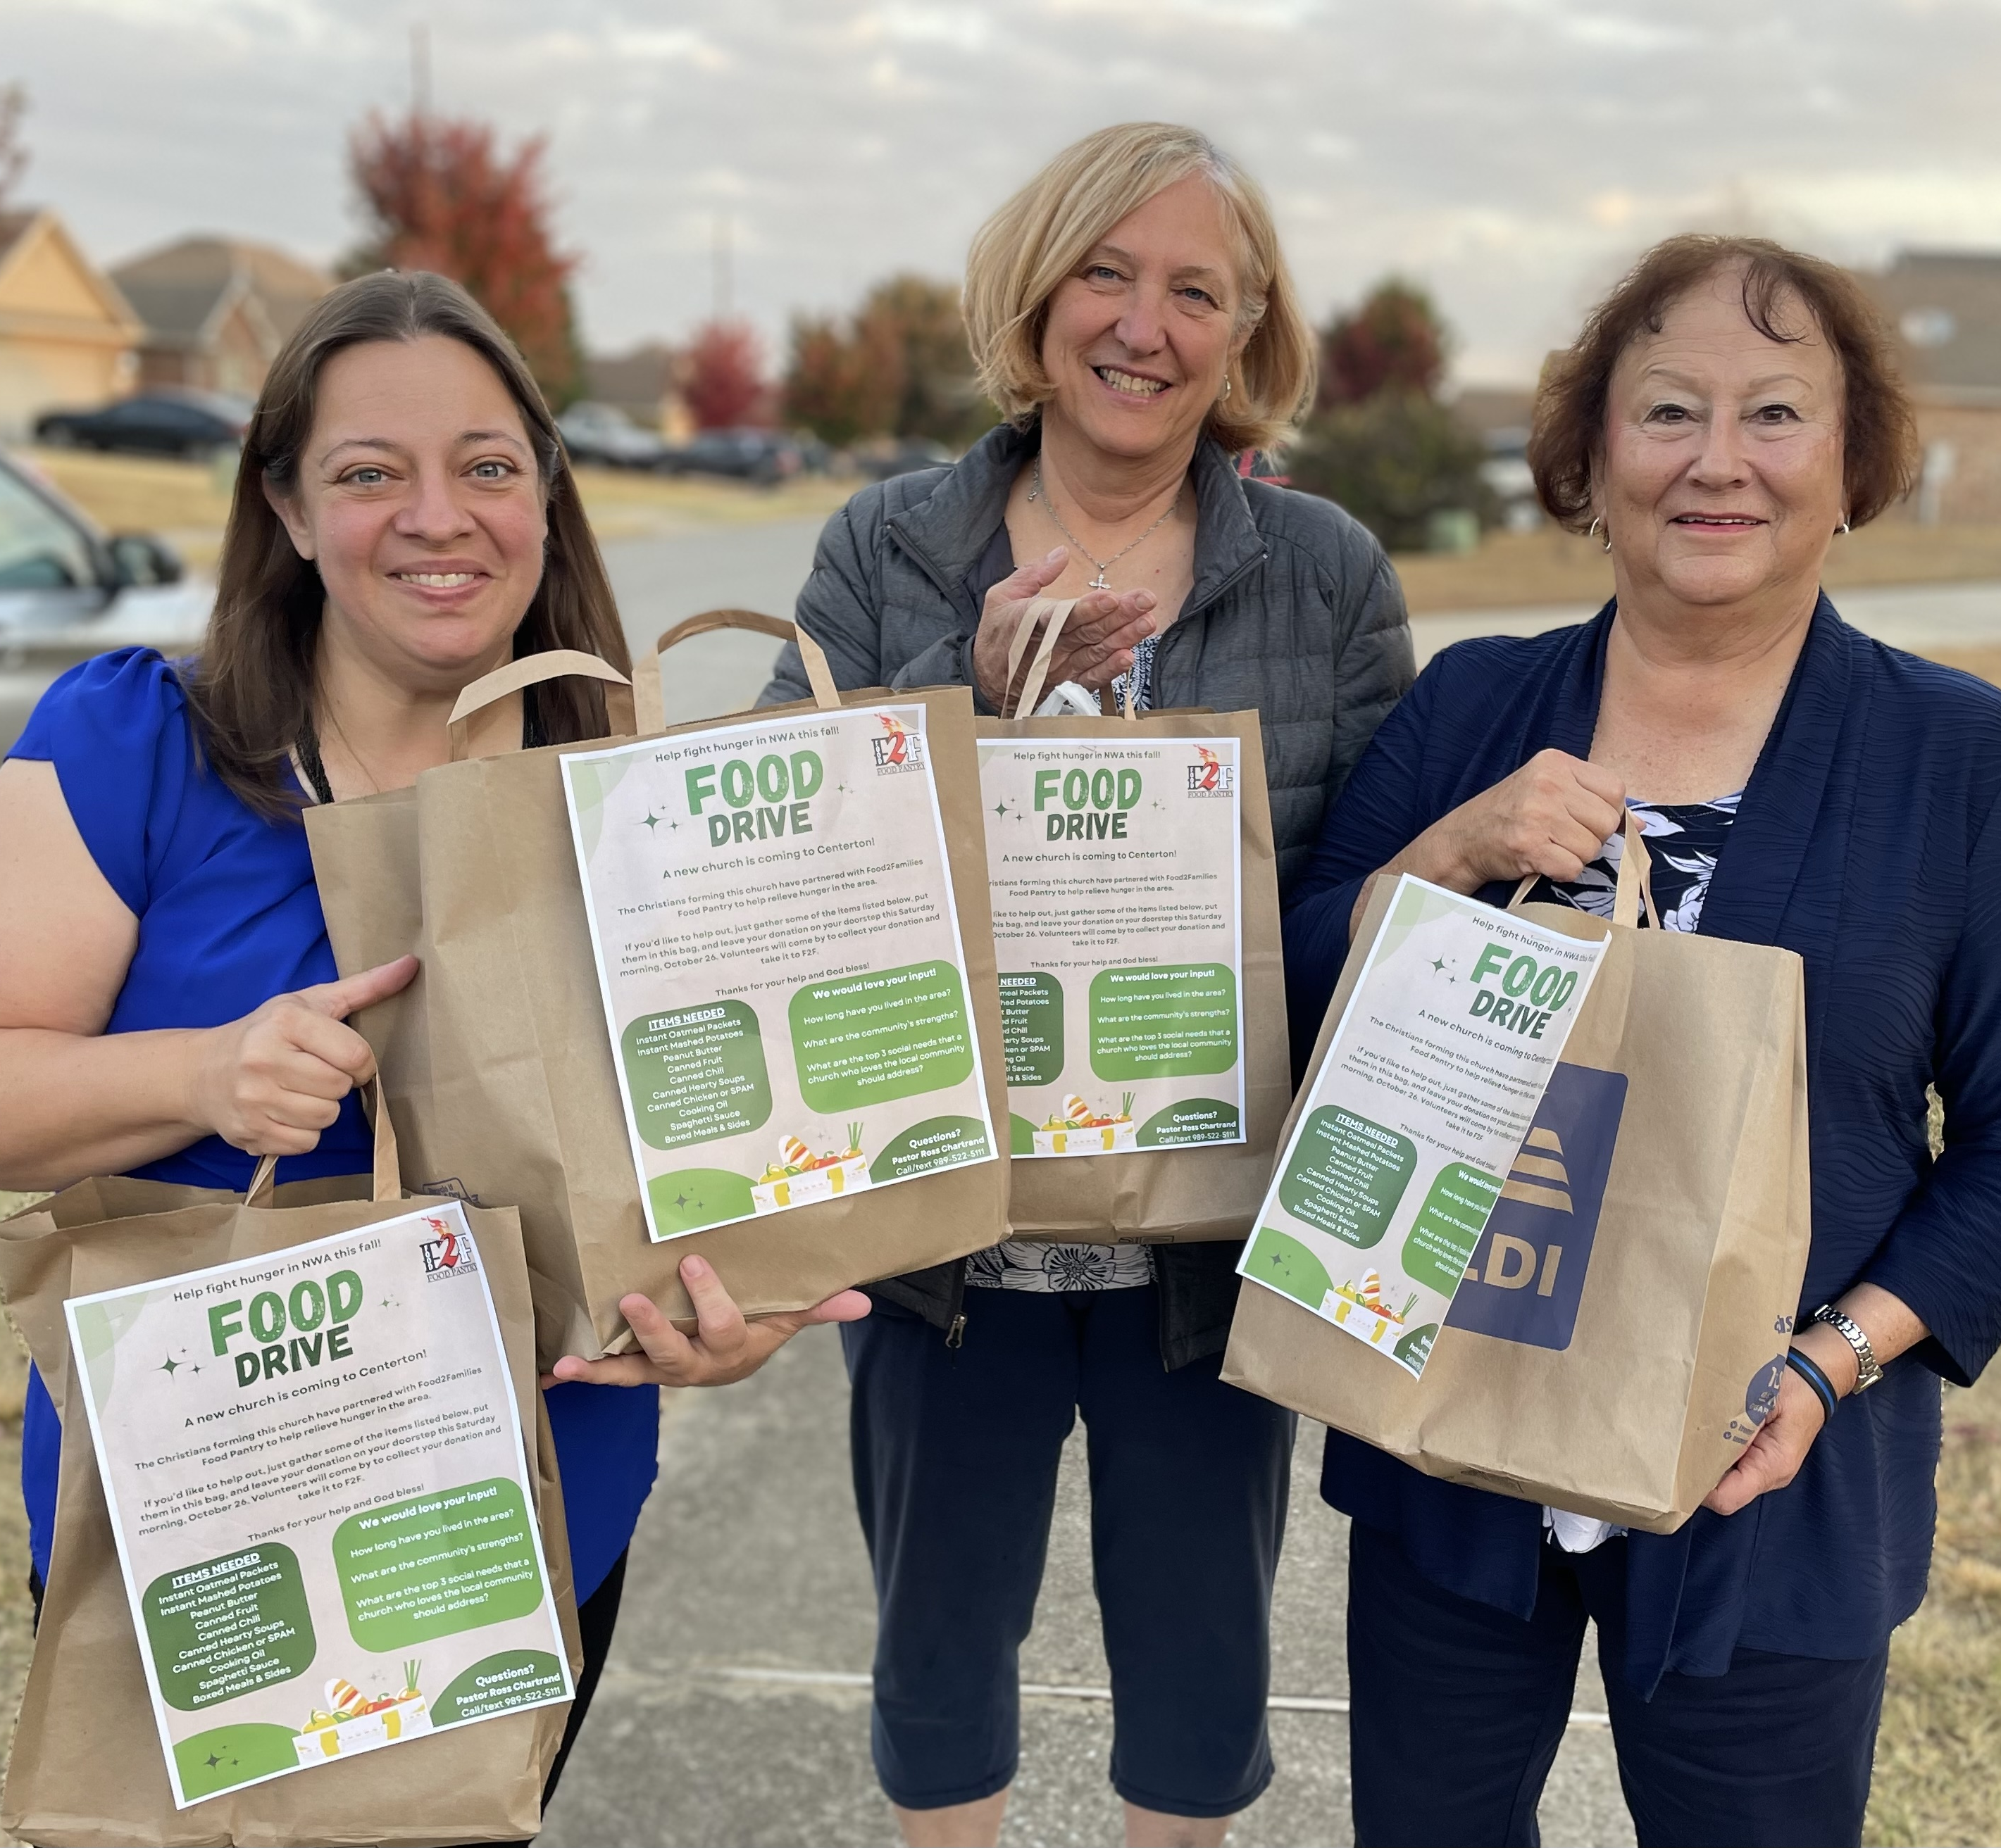
Mission Journeys opportunities at home mission congregations (Pictured: Trip to Bentonville, Ark.)
Notes:
A six-person WELS Mission Journeys team from St. Matthew's in Janesville, WI, traveled to Bentonville, AR, in October 2024 and May 2025 to assist the new mission start. They partnered with Home Missionary Ross Chartrand and the core group to survey individuals in the Bentonville town square regarding the strengths and needs of the community and how they see a new church meeting those needs. They also participated in a grocery bag food drive collection, bringing in 44 bags of food to be donated to a local food pantry and providing opportunities to talk face to face with residents of Centerton, the home mission’s anticipated future home.
St. Matthew’s is planning more Mission Journey trips with even more members to assist with outreach for the home mission. Likewise, Pastor Chartrand and members of his core group are planning to travel to Janesville to host a mission festival at St. Matthew’s.
Your congregation can also partner with a WELS home mission congregation for mission trips! Visit wels.net/missionjourneys and/or contact Mission Journeys coordinator Shannon Bohme at missionjourneys@wels.net or 651-324-4218 to learn more.

Slide 43
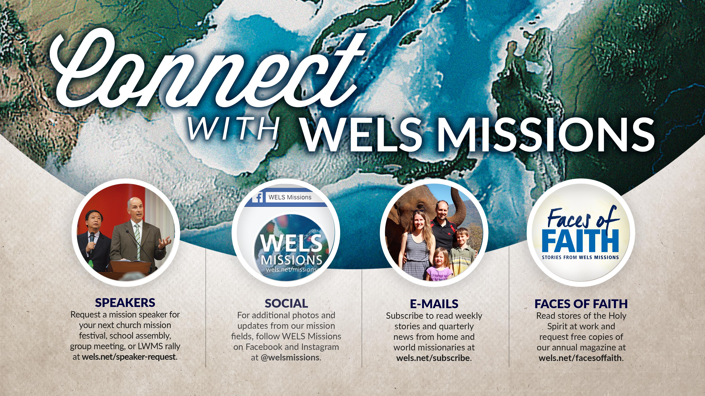
Notes:
Speakers: District Mission Board members, Home Missionaries, Mission Counselors, and other Home Missions representatives are willing and able to present on the 100 missions in 10 years initiative at your next church Mission Festival, LWMS circuit rally, school assembly, or small group gathering. Contact your local District Mission Board OR fill out a request at wels.net/speaker-request to find a speaker for your event this fall.
Social Media: Follow us on Facebook and Instagram @WELSmissions
E-Mails: Subscribe to weekly Missions Blogs and quarterly Missions Update E-Newsletters at wels.net/subscribe.
Faces of Faith: The 6th annual edition of Faces of Faith is now available. This is a great overview of the work we’re doing in Home, World, and Joint Missions, and you can learn more about the 100 missions in 10 years initiative in this magazine.
It is available online and by request at wels.net/facesoffaith. Any congregation OR LWMS circuit is welcome to request up to 50 copies of the magazine, and we are also offering 100 Missions in 10 Years brochures and large home and world mission maps (24” x 36”) free of charge. Note – Faces of Faith is automatically sent to any congregation hosting a Mission Festival.

Slide 44

GIVE GENEROUSLY!
Visit wels100in10.net/give to donate online!
Send in a check with “100 in 10” in the memo line to:
WELS
Attn: Gift Processing
N16W23377 Stone Ridge Dr.
Waukesha, WI 53188
Notes:
We confidently ask you to consider giving generously to this amazing opportunity to expand our efforts to share the saving gospel right here in our own backyard. This is a BIG challenge. An impossible one you might say. But we prepare and we plan, and we ask God to bless it. Trusting in the Lord, we boldly move forward knowing God will bless us and his kingdom.
You can support this effort by giving a gift online at wels.net/100in10gift; through the QR code on the slide; sending a check with the 100 Missions in 10 Years in the memo line to WELS, Attn: Gift Processing, N16W23377 Stone Ridge Drive, Waukesha, WI 53188; or through appreciated assets (e.g., stock) or from your IRA by calling 800-827-5482. Thank you for your support!

Slide 45
Notes:
Try something that is so hard, that if it succeeds, people will have to say God did this.
We submit all our plans to Him, for He is the Lord of the Church, and we are only servants. We’re trusting God to do immeasurably more than all we ask or imagine.

Slide 46
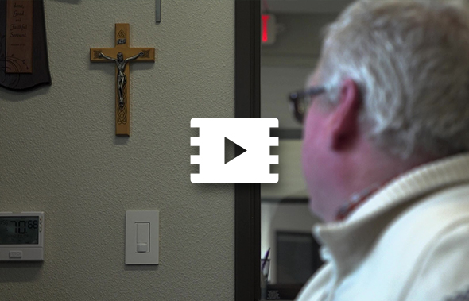
One soul at a time
Notes:
Video link: https://vimeo.com/952367165

