Slide 1
Notes:
At the 2021 Synod Convention, delegates enthusiastically approved a WELS Home Missions initiative to plant 100 home mission churches and enhance 75 ministries in 10 years beginning in 2023. During the same time, we want to support 75 enhancement grants to help existing congregations reach more souls, often in other cultures.

Slide 2
This is a big goal. Why start 100 new home missions?
Our Savior directs us to reach more souls with the good news. This initiative isn’t as much about planting more churches as it is about sharing the gospel of Jesus Christ. It’s about Christ’s mission to his church. It’s about aggressively reaching lost souls.
Notes:
Why are we doing this?

Slide 3
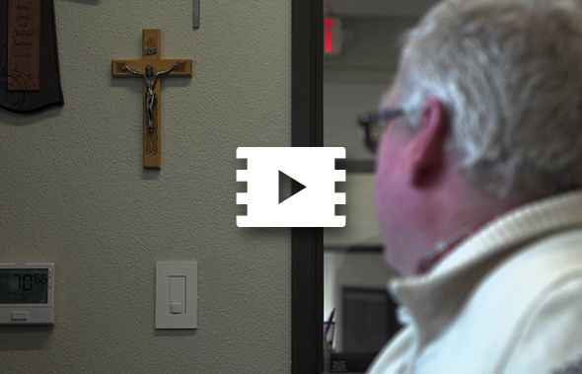
To reach more people like Sean
Notes:
Video link: https://vimeo.com/952367165

Slide 4
Notes:
WELS Home Missions plants new churches and assists mission-minded congregations in the United States, Canada, and English-speaking West Indies. Home Missions currently supports 144 congregations with financial subsidy or district mission board/mission counselor assistance, with 29 of those being cross-cultural mission congregations. Home Missions also provides over 45 campus ministries with financial support, while assisting hundreds of other congregations that serve college students around the United States and Canada.

Slide 5
Supporting home mission churches
100 Mission in 10 Years
Notes:
So how does it work?

Slide 6
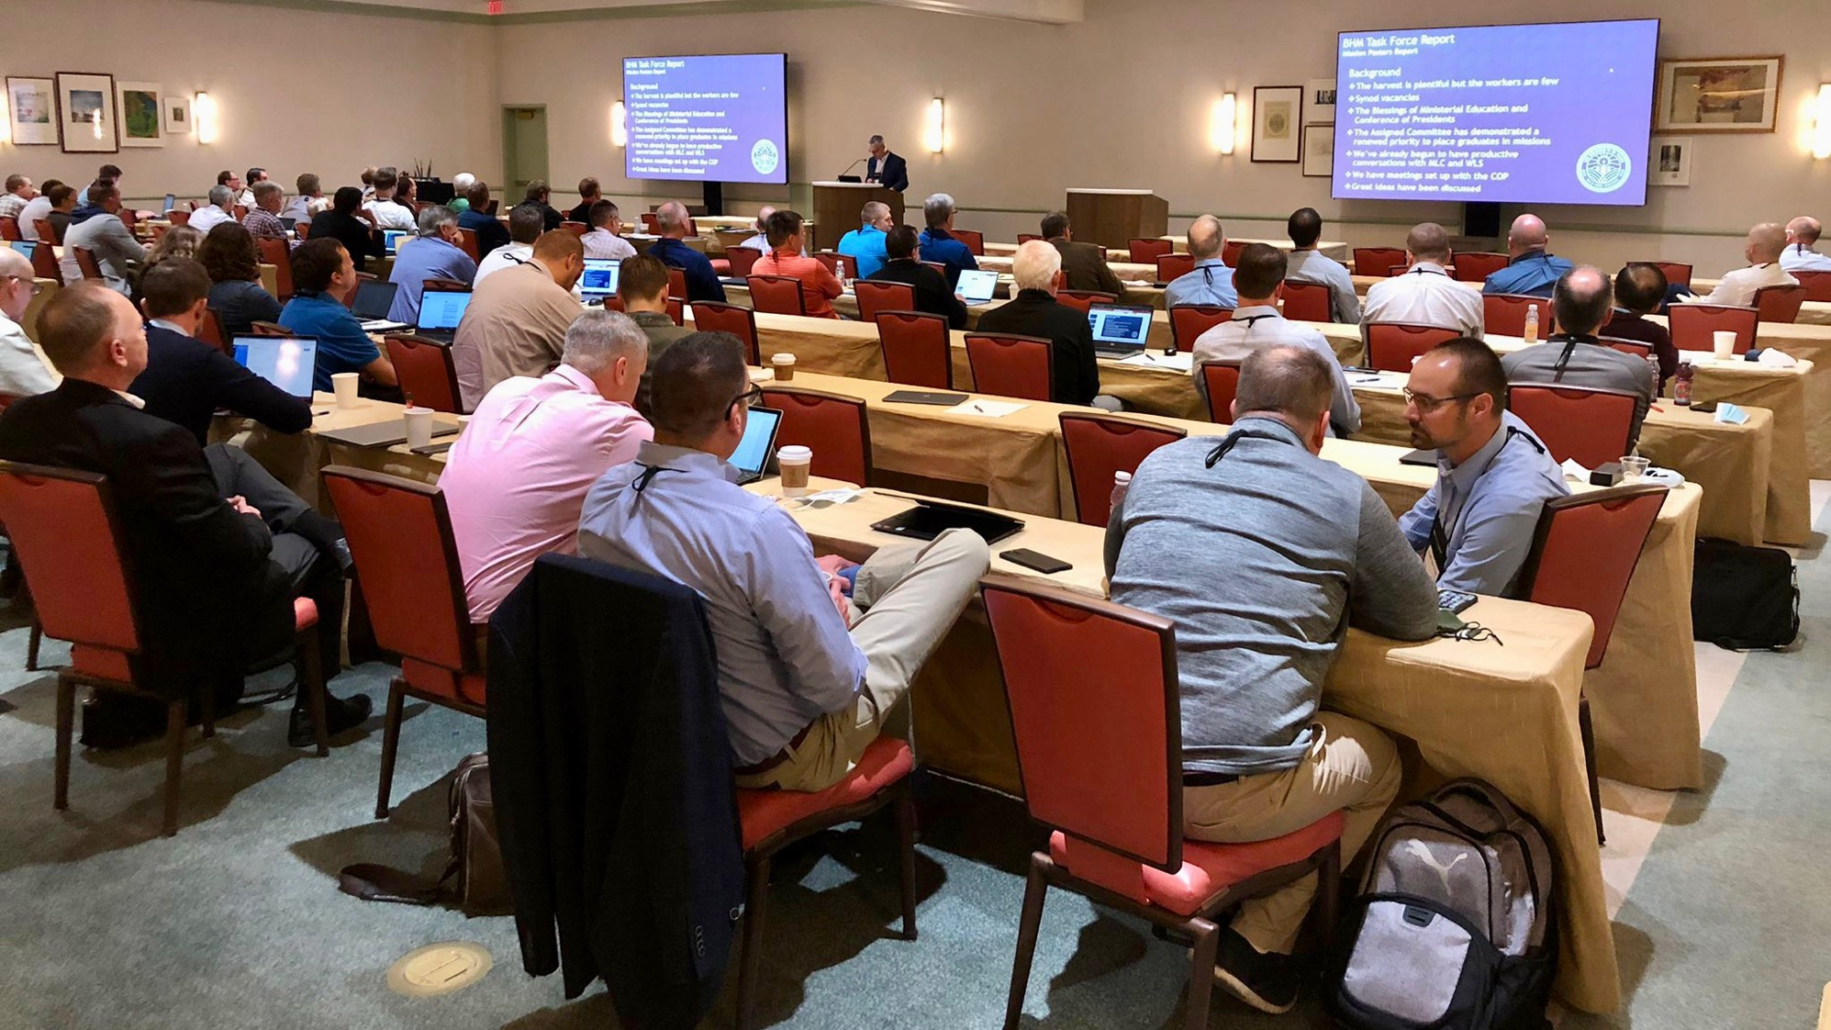
District Mission Boards (DMB)
The heart and core of Home Missions
Notes:
FOR PRESENTERS: I would recommend including a group photo of the DMB where you’re presenting for this slide.
District mission boards (DMB) are the heart and core of Home Missions. They are the “boots on the ground” as they support existing home mission churches and work with area congregations to identify locations to plant new churches throughout their district. This group of 2-4 pastor and 2-4 laymen volunteers helps build a solid foundation for each new mission start and shepherds these new churches and their pastors on their path from starting a new mission to being a self-supporting church. Learn more at wels100in10.net/timeline/dmb.

Slide 7
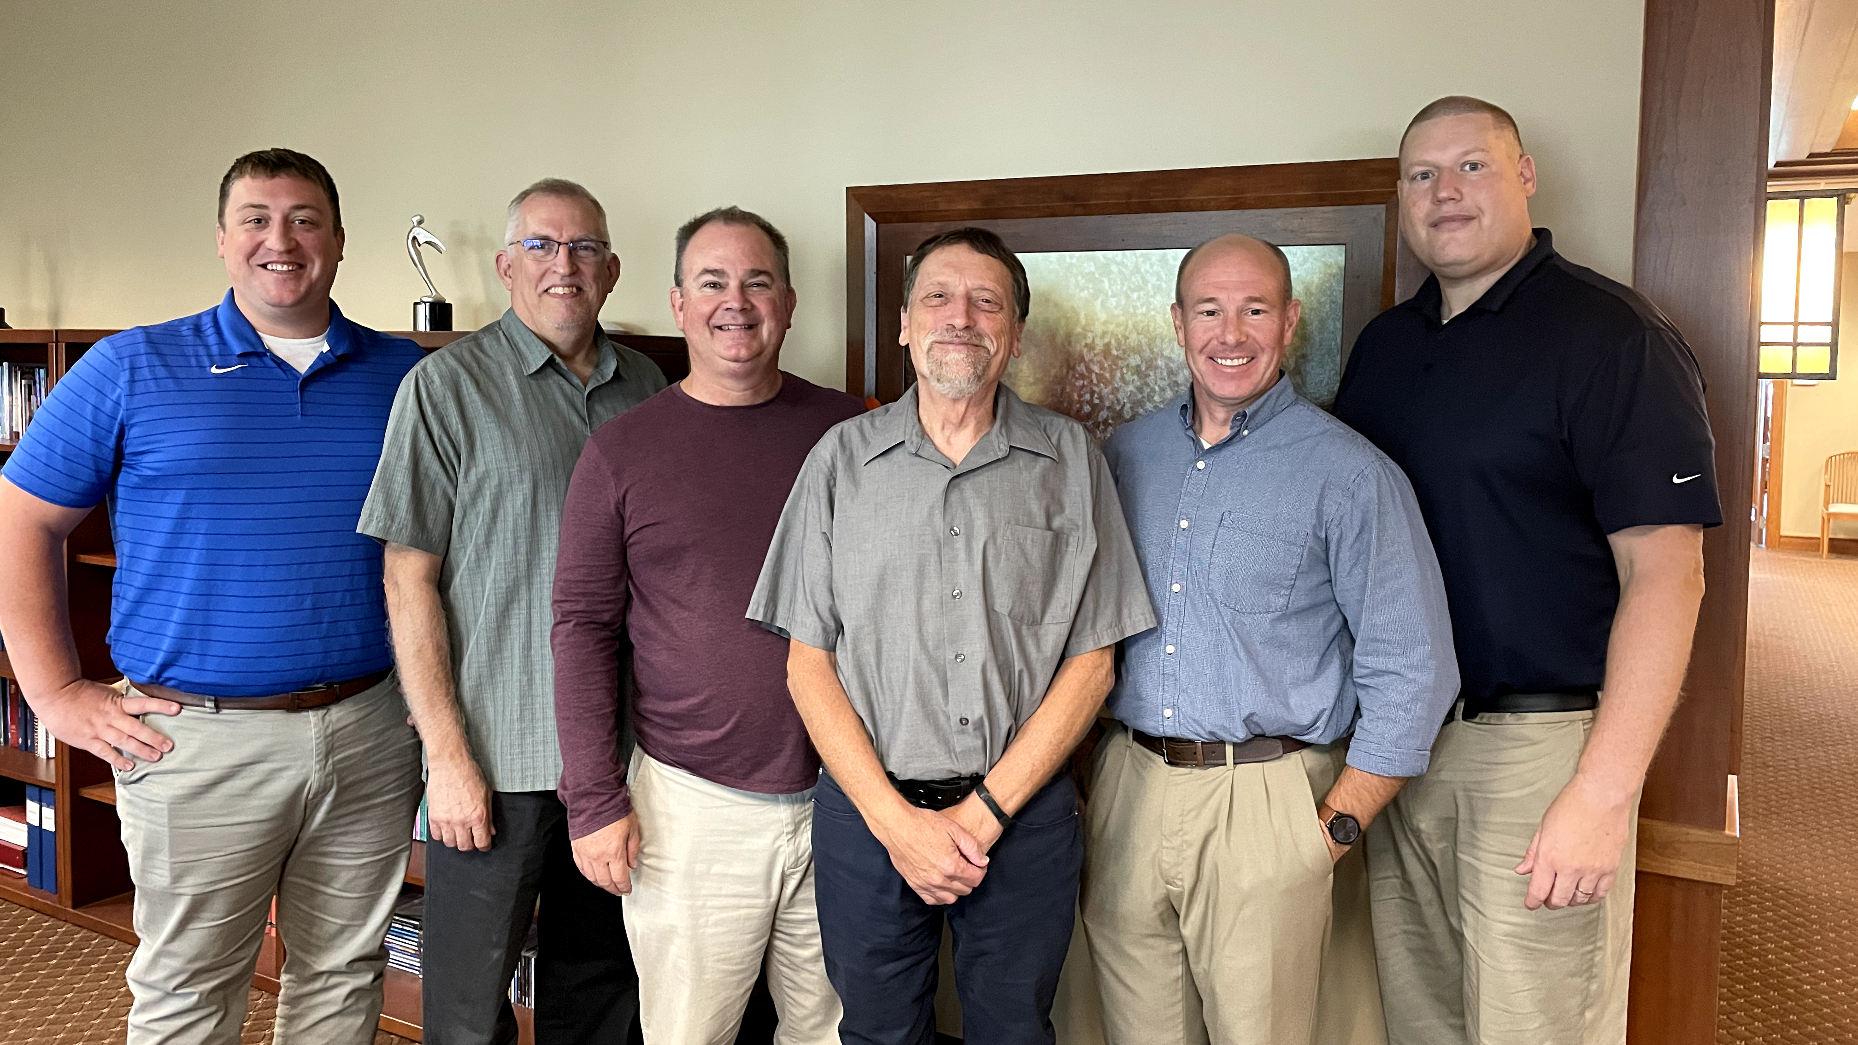
Mission Counselors: Guiding mission congregations and assisting District Mission Boards
Notes:
District mission boards (DMBs) and home mission churches are supported by three home mission counselors. They work with the DMBs to find, evaluate, and develop new home mission locations. They also provide onsite assistance to home mission congregations and counseling and training to the new missionaries who are called to serve them. This support is crucial in guiding mission churches on the way to becoming self-supporting congregations. WELS Home Missions also works with three specialized mission counselors that assist congregations with Hispanic, Asian, and Campus Ministry outreach.
Pictured (from left to right):
Rev. Neil Birkholz, North American Asian Ministry Consultant
Rev. Tim Flunker, Hispanic Outreach Consultant
Rev. Wayne Uhlhorn, Mission Counselor
Rev. Mark Birkholz, Mission Counselor
Rev. Matt Vogt, Mission Counselor,
Rev. Dan Lindner, Campus Ministry Mission Counselor

Slide 8
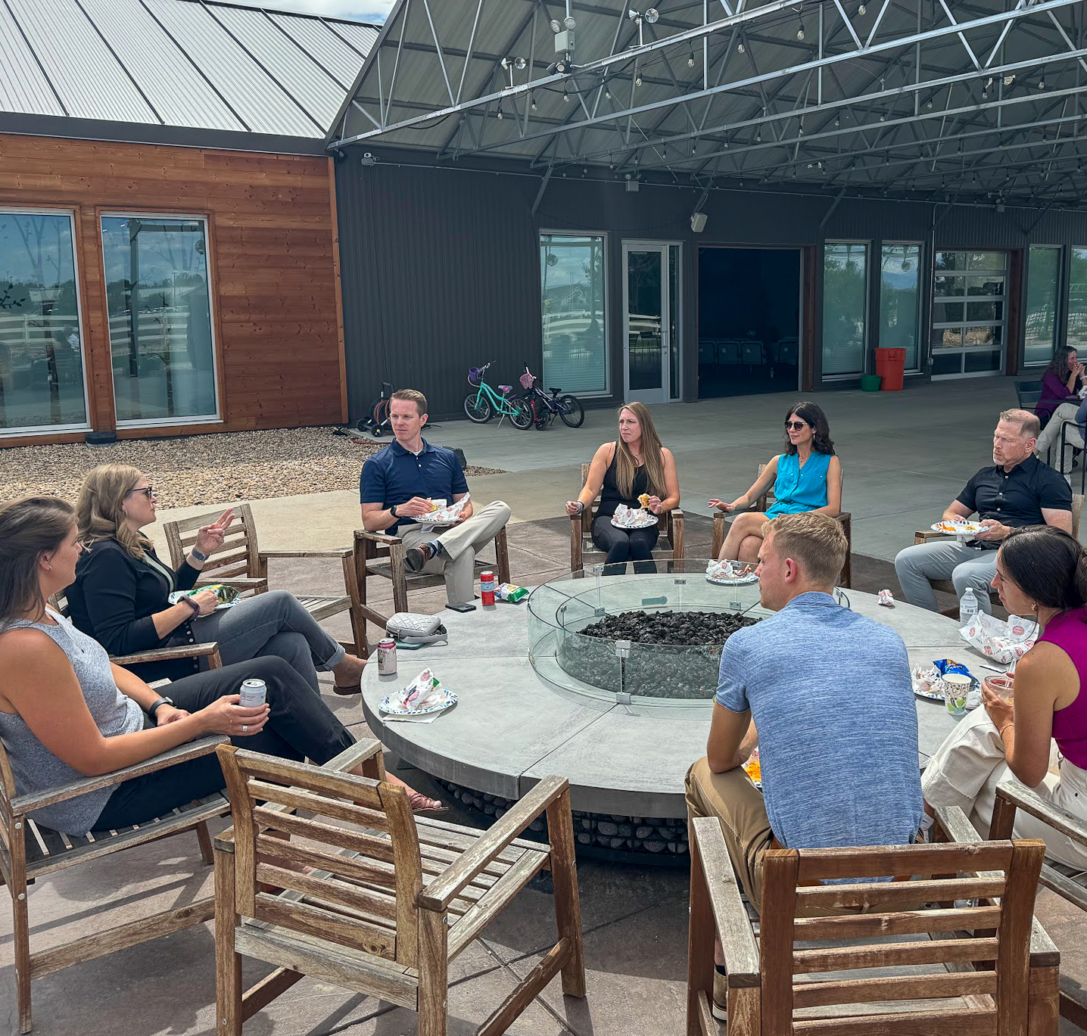
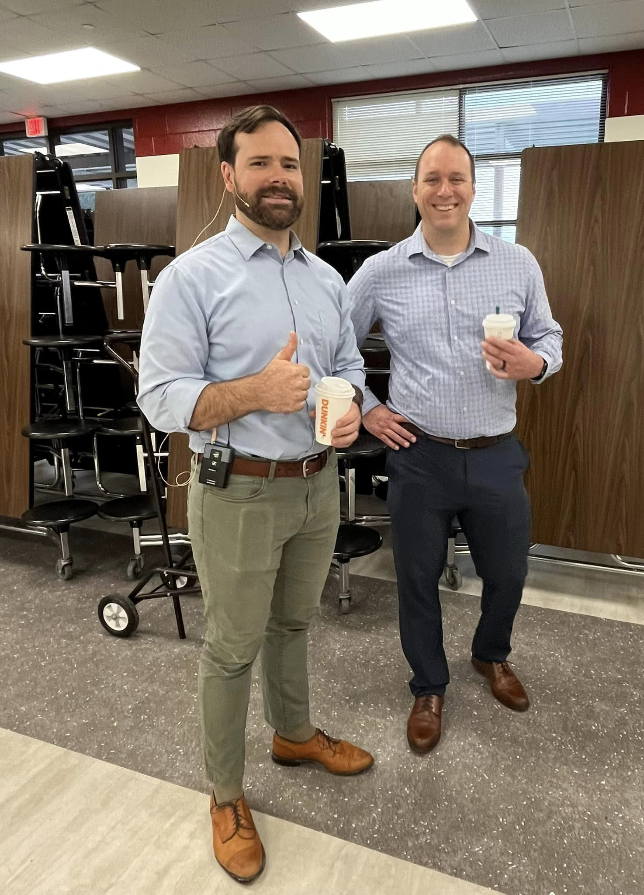
Church Planter Intensive and coaching program
Notes:
Pictured:
Left: Church Planter Intensive, August 2024
Right: Home Missionary Cale Mead (left) from Christ the Rock in Canton, GA, with his mentor Steven Prahl (Foundation, Payton, CO) during a visit leading up to their worship launch in October 2023.
New church planters are not left to fend on their own!
Brand new church planters gather together with experienced home missionaries for a Church Planter Intensive at Carbon Valley Lutheran Church in Firestone, Colo. The most recent one occurred in August 2024. Experienced church planter Jared Oldenburg (Eternal Rock – Castle Rock, Colo.) developed the program and Home Missionary Matt Rothe (The Way – Fredericksburg, Va.) now leads the training. This extended weekend seminar encourages and equips pastors who are called to plant brand new home mission churches. The purpose of this event is to:
Talk through church planting principals.
Be a sounding board to new missionaries and their unique situations.
Give the missionary a chance to think about all aspects of starting a church
Encourage the missionary to make decisions and plans based on the core group, community and place God has placed him. In other words, don’t copy, but instead learn to lead intuitively.
Help the missionary establish some big picture benchmarks/activities.
Offer encouragement by openly sharing what it’s like to be a church planter
Provide the opportunity for a new missionary to network with other missionaries.
After the intensive, new church planters are paired with a coach from an established mission church to guide them for their first two years of launching a new church. Home Missionary Joel Schulz (Divine Savior – Delray Beach, Fla.) leads that portion of the program.
Both the Church Planter Intensive and the coaching program are sponsored and encouraged by WELS Home Missions.
“As much as Church Planter Intensive was able to ground me, set our ministry on a good path, and send us out with valuable information, the coaching program is now my lifeline in an ongoing way. My coach is the most-accessible avenue to bounce ideas off, get input from, and help me grow as a pastor.” – Rev. Joe Lindloff, church planter in Marquette, Mich.

Slide 9
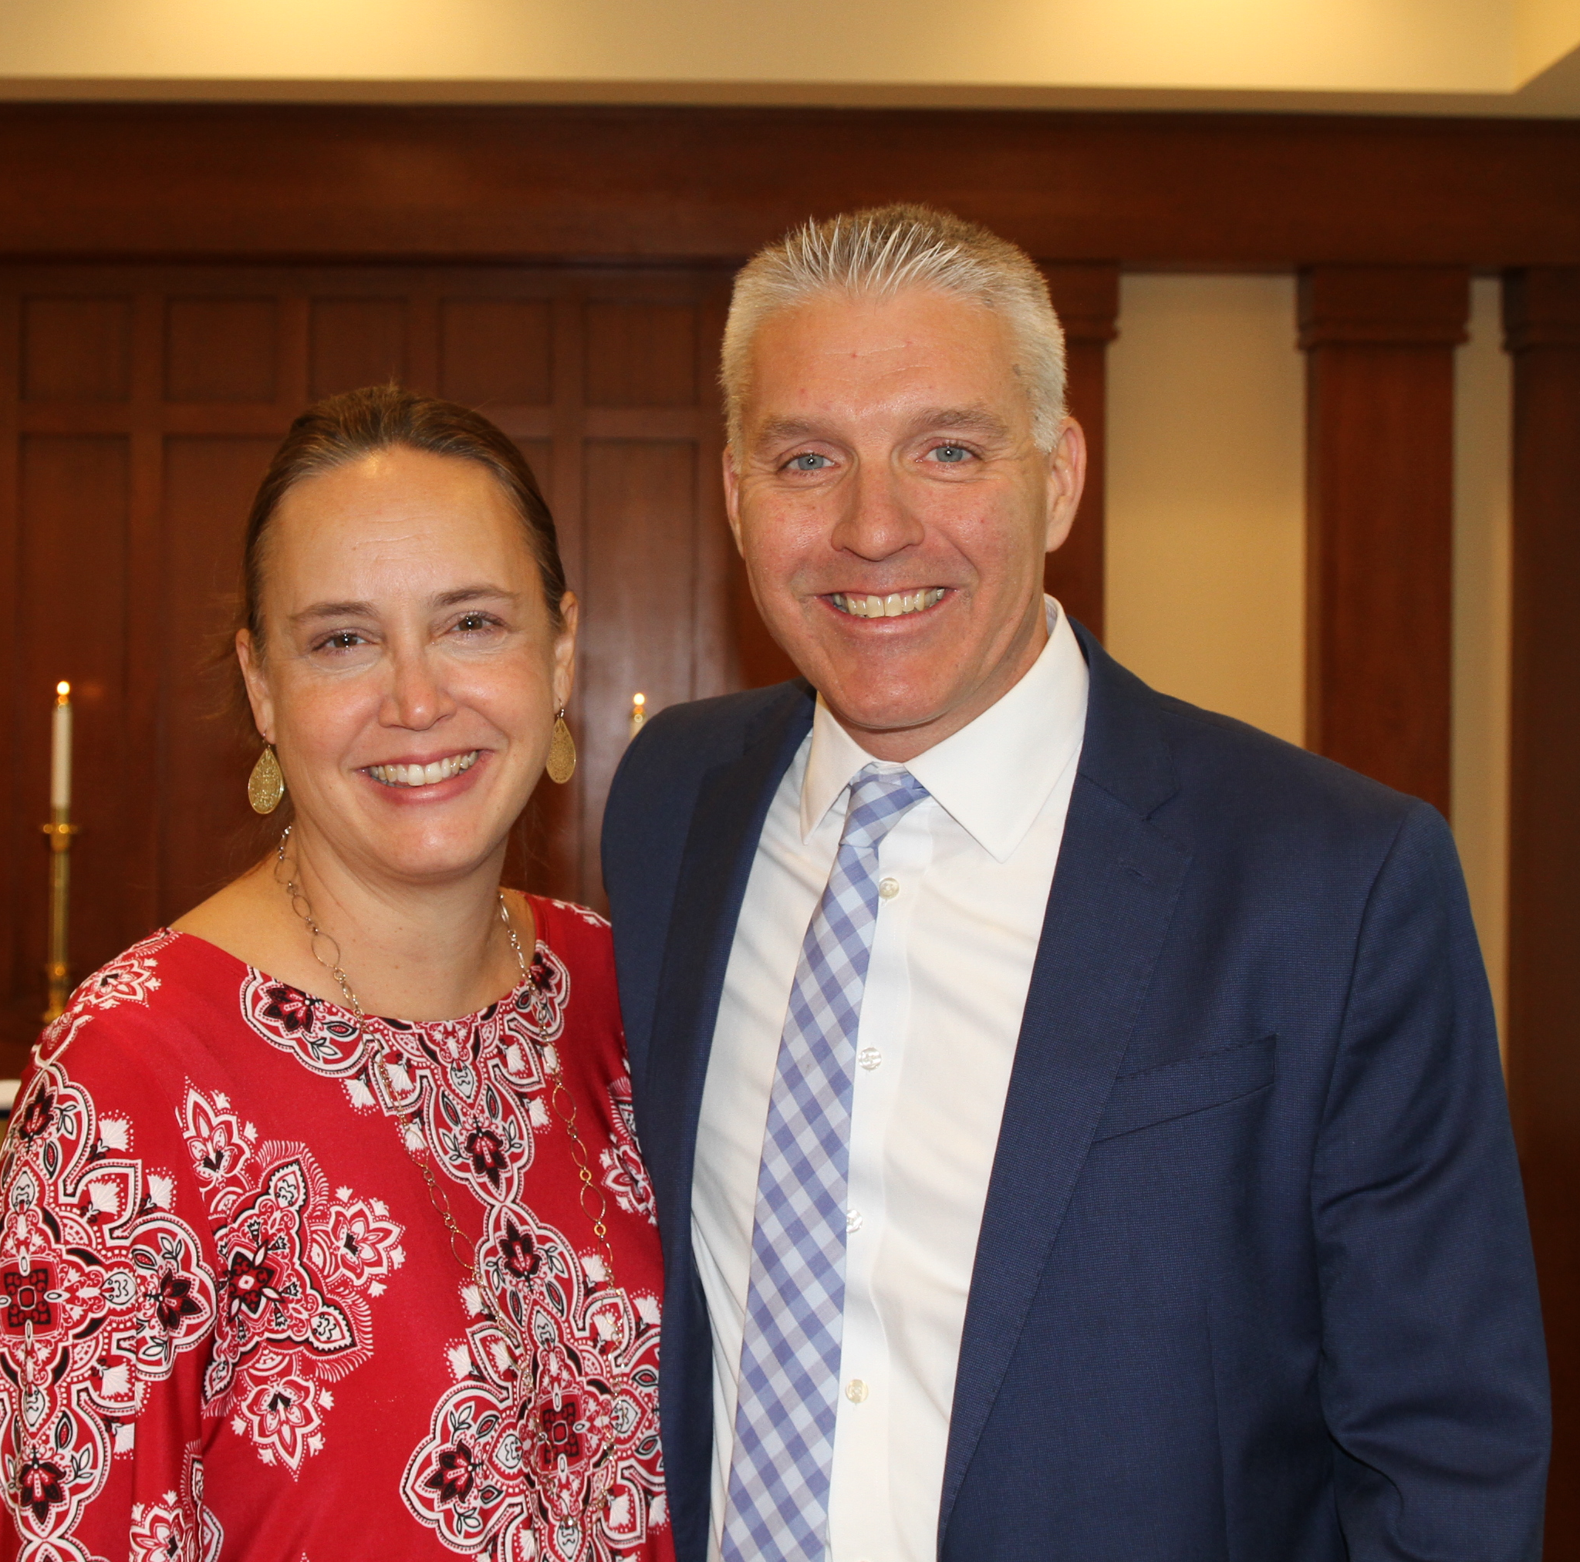
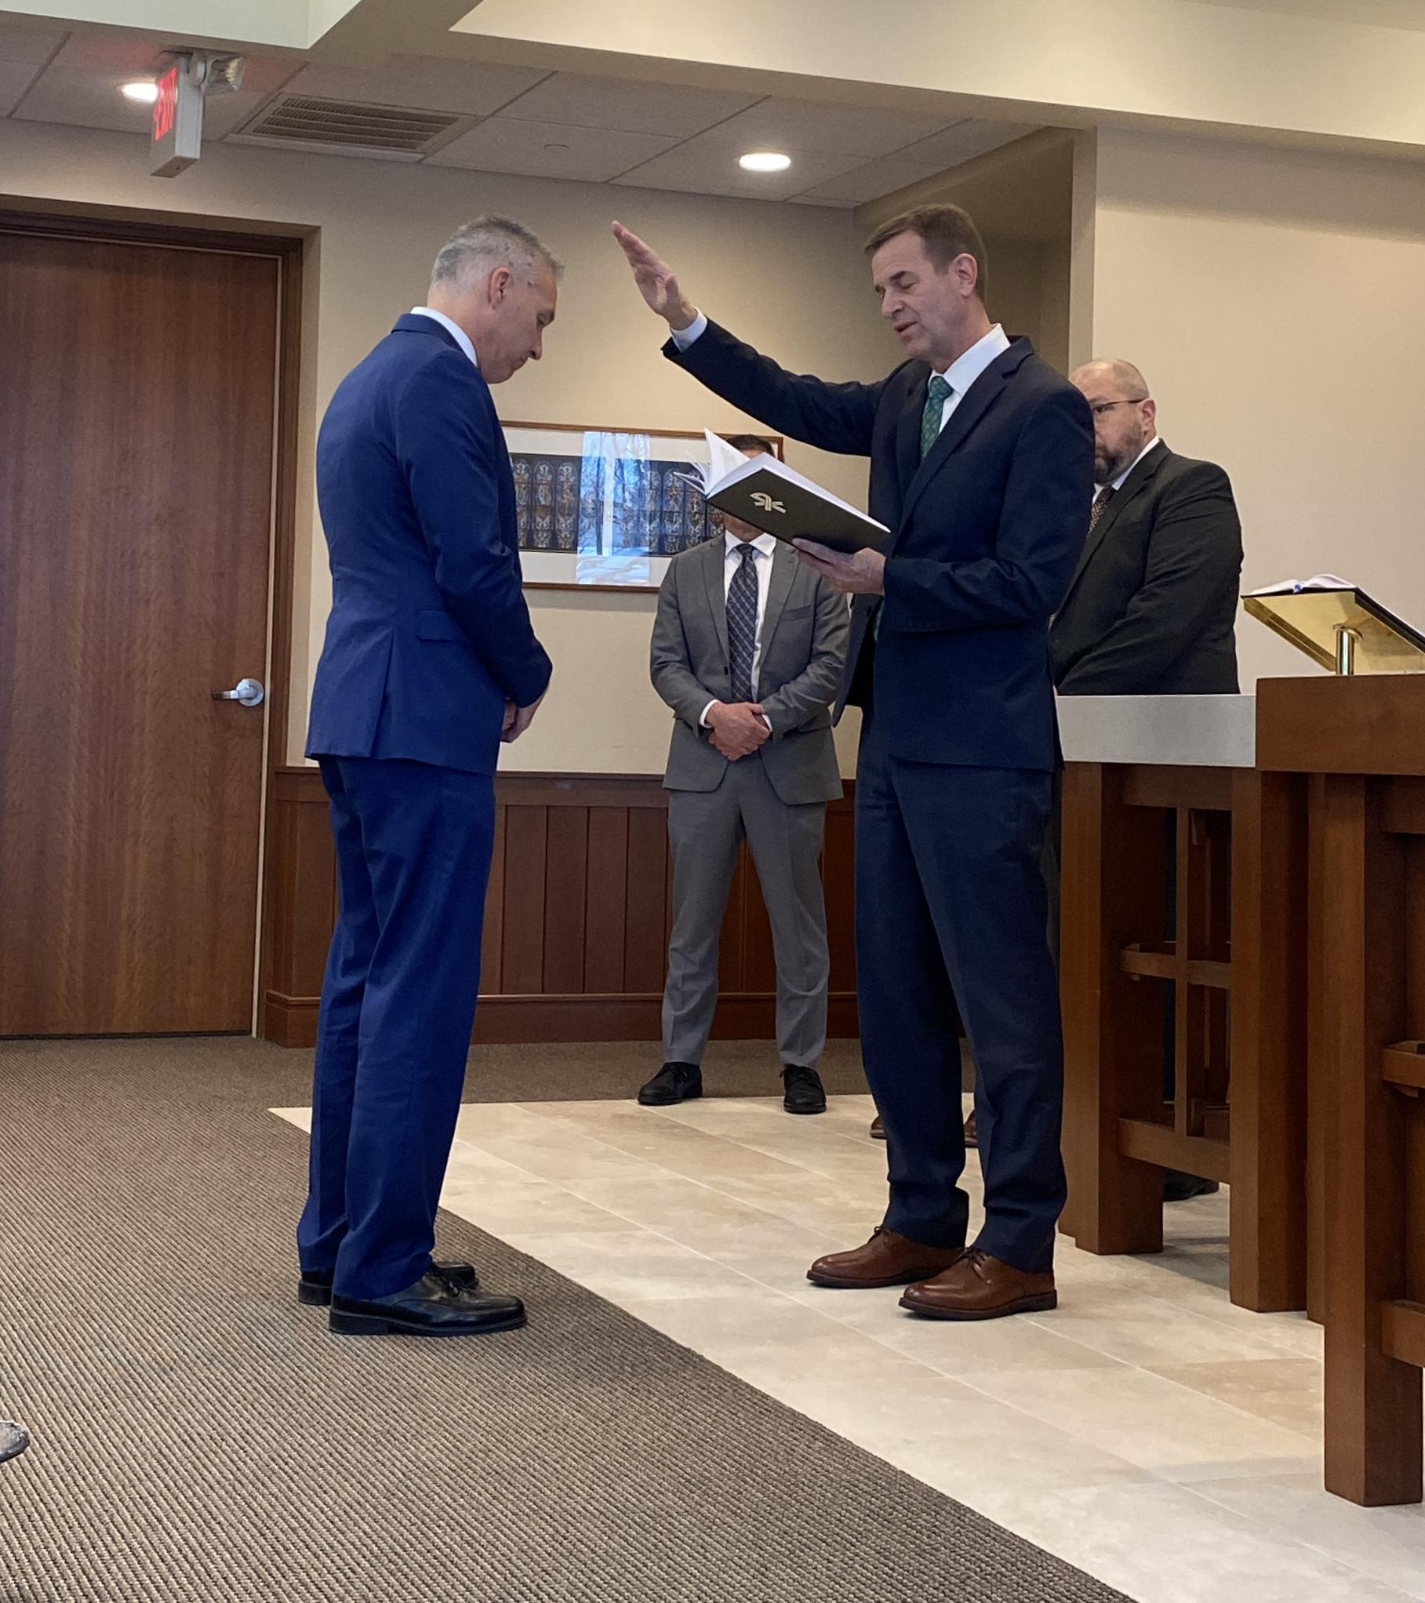
New Home Missions administrator
Rev. Mark Gabb
Notes:
WELS Missions welcomes Mark Gabb as the new administrator for WELS Home Missions. Gabb began serving in this role in January following a vacancy in the position since spring 2022, when previous administrator Keith Free accepted a call to parish ministry. Gabb was formally installed as the Home Missions administrator Wed., Jan. 31, at the WELS Center for Mission and Ministry weekly chapel service. Gabb is not new to the work of WELS Home Missions. He has served as a member of the Board for Home Missions for ten years and as chairman for three, taking on additional leadership responsibilities during the vacancy.

Slide 10
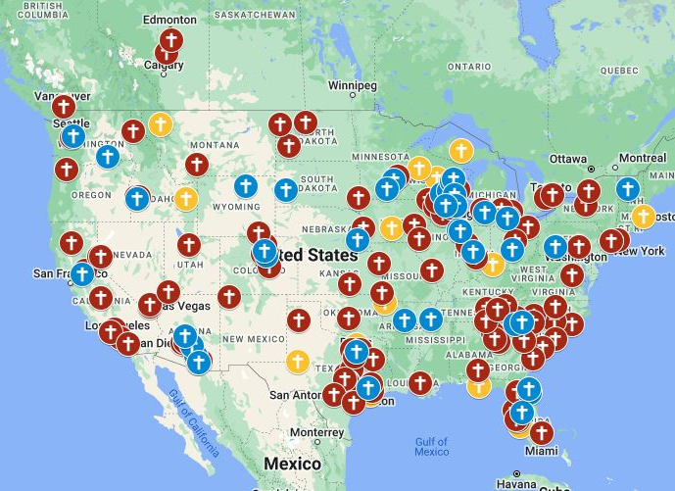
Exploratory missions in your district
Notes:
View our interactive Google map found at wels100in10.net to see where your district mission board is exploring outreach in your district. Anything in “blue” indicates an exploratory mission. District mission boards and mission counselors work with exploratory missions to develop a core group of members and begin Bible study and initial outreach before coming to the Board for Home Missions for official home mission status. These missions are not currently approved but are preparing the groundwork needed for their formal ministry request to the Board for Home Missions. Each request is thoroughly vetted and either prioritized, deferred, or denied. Prioritized requests are authorized as funding is available. Please note that there might be some exploratory missions on this list that will not end up receiving home mission status after the review process.

Slide 11
2024 New Starts:
Bend, Oregon
Cedar Lake, Indiana
Conway, Arkansas
Easley, South Carolina
Williston, North Dakota
Cypress/Waller, Texas
Notes:
In 2024, WELS Board for Home Missions approved 14 new missions and enhancements for the synodwide 100 Missions in 10 Years initiative.

Slide 12
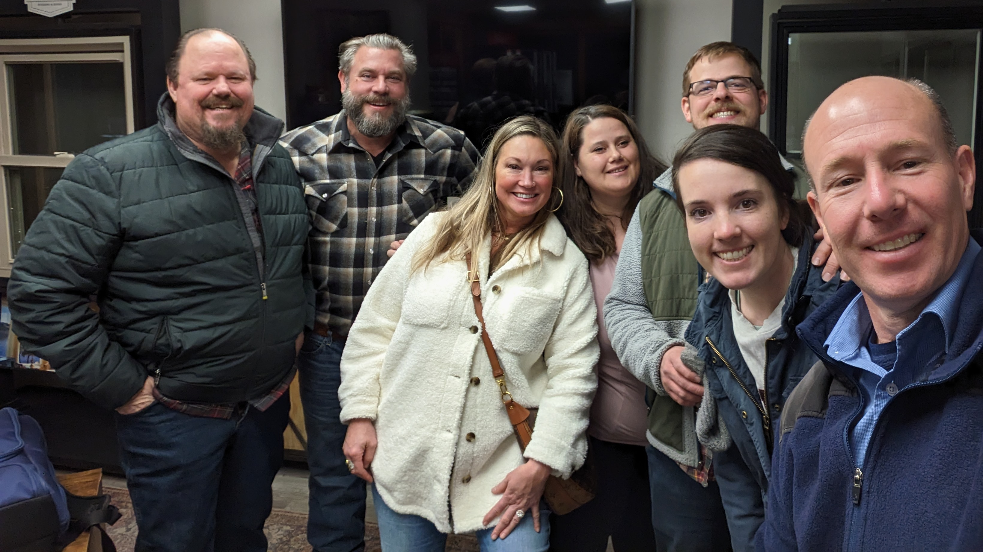
New Start – Bend, Oregon
Notes:
New Start: Bend was identified in 2020 as the second-fastest growing city in the U.S. A core group of eight families has been gathering twice a month for Bible study and planning as they plant a church in an area where 62 percent of people are not involved with any religious community.
Rev. Thad Bitter accepted the call to serve this new mission start in June 2024.
Learn more: https://wels100in10.net/new-starts/bend-or/

Slide 13
New Start – Cedar Lake, Indiana
Notes:
New Start: Members from Trinity and Zion in Crete, Ill., have formed a core group to plant a new mission in nearby Cedar Lake. This area of northwest Indiana is growing rapidly as Chicago commuters look for cheaper alternatives to living in Illinois.
Learn more: https://wels100in10.net/new-starts/cedarlake-in/

Slide 14
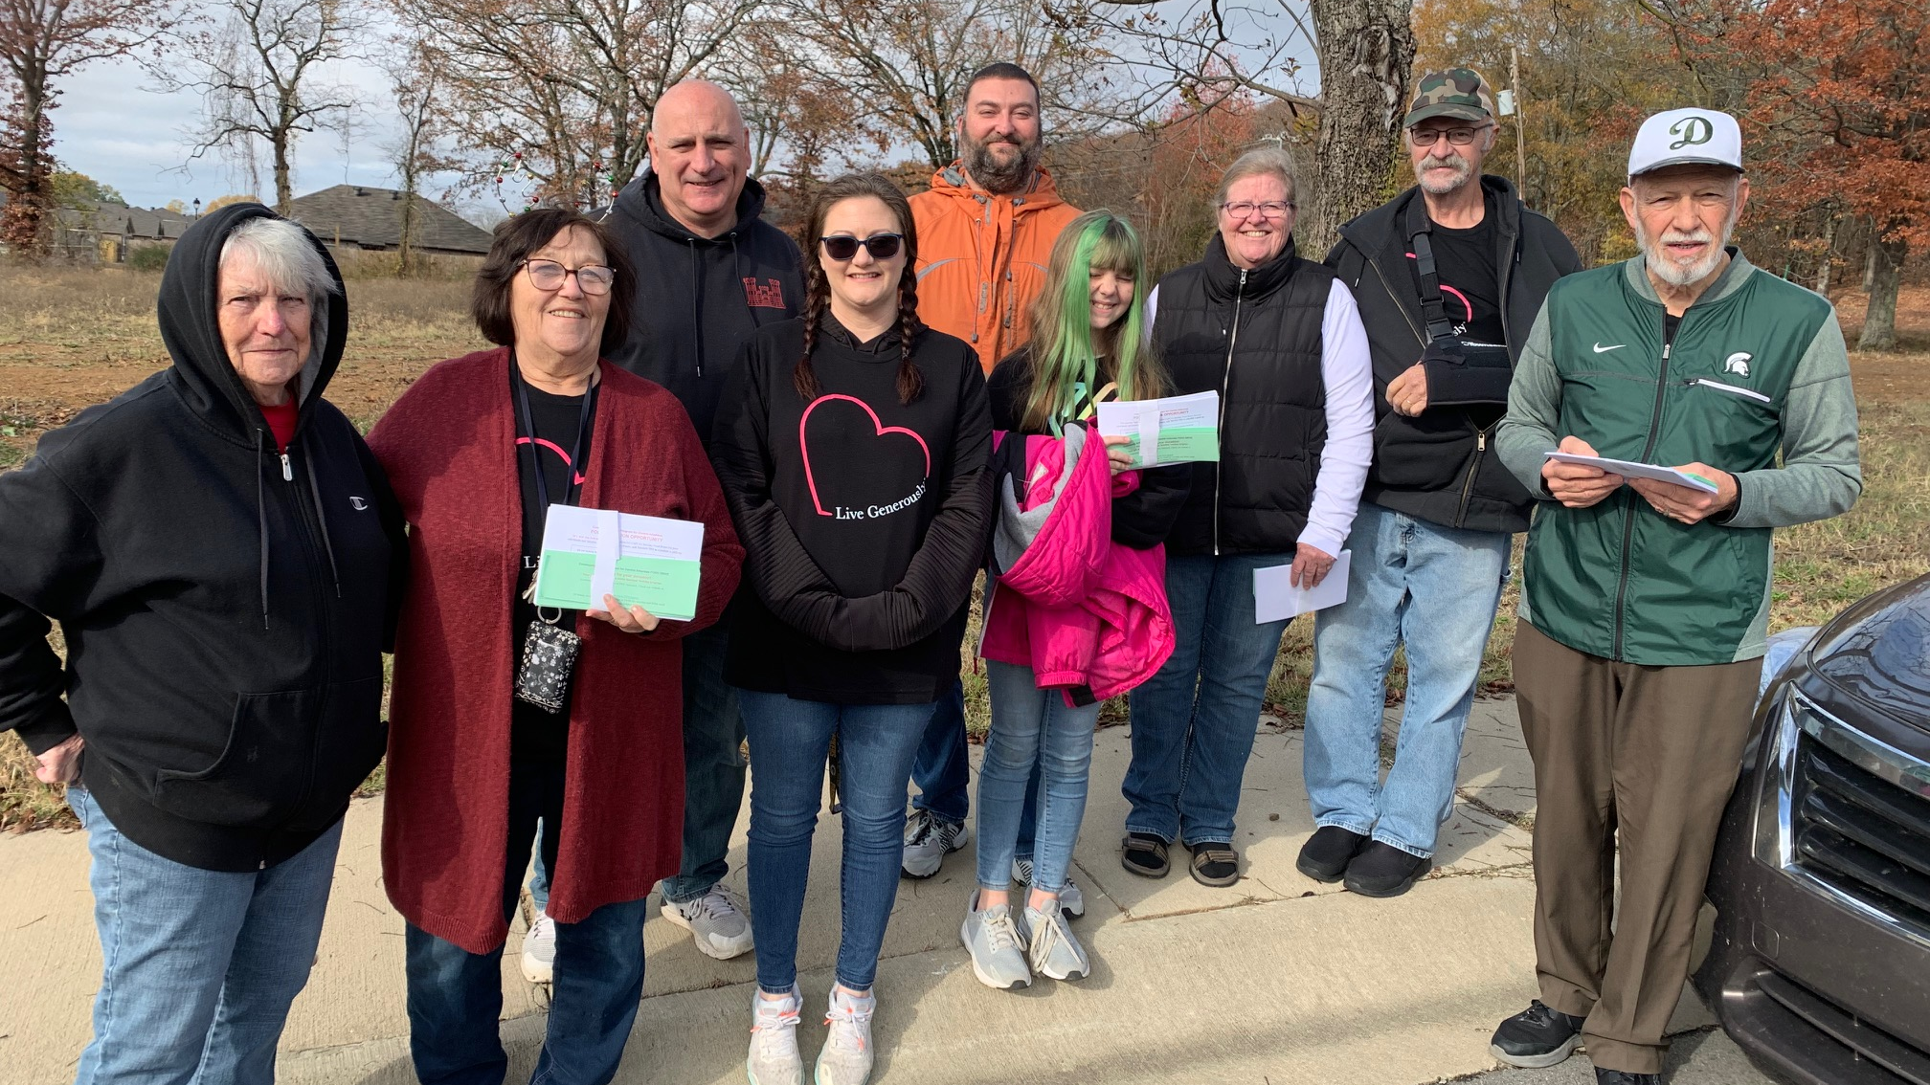
New Start – Conway, Arkansas
Notes:
New Start: Conway is a growing college town in the northwest of Little Rock with no WELS presence. A group of 19 WELS members has been gathering at a local hotel on Sundays for worship and Bible study with a part-time retired pastor and getting involved in the community as it prepares to launch a brand-new church.
Rev. Clayton Fury was assigned from Wisconsin Lutheran Seminary to serve this new mission start in May 2024.
Learn more: https://wels100in10.net/new-starts/conway-ar/

Slide 15
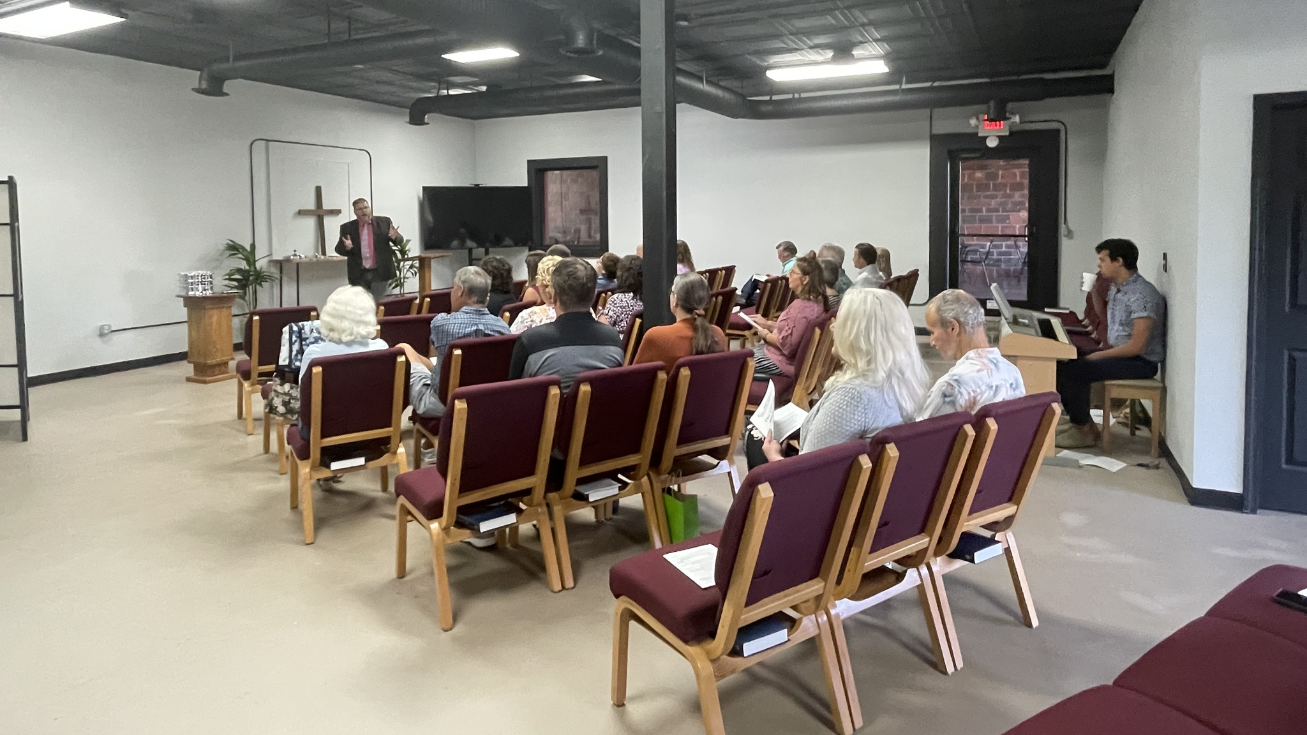
New Start – Easley, South Carolina
Notes:
New Start: Since 2016 Abiding Peace in Simpsonville, S.C., has been exploring the option of starting a second site in the greater Greenville area that includes Easley and Powdersville. Abiding Peace is currently offering worship and Bible study and getting involved in community events from a leased “homebase” in Easley as it evaluates where a future, permanent site might be established with a new missionary at the helm.
Rev. Michael Quandt accepted the call to serve this new mission start in July 2024.
Learn more: https://wels100in10.net/new-starts/easley-sc/

Slide 16
New Start – Williston, North Dakota
Notes:
New Start: The core group in Williston has been gathering for 15 years, now under the name Lamb of God Lutheran Church. It rents a full-time ministry center where members worship weekly online with the WELS church in Bismarck, N.D., and conduct outreach. Members look forward to reaching out with the gospel with a full-time missionary at the helm.
Learn more: https://wels100in10.net/new-starts/williston-nd/

Slide 17
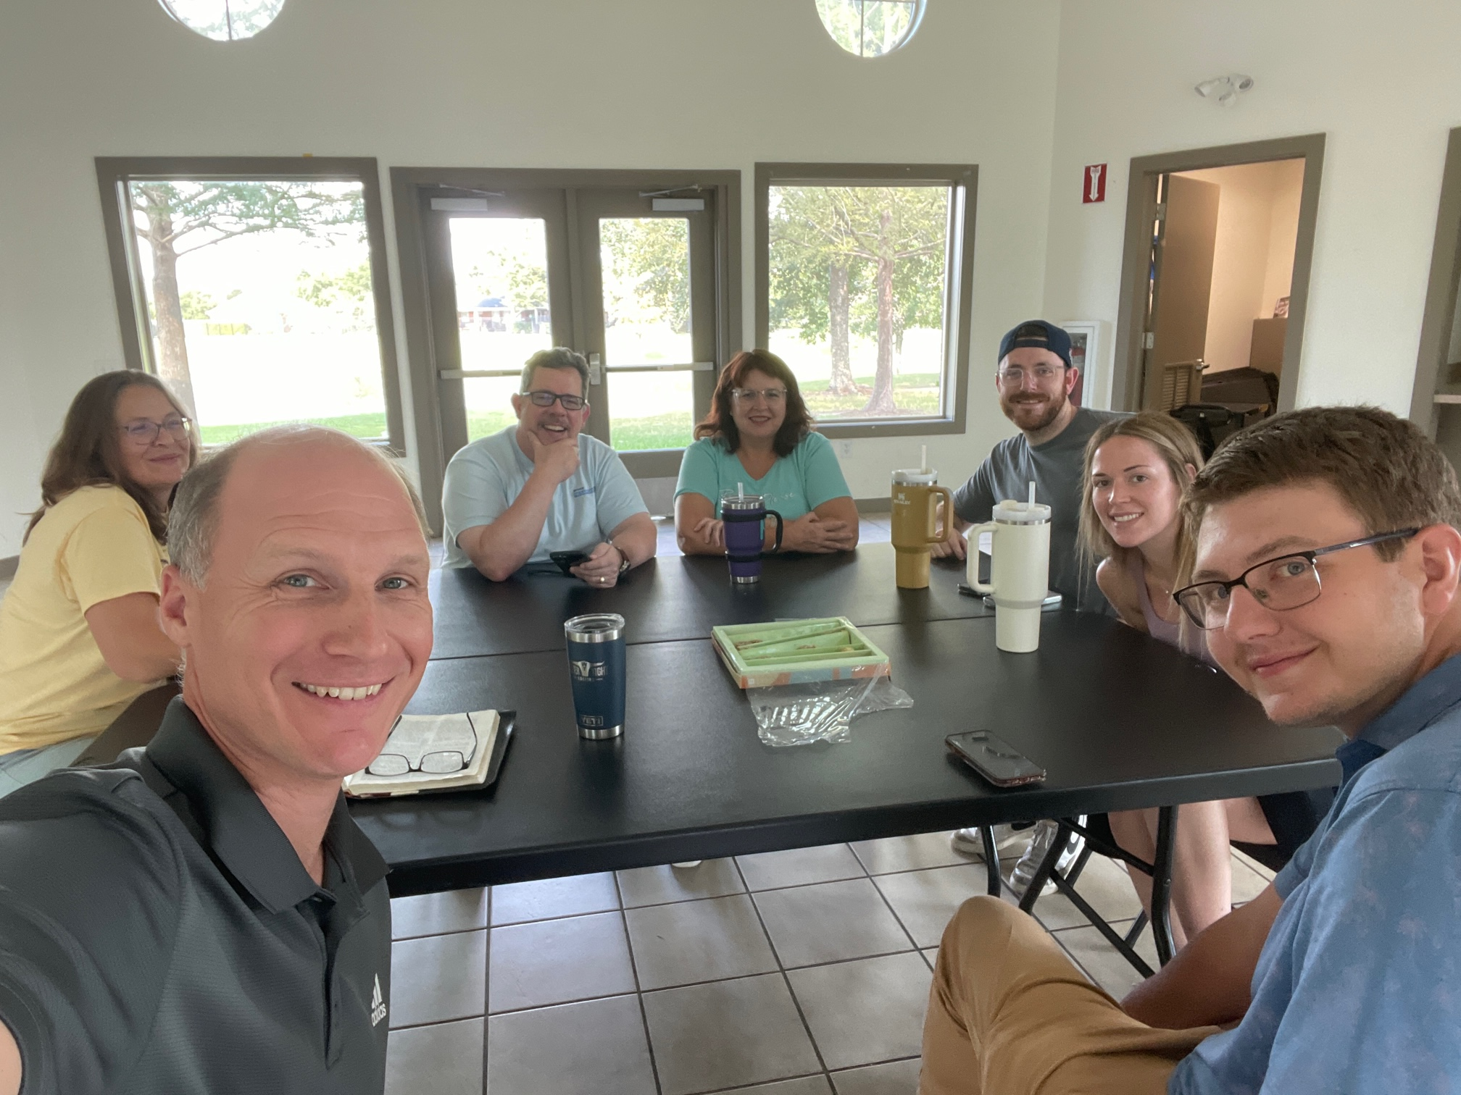
New Start – Cypress/Waller, Texas (Fall 2024)
Notes:
New Start: A core group of five families is looking to plant a new church somewhere between Cypress and Waller, Tex., in northwest Houston. The population in this area increased by 215% over a 13-year period, making it an ideal area to plant a new mission church.
Learn more: https://wels100in10.net/new-starts/cypress-waller-tx/

Slide 18
2024 Enhancements:
Calvary, Dallas, TX
Crossroads, Chicago, IL (Restart)
Faith, Prior Lake, MN
Good Shepherd, Plymouth, WI
Northdale, Tampa, FL
St. Marcus, Milwaukee, WI
St. Paul, Calgary, AB, Canada
Christ the Redeemer, Barre/Montpelier, VT (Restart)
Notes:
Calvary, Dallas, TX: Calvary will receive short-term support from Home Missions to call a second pastor who will be focused on outreach and connecting with unchurched early childhood and school families and the many other prospects Calvary has identified in the booming Lake Highlands area of Dallas.
Rev. Benjamin Schone accepted the call to serve as the outreach pastor in July 2024.
Crossroads, Chicago, IL (Restart): Crossroads is looking to restart its ministry on the north side of Chicago after COVID restrictions hurt its ministry and took away its worship location in a local elementary school. With Home Missions support, members look to position Crossroads as a permanent fixture in the neighborhood, enabling them to expand ministry to better serve the needs of the community.
Faith, Prior Lake, MN: Faith has developed a relationship with a standalone early childhood center that bought a portion of its vacant land and built a new facility across the parking lot from the church. The center has agreed to let Faith develop the Bible curriculum for use at the center, and Home Missions funding will allow a part-time staff minister to lead Bible lessons, connect with parents, and coordinate Faith’s members to volunteer at the center on a regular basis.
Good Shepherd, Plymouth, WI: Plymouth is a stable town in northern Wisconsin with 9,000 residents. Good Shepherd will receive short-term support to kickstart outreach efforts once again to take advantage of the gospel outreach opportunities the Lord is providing.
Rev. Eli Steinbrenner was assigned from Wisconsin Lutheran Seminary to serve this mission restart in May 2024. He was installed on July 14, 2024.
Northdale, Tampa, FL: Northdale is in a growing area of north Tampa, which has seen a large influx of Spanish-speakers move into the community. Northdale’s academy reflects this demographic shift, as 25 percent of its student body comes from a Spanish-speaking family. Short-term Home Missions support will allow Northdale to call a Spanish-speaking pastors to take advantage of these outreach opportunities.
St. Marcus, Milwaukee, WI: St. Marcus is looking for support to fund a “campus shepherd” at its third school campus, which serves 300 children, most of whom are unchurched. This person would be connecting with the parents of school children, overseeing the spiritual instruction of the kids on that campus, organizing baptism efforts, leading chapels, and supporting staff. This position will also be responsible for coordinating evangelism efforts across the three campuses.
St. Paul, Calgary, AB, Canada: St. Paul is located in one of the most diverse areas in Canada. The immediate neighborhood around St. Paul is 50 percent immigrants and includes people from India, the Philippines, Pakistan, Africa, and the Middle East. Home Missions support will allow St. Paul to hire two part-time workers to assist the pastor in discipleship, community outreach, service/volunteer coordination, and other cross-cultural mission efforts.
Christ the Redeemer, Barre/Montpelier, Vermont: Christ the Redeemer is restarting their ministry to go with the gospel to their target area of Montpelier, Berlin, and Barre, Vt. With a new home missionary leading their core group, Christ the Redeemer looks forward to bringing hope in Jesus to one of the least religious areas in the U.S.
Learn more about these enhancements at wels100in10.net/category/enhancement/.

Slide 19
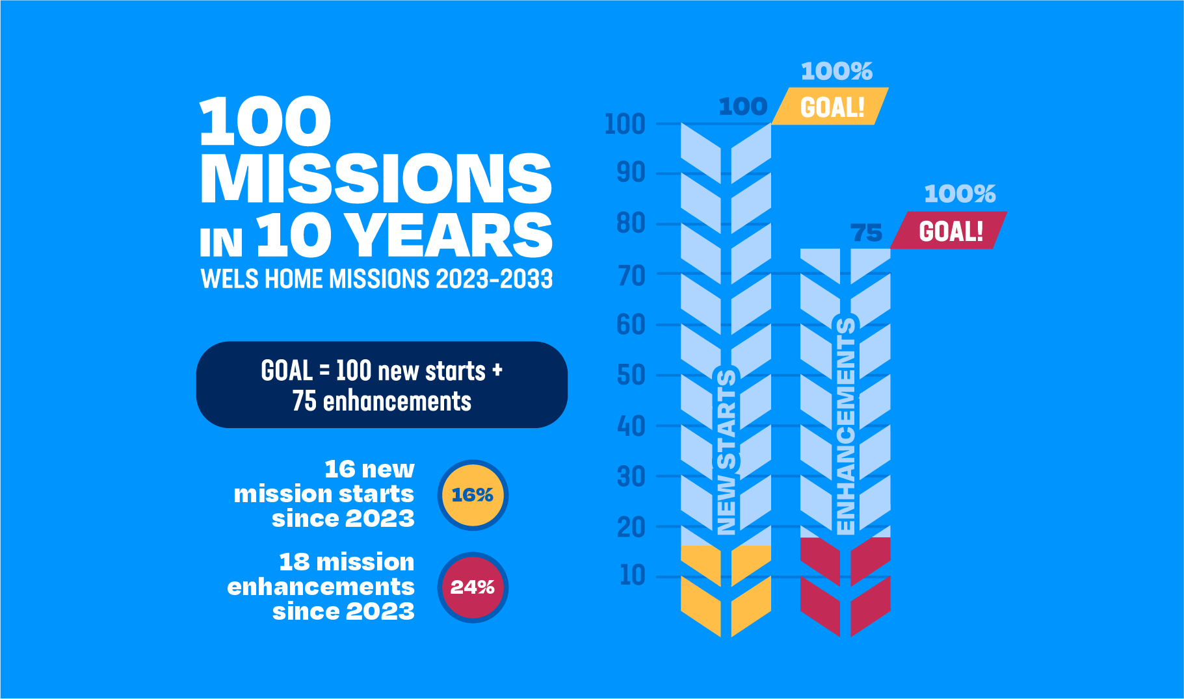
Notes:
Follow along! Watch each year as we track our progress towards our goal of 100 new starts and 75 enhancements in the next 10 years. Learn more about each approved mission by visiting our website at wels100in10.net.

Slide 20
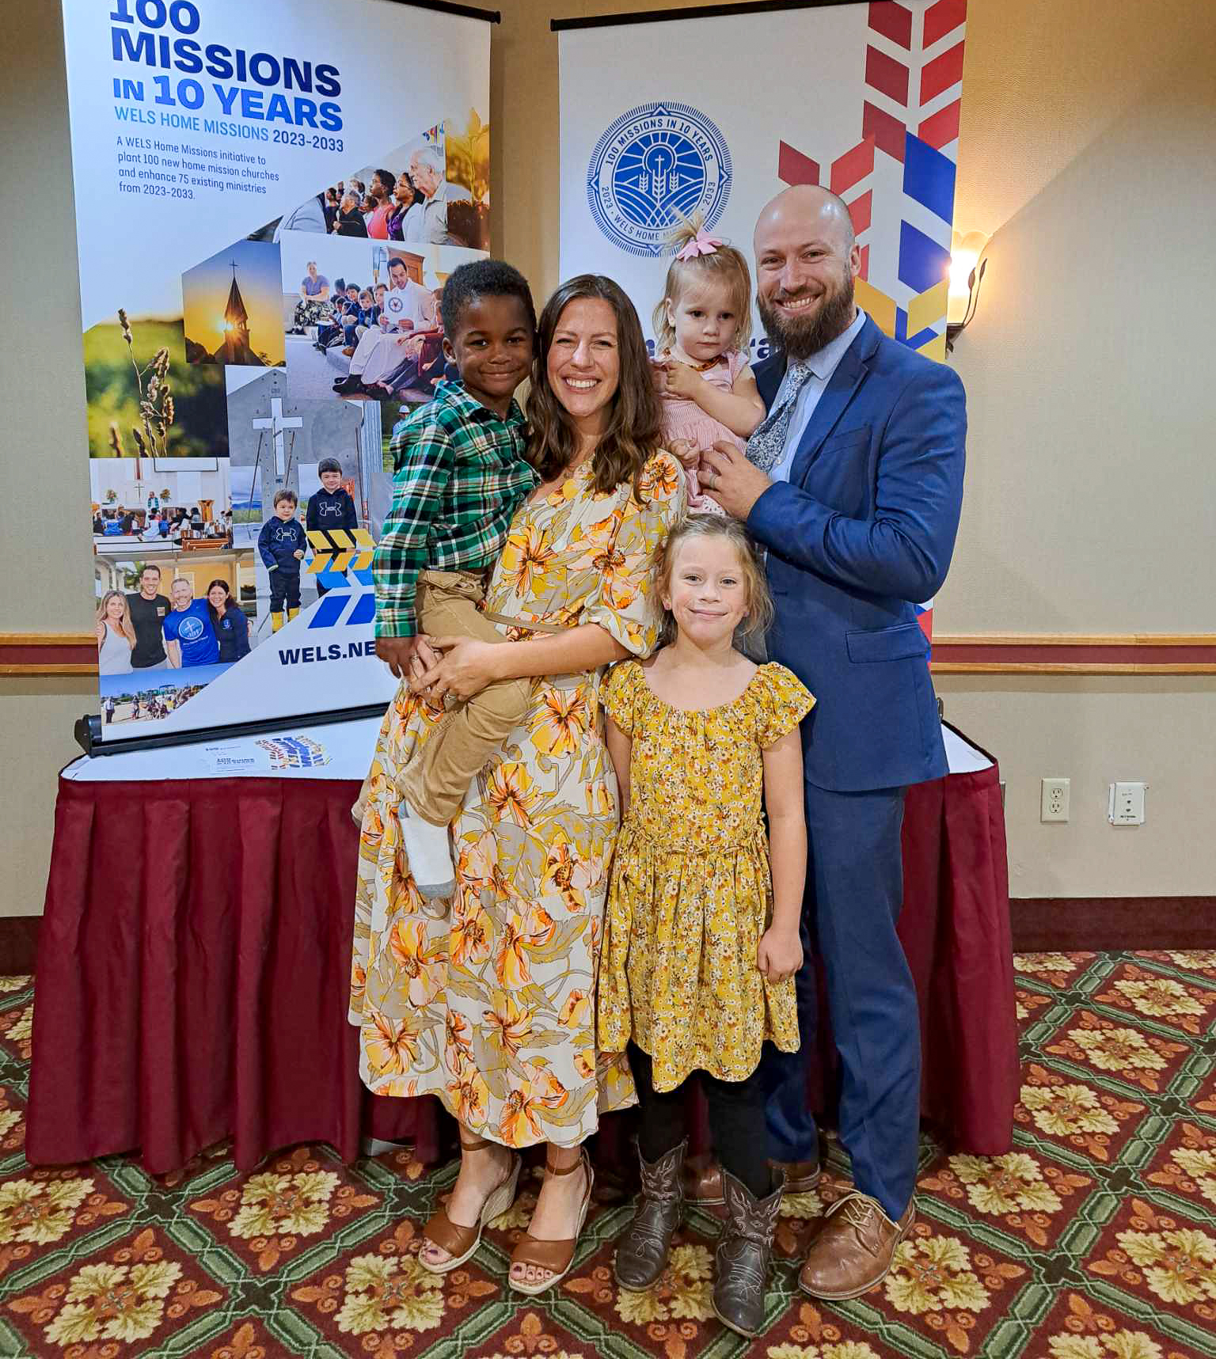
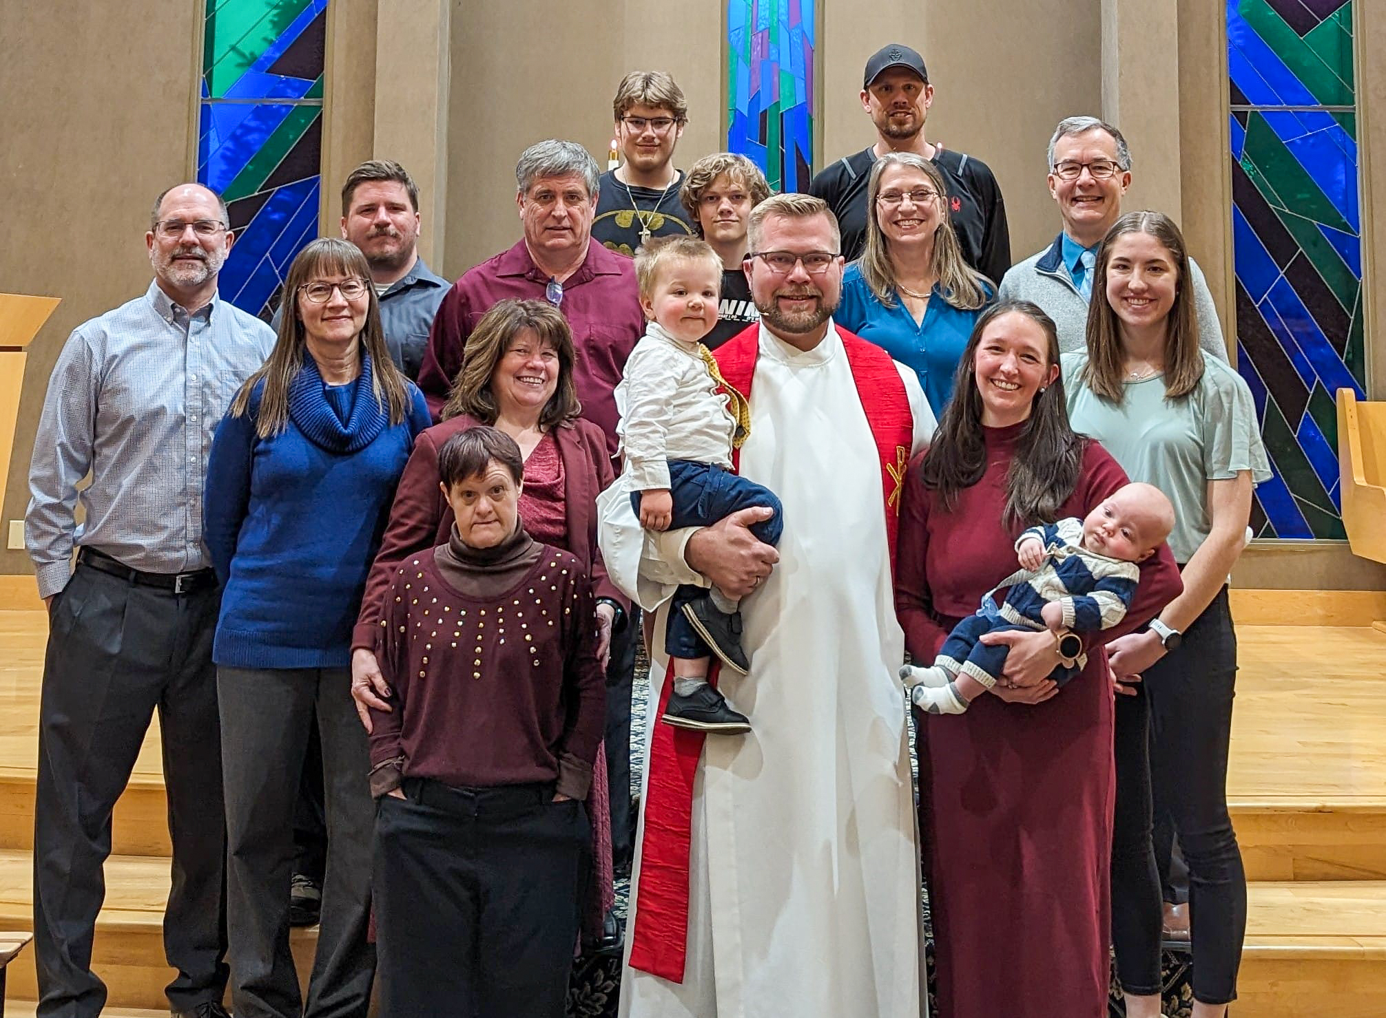
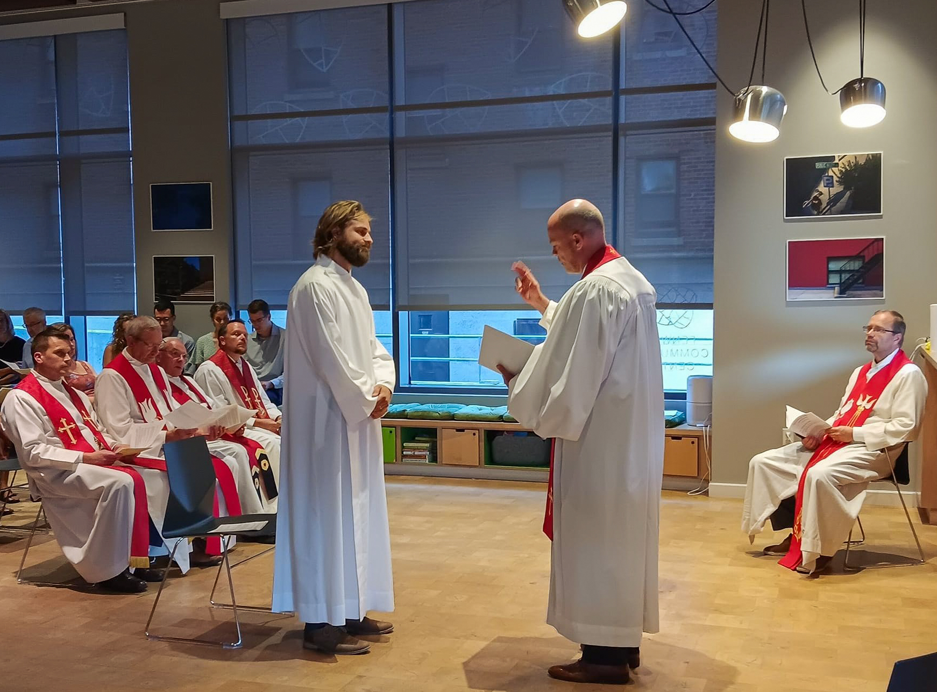
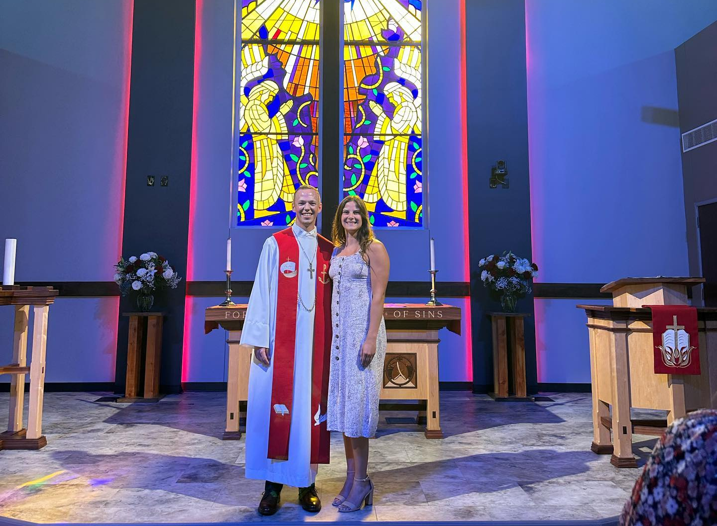
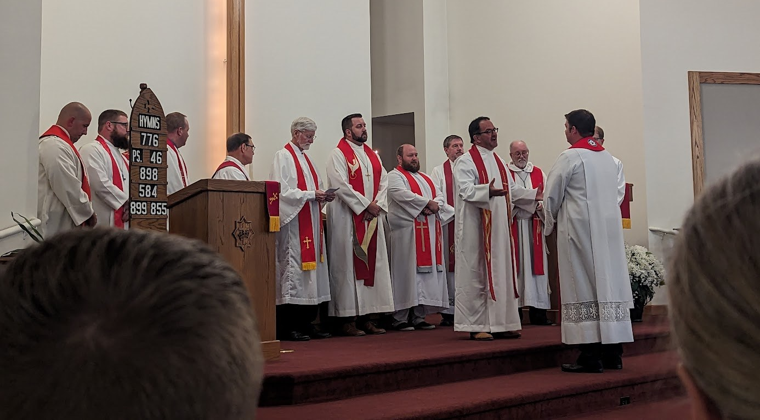
All 10 new mission starts from 2023 now have a home missionary!
Notes:
ALL positions filled!
Bentonville, Arkansas (New start) – Rev. Ross Chartrand
Boston, Massachusetts (New start) – Rev. Joshua Koelpin
Beautiful Savior, Cincinnati, Ohio (Multi-site) – Rev. Jacob Ungemach
Idaho Falls, Idaho (New start) – Rev. Paul Krueger
Kalispell, Montana (New start) – Rev. Josh Schroeder
Kronenwetter, Wisconsin (New start) – Rev. Frederic Berger
Marquette, Michigan (New start) – Rev. Joe Lindloff
North Collin County, Texas (New start) – Rev. Caleb King
Panama City Beach, Florida (Multi-Site) – Rev. Evan Chartrand
Buffalo, Wyoming (New start) - Rev. Fred Schurman

Slide 21
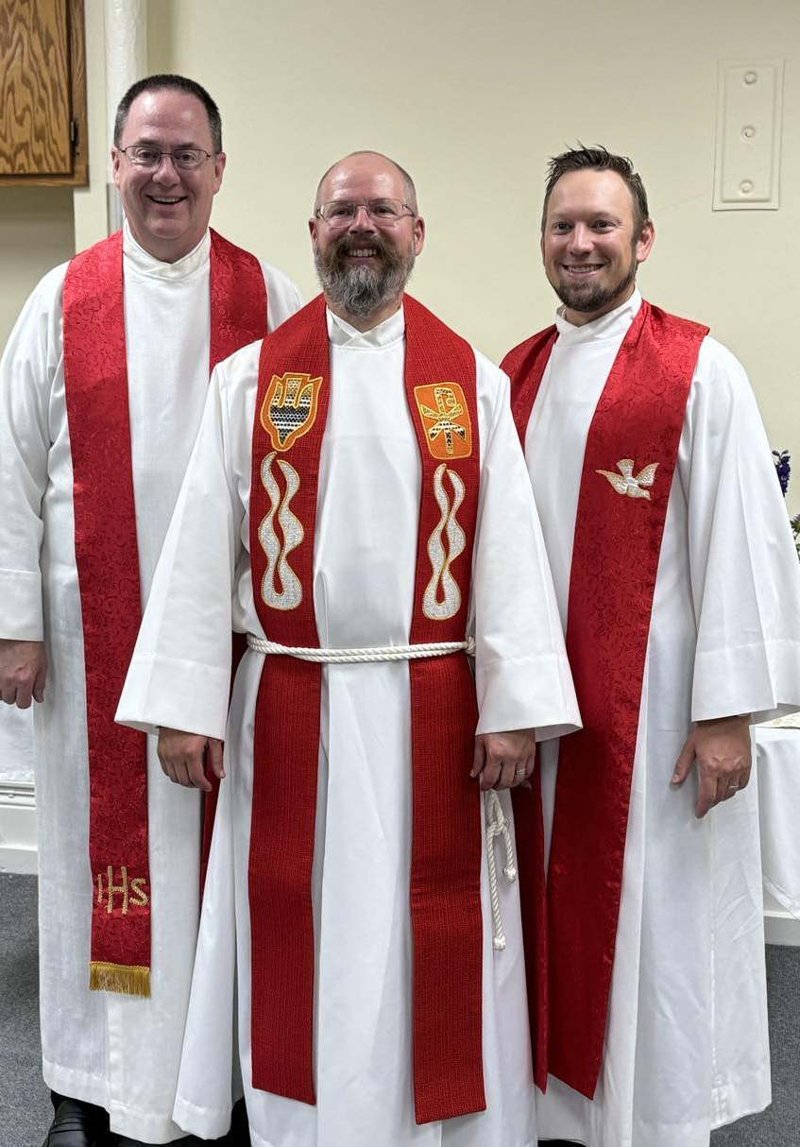
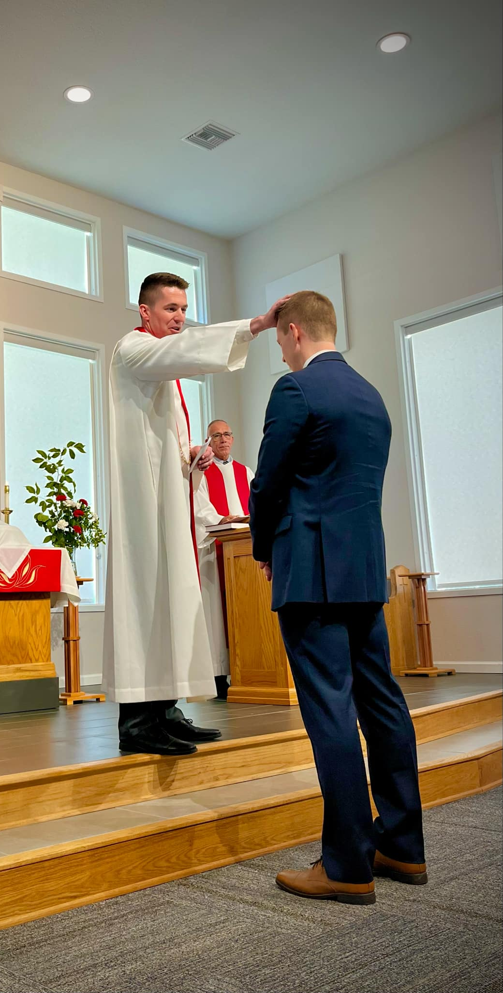
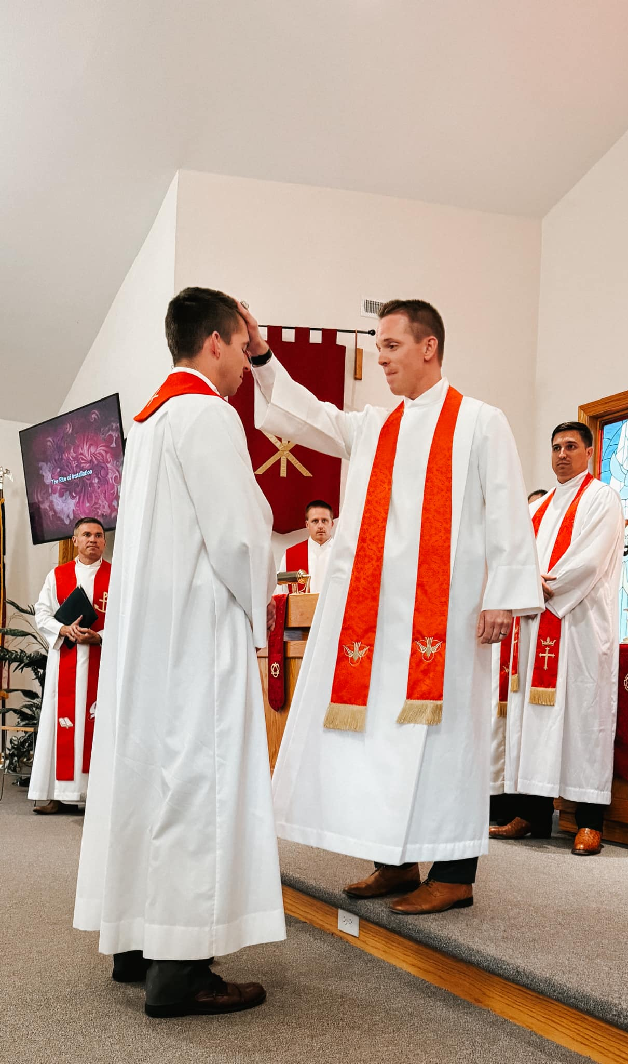
New home missionaries: 14 new home missionaries in total
Notes:
Eight current pastors accepted home mission calls since June 2024:
Rev. Fred Schurman: Christ the King, Buffalo, WY (New start approved Fall 2023)
Installed on July 7
Pictured left
wels100in10.net/new-starts/buffalo-wyoming/
Rev. Evan Chartrand: New Start, Panama City Beach, FL (New start approved Spring 2023)
Installed on July 21
Pictured center (Brother Ross Chartrand laying on hands)
wels100in10.net/new-starts/panamacitybeach-fl/
Rev. Ross Chartrand: New Start, Bentonville, AR (New start approved Spring 2023)
Installed on August 11
Pictured right (Brother Evan Chartrand laying on hands)
wels100in10.net/new-starts/bentonville-ar/
Rev. Fred Berger: New Start, Kronenwetter, WI (New start approved Spring 2023)
Installed on September 15
wels100in10.net/new-starts/kronenwetter-wi/
Rev. Thad Bitter: New Start, Bend, OR (New start approved Spring 2024)
Installation date upcoming
wels100in10.net/new-starts/bend-or/
Rev. Michael Quandt: New Start, Easley, SC (New start approved Spring 2024)
Installation date upcoming
https://wels100in10.net/new-starts/easley-sc/
Rev. Benjamin Schone: Calvary, Dallas, TX (Enhancement approved Spring 2024)
Installation date upcoming
https://wels100in10.net/enhancement/calvary-dallas-tx/
Rev. Andrew Ewings: Lamb of God, West Lafayette, IN (Existing home mission congregation)
Installation date upcoming

Slide 22
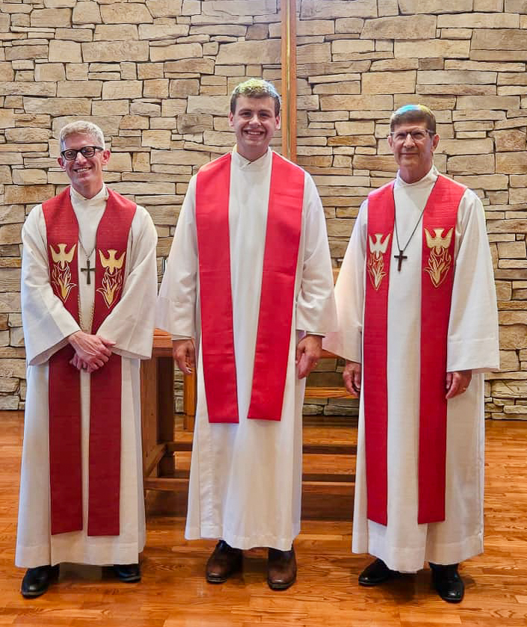
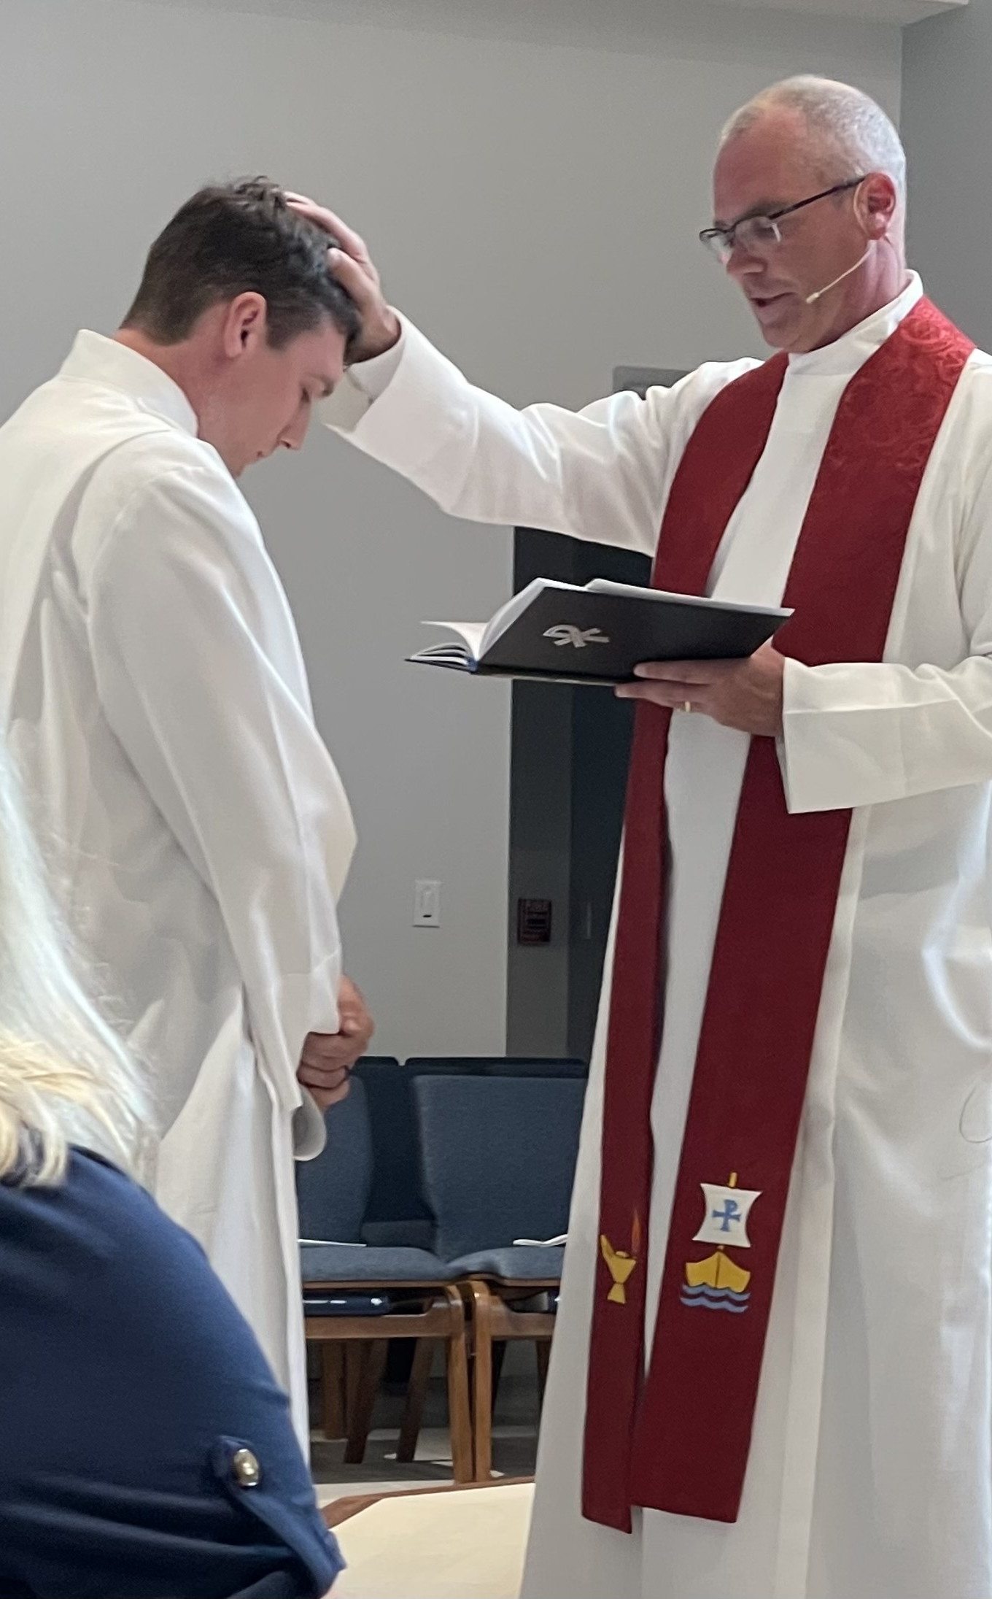
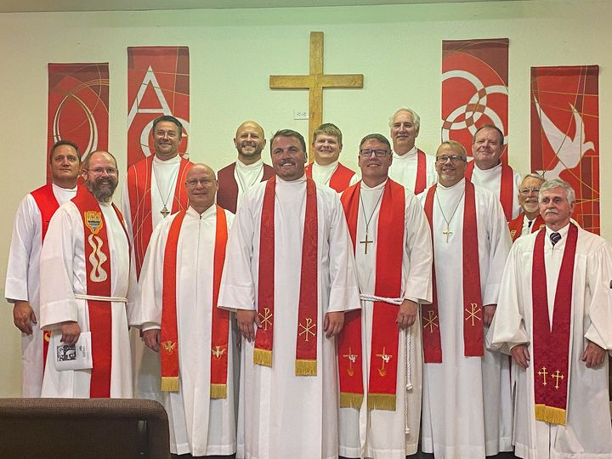
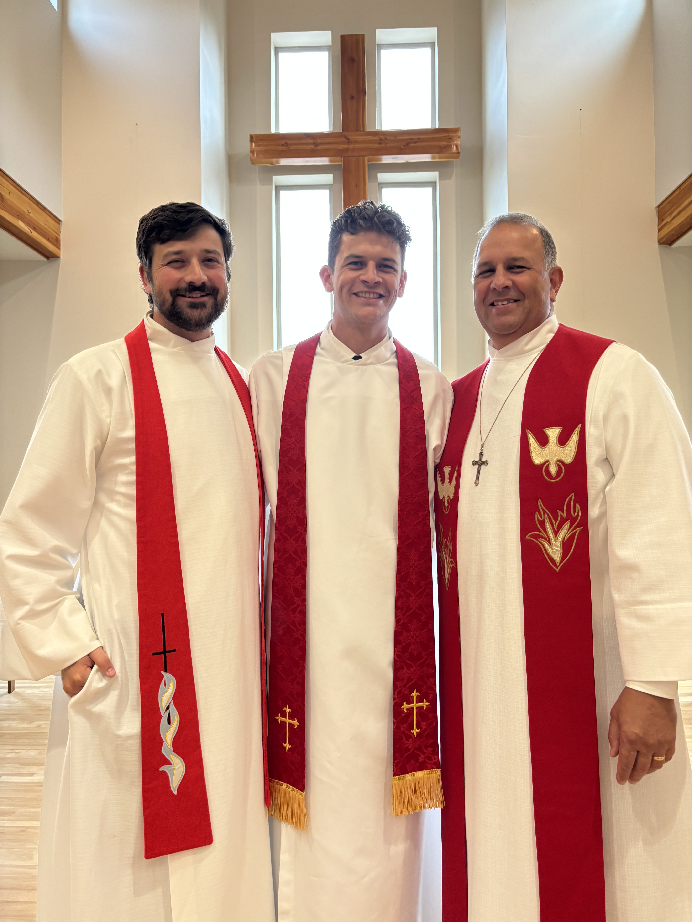
New seminary students assigned as home missionaries
Notes:
Six Wisconsin Lutheran Seminary graduates were assigned to home mission congregations in May 2024:
Rev. Eli Steinbrenner: Good Shepherd, Plymouth, WI (Restart approved in Spring 2024)
Installed on July 14
wels100in10.net/enhancement/good-shepherd-plymouth-wi/
Rev, Ben Bitter: Peace, Trinity, FL (Existing home mission congregation)
Installed on July 28
Pictured right
Rev. Tristan Pankow: Living Shepherd, Laramie, WY (Existing home mission congregation)
Installed on August 4
Pictured bottom middle
Rev. Jacob Ungemach: New Start, Oakley/Cincinnati, OH (New start approved in Spring 2023)
Installed on August 4
Pictured top left
wels100in10.net/new-starts/cincinnati-oh/
Rev. Josh Schroeder: New Start, Kalispell, MT (New start approved in Spring 2023)
Installed on August 21
Pictured bottom left
wels100in10.net/new-starts/kalispell-mt/
Rev. Clayton Fury: New Start, Conway, AR (New start approved in Spring 2024)
Installed on September 15
wels100in10.net/new-starts/conway-ar/

Slide 23
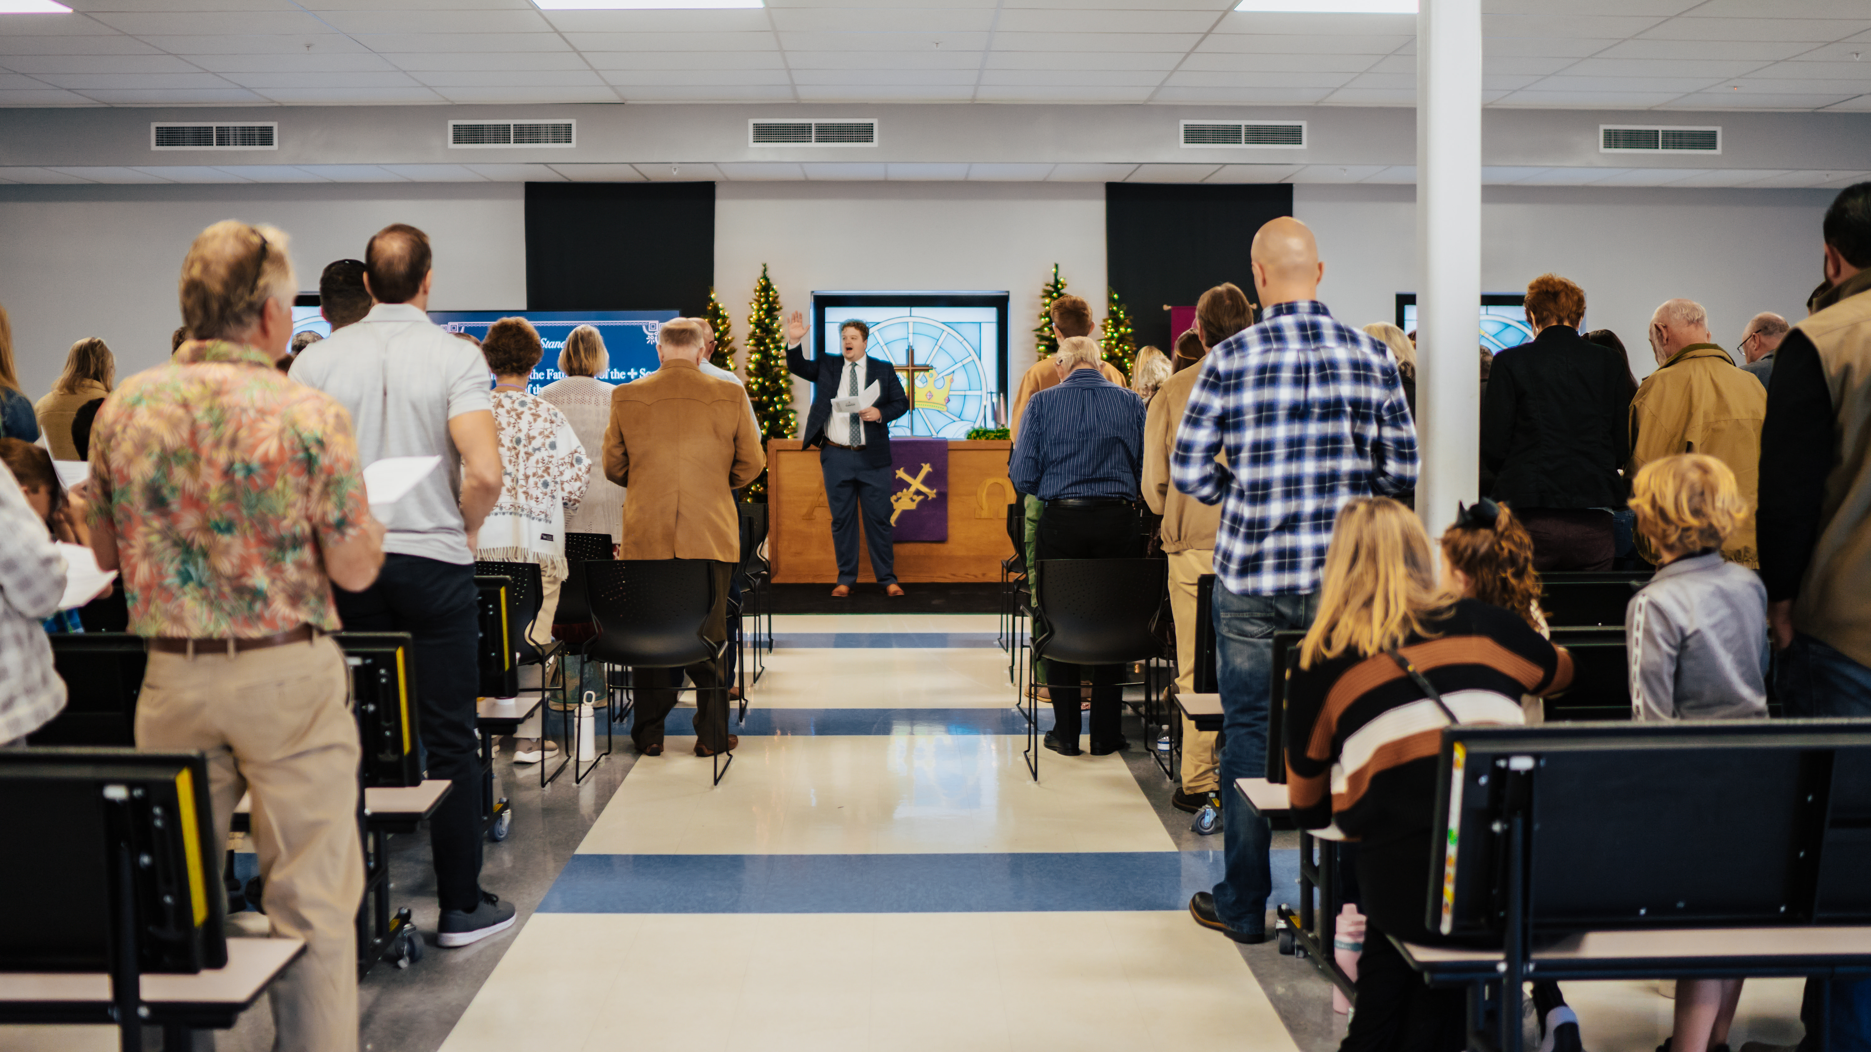
Public worship launch on December 8, 2024, at
Risen Savior in Parrish, Fla.
Notes:
Risen Savior, a home mission congregation in Parrish, Fla., launched public worship in the cafeteria of Parrish Charter Academy on Sunday, December 8, 2024. Nearly 90 people, including 18 first time visitors, gathered to be fed by God’s Word. This new outpost for the gospel is a second site of Risen Savior in Lakewood Ranch, Fla.
While they used social media and other marketing efforts to get the word out about their new church, every single visitor came because someone they knew personally invited them. What a powerful reminder that a simple invitation, shared within a trusted relationship, can make an eternal impact!

Slide 24
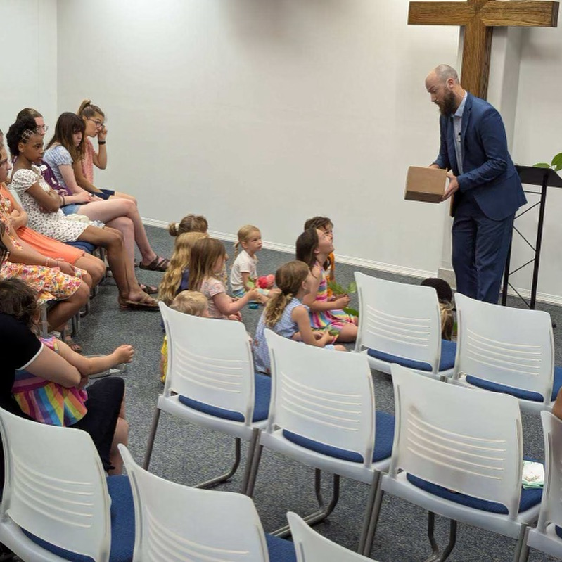
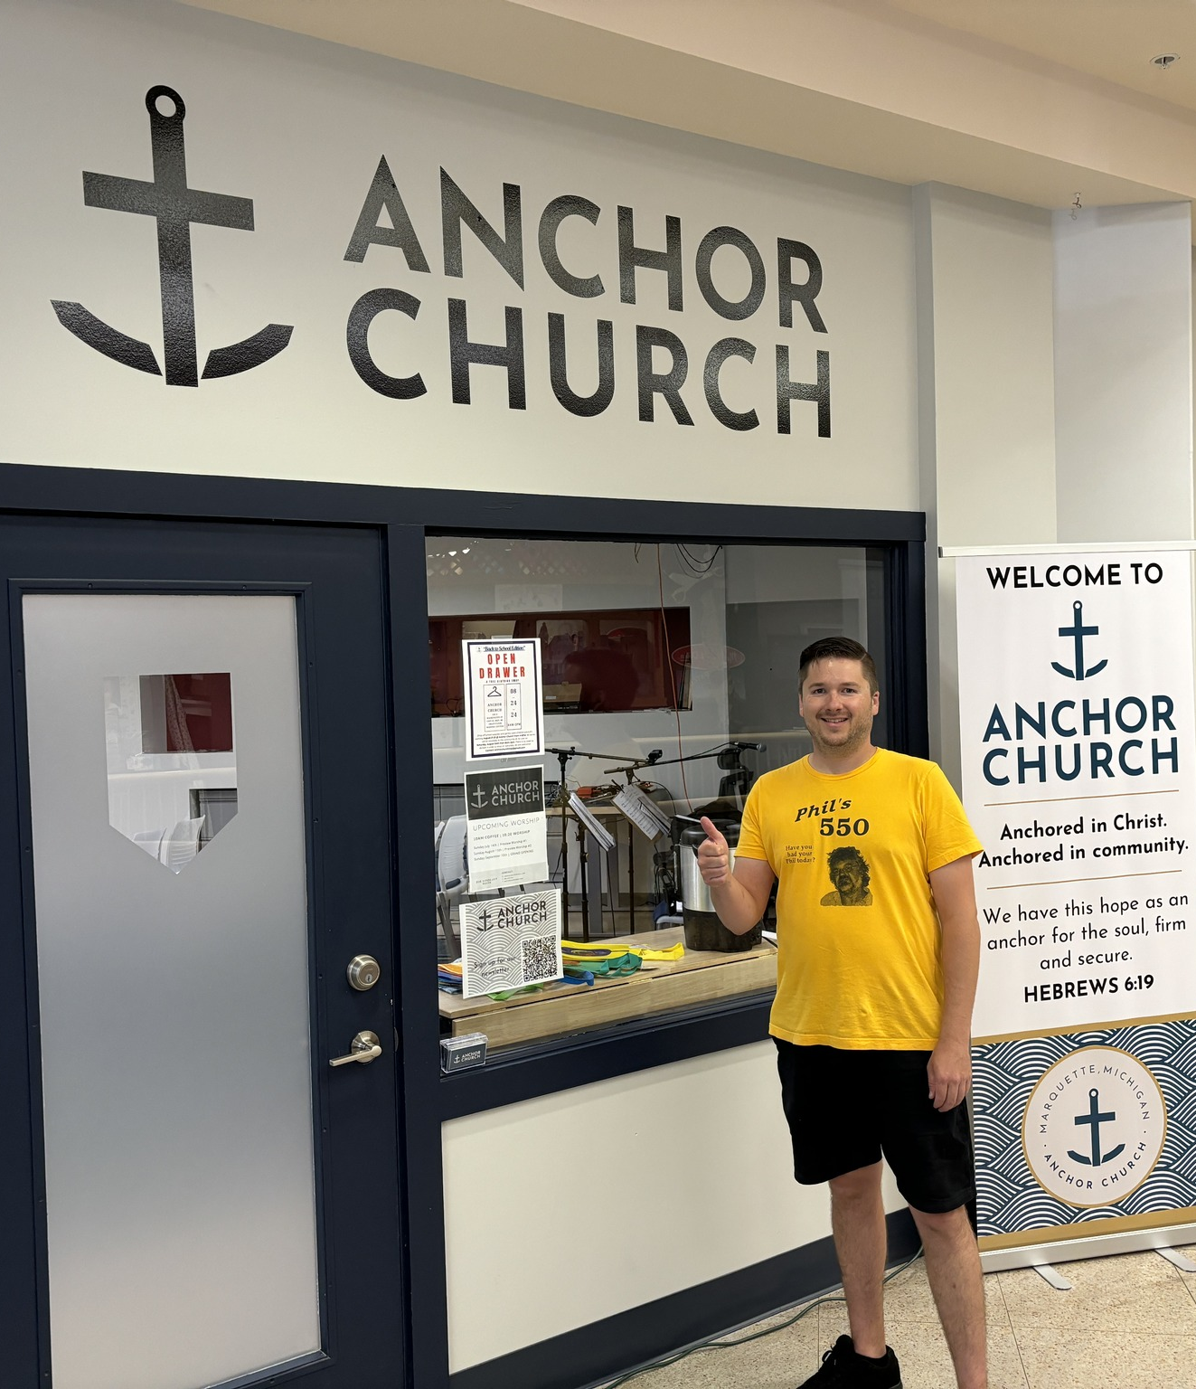
Worship launch in Marquette, Mich. September 15, 2024
Notes:
Marquette was approved as a new home mission start in Spring 2023. Marquette serves as the hub of the Upper Peninsula (U.P.) of Michigan, and 52% of the people in and around Marquette do not have a home church or attend a church. It is also home to 7,000 students at Northern Michigan University, a ripe opportunity for a Campus Ministry program. Learn more at https://wels100in10.net/new-starts/marquette-mi/.
Rev. Joseph Lindloff was installed as the new home missionary in Marquette on October 8, 2023. They have named their new church Anchor Church and found a 24/7 ministry center to lease in early 2024. They’ve hosted two “preview services” over the summer in preparation for their grand opening.

Slide 25
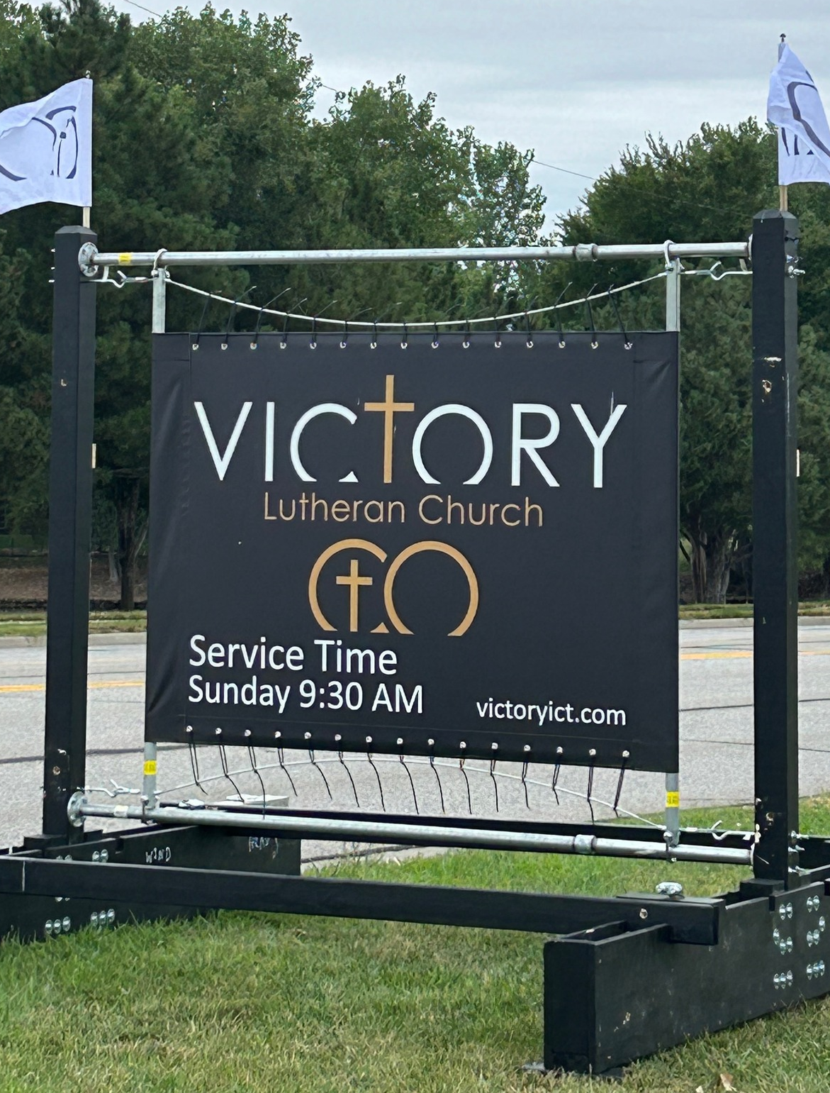
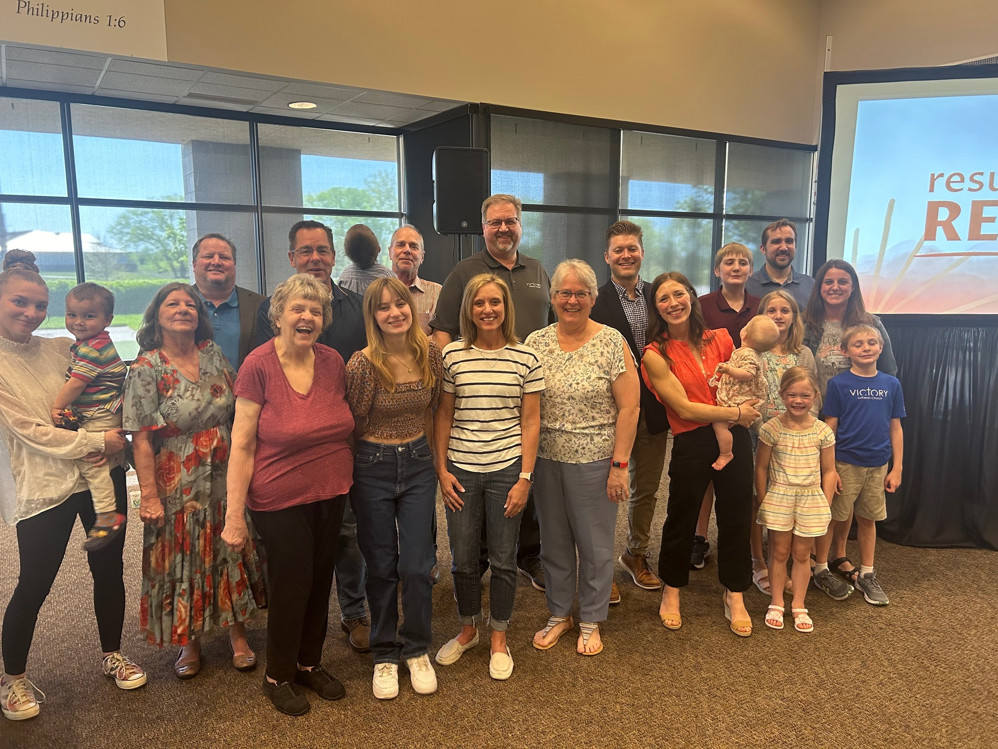
Grand opening on September 15, 2024, at Victory – Wichita, Kans.
Notes:
The new mission start on the east side of Wichita, Kansas, was approved as a new mission start in Spring 2022. Home Missionary Jacob Jenswold arrived in January 2023. This congregation is being daughtered by a core group from Messiah, a church on the west side of the city, in order to better serve the 650,000 people in the greater metropolitan area.

Slide 26
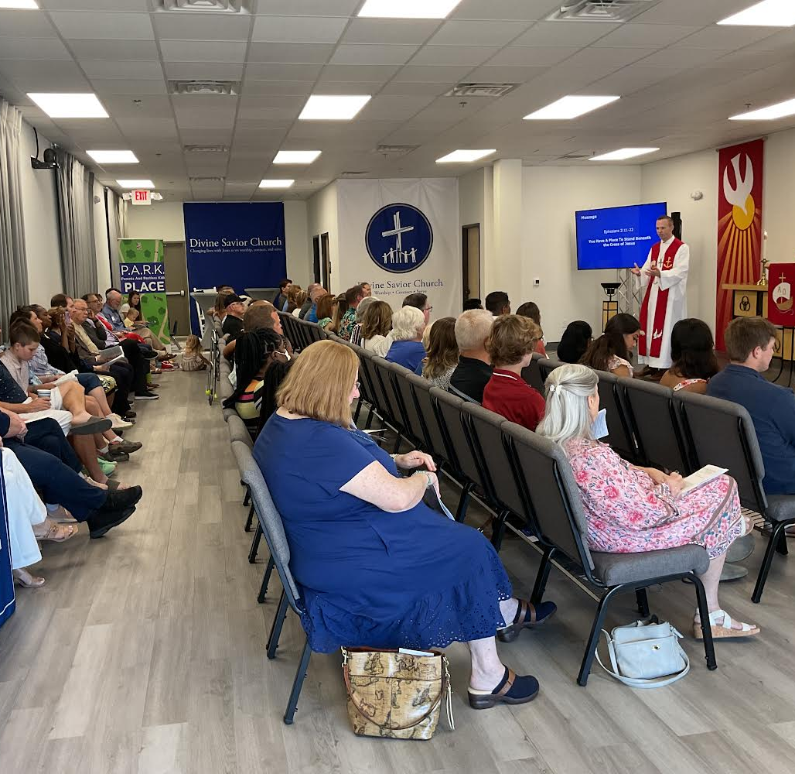
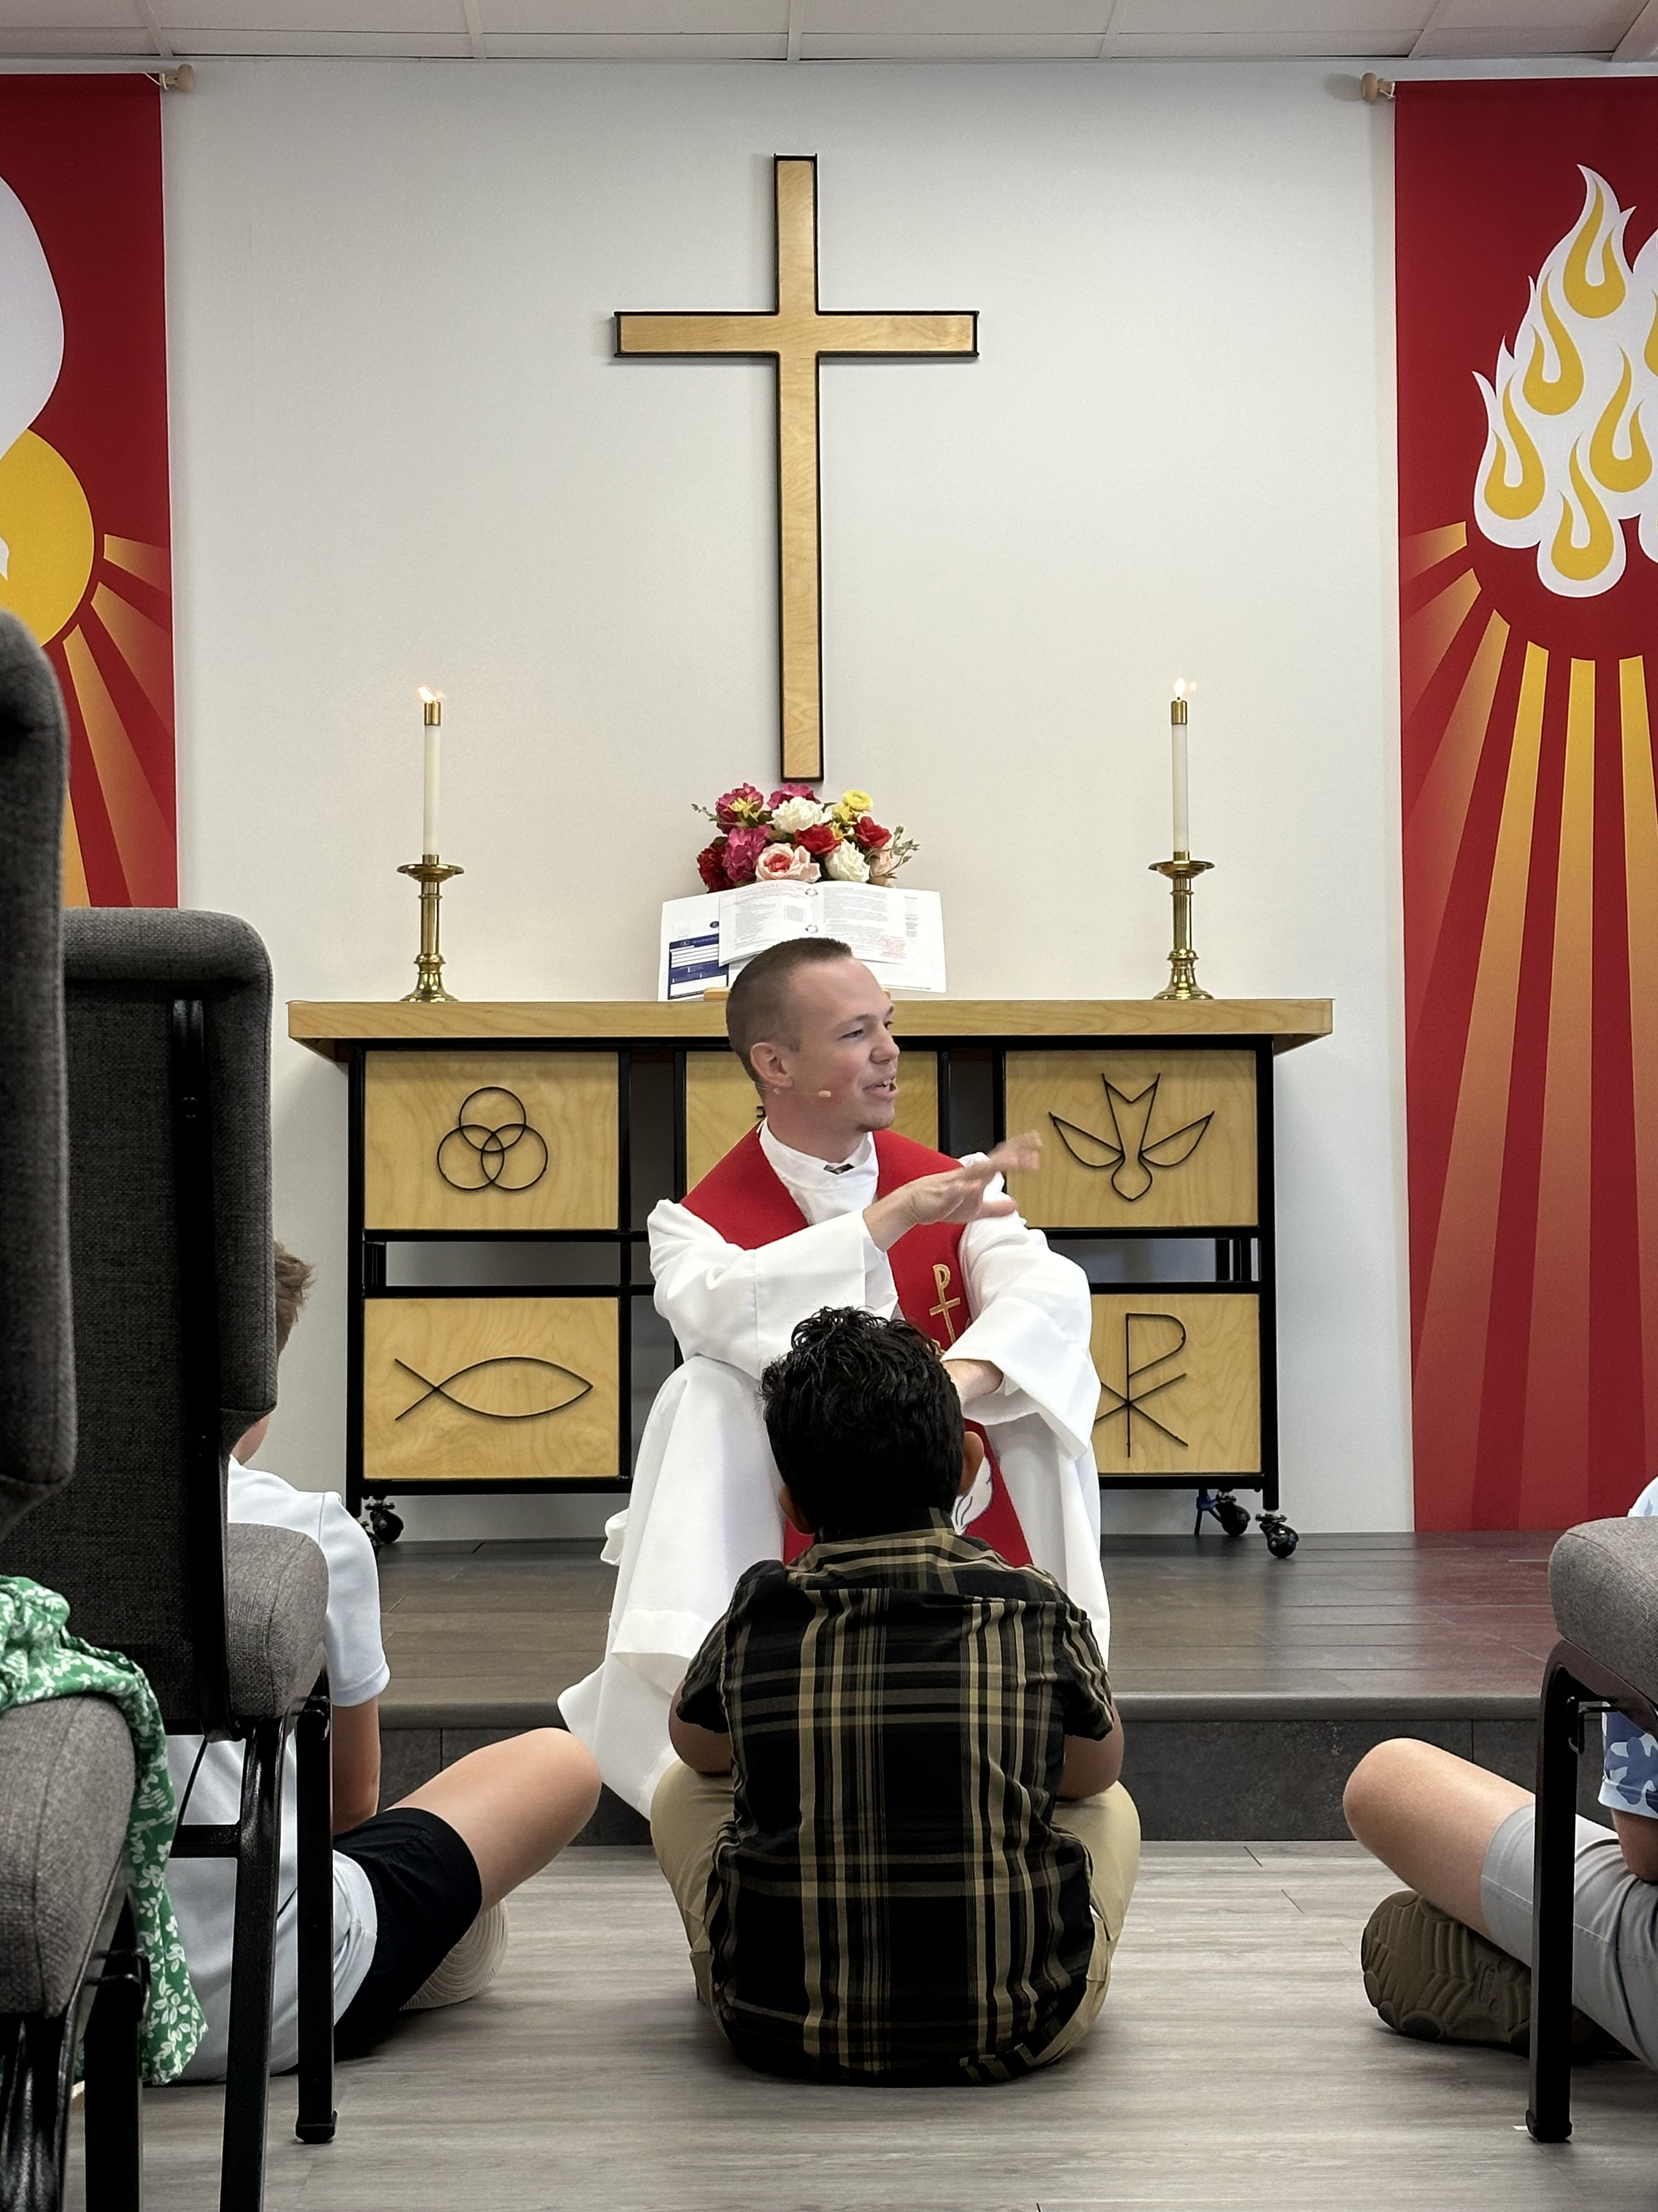
Public worship launch on September 8, 2024, at
Divine Savior – North Collin County, Tex.
Notes:
A core group of 15 members from Atonement in Plano, Tex., started a new church in North Collin County, a northern suburb of Dallas. They were approved as a new mission start in Spring 2023. Two of the top five fastest growing communities in the United States are in this target area. Divine Savior Ministries has committed to providing guidance and resources to the new mission and are planning build a Divine Savior Academy by year five of the mission start.
Caleb King was assigned from Wisconsin Lutheran Seminary in Mequon, Wis., in May 2023 to serve this new mission start. They had 71 guests join them for their opening worship and three musicians that participated in beautifying the service.
Learn more at https://wels100in10.net/new-starts/northcollincounty-tx/.

Slide 27
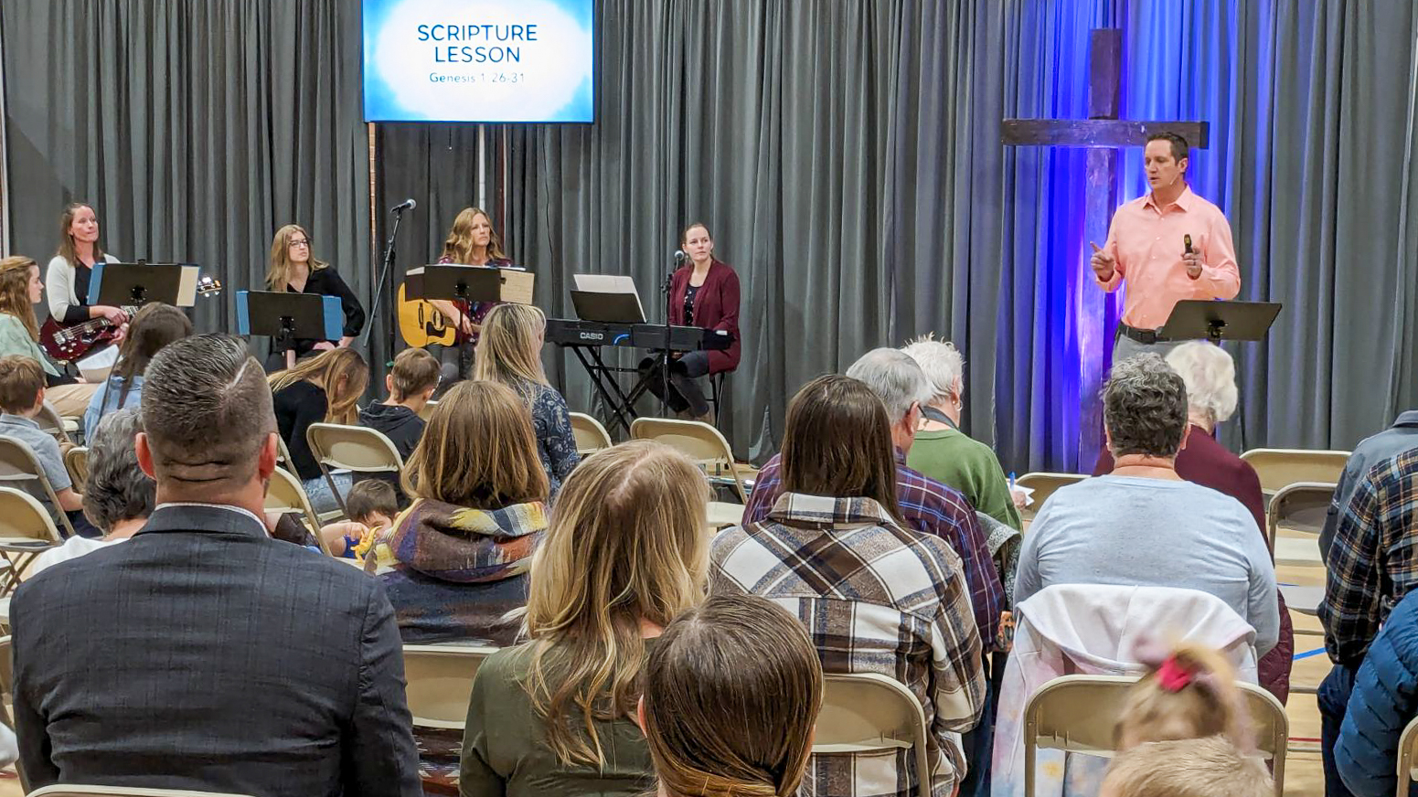
Grand opening at CrossLife, Windsor, Colo.
Notes:
On March 3, CrossView Church in Windsor, Colo., launched its public worship. This home mission plant was approved in 2022 and welcomed more than 85 guests to its opening worship service.
Home Missionary Stephen Koelpin arrived in January 2023 to work with the core group and prepare for their official launch. They received a donated trailer from a home mission church in Arizona and items for their portable church from the nearby home mission church in Castle Rock, Colo. After renting a local elementary school to host worship, the group held four preview services starting in January 2024 in preparation for launch. You can learn more about what the core group in Windsor did to prepare to start their church in this special video: wels100in10.net/lightindarkness

Slide 28
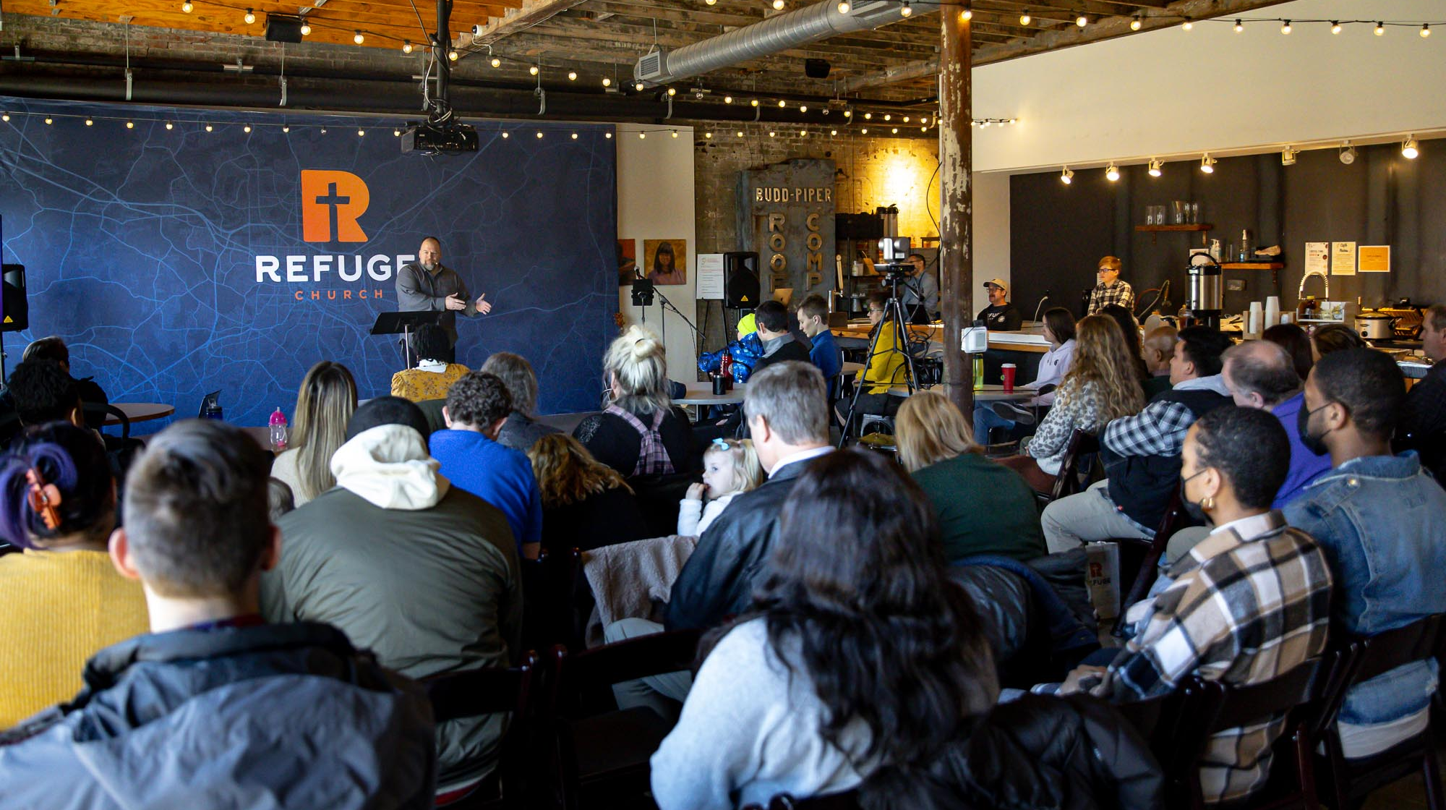
Worship launch in Durham, N.C. January 21, 2024
Notes:
Rev. Doug Lange was called to plant a new home mission church in Durham, N.C., in 2021. In the June 2023 WELS Connection, we saw Refuge in the early stages of development where they began to plan their ministry and look for opportunities to share Jesus with their community. Through many prayers, extensive planning, and outreach, God blessed their efforts, and they launched public worship on January 21 at a coworking space in downtown Durham.

Slide 29
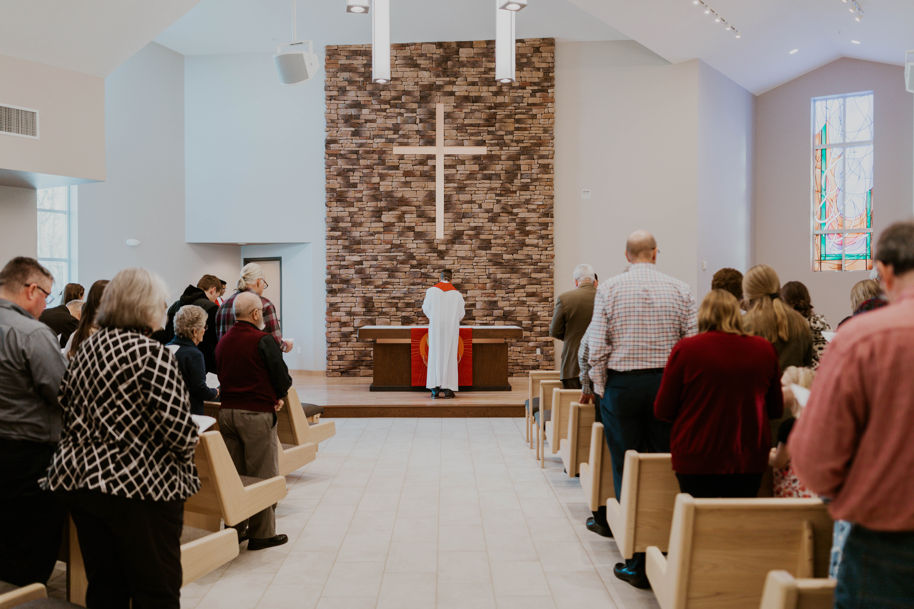
WELS Church Extension Fund A valuable partner of Home Missions
Fiscal Years 2022-2024:
$16.4 million in loans to home mission churches
$5.6 million in matching grants to home mission churches
$3.7 million in grants to WELS Home Missions
Building dedication at Good News in Mt. Horeb, Wis., Feb. 19, 2023
Notes:
WELS Church Extension Fund (CEF) is a VALUABLE partner of WELS Home Missions and the churches it supports. CEF supports the spreading of the gospel by providing loans and grants to WELS home mission congregations.
WELS CEF is a wholly owned, self-supporting, subsidiary corporation of WELS. Individual WELS members, WELS congregations, and WELS affiliates can assist the synod’s mission outreach efforts by investing in WELS CEF investment certificates. Your investments fund the WELS CEF loan program. Gifts, bequests, and donations made to WELS CEF support the grant program.
WELS CEF provides home mission churches a 4-to-1 matching grant for initial land purchase based on their 10% down payment. They also provide a 2-to-1 matching grant on a home mission congregation’s 10% down payment for their facility construction project.
Other stats:
Over 2,900 WELS members, congregations, and affiliates have entrusted WELS CEF with $103.8 million in member investments.
$37.5 million of matching grants to mission congregations and $7.7 million of special grants to Home Missions have been provided by WELS CEF since 1993.
Pictured: Good News, a home mission congregation in Mt. Horeb, WI, dedicated their new church on February 19, 2023. Good News received a $2,550,000 loan from Church Extension Fund and matching grants totaling $747,914 for their building project.

Slide 30
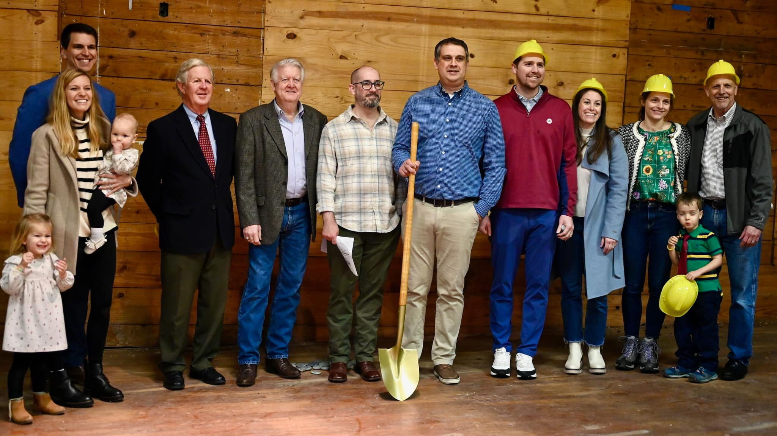
Hope in the Heights breaking ground on renovation of an old church in Houston, Tex.
Notes:
Hope in the Heights in Houston, TX, closed in Fall 2023 on a Church of Christ building for sale that was built in 1927 and remodeled in the late 1950s. It is situated on its own block within a neighborhood in their target area. There is a large parking lot, ample street parking, and plenty of green space for kids to run around.
Thanks to the Church Extension Fund’s grant program for new missions, they get a 4:1 match on the land value and a 2:1 match for every dollar they spend on the remodel. Because of this, they can afford the necessary renovations. And because Church Extension Funds grants keep the cost down, they will be able to taper off of synod subsidy faster, which enables WELS to start more missions in the future. They hope to have the remodel completed by late 2024, when they will be able to move in and open their doors to the community.

Slide 31
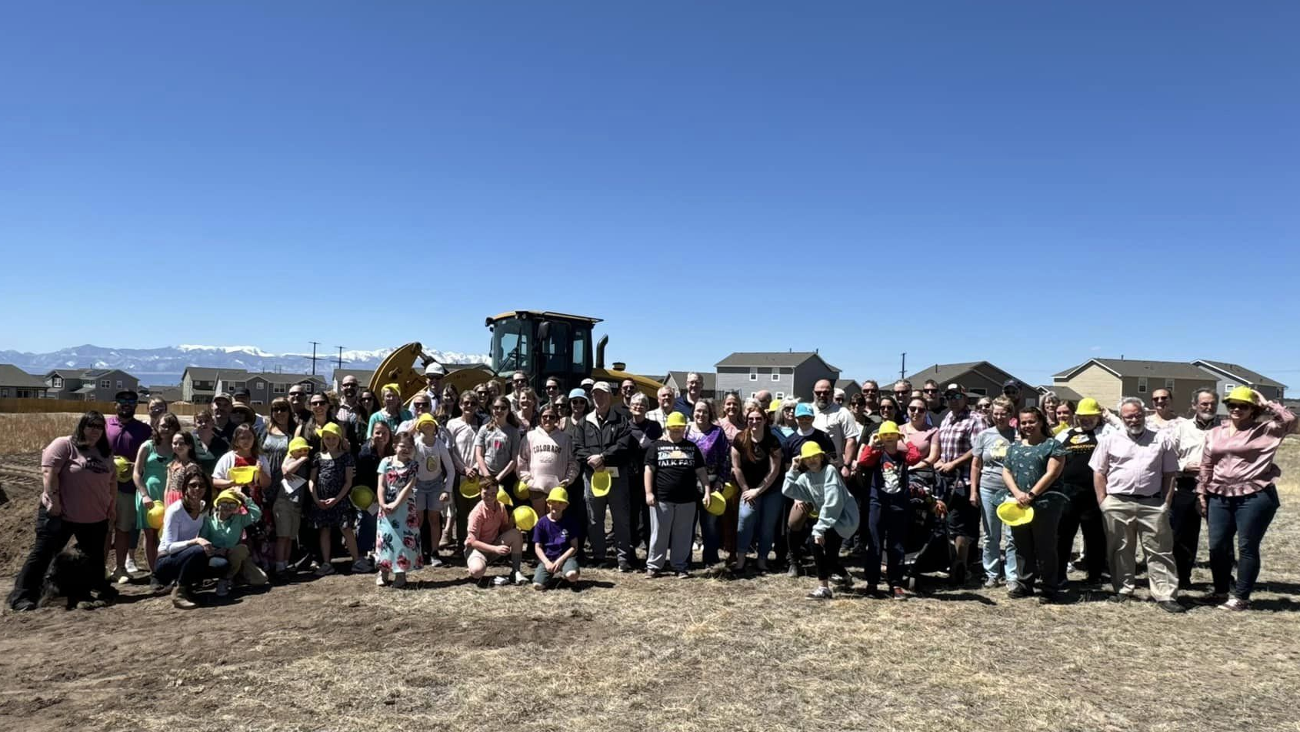
Groundbreaking for a new church in Peyton, Colo.
Notes:
Foundation Lutheran Church in Peyton, Colo., celebrated the groundbreaking for their new church building in April 2024.
WELS Church Extension Fund provided over $700,000 in land and facility matching grants to Foundation Lutheran Church to assist in the construction of their facility. Learn more about how you can invest with WELS Church Extension Fund and simultaneously support Home Missions at wels.net/cef.

Slide 32
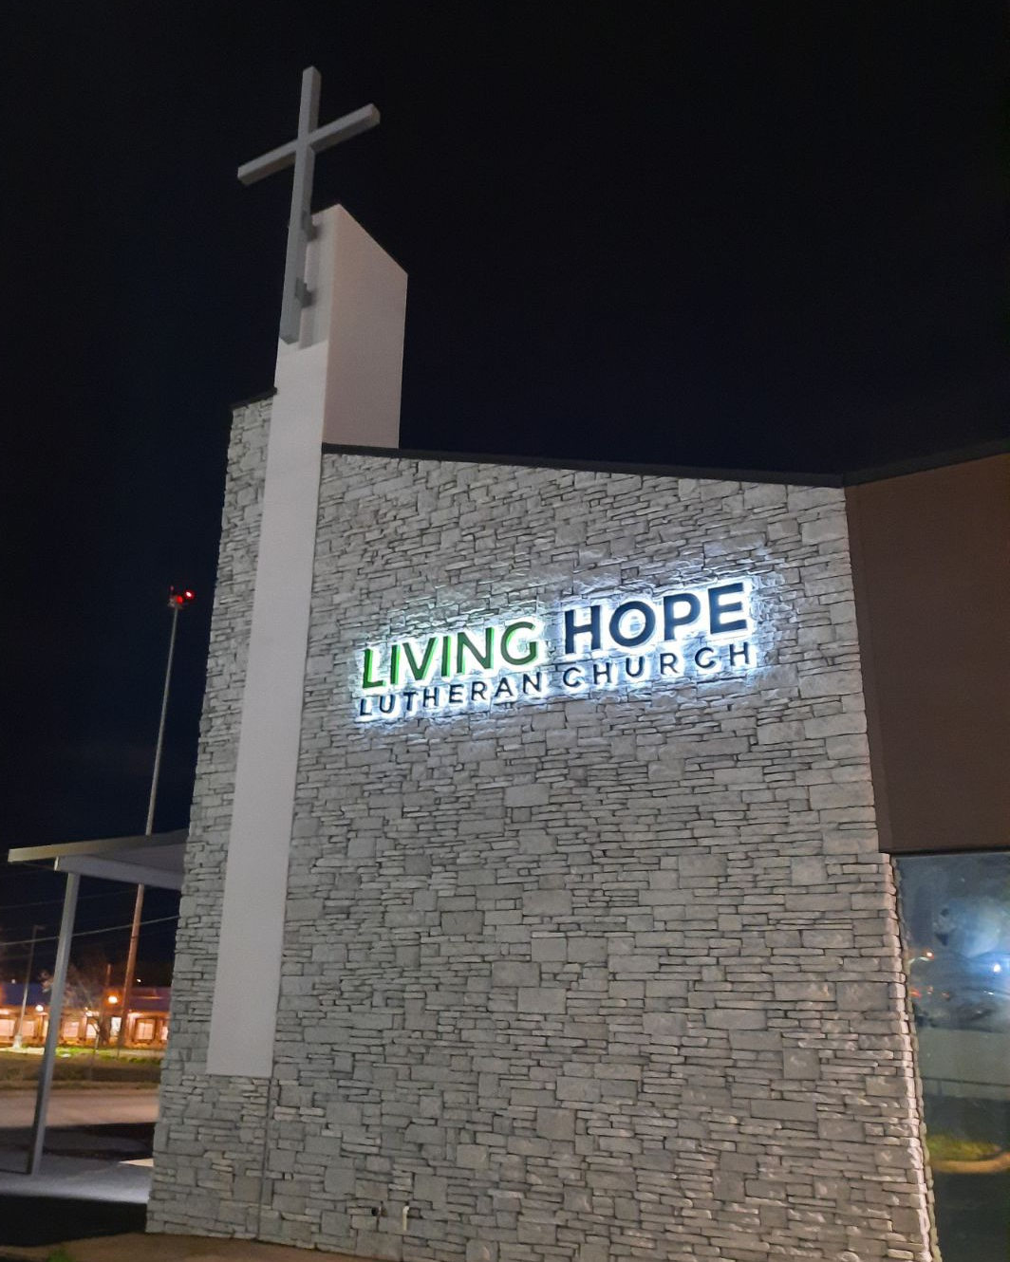
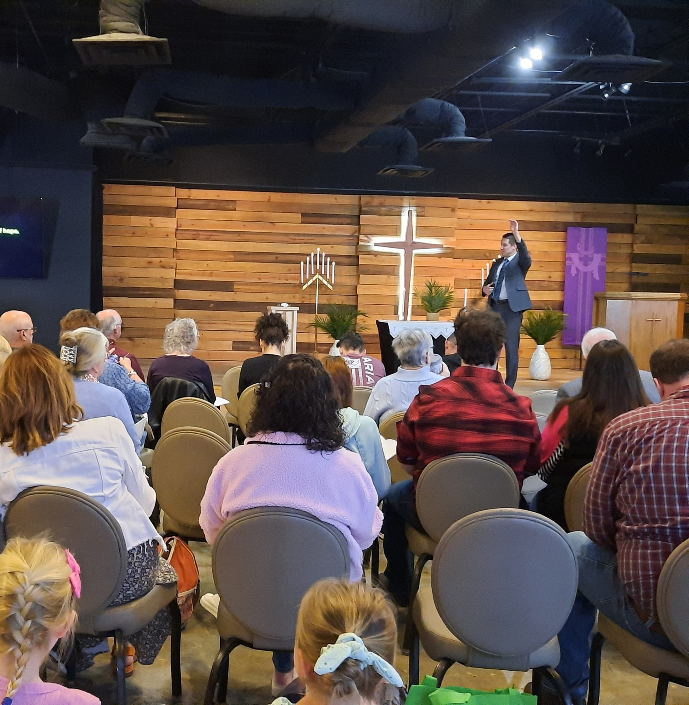
Grand re-opening in renovated worship space Living Hope, Chattanooga, Tenn.
Notes:
On March 24, Living Hope Lutheran Church in Chattanooga, Tenn., celebrated the grand re-opening of their newly renovated facility. Living Hope began as a new home mission in May 2017 and has worshiped in a movie theater, hotel conference room, and a university campus church since then. Thanks to over $350,000 in matching land and facility grants and a loan from WELS Church Extension Fund, the congregation purchased their current facility in December 2021. Now, their newly renovated space is complete and equipped to serve their congregation and community.

Slide 33
Share student information with
WELS Campus Ministry!
Notes:
Campus Ministry programs are a great way to enhance ministry and reach out to a new demographic that desperately needs the gospel.
WELS Campus Ministry, a ministry of WELS Home Missions, provides resources, support, and encouragement to WELS congregations that serve college students. These congregations are vital in connecting college students with fellow Christians, strengthening their faith with the gospel, and encouraging them to share that faith with other college students.
Almost every university in the United States and Canada has an assigned campus ministry contact pastor. Each contact pastor receives a list of WELS student that are attending their school. By sharing information with WELS Campus Ministry, these contact pastors know who the students are and can help them stay connected to Christ and strengthen their faith while at school.
We need your help in this process! Please work with the high school/college age students at your congregation and get them signed up with WELS Campus Ministry. Instructions on how to share student information was shared as supplemental information in your District Convention resources, and you can encourage students to sign up directly at wels.net/college.

Slide 34
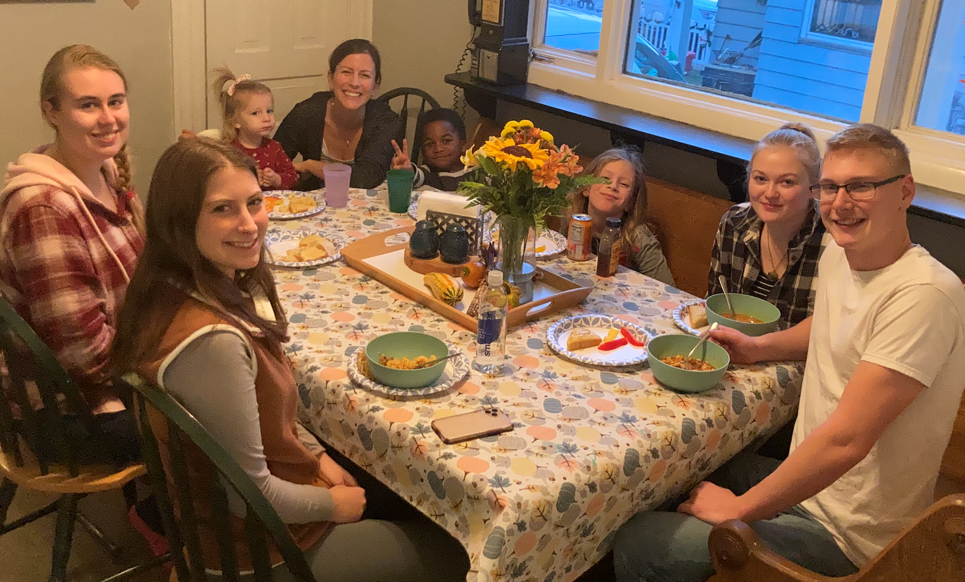
Growth in WELS Campus Ministry
Notes:
Left: Christ Our Refuge in Waco, TX, a home mission congregation that started public worship in 2022 received funding to start a Campus Ministry program. They hosted a Campus Ministry retreat with WELS students from Texas A&M and Baylor in February 2023.
Right: The new mission in Marquette, MI, that was approved in the first batch of new missions towards our goal of starting 100 new missions in the next 10 years. They are actively reaching out to students at Northern Michigan University as part of their outreach strategy.

Slide 35
Notes:
Pray: This is no small thing. Pray that the Lord of the church would provide workers. Pray for our WELS Home Missions leaders, our home missionaries, and our worker training schools as they recruit and train future missionaries. Pray that the Lord provides us with the financial support needed to do the work.
Get Involved: If you see nearby mission opportunities, talk with your district mission board to see what you or your congregation might do to get involved in this synod wide church planting effort. Encourage young men and women in your church to consider full-time ministry. Ask your pastor to keep our synod’s work in your congregational prayers and provide updates on a regular basis.
Give: You know the grace of our Lord Jesus Christ. He was rich, yet he became poor so that through his poverty we might become rich (2 Corinthians 8:9). God’s generosity has resulted in the riches of forgiveness, peace, joy, and hope. Let that move you to give generously to your local congregation, to your synod through your church, and to this initiative.
Encourage people to check out the website: Learn more and stay up to date on progress at wels.net/100in10.

Slide 36
Notes:
WELS Mission Journeys provides an opportunity for all WELS members to walk together in the Great Commission. Through short- or long-term service opportunities in WELS mission fields at home and abroad, members can engage in Christian service. While volunteering, the learning and sharing of outreach ideas will allow individuals and teams to explore how they can use their God-given abilities to engage in outreach activities in their local communities upon their return home. With the Lord’s blessing, these trips will inspire a lifelong journey of service and outreach for all who volunteer.
Learn more at wels.net/missionjourneys.

Slide 37
Notes:
Speakers: District Mission Board members, Home Missionaries, Mission Counselors, and other Home Missions representatives are willing and able to present on the 100 missions in 10 years initiative at your next church Mission Festival, LWMS circuit rally, school assembly, or small group gathering. Contact your local District Mission Board OR fill out a request at wels.net/speaker-request to find a speaker for your event this fall.
Social Media: Follow us on Facebook and Instagram @WELSmissions
E-Mails: Subscribe to weekly Missions Blogs and quarterly Missions Update E-Newsletters at wels.net/subscribe.
Faces of Faith: The 6th annual edition of Faces of Faith is now available. This is a great overview of the work we’re doing in Home, World, and Joint Missions, and you can learn more about the 100 missions in 10 years initiative in this magazine.
It is available online and by request at wels.net/facesoffaith. Any congregation OR LWMS circuit is welcome to request up to 50 copies of the magazine, and we are also offering 100 Missions in 10 Years brochures and large home and world mission maps (24” x 36”) free of charge. Note – Faces of Faith is automatically sent to any congregation hosting a Mission Festival.

Slide 38
Notes:
Save the date for Taste of Missions, happening on Saturday, June 14, 2025!
This family-friendly event, held at Wisconsin Lutheran Seminary in Mequon, Wis., and online, will give all WELS members a “taste of missions”, no matter where you might be around the world. The event kicks off with a special worship service where we will commission new home and world missionaries. Sample ethnic cuisine from some of our mission fields while enjoying fellowship and presentations from home and world missionaries alike. View displays, participate in outdoor family-friendly activities, and ask questions about the ups and downs of mission work. We hope you can join us!

Slide 39
GIVE GENEROUSLY!
Notes:
We confidently ask you to consider giving generously to this amazing opportunity to expand our efforts to share the saving gospel right here in our own backyard. This is a BIG challenge. An impossible one you might say. But we prepare and we plan, and we ask God to bless it. Trusting in the Lord, we boldly move forward knowing God will bless us and his kingdom.
You can support this effort by giving a gift online at wels.net/100in10gift; through the QR code on the slide; sending a check with the 100 Missions in 10 Years in the memo line to WELS, Attn: Gift Processing, N16W23377 Stone Ridge Drive, Waukesha, WI 53188; or through appreciated assets (e.g., stock) or from your IRA by calling 800-827-5482. Thank you for your support!

Slide 40
Notes:
Try something that is so hard, that if it succeeds, people will have to say God did this.
We submit all our plans to Him, for He is the Lord of the Church, and we are only servants. We’re trusting God to do immeasurably more than all we ask or imagine.

